Slide 1



Robocode
Eclipse
D
Lab 3 Java project
JUnit framework
B
A
BMB
Tests
C
Robot testing plugin
E
”se.lth.cs.etsa02.BasicMeleeBot.BasicMeleeBot*”

Slide 2
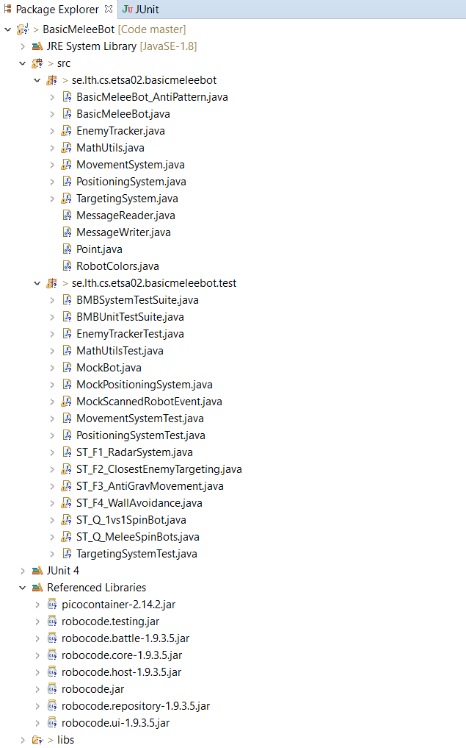
No longer used
Implemented in Lab 2, to be tested now
To be used
in the projects
Defines system test suite
Used in Lab 2, but should still pass
To be implemented in Lab 3
Test framework used in Lab 3

