Slide 1
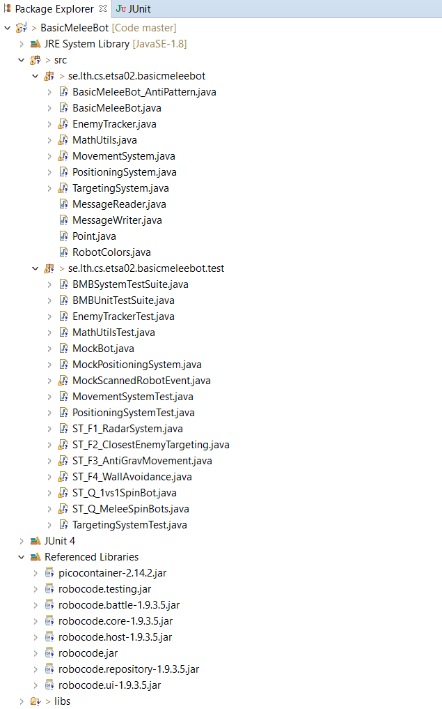
Source code to refactor
To be implemented in Lab 2
To be used
in the projects
To be used
in Lab 3
Defines test suite
Used to create
robot mock objects

