Slide 1
Exceptions in Java
Diana Poghosyan

Slide 2
Topics
What is an exception
Throwing and catching
Types of Exceptions
checked
unchecked
Throw, Throws, Try, Catch
2

Slide 3
What is an exception
An exception is anything that disrupts the normal flow of the Java program. Exceptions play an important role in Java programs, since it helps the program to skip the error and continue with the rest of the program. Truly, the error is not skipped; it is just enclosed in an exception object which can then be handled separately by the program.

Slide 4
Examples
Some typical causes of errors:
Memory errors (i.e. memory incorrectly allocated, memory leaks, “null pointer”)
File system errors (i.e. disk is full, file not found)
Calculation errors (i.e. divide by 0)
Array errors (i.e. accessing element –1)
Conversion errors (i.e. convert ‘q’ to a number)

Slide 5
Examples
By default, exceptions result in the thread terminating after printing an error message.
int a = 5;
int b = 0;
System.out.println(a / b);
Exception in thread "main" java.lang.ArithmeticException: / by zero
at com.test.Test.main(Test.java:14)

Slide 6
Throwing and catching
An error can throw an exception:
throw <exception object>;
By default, exceptions result in the thread terminating after printing an error message. However, exception handlers can catch specified exceptions and recover from error:
catch (<exception type> e) {
//statements that handle the exception
}

Slide 7
void func1(String[] args) {
if(args.length == 0) {
throw new IllegalArgumentException(“……");
}
}
void func2(String[] args) {
try {
func1(args);
}catch(IllegalArgumentException e) {
System.out.println(e.getMessage());
}
}

Slide 8
Throwing and catching
Java has 5 keywords for exception handling:
try
catch
finally
throw
throws

Slide 9
Exceptions - Checked and Unchecked
There are basically three kinds of exceptions:
checked exceptions
unchecked exceptions
runtime exceptions
errors
Checked:
If your code invokes a method which is defined to throw checked exception, your code MUST provide a catch handler
The compiler generates an error if the appropriate catch handler is not present
(IOException , ClassNotFoundException)

Slide 10
Exceptions - Checked and Unchecked
Unchecked(RuntimeException & Error):
These exceptions can occur through normal operation of the virtual machine. You can choose to catch them or not.
If an unchecked exception is not caught, it will go to the default catch-all handler for the application
All Unchecked exceptions are subclassed from RuntimeException

Slide 11
Error
“unchecked”, thus need not be in ‘throws’ clause
Serious system problems (e.g. StackOverflowError, OutOfMemoryError)
It’s very unlikely that the program will be able to recover, so generally you should NOT catch these.
RuntimeException
“unchecked”, thus need not be in ‘throws’ clause
Also can occur almost anywhere, e.g. ArithmeticException, NullPointerException, IndexOutOfBoundsException, ClassCastException
Try to prevent them from happening in the first place!

Slide 12
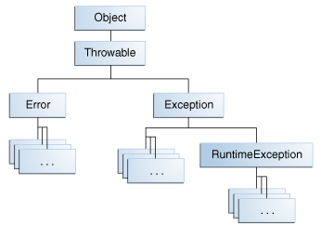
Exception - Class Hierarchy
Exceptions: An error which reasonable
applications should catch
- Array index out of bounds
- Arithmetic errors (divide by zero)
- Null Pointer Exception
- I/O Exceptions
Errors: An error represents a condition
serious enough that most reasonable
applications should not try to catch.
- Virtual Machine Error
- out of memory
- stack overflow
- Thread Death
- Linkage Error

Slide 13
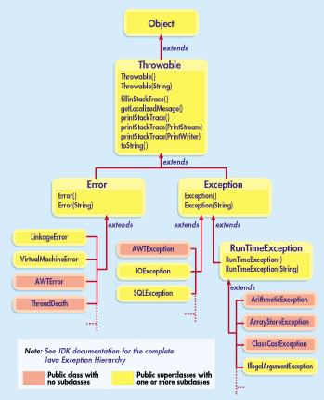

Slide 14
Throw
public void method3() {
……
if(size == 0) {
throw new SomeException();
// SomeException exc = new SomeException();
//throw exc;
}
}

Slide 15
Throws
public void method1() throws SomeException {
……
method2();
……
}
Try , Catch
try {
// some function call
} SomeException e) {
System.out.println(“Error: “ + e.getMessage());
}

Slide 16
Multiple Catch Blocks
try {
// some function call
} catch(InputMismatchException e) {
System.out.println("Error: Some msg");
} catch(NoSuchElementException e) {
System.out.println("Error: Some msg ");
} catch(IllegalStateException e) {
System.out.println("Error: Some msg ");
} finally {
System.out.println(“block finally”);
}

Slide 17
Multi-Catch Blocks (java 7)
try {
// some function call
} catch(NoSuchElementException | IllegalStateException exc) {
System.out.println("Error: “ + exc. getMessage()) ;
} finally {
System.out.println(“block finally”);
}

Slide 18
Finally
The garbage collector (GC) is responsible for releasing only memory resources. If you are using any class that acquires system resources, it is your responsibility to release them by calling the close() method on that object.
try {
// try block code;
// System.exit()
} finally {
// finally block code;
//clean all necessary resources
}

Slide 19
Try-with-Resources
try(Scanner consoleScanner = new Scanner(System.in)) {
int i = consoleScanner.nextInt();
} catch(Exception e) {
System.out.println("Error: exception msg ... ");
}
try(
Scanner consoleScanner = new Scanner(System.in);
SomeClosableObj obj = new SomeClosableObj ();
) {
……
(Implements java.lang.AutoCloseable interface and define the close() method)

Slide 20
Defining Your Own Exceptions
Custom exceptions should extend either the Exception or RuntimeException class.
It is a bad practice to create custom exceptions by extending the Throwable or Error classes.

Slide 21

Questions
21
Notes:
Call a subclass method with superclass reference
Compiler error
Subclass methods are not superclass methods

Slide 22
Thank you!
22
Notes:
Call a subclass method with superclass reference
Compiler error
Subclass methods are not superclass methods

