Slide 1
DevOps Project
Automating process of
deployment web sites
in different platform Ivanov I.V.
Servers EPAM DevOps 2020

Slide 2









Used tools

Slide 3
Steps on AWS
1) Raising 3 Instances
- Git, Jenkins and Ansible server
- Deployment server on Debian OS
- Deployment server on Red Hat OS

Slide 4
Steps on AWS
2) Creating SSH Key pairs, Downloading
and transferring to servers to connect.

Slide 5
Steps on AWS
3) Creating and suggesting
Elastic IP Public addresses
to instances

Slide 6
Steps on Git Hub
1) Creating a repository
Where our site with
A database and playbooks
Will be stored

Slide 7
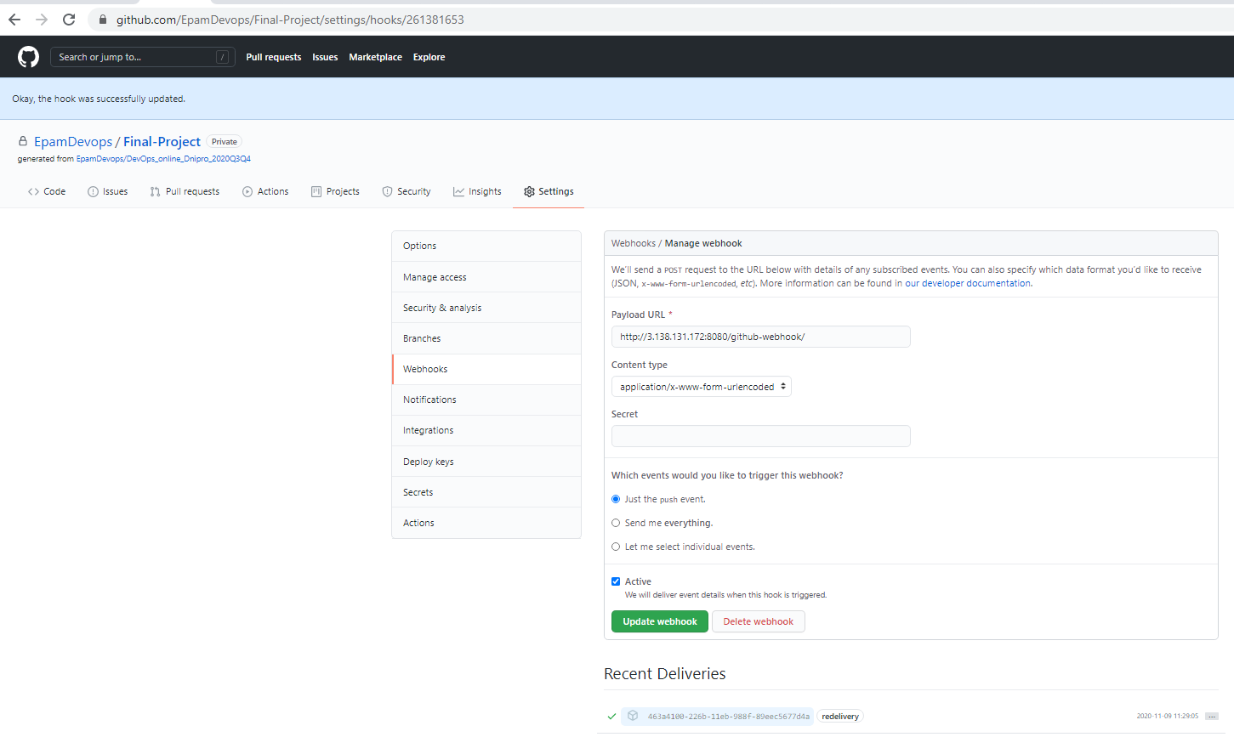
Steps on Git Hub
2) Updating code
with Github Web Hook

Slide 8
Steps on Jenkins
1)Integrating our GitHub
Repository to our
Jenkins Project

Slide 9
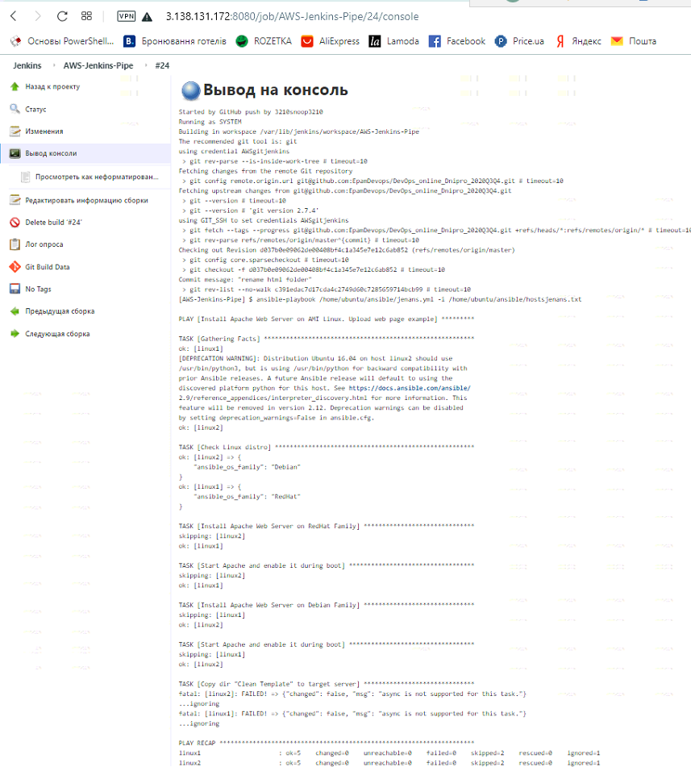
Steps on Jenkins
2)CI/CD by Build
In step -Ansible
plugin

Slide 10
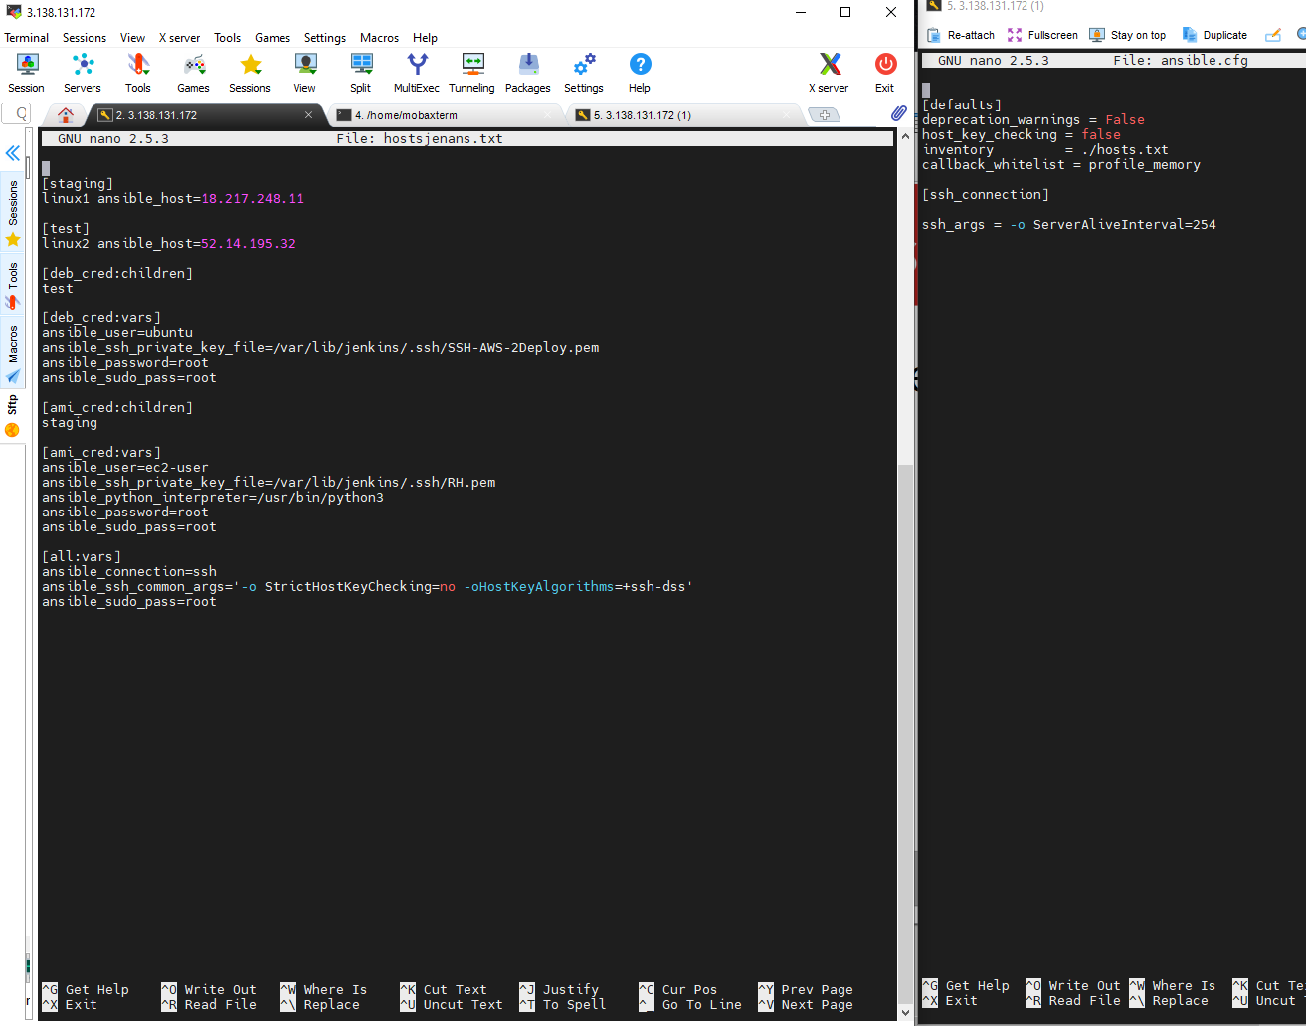
Steps on Ansible
1)Creating inventory file
“hostsjenans.txt”
2)Config file
“ansible.cfg”

Slide 11
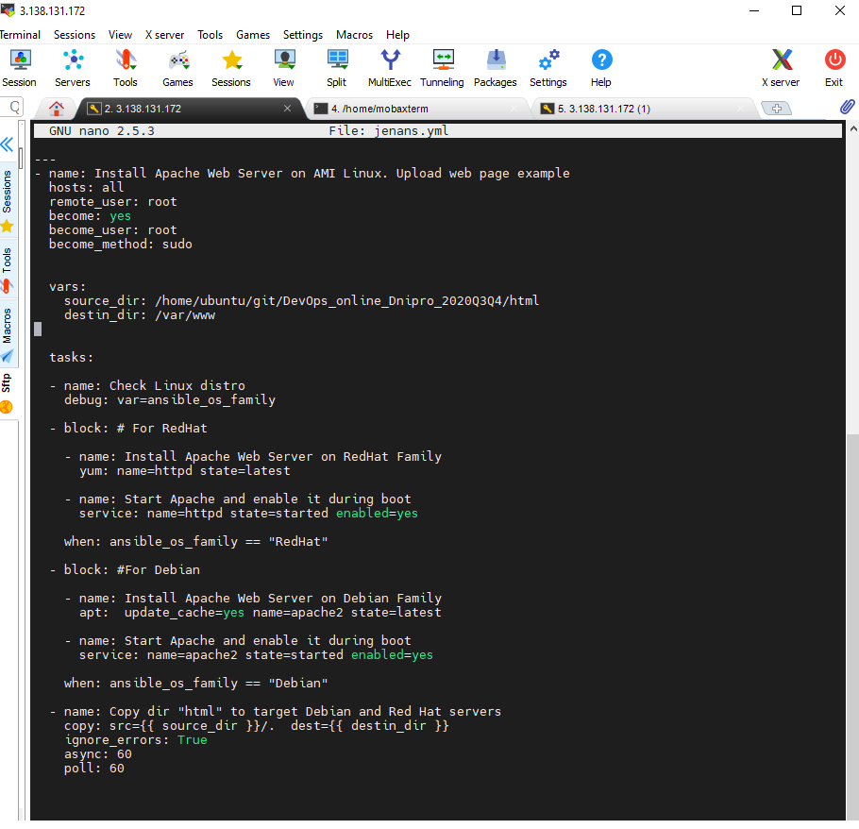
Steps on Ansible
3)Creating playbook
Jenans.yml ,which
Include some steps:
-hosts parameters
-vars
-tasks

Slide 12

Deployed Web sites on servers at work

Slide 13
In future
What we can made better in future :
-we could use wordpress site db to deploy by ansible;
-we could use docker containers for building and testing artefact (saving in volume). After that we killing containers to saving machines power.

Slide 14
End of presentation
Thanks for watching my presentation,
waiting for your questions!

