Slide 1
Welcome, Ladies and Gentlemen !
SPS/IPC/DRIVES/
IEC 61131 - 3 Tutorial
Function Block Diagram

Slide 2


Who is Who ?
Software
KW-Software GmbH
D-32657 Lemgo
since 1981 PLC Automation Software
www.kw-software.de
Götz Jäckel
Technical Trainer
since 1989 at KW-Software

Slide 3
The Program
The Example: My Flipflop
The Entry: What are the advantages of FBD ?
The Overview: What are the elements of FBD ?
The Execution: What are the execution rules ?
The Standard: What's the range of standard elements ?
The Individualist: What's possible beyond the standard ?

Slide 4
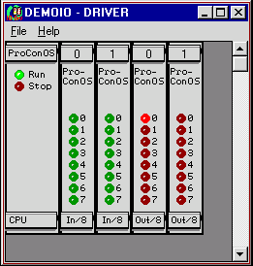
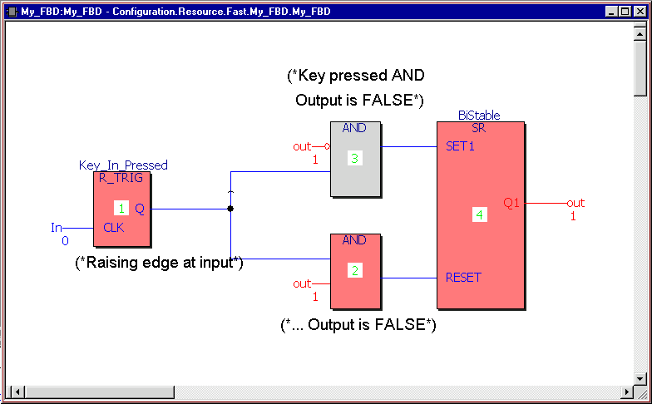
An Example

Slide 5
Advantages (4 of all)
Simultanous programming and documenting (overview, comments, reliability, information flow)
Universal applicability (Signal processing, numeric, arithmetic, integer, floating point)
Structured programming (define and call subroutines)
Standardized set of Functions and Function Blocks

Slide 6
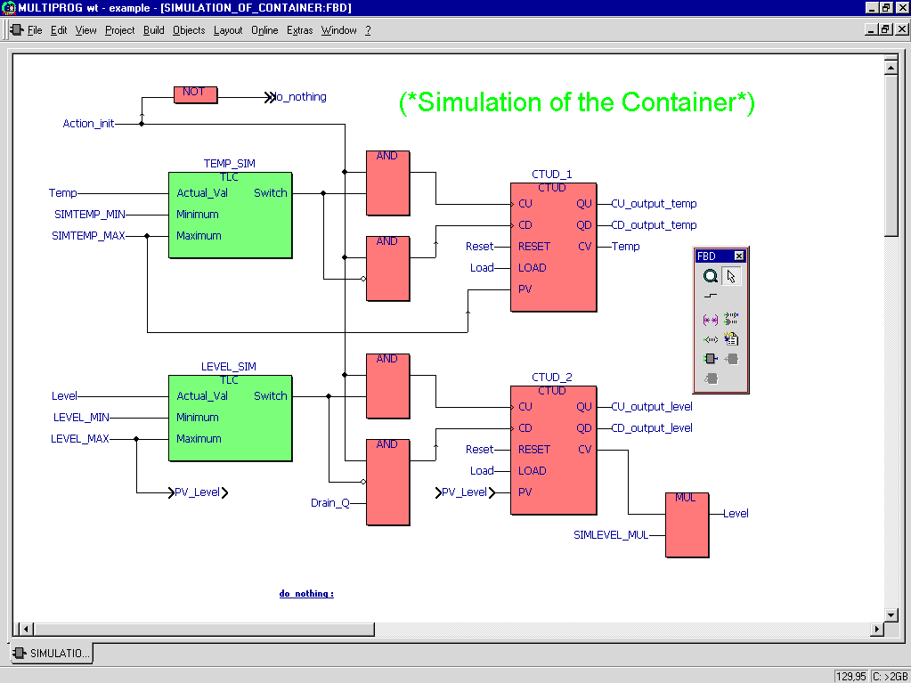
The Elements - Overview

Slide 7
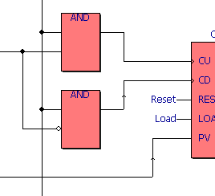
Elements - Lines
horizontal, vertical
flow direction
crossing with / without contact

Slide 8
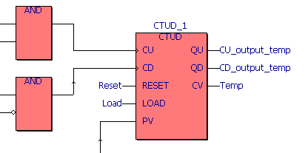
Elements - Fus, FBs, Variables
Functions
Functions Blocks
Input / Output Variables

Slide 9
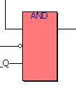
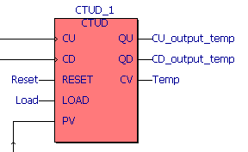
Elements - Parametrization
Negation
Duplication
Implicit edge detection
Formal Parameters
Actual Parameters

Slide 10


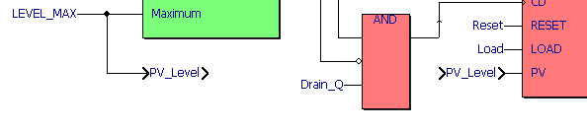
Elements - additionals
Jumps
Connectors

Slide 11
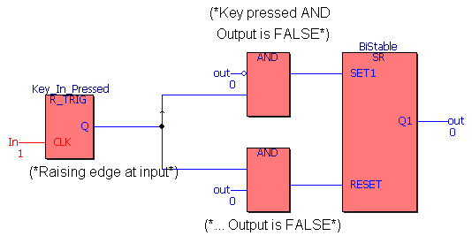
Execution rules
1. An element is executed, when all its inputs have been calculated.
2. An element is completely evaluated, when all outputs are calculated.
3. The evaluation of network is finished, when all its output values are calculated.

Slide 12
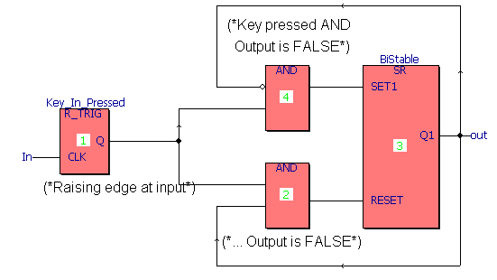
Feedback
implicite
explicite
standardized execution order
IEC 61131: depends on implementation
e.g. KW-Software:
display of a warning message
indication of the execution order

Slide 13
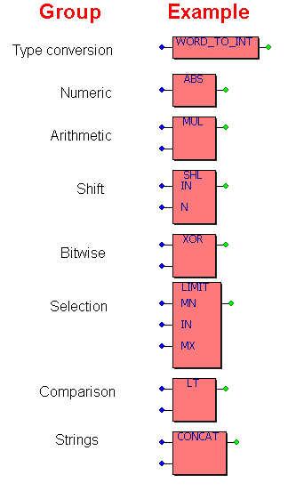
Standard Functions
IEC 61131:
"If you know one standard system, you know them all."

Slide 14
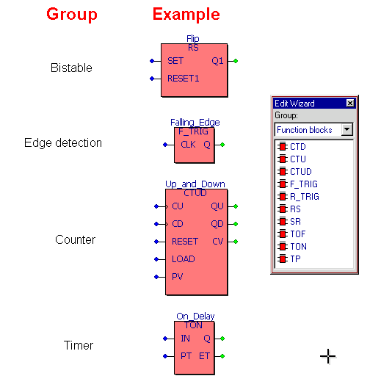
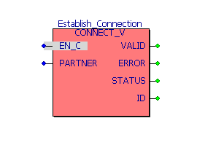
Standard Function Blocks
Communication FBs are described in IEC 61131 - 5

Slide 15
User Functions and Function Blocks
An example:
1. Change the Flipflop from a PROGRAM to a Function Block.
2. Call the new user FB from annother PROGRAM.

Slide 16
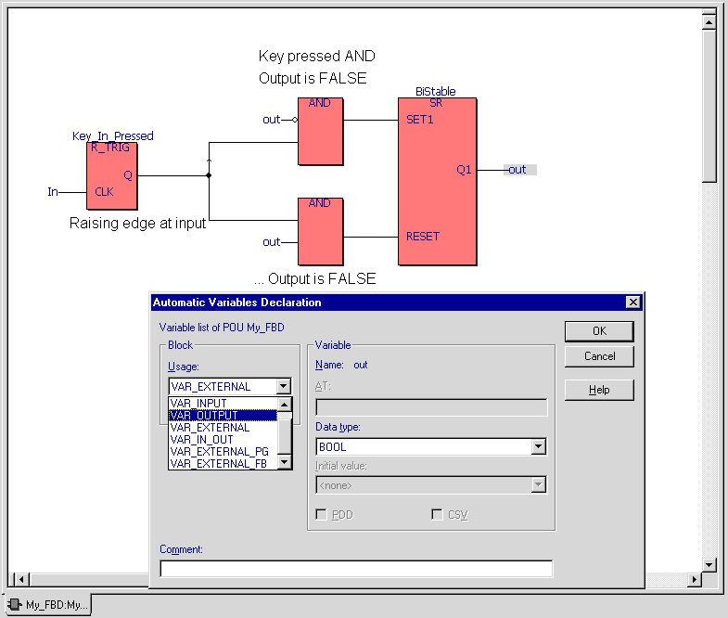
User FB I: Formal Parameters
Change the declaration type from VAR / VAR_EXTERNAL to VAR_INPUT resp. VAR_OUTPUT

Slide 17
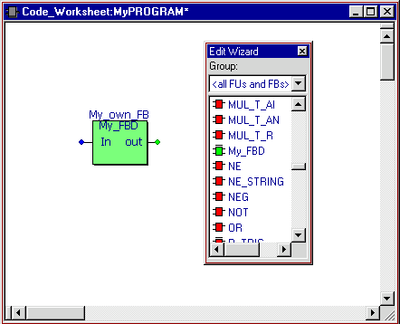
User FB II: Insert the User FB
The new FB can be used like IEC 61131-3 FBs.

Slide 18
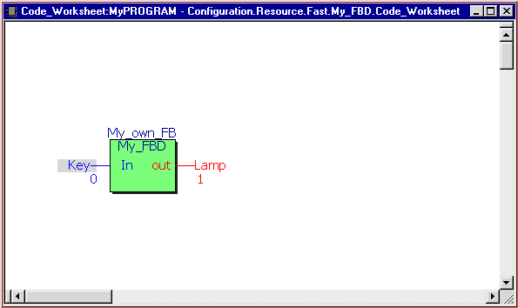
User FB III: It works !

