Slide 1
Introduction to IEC1131-3 Ladder Diagram

Slide 2
Origins of Ladder Diagram
The Ladder Diagram (LD) programming language originated from the graphical representation used to design an electrical control system
Control decisions were made using relays
After a while Relays were replaced by logic circuits
Logic gates used to make control decisions
Finally CPUs were added to take over the function of the logic circuits
I/O Devices wired to buffer transistors
Control decisions accomplished through programming
Relay Logic representation (or LD) was developed to make program creation and maintenance easier
Computer based graphical representation of wiring diagrams that was easy to understand
Reduced training and support cost
OR
AND
CPU

Slide 3
What is a Rung?
A rung of ladder diagram code can contain both input and output instructions
Input instructions perform a comparison or test and set the rung state based on the outcome
Normally left justified on the rung
Output instructions examine the rung state and execute some operation or function
In some cases output instructions can set the rung state
Normally right justified on the rung
Input Instruction
Output Instruction

Slide 4
Series Vs Parallel Operations
Ladder Diagram input instructions perform logical AND and OR operations in and easy to understand format
If all Input Instructions in series must all be true for outputs to execute (AND)
If any input instruction in parallel is true, the outputs will execute (OR)
Paralleling outputs allows multiple operations to occur based on the same input criteria
A
C
D
E
B
AND
F
Branches
OR
IF ((A OR B) AND (NOT C) AND D) THEN E=1; F=1 END_IF

Slide 5
Ladder Logic Execution
Rungs of Ladder diagram are solved from Left to right and top to bottom
Branches within rungs are solved top left to bottom right
Ladder Rung
A
D
E
Left Power Rail
Right Power Rail
B
Branch
F
G
H
P
S
I
J
K
R

Slide 6
Non Retentive Coils
The referenced bit is reset when processor power is cycled
Coil -( )-
Sets a bit when the rung is true(1) and resets the bit when the rung is false (0)
PLC5 calls this an OTE Output Enable
Negative coil -( / )-
Sets a bit when the rung is false(0) and resets the bit when the rung is True(1)
Not commonly supported because of potential for confusion
Set (Latch) coil -(S)-
Sets a bit (1) when the rung is true and does nothing when the rung is false
Reset (Unlatch) Coil -(R)-
Resets a bit (0) when the rung is true and does nothing when the rung is false

Slide 7
Contacts
Normally Open Contact -| |-
Enables the rung to the right of the instruction if the rung to the left is enabled and underlining bit is set (1)
Normally Closed Contact -|/|-
Enables the rung to the right of the instruction if the rung to the left is enabled and underlining bit is reset (0)
Positive transition contact -|P|-
Enables the right side of the rung for one scan when the rung on left side of the instruction is true
Allen Bradley PLC5 uses -[ONS]-
Negative transition contact -|N|-
Enables the right side of the rung for one scan when the rung on left side of the instruction is false

Slide 8
Retentive Vs Non-retentive Operation
Definitions
Retentive values or instructions maintain their last state during a power cycle
Non-retentive values or instructions are reset to some default state (usually 0) after a power cycle
IEC1131 permits values to be defined as retentive
A contradiction to this is ladder diagram where 3 instructions are classified as retentive
In most PLCs only timer and coil instructions operate as non-retentive

Slide 9
Retentive Coils
The referenced bit is unchanged when processor power is cycled
Retentive coil -(M)-
Sets a bit when the rung is true(1) and resets the bit when the rung is false (0)
Set Retentive (Latch) coil -(SM)-
Sets a bit (1) when the rung is true and does nothing when the rung is false
PLC5 uses OTL Output Latch
Reset Retentive (Unlatch) Coil -(RM)-
Resets a bit (0) when the rung is true and does nothing when the rung is false
PLC5 uses OUT Output Unlatch

Slide 10
Transition Sensing Coils
Positive transition-sensing coil -(P)-
Sets the bit bit (1) when rung to the left of the instruction transitions from off(0) to on(1)
The bit is left in this state
PLC5 use OSR (One Shot Rising)
Negative transition-sensing coil -(N)-
Resets the bit (0) when rung to the left of the instruction transitions from on(1) to off(0)
The bit is left in this state
PLC5 uses OSF (One Shot Falling)

Slide 12
IEC Comparison Instructions in Ladder
If the rung input (EN) is enabled, the instruction performs the operation and sets the rung output (ENO) based on the comparison
Example: when EN is true, EQ (=) function compares In1 and to In2 and sets ENO
Comprehensive instruction set
EQ(=), GT (>), GE (>=), LT (<), LE (<=), NE (<>)
EQ
EN
ENO
Tank1_Level
IN1
100.000
Tank_max
IN2
78.251

Slide 13
Timers in Ladder Diagram
There three timer instructions in IEC1131
TP - Pulse timer
TON - Timer On Delay
TOF - Timer Off Delay
Time values
Time base is 1msec (1/1000 of a sec)
Values entered using duration literal format
Two possible visualizations Depending on use of EN/ENO
1st method requires extra programming if timer done status needs to be referenced on other rungs
2nd method sets a bit with Q which can be referenced by other logic, ENO=EN
Pump_Tmr
TON
IN
Q
T#200ms
PT
ET
178
Pump_Tmr
TON
IN
ENO
Q
Pump_Tmr_DN
T#200ms
PT
ET
178

Slide 14
Timer Operation
IN = Rung input condition
Q = Comparison output results
Varies with timer types
PT = Preset Time
ET = Elapse Time
Pulse (TP) Timing
IN
Q
ET
PT
|
0
On-Delay (TON) Timing
IN
Q
ET
PT
|
0
Off-Delay (TOF) Timing
IN
Q
ET
PT
|
0

Slide 15
Counters in Ladder Diagram
There three counter instructions in IEC1131
CTU - Count Up Counter
CTD - Count Down Counter
CTUD - Count Up/Down Counter
All three count rung transitions
Two possible visualizations Depending on use of EN/ENO
1st method requires extra programming if timer done status needs to be referenced on other rungs
2nd method sets a bit with Q which can be referenced by other logic, ENO=EN
Load_Cnt
CTU
IN
ENO
R
Q
Load_Cnt_DN
200
PV
CV
178
Load_Cnt
CTU
IN
Q
R
200
PV
CV
178

Slide 16
Counter Operation
Parameters
CU/CD = Count up/Down
Q/QU/QD = Comparison Output
R = Reset to Zero
LD = Load CV with PV
PV = Preset Value
CV = Count Value
Count Up (CTU) Counter
...
...
IN
Q
PV
|
0
CV
R
Count Down (CTD) Counter
Count Up/Down (CTUD) Counter
...
...
...
IN
CU
Q
QU
...
PV
|
0
CD
CV
QD
LD
PV
|
0
CV
R
LD

Slide 17
Execution Control Elements
Jump / Label Instructions
Jump to a label skips a block of code without it being scanned
LBL - Named target for a jump operation
JMP - Performs a jump when the rung conditions are true
CALL / RETURN Instructions
Used to encapsulate logic and call it as a subroutine
Causes execution to change between functions or subroutines
CAL - Passes control to another named function
PLC5 uses JSR
RET - Exits a function and returns control back to the calling routine
| Skip_Calc |
|-| |-------------(JMP)--|
| ... |
| Skip_Calc |
|---[LBL]---...
CAL
CAL
RET
RET

Slide 18
Different Instruction Presentations
The look and feel of IEC 1131-3 is somewhat different from the 1Million+ PLC’s that Allen Bradley has running in factories throughout the world
IEC places the input parameters on the outside of the instruction block vs the PLC5 where they are presented inside of the block
ADD
TON
Pump_Tmr
(EN)
Source A
Tank1_In
Timer
100.000
Preset
200.000
(DN)
Source B
Offsetr
Accum
178.251
Destination
78.251
Tank_Level
178.251
Pump_Tmr
+
TON
EN
ENO
IN
ENO
Tank1_In
Tank_Level
Q
Pump_Tmr_DN
100.000
178.251
Offsetr
T#200ms
PT
ET
178
78.251

Slide 19
Extending the IEC1131-3 Instruction Set
IEC1131-3 Provides a very basic set of instructions to do simple operations (81 Ladder Diagram Instructions)
Data Type Conversion - Trunc, Int_to_Sint, Dint_to_Real, Bcd_To_Int …
Boolean Operations - Bit Test, Bit Set, One Shot, Semaphores …
Timers / Counters - Ton, Tp, Ctu, Ctd, Ctud
Simple Math - Add, Sub, Mul, Div, Mod, Move, Expt
Misc. Math - Abs, Sqrt, Ln, Log, Exp, Sin, Cos, Tan, Asin, Acos, Atan
Bit Shift - Shl, Shr, Ror, Rol
Logic - And, Or, Xor, Not
Selection - Sel, Max, Min, Limit, Mux
Compare - GT, GE, EQ, LE, LT, NE
String - Len, Left, Right, Mid, Concat, Insert, Delete, Replace, Find
Control - JMP, LBL, JSR, RET
All complex operations are left to the user or vendor to define
File Operations, PID, Diagnostic, For/Nxt Loop, Search, Sort are not in IEC1131-3
Extensions to the instruction set are permitted so that vendors can add instructions that their customers need
All vendors have defined their own set of extensions
Rockwell Automation controllers have significantly more capability with over 130 Ladder Instructions

Slide 20
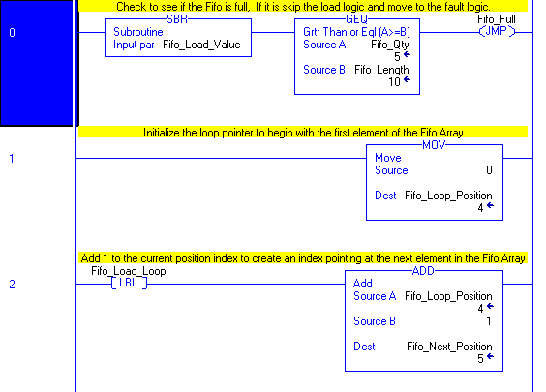
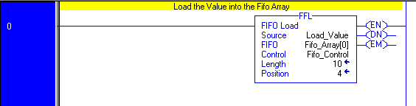
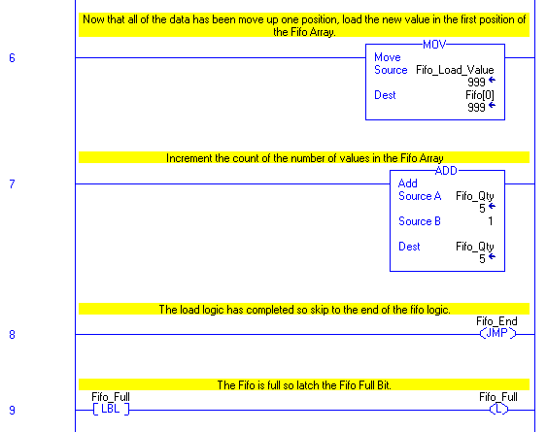
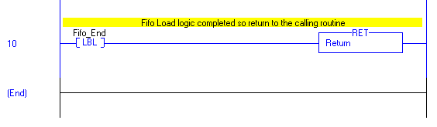
Extensions to IEC provide code optimization and ease of use
IEC1131-3 Load FIFO Logic
Rockwell Automation FIFO Load Instruction
=
1 Rung of Logic
1 Instruction
Minutes to code and debug
11 Rungs of Logic
17 Instructions
Hours to code and debug

Slide 21
Rockwell Automation Instruction Extension to IEC1131-3
FIFO & LIFO - FFL, FFU, LFL, LFU
File math and search - FAL, FSC
Table operations - SRT, STD, AVE
Sequencers - SQI, SQL, SQO, SDS
Diagnostics - DDT, DFA, FBC
Compare - CMP, MEQ
Compute - CPT, NEG
Data moves - MVM, COP, BTD
Program Control - AFI, NOP, MCR, TND
Interrupt Services - UID, UIE
Retentive Timer - RTO
Ladder Loop Instruction - FOR, NXT
Process - PID
Motion - 30+ instructions to perform closed loop servo control

