Slide 1
Artificial Intelligence
Artificial Intelligence (AI) refers to the capability of machines, typically computer systems, to perform tasks that would typically require human intelligence. These tasks encompass a broad range of activities, including problem-solving, learning, reasoning, perception, natural language understanding, and decision-making. AI systems are designed to mimic or simulate human cognitive functions, enabling them to analyze data, adapt to changing conditions, and make informed choices.
AI systems rely on algorithms and data to process information and improve their performance over time. Machine learning, a subset of AI, involves training algorithms on large datasets to recognize patterns and make predictions or decisions based on new data.
COM 316

Slide 2
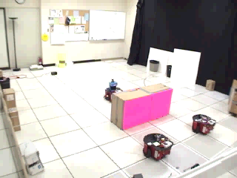
Robot Teams
USC robotics Lab
COM 316

Slide 3
What is AI? (Some Definitions of AI, Organized into 4 Categories)
Systems that think like human | Systems that think rationally
“The exciting new effort to make computers thinks … machine with minds, in the full and literal sense” (Haugeland 1985) “The automation of activities that we associate with human thinking, activities: decision-making, problem-solving, learning….” (Bellman 1978) | “The study of mental faculties through the use of computational models” (Charniak et al. 1985) “The study of the computations that make it possible to perceive,reason, and act.” (Winston 1992)
Systems that act like human | Systems that act rationally
“The art of creating machines that perform functions that require intelligence when performed by people” (Kurzweil, 1990) “The study of how to make computers do things at which, at the moment, people are better.” (Rich&Knight 1991) | A field of study that seeks to explain and emulate intelligent behavior in terms of computational processes” (Schalkol, 1990) “AI ….. Is concerned with intelligent behavior in artifacts.” (Nilsson 1998)
COM 316

Slide 4
What is AI? (Some Definitions of AI, Organized into 4 Categories)
Theses definitions vary along two dimentions:
1. Thought Processes and Reasoning (thinking)
2. Behavior (acting)
The definitions on the left measure success in terms of fidelity to human performance
The definitions on the right measure against an ideal concept of intelligence, which is called Rationality.
A system is rational if it does the “right thing”, given what it knows.
COM 316

Slide 5
What is AI? Four Approches
Human-centered approaches (Empirical Science) that involves : Hypothesis and Experimental confirmation
Acting Humanly: The Turing Test
Thinking Humanly: Cognitive Science
Rationalist approach that involves: Combination of Mathematics and Engineering
Thinking Rationally: Laws of Thought
Acting Rationally: The Rational Agent
COM 316

Slide 6
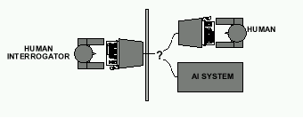
Acting Humanly: The Turing Test
Alan Turing's 1950 article Computing Machinery and Intelligence discussed conditions for considering a machine to be intelligent
  “Can machines think?” ←→ “Can machines behave ntelligently?”
  The Turing test (The Imitation Game): Operational definition of intelligence.
COM 316

Slide 7
Versions of the Turing test : Imitation Game
Turing's original game described a simple party game involving three players: Player A is a man, player B is a woman and player C (who plays the role of the interrogator) is of either sex.
In the Imitation Game, player C is unable to see either player A or player B, and can communicate with them only through written notes. By asking questions to both players, player C tries to determine which of the two is the man and which is the woman.
Player A's role is to trick the interrogator into making the wrong decision, while player B attempts to assist the interrogator in making the right one.
Turing proposed : that the role of player A be filled by a computer so that its task was to pretend to be a woman and attempt to trick the interrogator into making an incorrect evaluation.
The success of the computer was determined by comparing the outcome of the game when player A is a computer against the outcome when player A is a man.
Turing stated : if "the interrogator decide wrongly as often when the game is played [with the computer] as he does when the game is played between a man and a woman", it may be argued that the computer is intelligent.
COM 316

Slide 8
Acting Humanly: The Turing Test
What computer needs to possess: Natural language processing, Knowledge representation, Automated reasoning, and Machine learning
Are there any problems/limitations to the Turing Test?
COM 316

Slide 9
What tasks require AI?
“AI is the science and engineering of making intelligent machines which can perform tasks that require intelligence when performed by humans …”
COM 316

Slide 10
What tasks require AI?
Tasks that require AI:
  Solving a differential equation
  Brain surgery
  Inventing stuff
  Playing Jeopardy
  Playing Wheel of Fortune
  What about walking?
  What about grabbing stuff?
  What about pulling your hand away from fire?
  What about watching TV?
  What about day dreaming?
COM 316

Slide 11
The Full Turing Test : Standard interpretation
"standard interpretation." In this version, player A is a computer and player B a person of either sex. The role of the interrogator is not to determine which is male and which is female, but which is a computer and which is a human.
The fundamental issue with the standard interpretation is that the interrogator cannot differentiate which responder is human, and which is machine. There are issues about duration, but the standard interpretation generally considers this limitation as something that should be reasonable.
COM 316

Slide 12
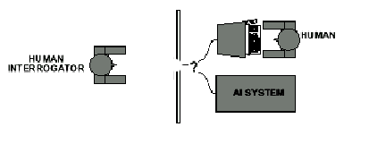
Acting Humanly: The Full Turing Test
Problem:
1) Turing test is not reproducible, constructive, and amenable to mathematic analysis.
2) What about physical interaction with interrogator and environment?
Trap door
COM 316

Slide 13
What would a computer need to pass the Turing test?
Natural language processing: to communicate with examiner.
Knowledge representation: to store and retrieve information provided before or during interrogation.
Automated reasoning: to use the stored information to answer questions and to draw new conclusions.
Machine learning: to adapt to new circumstances and to detect and extrapolate patterns.
COM 316

Slide 14
What would a computer need to pass the Turing test?
Vision (for Total Turing test): to recognize the examiner’s actions and various objects presented by the examiner.
Motor control (total test): to act upon objects as requested.
Other senses (total test): such as audition, smell, touch, etc.
COM 316

Slide 15
Thinking Humanly: Cognitive Science
1960 “Cognitive Revolution”: information-processing psychology replaced behaviorism
Cognitive science brings together theories and experimental evidence to model internal activities of the brain
  What level of abstraction? “Knowledge” or “Circuits”?
  How to validate models?
    Predicting and testing behavior of human subjects (top-down)
    Direct identification from neurological data (bottom-up)
    Building computer/machine simulated models and reproduce results (simulation)
COM 316

Slide 16
What is Cognitive Science About?
How information is represented, processed, and transformed (in faculties such as perception, language, memory, attention, reasoning, and emotion) within nervous systems (humans or other animals) and machines (e.g. computers).
Cognitive science consists of multiple research disciplines, including psychology, artificial intelligence, philosophy, neuroscience, linguistics, and anthropology.[3] It spans many levels of analysis, from low-level learning and decision mechanisms to high-level logic and planning; from neural circuitry to modular brain organization.
The fundamental concept of cognitive science is that "thinking can best be understood in terms of: (1) representational structures in the mind and (2) computational procedures that operate on those structures."[
COM 316

Slide 17
Thinking Rationally: Laws of Thought
Aristotle (~ 450 B.C.) attempted to codify “right thinking”
What are correct arguments/thought processes?
E.g., “Socrates is a man, all men are mortal; therefore Socrates is mortal”
Several Greek schools developed various forms of logic:
notation plus rules of derivation for thoughts.
COM 316

Slide 18
Thinking Rationally: Laws of Thought
Problems:
  Uncertainty: Not all facts are certain (e.g., the flight might be delayed).
  Resource limitations:
    Not enough time to compute/process
    Insufficient memory/disk/etc
    Etc.
COM 316

Slide 19
Acting Rationally: The Rational Agent
Rational behavior: Doing the right thing!
The right thing: That which is expected to maximize the expected return
Provides the most general view of AI because it includes:
  Correct inference (“Laws of thought”)
  Uncertainty handling
  Resource limitation considerations (e.g., reflex vs. deliberation)
  Cognitive skills (NLP, AR, knowledge representation, ML, etc.)
Advantages:
  More general
  Its goal of rationality is well defined
COM 316

Slide 20
How to achieve AI?
How is AI research done?
AI research has both theoretical and experimental sides. The experimental side has both basic and applied aspects.
There are two main lines of research:
  One is biological, based on the idea that since humans are intelligent, AI should study humans and imitate their psychology or physiology.
  The other is phenomenal, based on studying and formalizing common sense facts about the world and the problems that the world presents to the achievement of goals.
The two approaches interact to some extent, and both should eventually succeed. It is a race, but both racers seem to be walking. [John McCarthy]
COM 316

Slide 21
Branches of AI
Logical AI
Search
Natural language processing
pattern recognition
Knowledge representation
Inference From some facts, others can be inferred.
Automated reasoning
Learning from experience
Planning To generate a strategy for achieving some goal
Epistemology Study of the kinds of knowledge that are required for solving problems in the world.
Ontology Study of the kinds of things that exist. In AI, the programs and sentences deal with various kinds of objects, and we study what these kinds are and what their basic properties are.
Genetic programming
Emotions???
…
COM 316

Slide 22
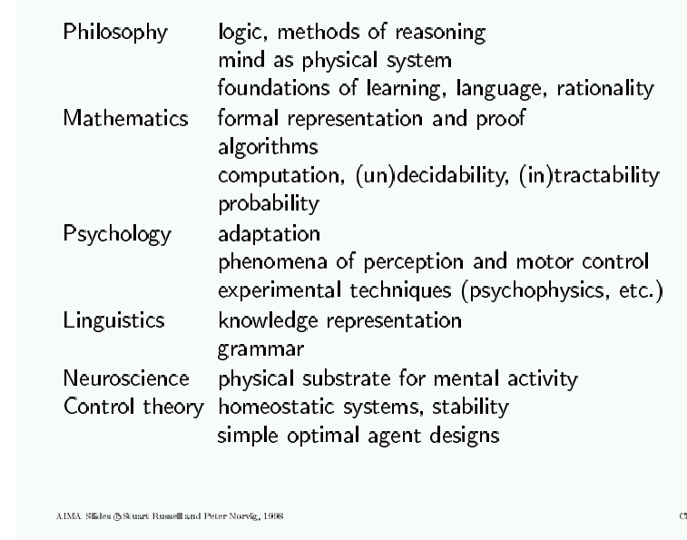
AI Prehistory
COM 316

Slide 23
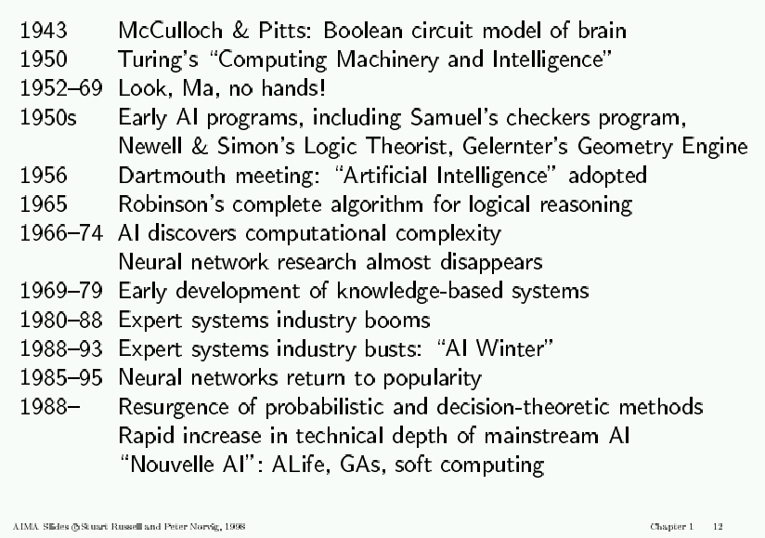
AI History
COM 316

Slide 24
AI State of the art
Have the following been achieved by AI?
  World-class chess playing
  Playing table tennis
  Cross-country driving
  Solving mathematical problems
  Discover and prove mathematical theories
  Engage in a meaningful conversation
  Understand spoken language
  Observe and understand human emotions
  Express emotions
  …
COM 316

Slide 25
A driving example: Beobots
Goal: build robots that can operate in unconstrained environments and that can solve a wide variety of tasks.
COM 316

Slide 26
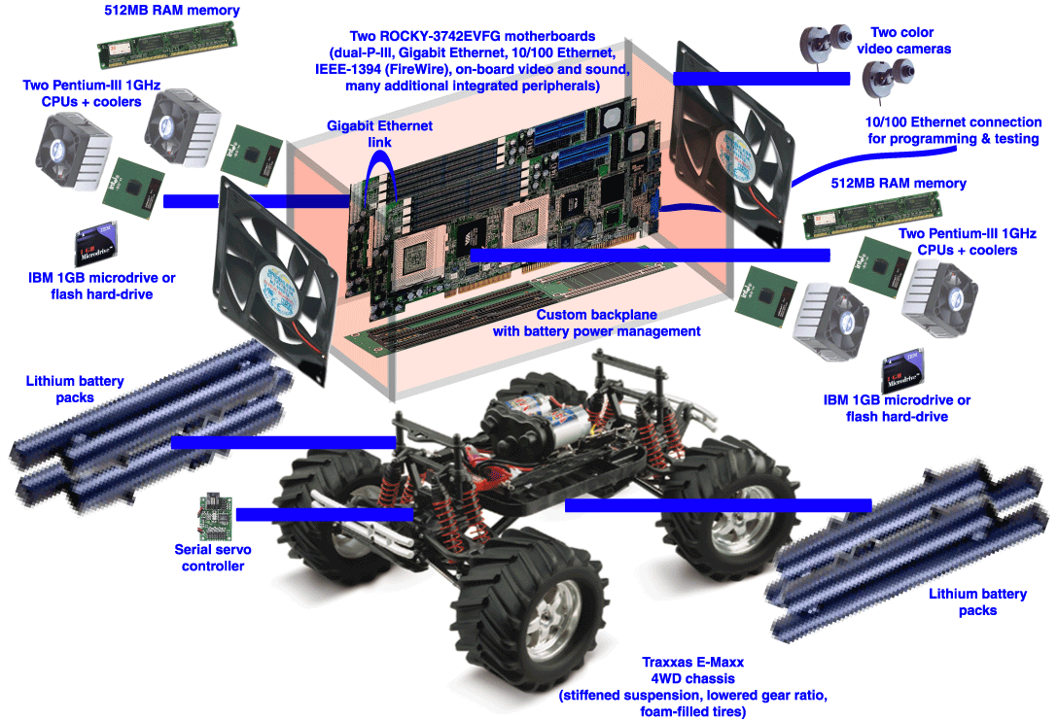
Beowulf + robot =
“Beobot”
COM 316

Slide 27
A driving example: Beobots
Goal: build robots that can operate in unconstrained environments and that can solve a wide variety of tasks.
We have:
  Lots of CPU power
  Prototype robotics platform
  Visual system to find interesting objects in the world
  Visual system to recognize/identify some of these objects
  Visual system to know the type of scenery the robot is in
We need to:
  Build an internal representation of the world
  Understand what the user wants
  Act upon user requests / solve user problems
COM 316

Slide 28
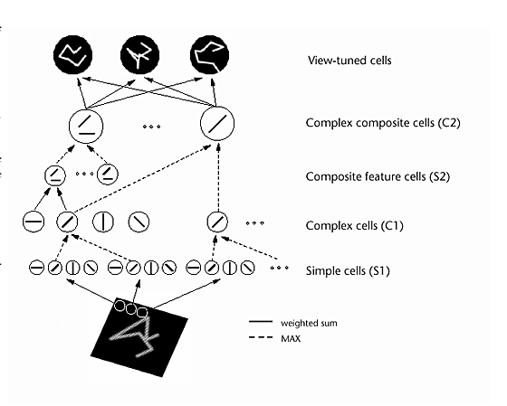
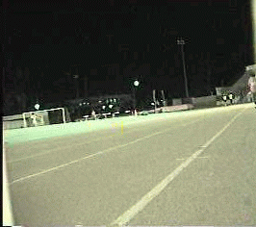
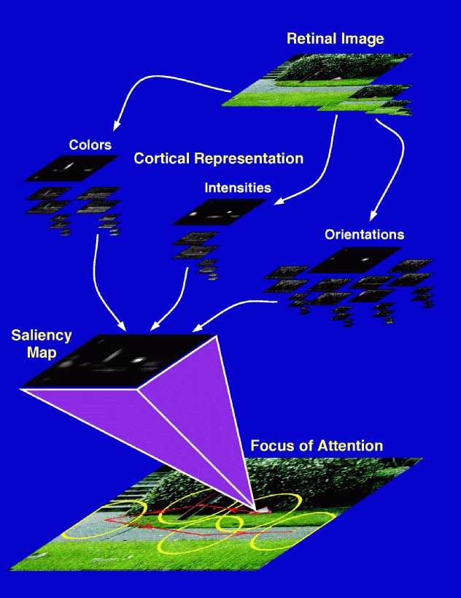
The basic components of vision
+
Original Downscaled Segmented
Scene Layout
& Gist
Riesenhuber & Poggio,
Nat Neurosci, 1999
Localized
Object
Recognition
Attention
COM 316

Slide 29
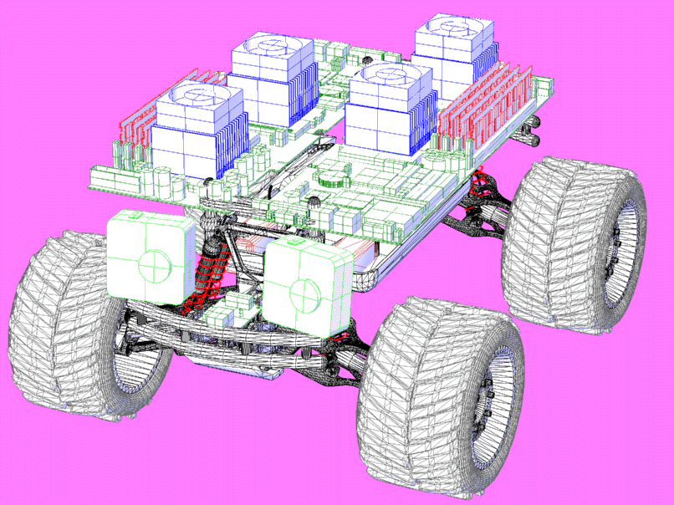
COM 316

Slide 30
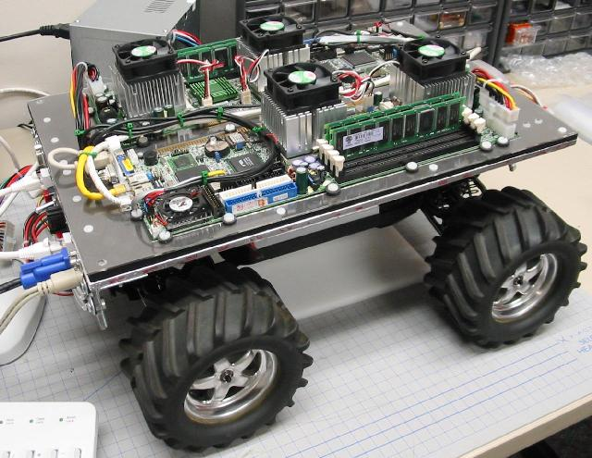
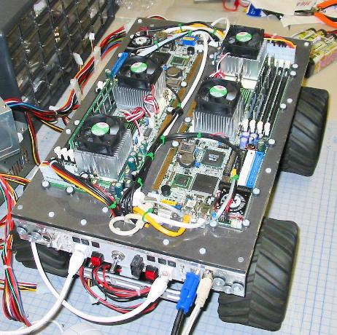
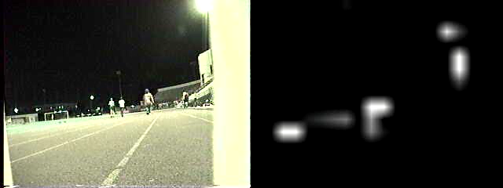
Beowulf + Robot =
“Beobot”
COM 316

Slide 31

Main challenge: extract the “minimal subscene” (i.e., small
number of objects and actions) that is relevant to present
behavior from the noisy attentional scanpaths.
Achieve representation for it that is robust and stable against
noise, world motion, and egomotion.
COM 316

Slide 32
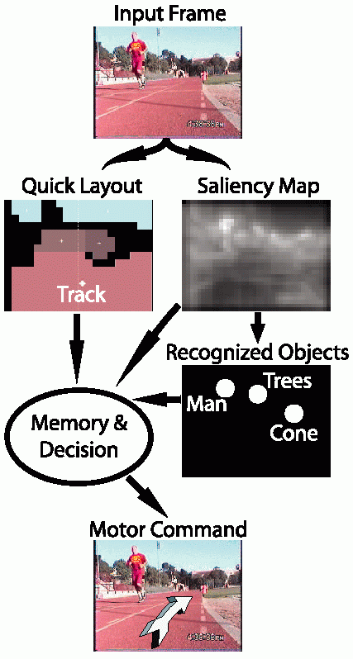
Prototype
Stripped-down version of proposed
general system, for simplified
goal: drive around USC olympic
track, avoiding obstacles
Operates at 30fps on quad-CPU
Beobot;
Layout & saliency very robust;
Object recognition often confused
by background clutter.
COM 316

Slide 33
Major issues
How to represent knowledge about the world?
How to react to new perceived events?
How to integrate new percepts to past experience?
How to understand the user?
How to optimize balance between user goals & environment constraints?
How to use reasoning to decide on the best course of action?
How to communicate back with the user?
How to plan ahead?
How to learn from experience?
COM 316

Slide 34
Outlook
AI is a very exciting area right now.
This course will teach you the foundations.
In addition, we will use the Beobot example to reflect on how this foundation could be put to work in a large-scale, real system.
COM 316

