Slide 1

Trend Analysis of Priest Lake Water Temperature Data
Ephraim Romesberg

Slide 2
The Data
Data consists of temperature measurements from Priest Lake
Only Data from top meter is used
Data is only used from the sites KALI, PLNO, and PLSO and months June, July, August, and September
Other sites and months contain too little data or have too large of gaps between observations

Slide 3
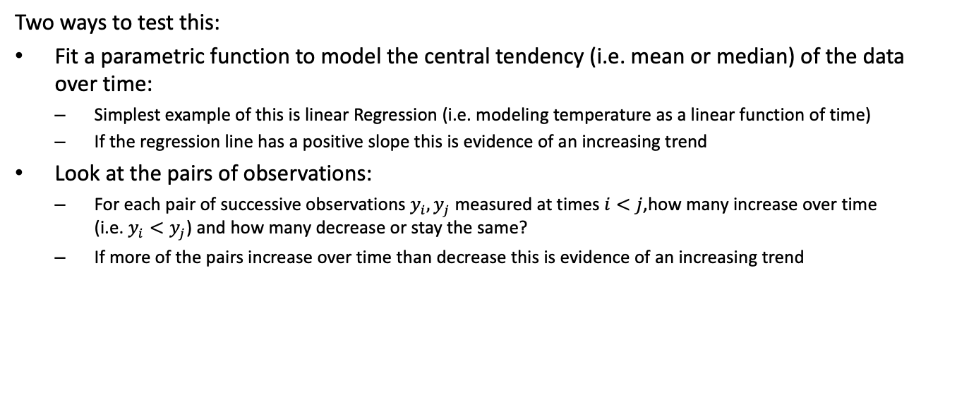
Is temperature increasing over time?
Two ways to test this:
Fit a parametric function to model the central tendency (i.e. mean or median) of the data over time:
Simplest example of this is linear Regression (i.e. modeling temperature as a linear function of time)
If the regression line has a positive slope this is evidence of an increasing trend
Look at the pairs of observations:
For each pair of successive observations $y_{i},y_{j}$ measured at times $i<j$,how many increase over time (i.e. $y_{i}<y_{j}$) and how many decrease or stay the same?
If more of the pairs increase over time than decrease this is evidence of an increasing trend

Slide 4
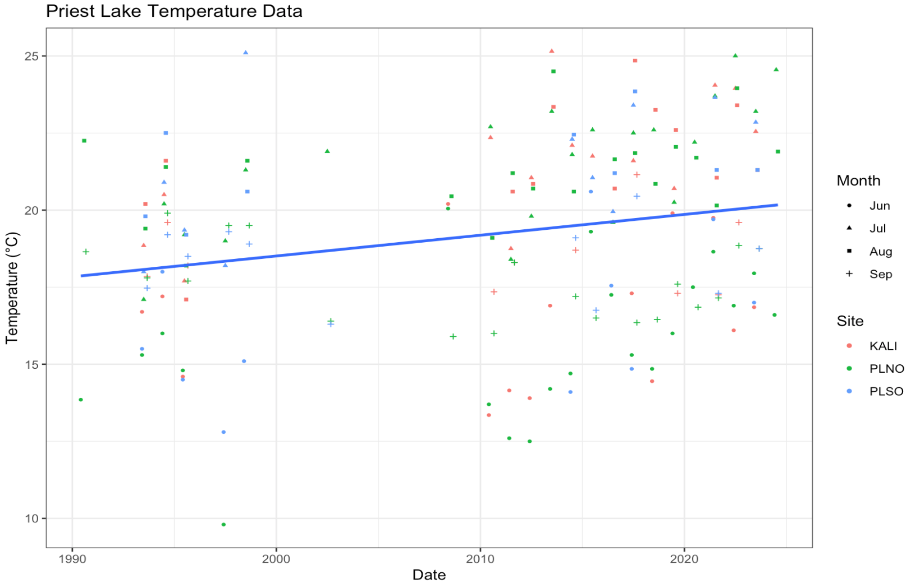
Can we use Linear Regression?

Slide 5

Problems With Using Linear Regression:
Assumes data is normally distributed
Assumes Relationship between x and y is linear
Doesn’t account for the Seasonal and Regional nature of the data
Doesn’t account for spatial or temporal dependence between observations (i.e. correlation between $Y_{i}$ and $Y_{j}$ is assumed to be zero for $i≠j$)

Slide 6
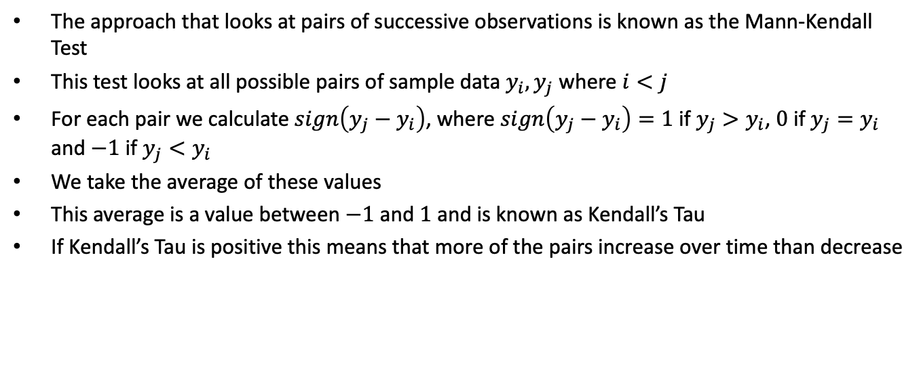
The Second Approach:
The approach that looks at pairs of successive observations is known as the Mann-Kendall Test
This test looks at all possible pairs of sample data $y_{i},y_{j}$ where $i<j$
For each pair we calculate $sign\left(y_{j}−y_{i}\right)$, where $sign\left(y_{j}−y_{i}\right)=1$ if $y_{j}>y_{i}$, $0$ if $y_{j}=y_{i}$ and $−1$ if $y_{j}<y_{i}$
We take the average of these values
This average is a value between $−1$ and $1$ and is known as Kendall’s Tau
If Kendall’s Tau is positive this means that more of the pairs increase over time than decrease

Slide 7
The Mann-Kendall Test:
Null Hypothesis: Observations are equally likely to increase or decrease over time (no trend)
Alternative Hypothesis: Observations are more likely to increase than decrease over time (positive trend)
The Mann-Kendall Test tells us if Kendall’s Tau is different enough from zero to conclude there is a trend
If the null hypothesis is true then (the sample) Kendall’s Tau is approximately normal (for large enough sample sizes) with an expected value of zero
Hypothesis test is constructed using the approximate normality of Kendall’s Tau
The approximate normality of Kendall’s Tau holds regardless of whether the data is normal
Mann-Kendall test makes no assumption that the relationship between x and y is linear
Only depends on the ranks of the observations

Slide 8
Issues with the Mann-Kendall Test:
Seasonal/Regional effects:
While the MK test can deal with non-normal and non-linear data it is not designed to deal with seasonal or regional effects
This can lead to misleading results
When observations are compared across seasons or regions seasonal and regional differences can be mistaken for trend
Spatial/Temporal dependence:
MK test also assumes that observations are independent
This is often an unrealistic assumption
It is natural for observations close in space and time to have some type of dependence

Slide 9
Dealing with Seasonal/Regional Effects:
Fortunately there are seasonal and regional versions of the MK test
Rather than looking at all pairs of sample data we can only look at pairs within the same season and region
This is known as a Regional-Seasonal Kendall test
We only compare pairs within each Region-Season combination
These pairwise comparisons are then put together and averaged like before to calculate Kendall’s Tau
A positive R-S Kendall’s Tau tells us that there is an increasing trend in one or more Region-Season combination

Slide 10
Dealing with Spatial and Temporal Dependence:
R-S Kendall test still assumes that the observations are independent
Using a test on correlated observations that assumes independence will often lead to misleading results
A correlated sample provides less information than an independent sample
We need to adjust for this loss of information when performing our hypothesis test
Dependent Sample=Less Information
There is a version of the Seasonal Kendall test that is adjusted for serial dependence over time
For technical details see Hirsch and Slack (1984)
This test is easily extended to also account for spatial dependence in regional data

Slide 11
Which test is best for our data?
We have no reason to assume our data is normal or that if there is a trend it is linear
Our data is from multiple seasons (June, July, August, and September) and Regions (KALI, PLNO, and PLSO)
More than likely there is spatial and temporal dependence between observations
This makes a Regional-Seasonal Kendall test adjusted for Spatiotemporal dependence a better choice than a more conventional method such as linear regression

Slide 12
Regional-Seasonal Test Results:
R-S Kendall test adjusted for Spatiotemporal dependence was performed using rkt package in R
Here regions are sites (KALI, PLNO, and PLSO) and seasons are months (June, July, August, and September)
Based on this test we got a Tau value of approximately .27 and p-value of approximately 0.005
Using a standard significance level of .05 we reject the null hypothesis and conclude that there is an increasing trend; later observations are likely to be larger than earlier ones

Slide 13
Trend Within Seasons:
The R-S Kendall test tells us that there is a trend in at least some of the region-season combinations
It does not tell us which specific regions and seasons have a trend
It seems plausible that warmer months could have more of a trend than cooler months
We can investigate this further by running individual Regional Kendall tests for data from each month
Results From By-Month tests:
Greatest trend is in July (Tau value of 0.49 and p-value of 0.002)
Weakly significant positive trends in June and August
No significant trend in September

Slide 14
Quantifying the Trend:
A positive Kendall’s Tau tells us that observations are more likely to increase over time
It does not tell us how much they increase (i.e. °C/Year)
To estimate the magnitude of the trend we have another statistic known as the Theil-Sen’s slope
Theil-Sen’s slope also uses pairs of successive observations
To calculate Theil-Sen’s slope we calculate the slope of the line connecting each pair of observations, we then take the median of these slopes
This approach can be adjusted for regional/seasonal data just as with Kendall’s Tau
Theil-Sen slope does not assume normality and is much less sensitive to outliers than ordinary regression slope
It does however assume the trend is linear, so interpret with caution

Slide 15
Theil-Sen Slopes:
The Regional-Seasonal Theil-Sen Slope is approximately .08
As a (very rough) approximation we can say that Temperature is increasing at about .08 °C/Year
Since some months have a more significant trend than others it is better to look at the slopes by month
We get the largest slope in July at approximately 0.14 °C/Year

Slide 16
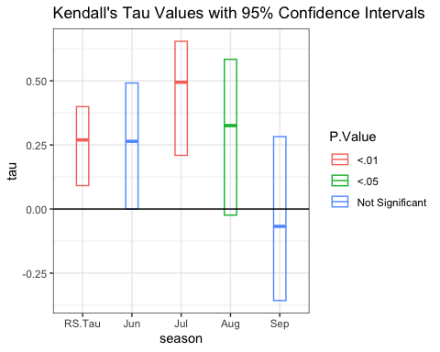
Confidence Intervals for Tau:

Slide 17
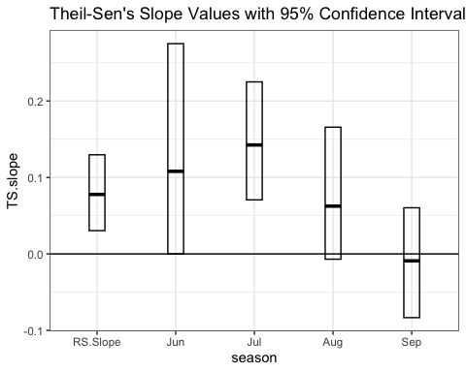
Confidence Intervals for Theil-Sen’s Slope:

Slide 18
Interpreting the Confidence Intervals:
The confidence intervals give us a range of plausible values for Tau and TS-Slope values
If a confidence interval contains zero this indicates that the trend is not significant
We get the same results from the CI’s as we did from the hypothesis tests
Overall Regional Seasonal trend is positive
By season we have the greatest trend and largest slope in July

Slide 19
Conclusion:
The Regional-Seasonal Kendall Test relies on much less restrictive assumptions than linear regression
Data does not need to be normal and relationship does not need to be linear
Test accounts for the regional and seasonal nature of the data and spatial/temporal dependence
Based on this test we can conclude that the water temperature is increasing over time in Priest Lake
The most significant trend and largest rate of increase is in July

Slide 20
Refrences:
Design Trend Seasonal Kendall. (n.d.). Vsp.pnnl.gov. https://vsp.pnnl.gov/help/Vsample/Design_Trend_Seasonal_Kendall.htm
Helsel, D. R., & Hirsch, R. M. (2020). Statistical methods in water resources (pp. 342–349). U.S. Geological Survey.
Hirsch, R. M., & Slack, J. R. (1984). A Nonparametric Trend Test for Seasonal Data With Serial Dependence. Water Resources Research, 20(6), 727–732. https://doi.org/10.1029/wr020i006p00727
Mann, H. B. (1945). Nonparametric Tests Against Trend. Econometrica, 13(3), 245. https://doi.org/10.2307/1907187‌
Marchetto, A. (2024). rkt: Mann-Kendall Test, Seasonal and Regional Kendall Tests. R-Project.org. https://cran.r-project.org/package=rkt

