Slide 1
Maryland Sales Territory Analysis
EmporiUm · In-store sales · Northeast region · Jan 2022 – Dec 2025
Prepared for Shruti Reddy, Sales Manager
Ephrata Mulugeta

Slide 2
Agenda
1
Scenario
6
Trend: Maryland
2
Summary stats: whole database
7
Trend analysis
3
Summary stats: Maryland
8
Relationship analysis
4
Comparative analysis
9
Findings & recommendations
5
Trend: whole database

Slide 3
Scenario
EmporiUm: a student bookstore chain selling books, technology, art supplies and more
How is Maryland performing, and where should we focus sales attention next quarter?
Maryland
In-store sales territory
Northeast
Region (with MA, NJ, ME)
Shruti Reddy
Sales manager (my "client")
Tools: MySQL Workbench (JOIN, WHERE, SUM, COUNT, AVG, GROUP BY, UNION) · Excel PivotChart · GitHub

Slide 4
Summary stats: whole database
All in-store sales, all stores, Jan 2022 – Dec 2025
$45.37M
In-store revenue
335,129
Transactions
$135.38
Average sale
111
Stores in 10 states

Slide 5
Summary stats: Maryland
Q1: Maryland in-store sales, Jan 1, 2022 – Dec 31, 2025
$11.45M
Maryland revenue
89,466
Transactions
$128.00
Average sale
9
Stores

Slide 6
Maryland is the #1 state by far
Q3: Maryland vs. its region and the company
47%
of Northeast revenue ($11.45M of $24.24M)
25%
of company revenue, with 8% of the stores (9 of 111)
$1.27M
per store vs. about $409K company average

Slide 7
Trend: whole database
Company in-store revenue by year
2.0×
2025 vs. 2022 ($15.9M vs. $7.8M)
+47%
growth from 2024 to 2025
Flat
2023 ≈ 2024 ($10.8M)

Slide 8
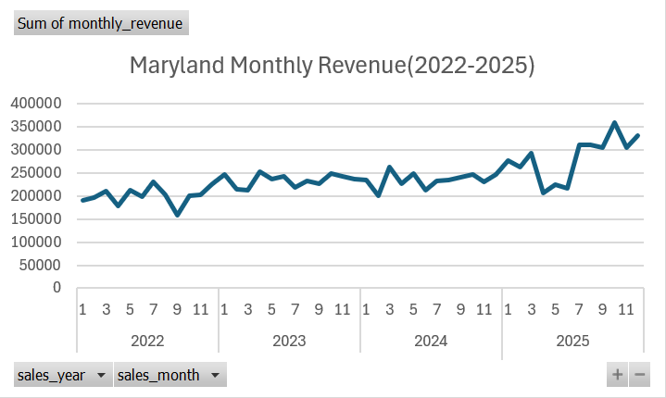
Trend: Maryland
Q2: my Excel PivotChart of Maryland monthly revenue
2022 $2.41M
2023 $2.81M
2024 $2.82M
2025 $3.41M

Slide 9
Maryland is growing slower than the company
Revenue growth from 2024 to 2025
31% → 21%
Maryland's share of company revenue, 2022 → 2025
+8%
North Harford growth: slowing
+65%
Other 8 stores combined (Germantown +64%)

Slide 10
Store revenue follows store traffic
Q5: Maryland stores, number of transactions vs. revenue
69,530
North Harford transactions, 78% of Maryland's
$125
North Harford's average sale, the lowest in Maryland
r ≈ 0.99
Strong link, even without North Harford

Slide 11
Findings & recommendations
Maryland: $11.45M · #1 state · 47% of the Northeast · North Harford = 76% · growing slower than the company
Protect North Harford
Keep its technology sales strong ($5.9M of its $8.7M) and find out why its growth slowed to 8%.
1
Invest in the growing stores
The other 8 stores grew 65% in 2025; Germantown grew fastest ($132K → $217K).
2
Reduce the risk
Growing the smaller stores lowers dependence on one location. Also review why textbook sales fell 26%.
3
Thank you! Questions?

