Slide 1
RESULTS
Accelerometer and Barometer

Slide 2
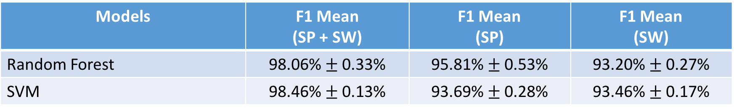
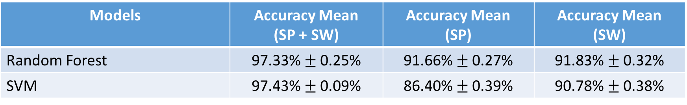
5-Fold CV on Combined Dataset (9 persons)
14 activities (WITHOUT EATING), Sampling @ 10 Hz, Window size = 2s
Comparison → 14 activities (WITHOUT EATING), 6 Persons results:
Models | F1 Mean (SP + SW) | F1 Mean (SP) | F1 Mean (SW)
Random Forest | 98.06% $±$ 0.33% | 95.81% $±$ 0.53% | 93.20% $±$ 0.27%
SVM | 98.46% $±$ 0.13% | 93.69% $±$ 0.28% | 93.46% $±$ 0.17%
Models | Accuracy Mean (SP + SW) | Accuracy Mean (SP) | Accuracy Mean (SW)
Random Forest | 97.33% $±$ 0.25% | 91.66% $±$ 0.27% | 91.83% $±$ 0.32%
SVM | 97.43% $±$ 0.09% | 86.40% $±$ 0.39% | 90.78% $±$ 0.38%

Slide 3
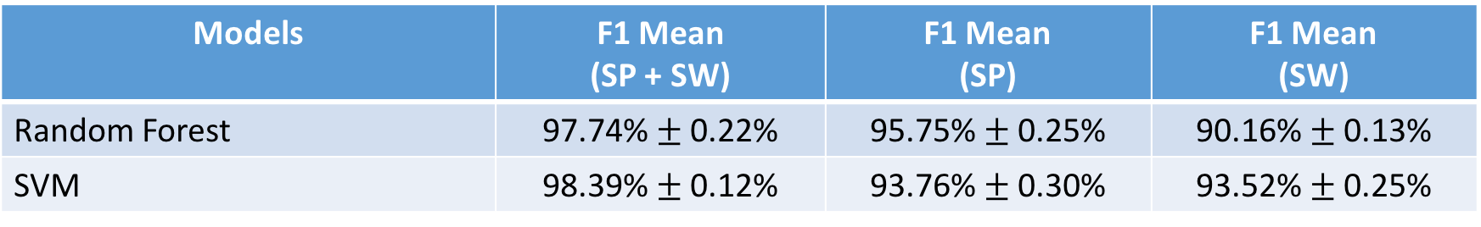
5-Fold CV on Combined Dataset (9 persons) – WITHOUT SW BAROMETER
14 activities (WITHOUT EATING), Sampling @ 10 Hz, Window size = 2s
Comparison → 14 activities (WITHOUT EATING), 6 Persons results:
Models | F1 Mean (SP + SW) | F1 Mean (SP) | F1 Mean (SW)
Random Forest | 97.74% $±$ 0.22% | 95.75% $±$ 0.25% | 90.16% $±$ 0.13%
SVM | 98.39% $±$ 0.12% | 93.76% $±$ 0.30% | 93.52% $±$ 0.25%
Models | Accuracy Mean (SP + SW) | Accuracy Mean (SP) | Accuracy Mean (SW)
Random Forest | 97.33% $±$ 0.25% | 91.66% $±$ 0.27% | 91.83% $±$ 0.32%
SVM | 97.43% $±$ 0.09% | 86.40% $±$ 0.39% | 90.78% $±$ 0.38%

Slide 4
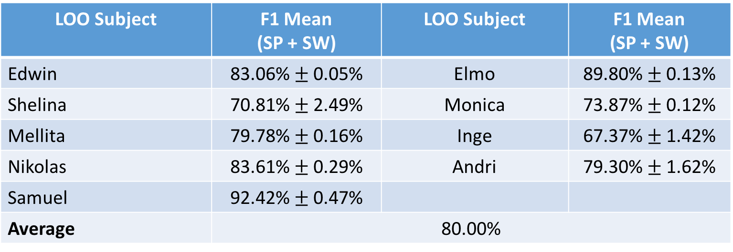
LOO (9 PERSONS)
14 Activities (without Eating)
RF → N = 500
LOO Subject | F1 Mean (SP + SW) | LOO Subject | F1 Mean (SP + SW)
Edwin | 83.06% $±$ 0.05% | Elmo | 89.80% $±$ 0.13%
Shelina | 70.81% $±$ 2.49% | Monica | 73.87% $±$ 0.12%
Mellita | 79.78% $±$ 0.16% | Inge | 67.37% $±$ 1.42%
Nikolas | 83.61% $±$ 0.29% | Andri | 79.30% $±$ 1.62%
Samuel | 92.42% $±$ 0.47%
Average | 80.00%

Slide 5
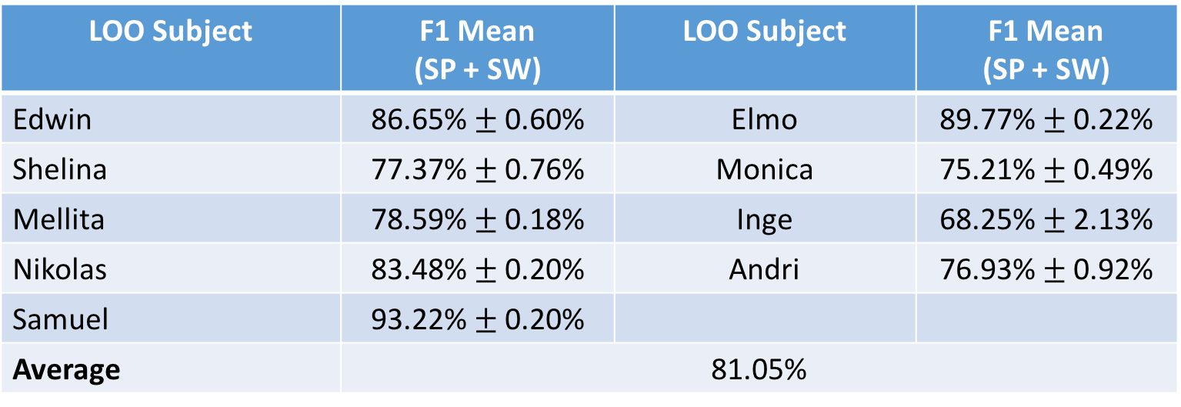
LOO (9 PERSONS) – WITHOUT SW BAROMETER
14 Activities (without Eating)
RF → N = 500
LOO Subject | F1 Mean (SP + SW) | LOO Subject | F1 Mean (SP + SW)
Edwin | 86.65% $±$ 0.60% | Elmo | 89.77% $±$ 0.22%
Shelina | 77.37% $±$ 0.76% | Monica | 75.21% $±$ 0.49%
Mellita | 78.59% $±$ 0.18% | Inge | 68.25% $±$ 2.13%
Nikolas | 83.48% $±$ 0.20% | Andri | 76.93% $±$ 0.92%
Samuel | 93.22% $±$ 0.20%
Average | 81.05%

Slide 6
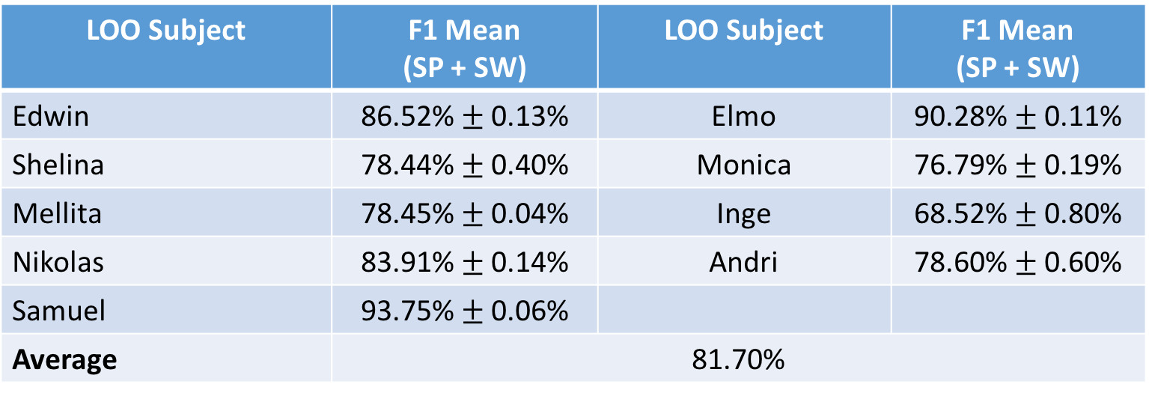
LOO (9 PERSONS) – WITHOUT SW BAROMETER
14 Activities (without Eating)
RF → N = 500
LOO Subject | F1 Mean (SP + SW) | LOO Subject | F1 Mean (SP + SW)
Edwin | 86.52% $±$ 0.13% | Elmo | 90.28% $±$ 0.11%
Shelina | 78.44% $±$ 0.40% | Monica | 76.79% $±$ 0.19%
Mellita | 78.45% $±$ 0.04% | Inge | 68.52% $±$ 0.80%
Nikolas | 83.91% $±$ 0.14% | Andri | 78.60% $±$ 0.60%
Samuel | 93.75% $±$ 0.06%
Average | 81.70%

Slide 7
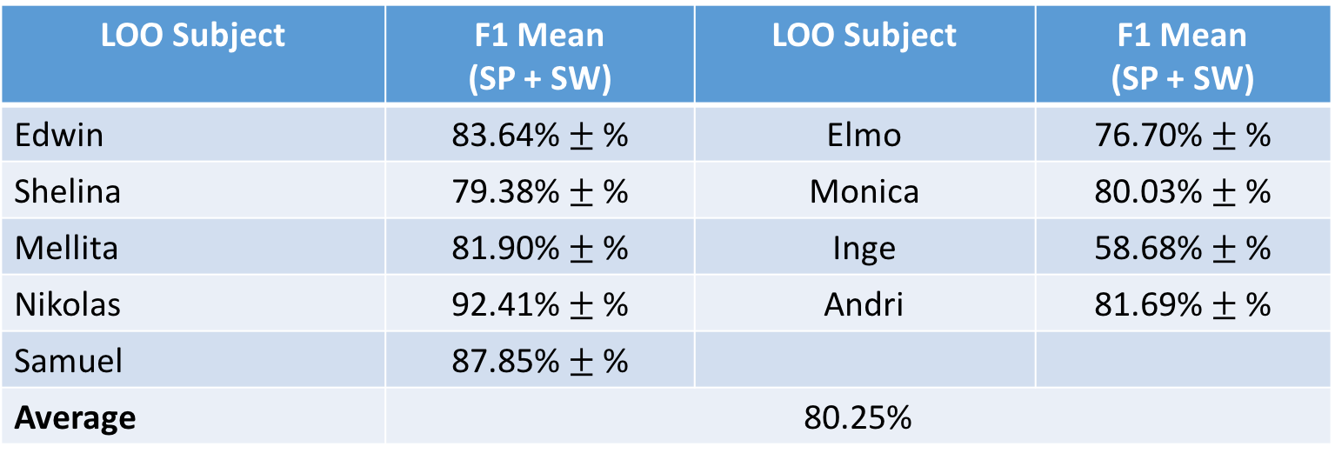
LOO (9 PERSONS) – WITHOUT SW BAROMETER
14 Activities (without Eating)
SVM → C = 1, Gamma = 0.1
LOO Subject | F1 Mean (SP + SW) | LOO Subject | F1 Mean (SP + SW)
Edwin | 83.64% $±$ % | Elmo | 76.70% $±$ %
Shelina | 79.38% $±$ % | Monica | 80.03% $±$ %
Mellita | 81.90% $±$ % | Inge | 58.68% $±$ %
Nikolas | 92.41% $±$ % | Andri | 81.69% $±$ %
Samuel | 87.85% $±$ %
Average | 80.25%

