Slide 1
Human Activity Recognition And Tracking
June Quak Ren Feng

Slide 2
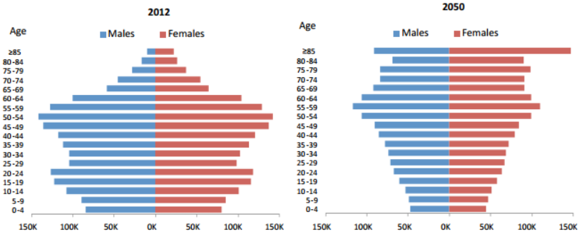
Current Trend on The Number of Elderlies In Singapore
Total number of elderlies, approximately 353K
Total number of elderlies, approximately 919K

Slide 3

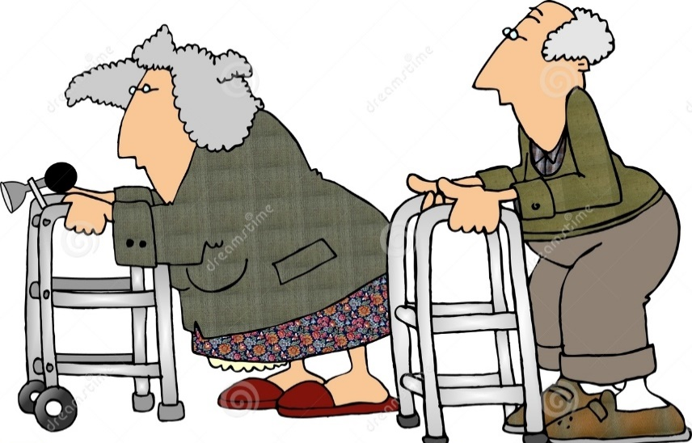
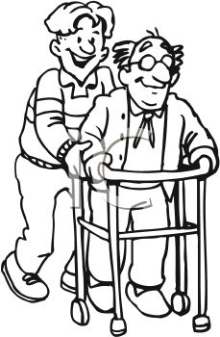
Effect of Rising Trend of Elderlies

Slide 4
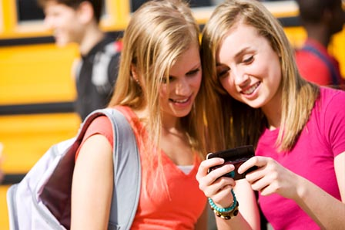
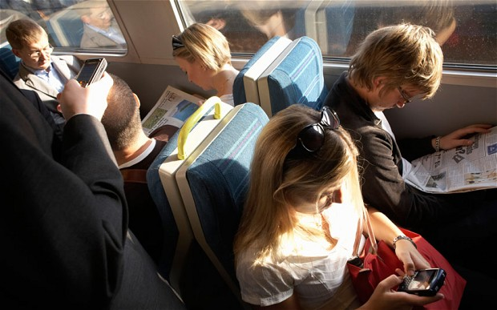
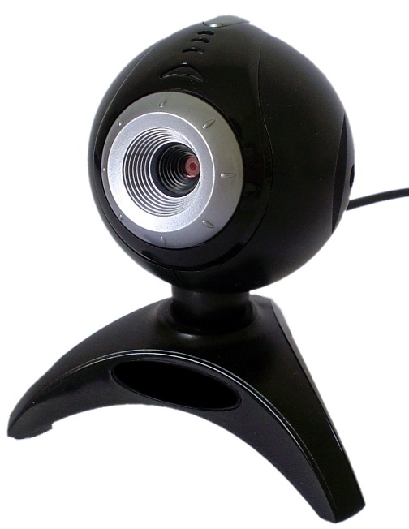
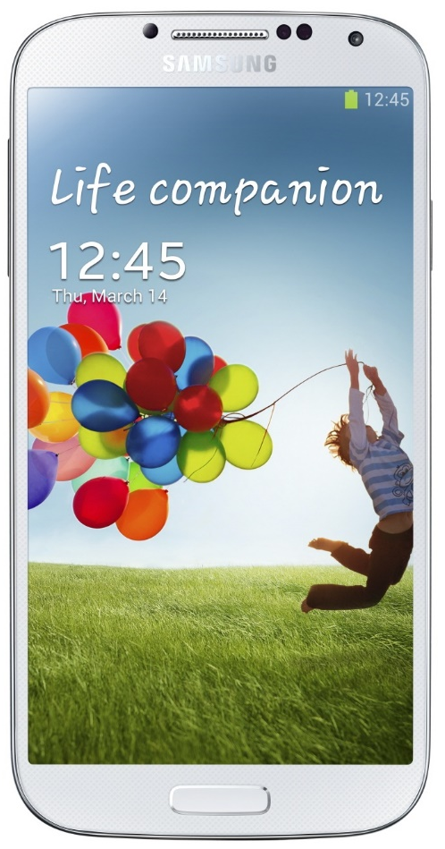

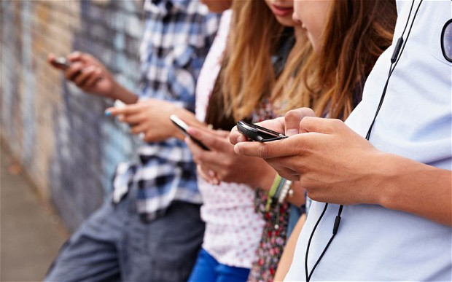
Smart Devices Are Created

Slide 5

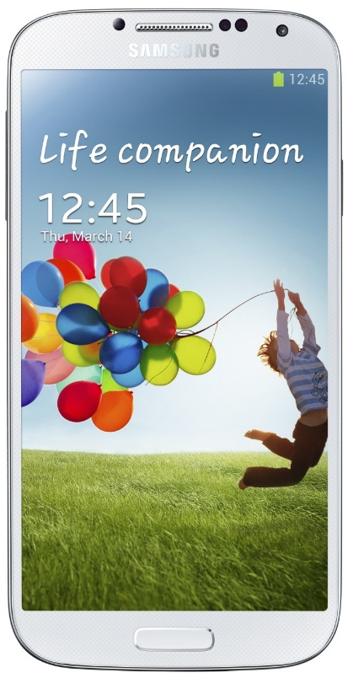
Samsung Galaxy S4 Sensors
Linear Accelerometer
Accelerometer
Gyroscope

Slide 6
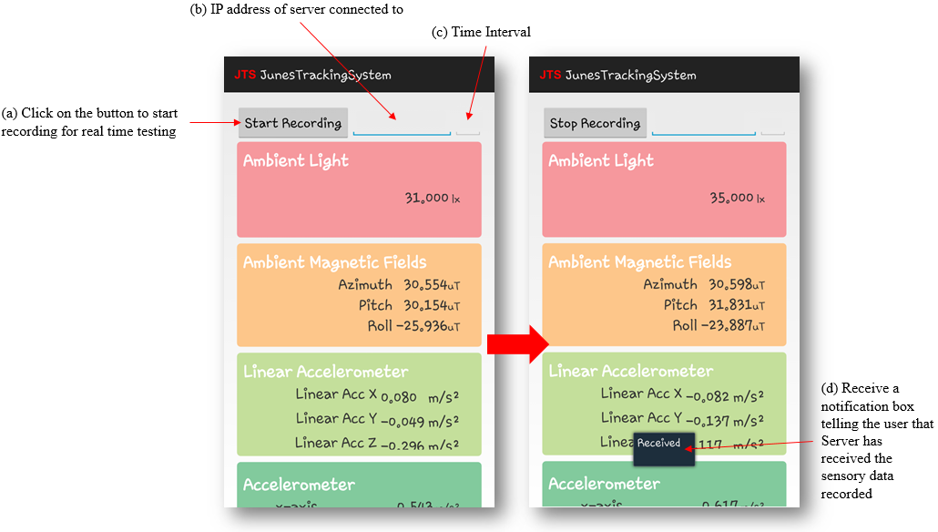

Slide 7
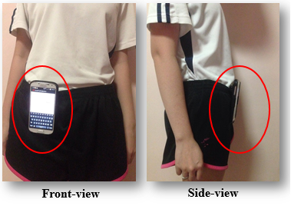

Slide 8
Methodologies
Hidden Markov Models
Training
Testing
Pre-Processing Steps

Slide 9
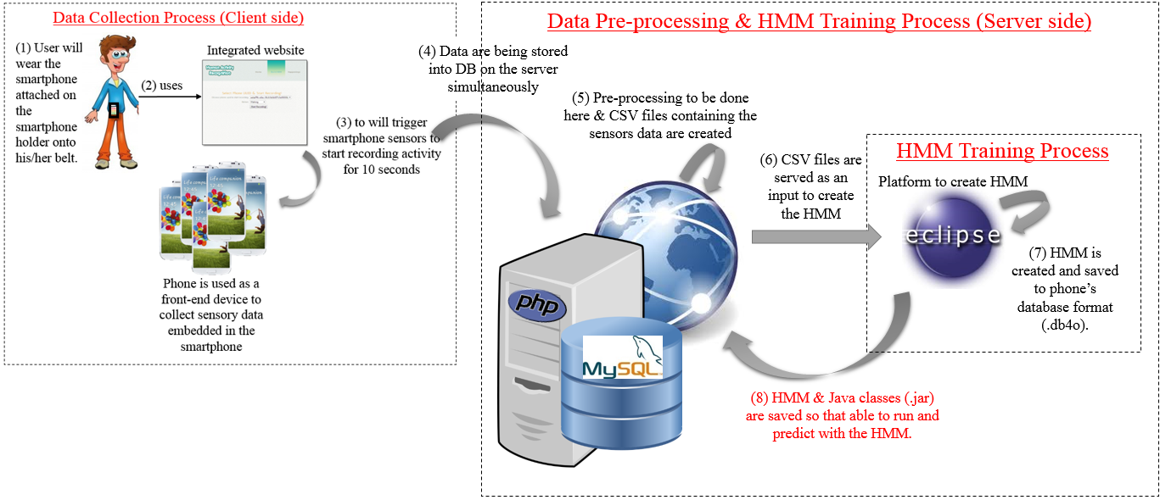
Training & Pre-processing Phases

Slide 10
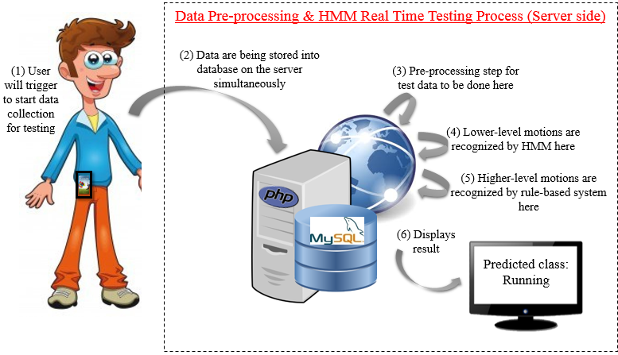
Testing Phase

Slide 11
Recognized Motions
Motions
Lower-level
Higher-level
Running
Walking
Sitting
Standing
Lying
Sit down
Stand up
Fall
Lie down

Slide 12
Higher-level Motions
Situation | From Lower-level motion | To Lower-level motion
Stand up | Sitting | Standing
Fall | Running | Lying
 | Walking | Lying
 | Standing | Lying
Lie down | Sitting | Lying
 | Standing | Lying
Sit down | Running | Sitting
 | Standing | Sitting
 | Walking | Sitting

Slide 13
My Contributions
Built a system that can recognize continuous and transitional motions using models
Continuous Motions (Lower-level Motions) – Accuracy of 99.98%
Running, Walking, Standing, Lying, Sitting
Transitional Motions (Higher-level Motions) – Accuracy of 76.25%
Sit down, Stand up, Lie down, Fall
Lower-level Motions were recognized by Hidden Markov Model
Higher-level Motions were recognized by rule-based system

Slide 14
Demo Time

