Slide 1
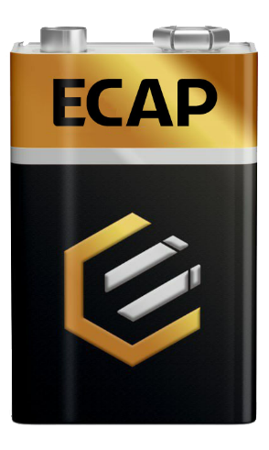

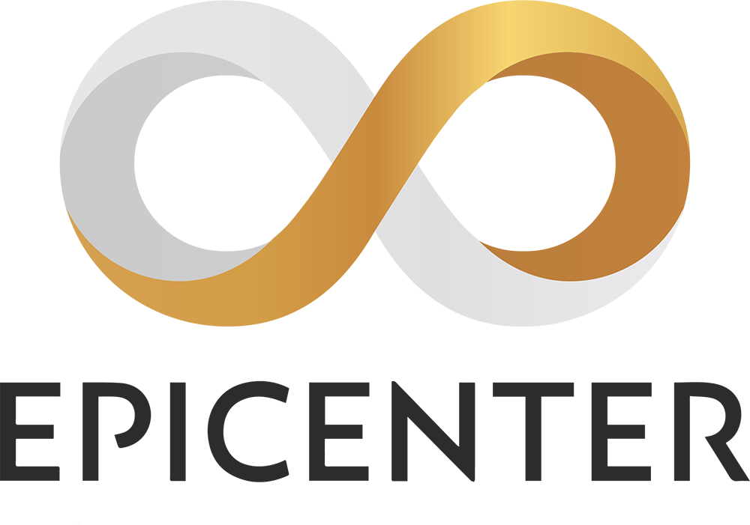

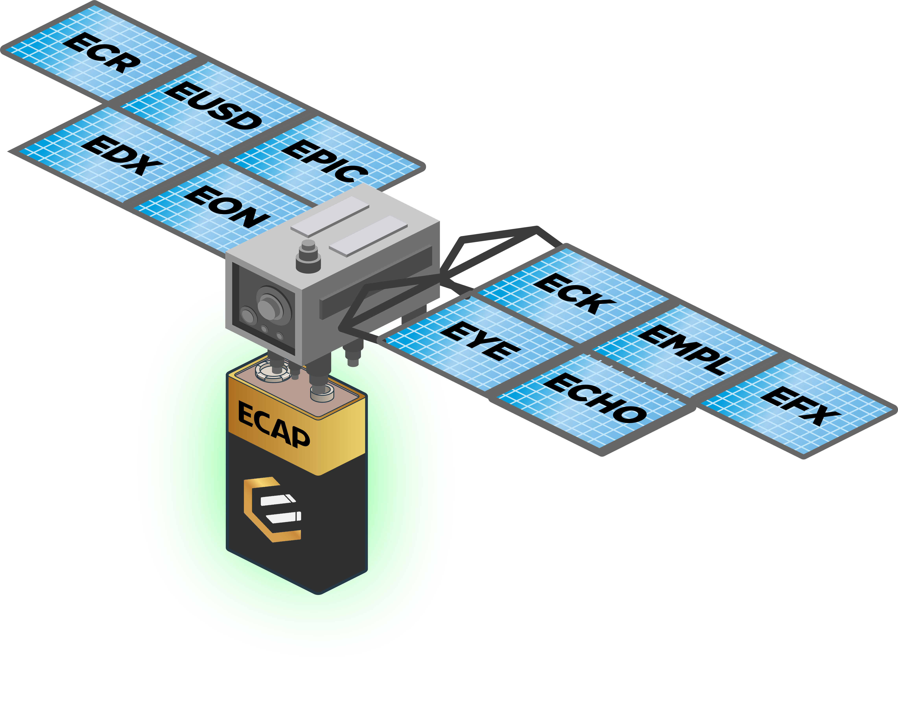
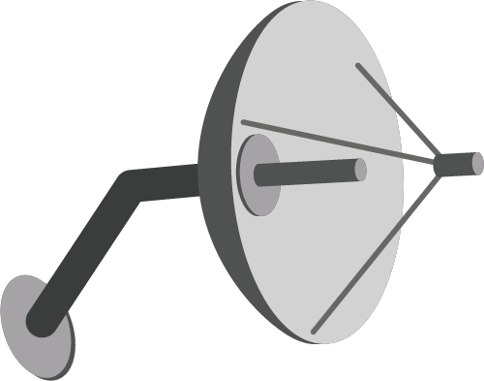



EPICENTER CAPITAL ACCUMULATION PROTOCOL
A portion of system cashflows accrue to ECAP, fueling token buyback
WHAT IS ECAP?
ECAP tokens are designed to absorb a small slice of value from each new asset created in the entire Epicenter ecosystem and store this value in a limited fixed supply of tokens. For every transaction that occurs, these tokens accrue a tiny slither of value from each. Over time, as the network grows, the use cases grow and the volume grows, these small slithers may start to add up to significant value.
This is used to buy back tokens from the market and burn them. This creates a downward pressure on the number of tokens in existence.
1,000 ECAP tokens max supply
Tokens destroyed
# Tokens
Tokens in existence
Time
Autonomous | Censorship Resistant | Governance-Free | Tax-efficient | Transparent | Trustless
5th October 2021

