Slide 1





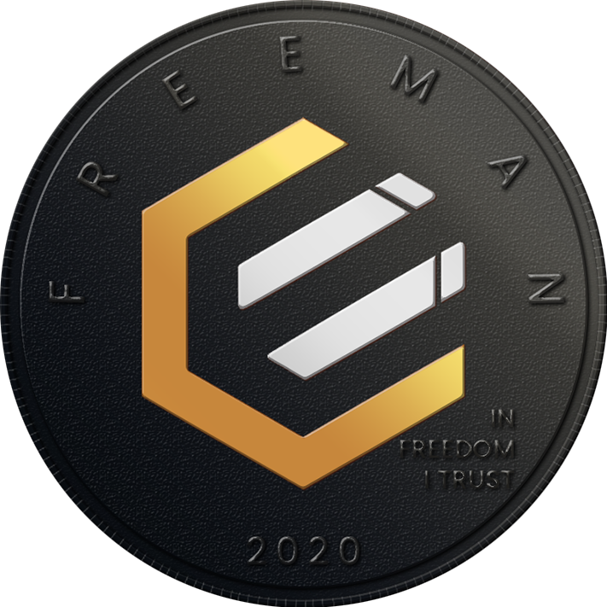




Innovation: A History of Leadership
In September 2019, the EPIC Blockchain Protocol came into existence with the fairest launch of a layer one protocol since the original Bitcoin Core.
NO ICO
NO Pre-mine
NO VC’s
FAIR Launched
Sep 2019
Nov 2019
Sep 2021
Nov 2021
Feb 2022
RandomX
(+63 days)
Dandelion ++
(+520 days)
Schnorr Signatures
(Taproot +803 days)
Mimblewimble
(Layer 2 +884 days)
Can your blockchain do this?
Scalability
Privacy & Anonymity
Future Proofing
Eco-friendly
Pedersen Commitments
Cut-Through Aggregation
Ring Signatures
CoinJoin
Cold-Cold offline transfers
I2P
Tor
zkPoK
Polymorphic Proof-of-Work
Quantum-Ready
No ASIC Waste Stream
Minimized Negative Externalities
Innovation One Pager v04

