Slide 1
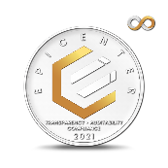





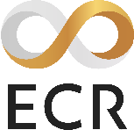

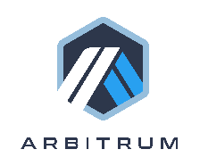

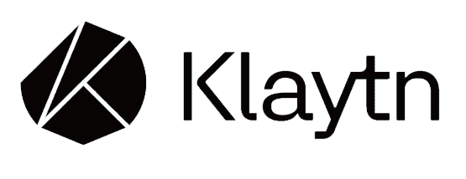


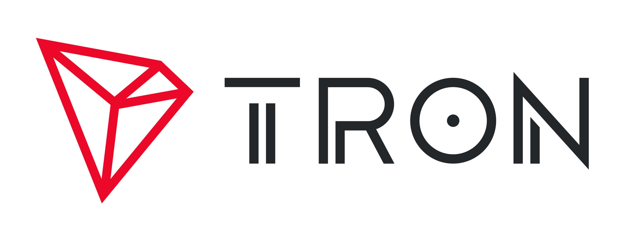
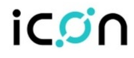



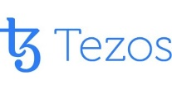







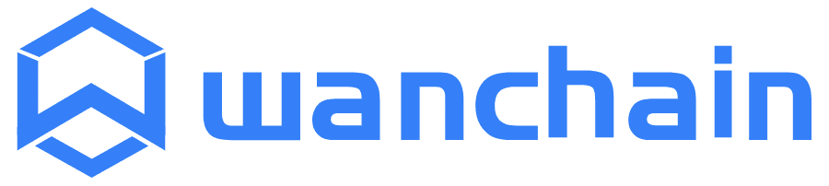

$1 worth of:
Censorship Resistant | Trustless | Permissionless | High Assurance | Compliant | Regulatory Compatible | Privacy-Preserving | Composable | Interoperable
Borrow up to 50% loan to value on $EPIC holdings.
Minting rights determined by ECR stakers.
What can I do with EUSD?
Available across multiple chains
XDAI
+22 more…
20 September 2021

