Slide 1
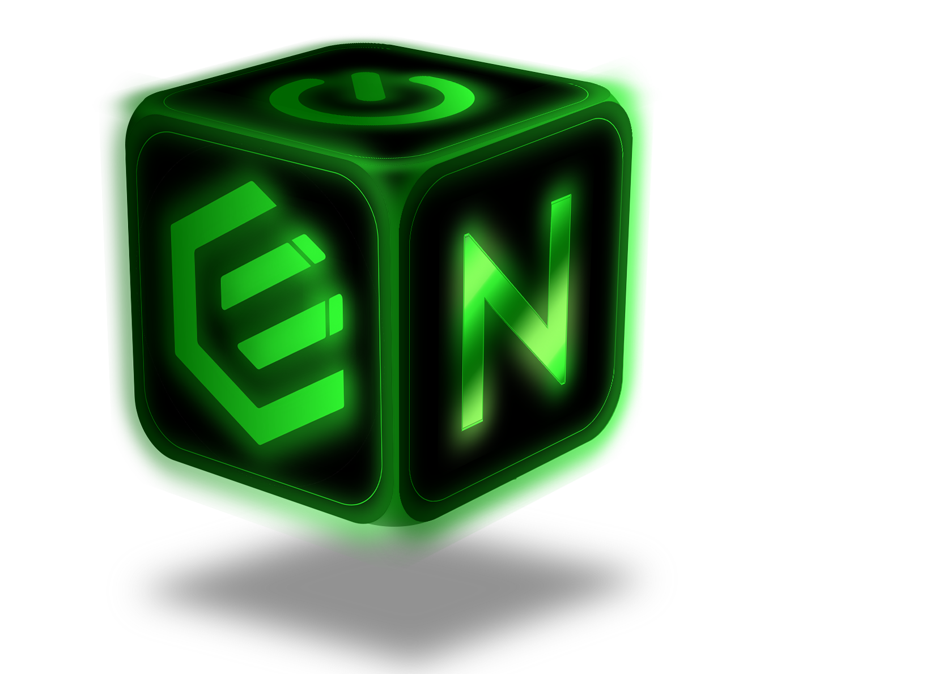



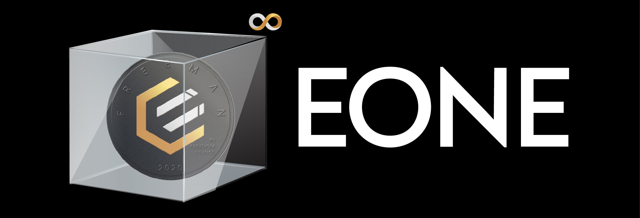

TURING-COMPLETE SOLIDITY++ (EVM) COMPATIBLE CRYPTO CLOUD COMPUTER
Coalescent ConsensusTM
Enhanced Hierarchical Delegated Proof of Stake EHDPoS
Proof of Work
ProgPoW-GPU Mobile PoW
Proof of Stake Cosmos – Polkadot
PoS
Proof of Spacetime Farm with Storage Space PoST
Merkle of Merkle of Merkle
Veriblock Proof of Proof
+
Komodo Delayed Proof of Work
Directed Acyclic Graph
3x Blockchains – E0, EMPL, EON
Distributed Ledger Matrix
SECURE | SCALABLE | DECENTRALIZED
0
0
0
Gas Fees
Failed Transactions
Frontrunning & Slippage
POWERING:
 | COINS
 | Basic | Pro
 | White Night (confidential) Dark Forest (observable)
 | Privacy Solutions | Lelantus | Mimblewimble | Aguamenti | Zk-Snark | CoinSwap
 | NFT Cloud Hashrate Leasing
ECMART | Physical E-commerce
Local EPIC | P2P Fiat Network
P2P Lending
Learn2Earn
Yield Farming
COMPOSABLE | Permissionless, Trustless, Coordination-free
INTEROPERABLE | ADD LOGOS HERE
CENSORSHIP RESISTANT | 100% free open source Enhanced Nakamoto Consensus, Not a company
COMMUNITY DRIVEN | Volunteer-led
FAIR LAUNCH | No ICO, No Premine
PRIVACY PRESERVING | No KYC
REGULATORY COMPATIBLE | Howey Safe, Stable Act, 1774, Infrastructure Bill
P2P Meta-Dex
Atomic
OrderBook
Swap
Whirlpool
FEATURING:
ERC20 WRAPPED EPIC
Powered by:
EON One Pager v01 | Nov 21

