Slide 1


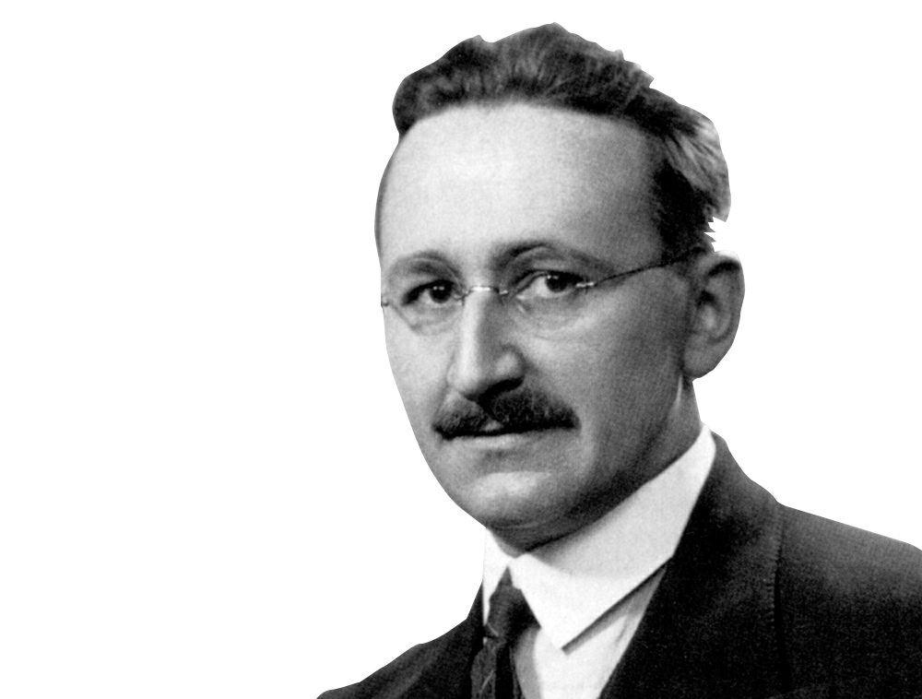
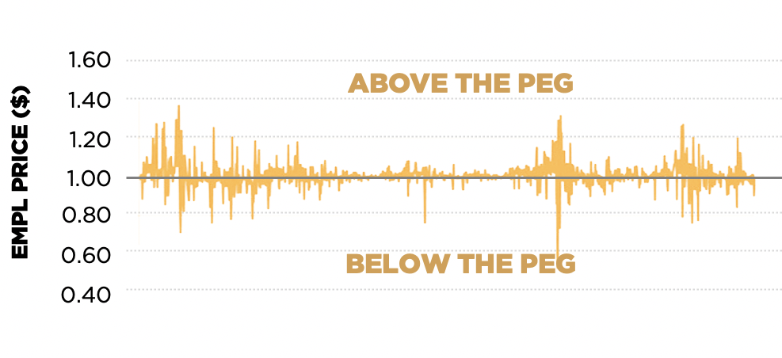












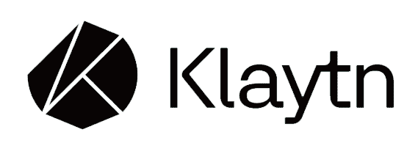














Elastic Multi Protocol Liquidity
International Monetary Fund
Soft-pegged via elastic rebase to:
1 SDR
(~$1.39)
This represents a basket of the world’s fiat currencies
F.A. Hayek
WHAT IS IT?
HEDGE CURRENCY RISK
“Hayek Money” refers to a concept put forth by F.A. Hayek wherein the desired macroeconomic result – in this case market price level equilibrium at $1.39 – is attained through “rebasing” the number of units of currency in each user’s wallet.
Physical commodities
Precious metals
Real estate
Insurance & derivatives
Fixed income products
1.78
Wallet balance increases
1.39
WHAT GIVES IT VALUE?
Wallet balance decreases
EMPL accrues cash flows from fees within the ecosystem
Transfer fees (Tobin Tax) on EMPL traders
1.00
HOW DOES IT WORK?
SUPPORTED CHAINS
Protocol-owned liquidity provided to Convex, Curve etc.
These income streams fund ongoing buyback & burn events
The protocol accumulates physical gold
HOWEY SAFE
NO ICO
NO Pre-mine
100% Decentralized
POWERED BY
EMPL One Pager v09

