Slide 1
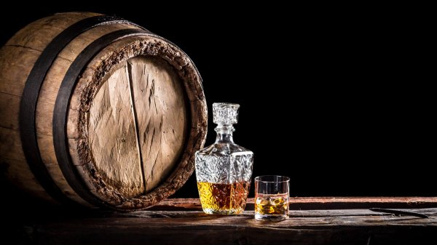
WHISKY Discography

Slide 2


The Motivation

Slide 3

Questions – Whisky hunters
Where in the world has most highly rated whisky?
Which country has the most distilleries?
Is there a visible relationship between the number of whiskies produced by a distillery and their average ratings?
What are the top-rated distilleries in both the world, and within a specific country?

Slide 4

Data preparation
We got our data from Kaggle and Whisky Base.
We imported the data and cleaned it using Pandas. The data was exported to SQLite where we used flask APIs to call the data for our HTML.
To visualise our data, we used Plotly, Highchart, jQuery.
Other libraries used include D3 and Lodash.

Slide 5

DEPLOYMENT TO HEROKU
Whisky Discography (whisky-discography.herokuapp.com)

Slide 6

Conclusions
The highest rated whisky was in Italy, however it only had one vote.
Perhaps its distiller was a bit biased?
United States had the most distilleries.
Scotland had the most reviewed distilleries.
Our website can be used by Whisky fans to find their next whisky to sample. They could also use the website to plan their next Whisky road trip!

Slide 7
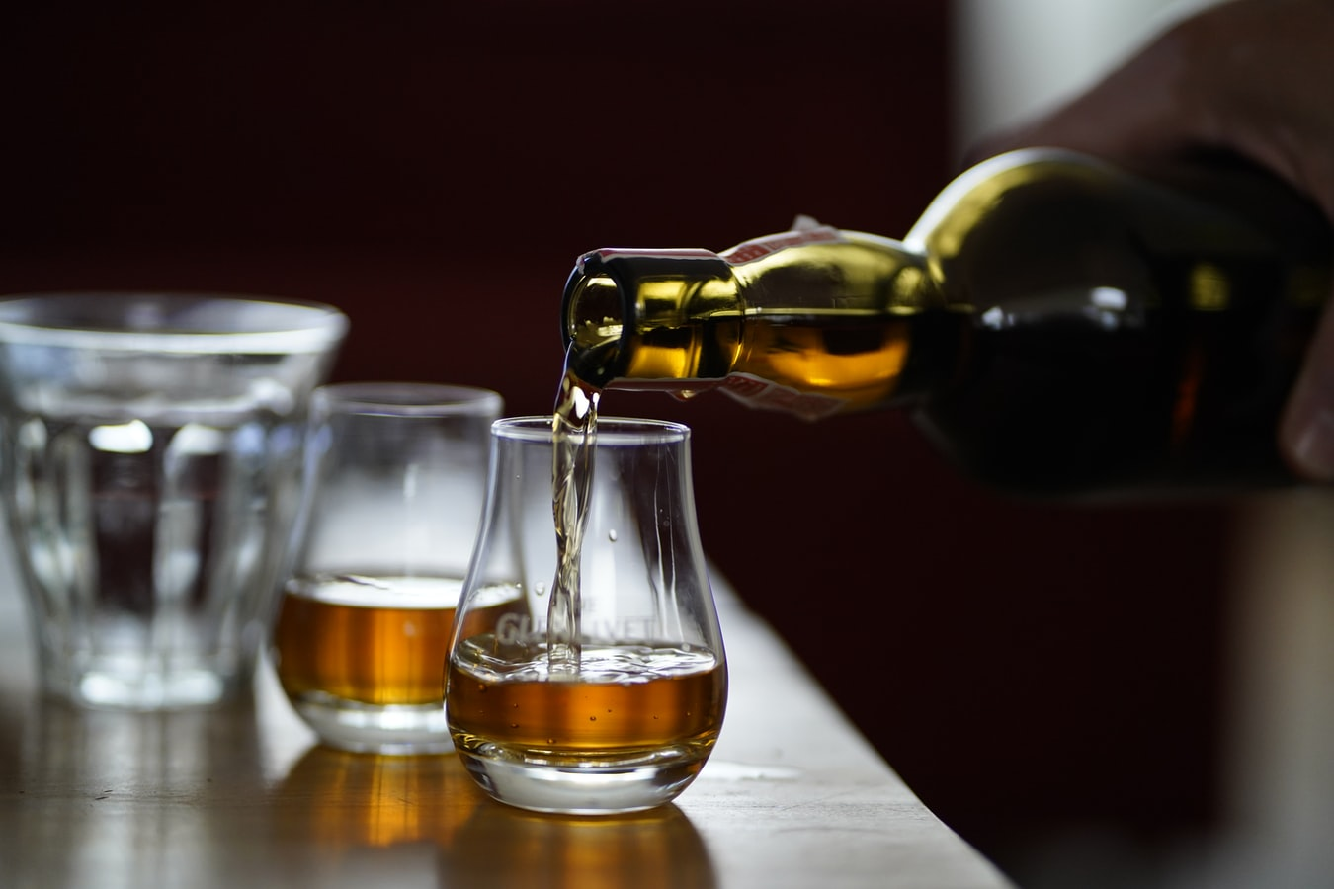
NEXT STEPS
With more time:
Plot the individual distilleries (requires a GeoJSON).
Add whisky characteristics to the study.
This could include price.
Increased the filterability of the data table.
Perhaps add summary statistics to the jQuery table.
Add a Comparisons page which allows side by side comparisons of whiskies and / or distilleries by country.

