Slide 1
S&P Global & Crisil Campus Hackathon 2026
Autonomous Financial News Intelligence Engine
Name : Mehul Kaushik
College: MIT Manipal

Slide 2
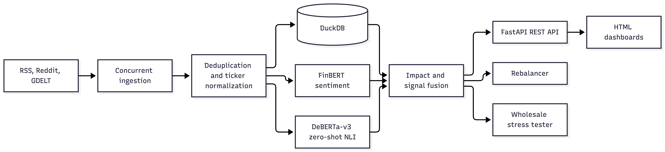
Business Problem: Financial markets react to breaking news quickly, but traditional risk-management systems can be slow to identify important events and assess their potential impact on investments and bank portfolios. This can delay critical decisions and increase financial risk.
My Solution
I built a Python-based financial intelligence platform that ingests news from multiple sources using concurrent fetching, cleans and deduplicates the data, and uses FinBERT for sentiment analysis and DeBERTa for event classification. I combined these outputs with custom impact-scoring logic to prioritize important news, dynamically rebalance a 20-stock portfolio, and stress-test a synthetic $1 billion banking portfolio for potential losses and CET1 capital impact.
What Problem is and How I Solved ?

Slide 3
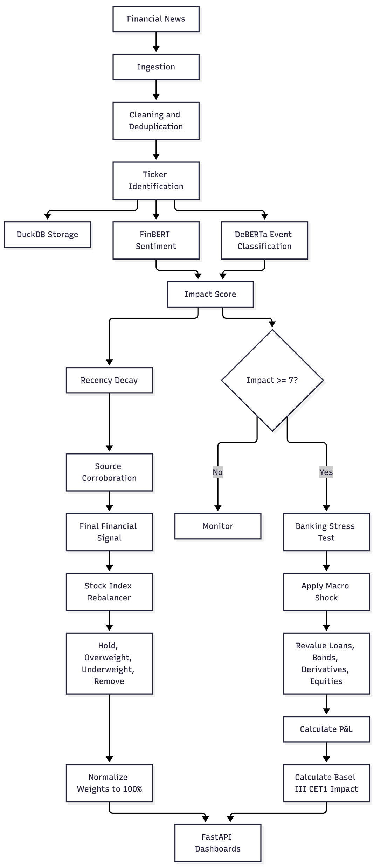
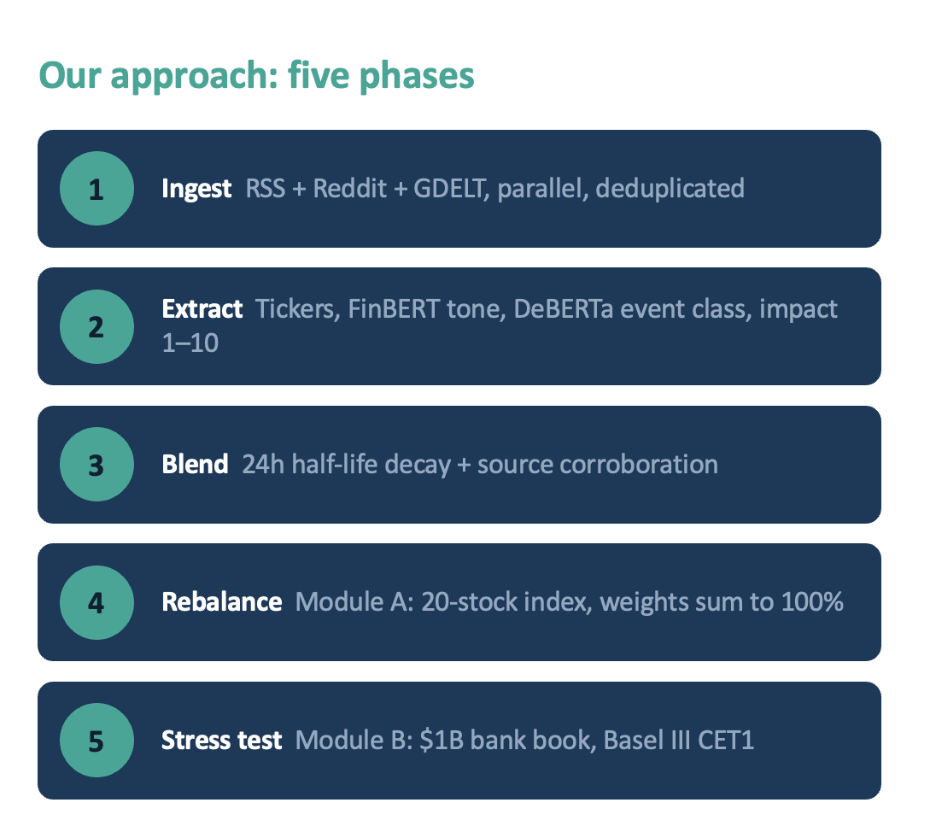
Architecture and Data Flow
The system is a financial news intelligence platform that converts unstructured financial news into investment and risk-management decisions.
Data ingestion: News is collected concurrently from RSS feeds, Reddit, and GDELT.
Preprocessing: Articles are cleaned, deduplicated using SHA-1 identifiers, linked to company tickers, and stored in DuckDB.
NLP analysis:
  FinBERT calculates financial sentiment.
  DeBERTa-v3 classifies the event type, such as earnings, credit, geopolitical, or macroeconomic.
Impact calculation: The system combines event severity, financial magnitude, urgency, geographic scope, and model confidence to produce an impact score from 1 to 10.
Signal fusion: Signals are adjusted using 24-hour time decay and source corroboration, producing a final ticker-level risk signal.
Decision engines:
  Module A: Uses the signal to hold, overweight, underweight, or remove stocks while maintaining a 100% portfolio allocation.
  Module B: High-impact events, generally scores of 7 or above, trigger stress tests on a synthetic $1 billion banking portfolio.
Risk outputs: The stress engine calculates asset-level P&L, total portfolio losses, and Basel III CET1 capital impact.
Presentation layer: FastAPI exposes the results through REST endpoints and dashboards for news analysis, portfolio rebalancing, and stress testing.

Slide 4
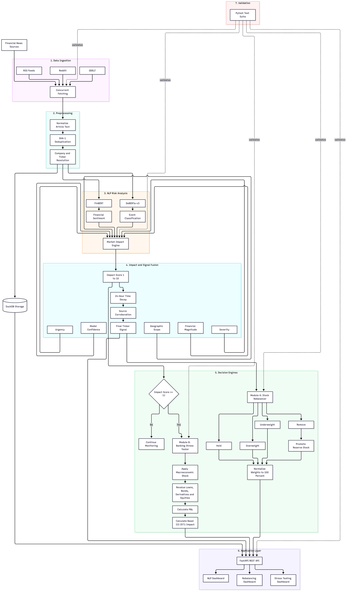
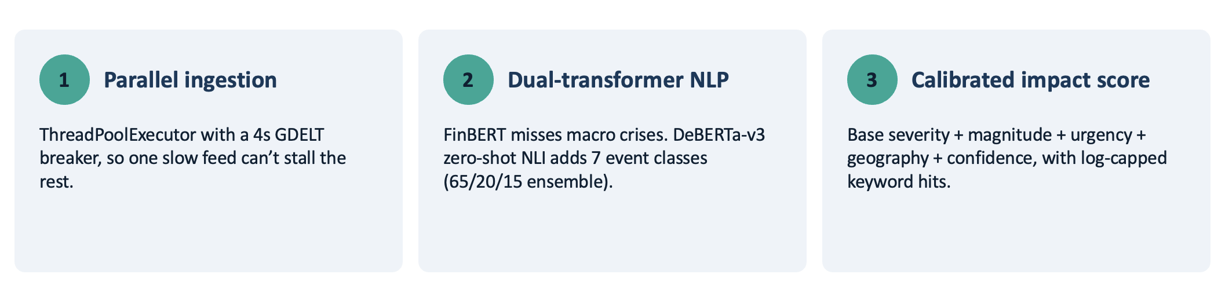
Implementation Highlights
Runtime | Python | Strong ecosystem for NLP, data processing, and finance
API | FastAPI | Fast, typed, and easy to expose REST endpoints
Storage | DuckDB | Embedded, lightweight, and optimized for analytical queries
Sentiment | FinBERT | Specialized for financial language
Event classification | DeBERTa-v3 | Context-aware zero-shot event classification
ML framework | PyTorch and Transformers | Standard tools for loading and running transformer models
Ingestion | ThreadPoolExecutor | Parallel fetching from multiple news sources
Frontend charts | HTML5 Canvas | Lightweight visualization without a frontend build system
Validation | Pytest | Automated regression and behavior testing

Slide 5
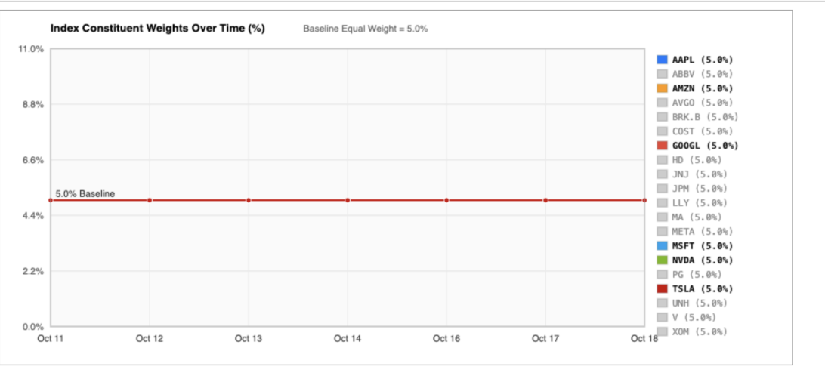
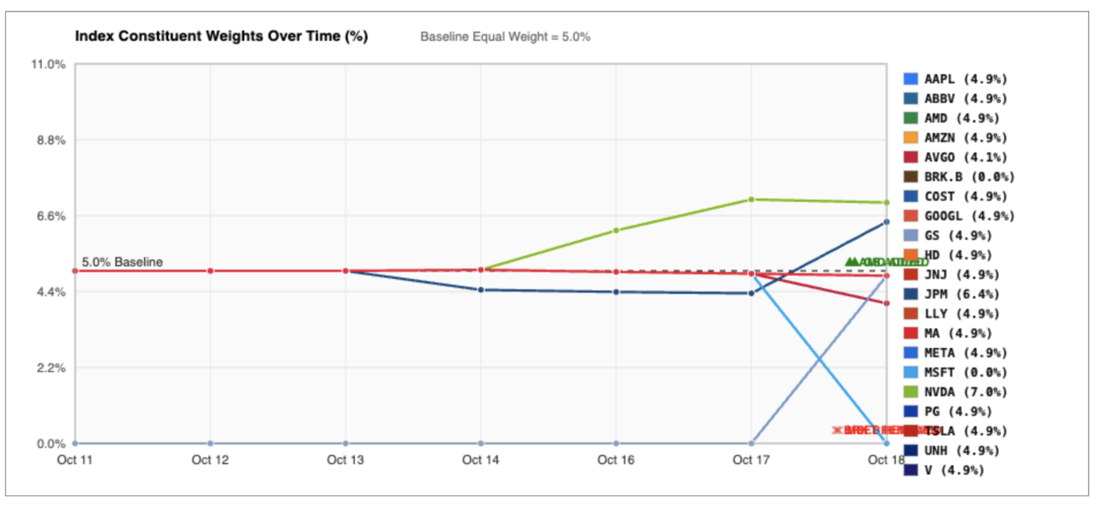
Key Results
Outputs and Metrics
News output: Clean, deduplicated articles with company tickers, sentiment, event type, confidence, and impact score.
Sentiment metric: FinBERT score from -1.0 to +1.0.
Impact metric: Calibrated market impact score from 1.0 to 10.0.
Signal metric: Ticker-level signal using sentiment, impact, 24-hour time decay, and source corroboration.
Rebalancer output: HOLD, OVERWEIGHT, UNDERWEIGHT, REMOVE, and ADD decisions for a 20-stock index.
Portfolio constraint: Final stock weights are normalized to exactly 100%.
Stress-test output: Asset-level P&L, total portfolio loss, and Basel III CET1 capital impact for a synthetic $1 billion banking portfolio.
Stress trigger: Events with an impact score of 7.0 or higher trigger stress testing.
Performance metric: Warm transformer inference is documented at approximately 18 ms after model loading.
Validation metric: 65 out of 65 automated tests passed.
Data metric: Supports 10+ news feeds, Reddit sources, GDELT events, and a 20-stock universe with 10 reserve stocks.

Slide 6
Domain Impact
Converts large volumes of financial news into structured, actionable signals.
Helps portfolio managers identify market-moving events faster.
1
2
Connects NLP sentiment and event classification directly to portfolio actions.
Supports dynamic stock-index rebalancing while maintaining 100% allocation.
3
4
Estimates the effect of geopolitical, credit, interest-rate, and macroeconomic events on a banking portfolio.
Provides asset-level P&L and Basel III CET1 impact for easier risk assessment.
5
6
Improves transparency through explainable impact scores and decision rules.
Can support financial institutions, investment firms, risk teams, and analysts.
7
8
Notes:
Left column: from news to portfolio actions. Right column: banking-portfolio risk and transparency.

Slide 7
Limitations and Next Steps
Current Limitations
Next Steps
Stress testing uses a synthetic $1 billion portfolio, not real bank holdings.
News quality depends on the reliability, availability, and coverage of external feeds.
Transformer models may produce incorrect results for ambiguous or misleading headlines.
Impact scores are calibrated rules, not guaranteed predictions of market movement.
The system does not execute real trades or provide investment advice.
Real-world markets include liquidity, transaction costs, and behavioral factors that are simplified.
Validate signals against larger historical financial-news datasets.
Add real-time market prices, volatility, spreads, and trading volumes.
Improve event classification using labeled domain-specific data.
Expand coverage to international markets, currencies, and commodities.
Add portfolio optimization based on risk-adjusted returns and transaction costs.
Integrate probabilistic forecasting and scenario comparison.
Deploy with monitoring, model drift detection, access control, and audit logging.
Notes:
Limitations are about data realism and model reliability; next steps move toward validation on real data and production readiness.

