Slide 1

Abu A Hadoop Scripting Language & Visualizer
Vinod Dinakaran
CHUG Oct 21 2010

Slide 2


I started learning Hadoop…
Using 2 standard texts…

Slide 3
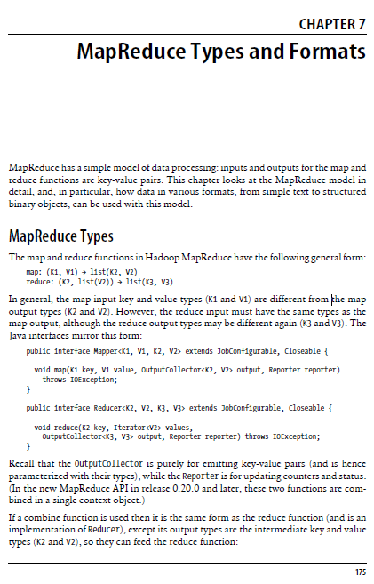

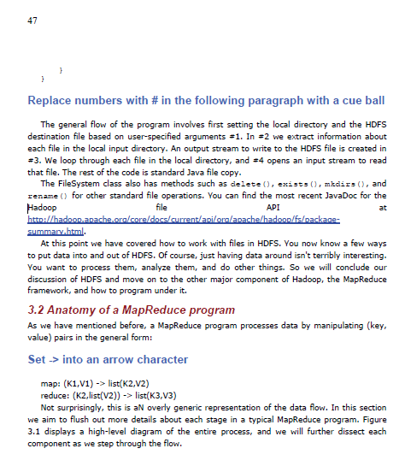



But it was not until…
… that they had this simple notation for the map reduce process:

Slide 4
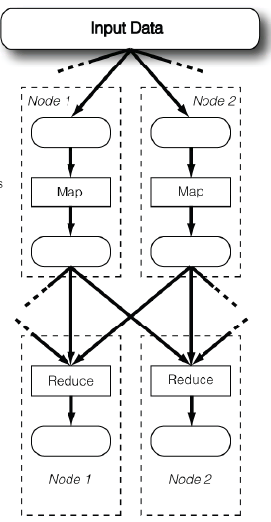
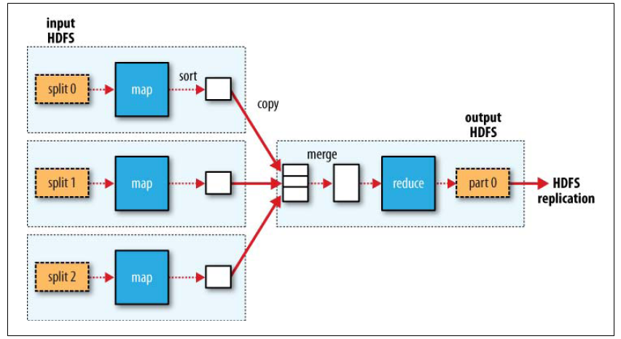
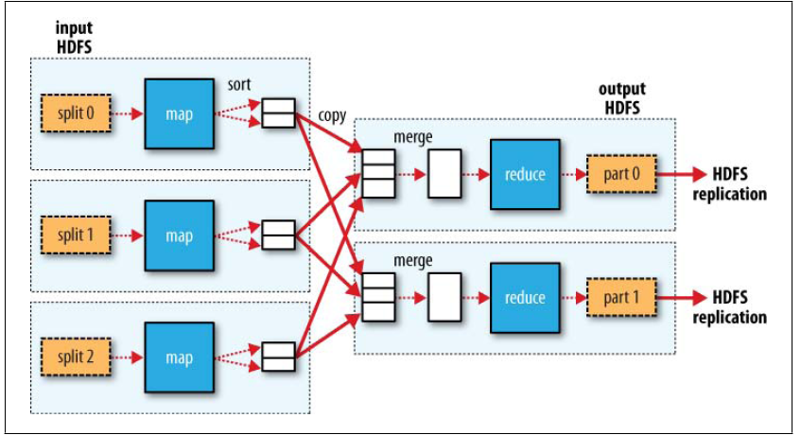
…scattered through the text they also had….

Slide 5
… both of which seemed like really good ways to represent the process.
Which led me to think…

Slide 6
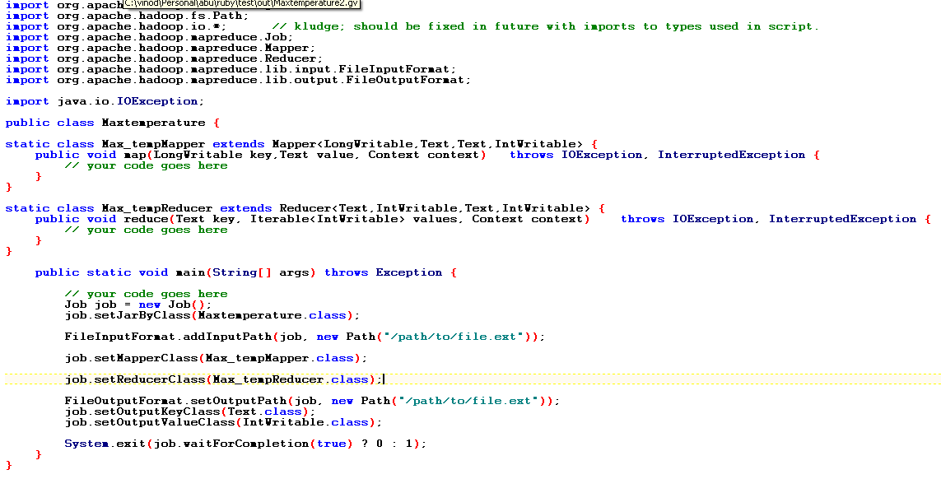
What if I made the nice notation the core, and generate everything else?
Generate
Visualize

Slide 7
Abu is an implementation of this idea.
Goals:
No boilerplate in the script, just the core MR logic
Still looks like map reduce, i.e., not high level like Pig/Cascade
Generates boilerplate Java, you fill in the method bodies
Generates dot format output so that it can be easily visualized
Analyzes i/o and ensures correctness at DSL level
Entirely aspirational notion at this point

Slide 8
A simple example
Original Syntax
job MaxTemperature:
read (LongWritable,Text) from "/path/to/file.ext" using DataReaderClassName
mr1 (LongWritable,Text) to ('Text', 'IntWritable')
write ('Text', 'IntWritable') to "/path/to/file.ext" using DataWriterClassName
mapreduce mr1:
map (LongWritable,Text) to ('Text', 'IntWritable') using mapClassname
reduce ('Text', 'IntWritable') to ('Text', 'IntWritable') using redClassname
Ruby Syntax
job 'MaxTemperature' do
read 'LongWritable','Text','/path/to/file.ext', ''
execute 'max_temp','LongWritable','Text','Text', 'IntWritable'
write 'Text', 'IntWritable', '/path/to/file.ext', ''
end
mapreduce 'max_temp' do
map 'LongWritable','Text','Text', 'IntWritable', ''
reduce 'Text', 'IntWritable','Text', 'IntWritable', ''
end
… obviously more simple and complex ones are possible

Slide 9
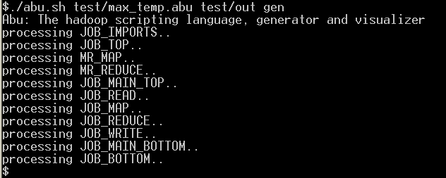
Demo: Java Code Generation
Produces….

Slide 10
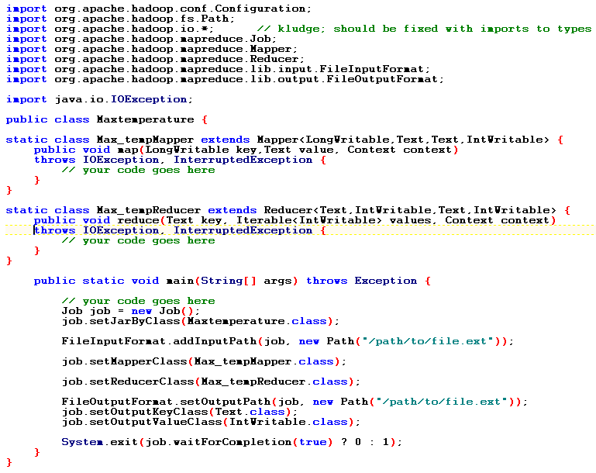
… which can be enhanced with the actual method bodies, and other details

Slide 11
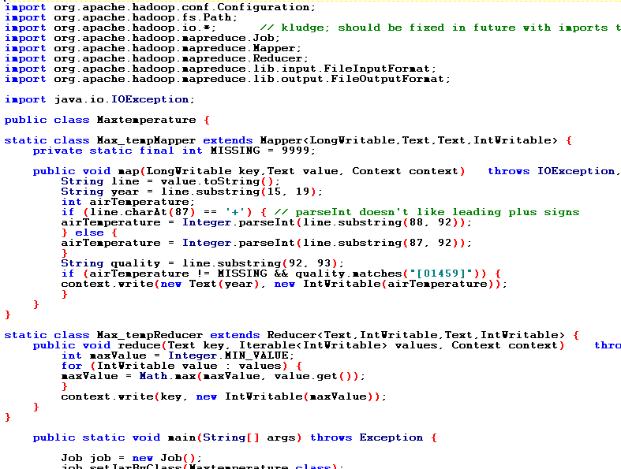
… like so

Slide 12
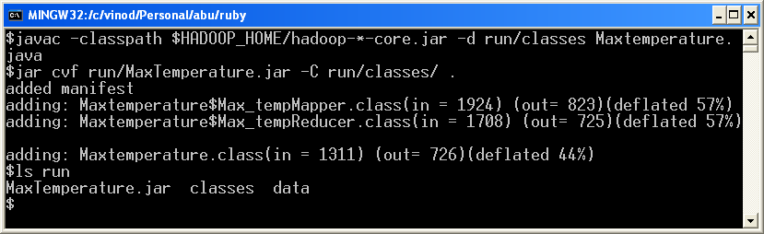
Compile and jar up the code…

Slide 13
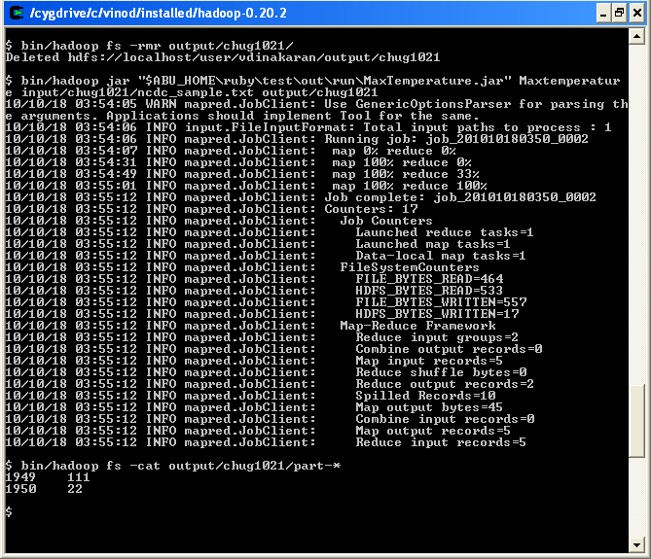
.. And run it
Todo: Use the tool interface.

Slide 14
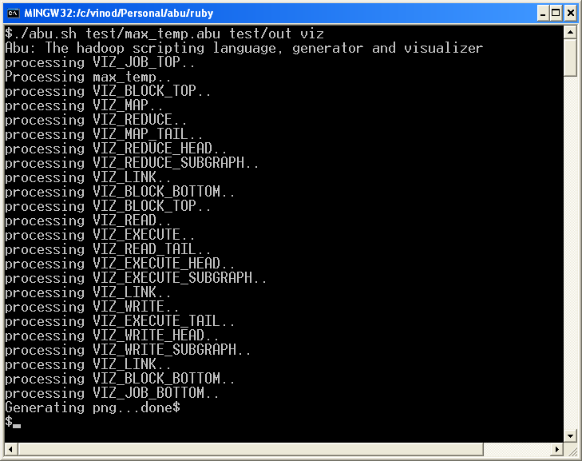
Demo: Graphviz Visualization
Produces….

Slide 15
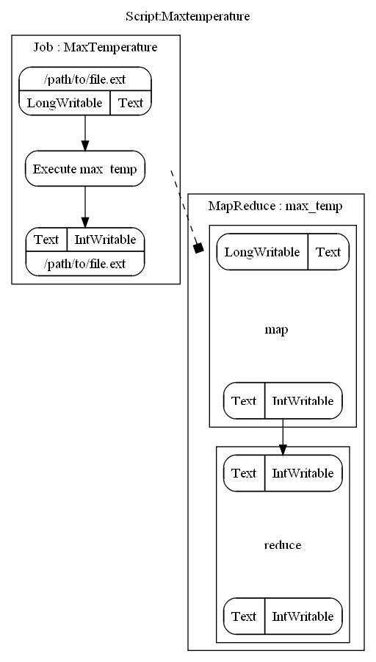

Slide 16
That was v0.1

Slide 17

It could do a whole lot more
..and add includes while you’re at it!
Make the syntax DRY
Add flow validation
How about a high level Viz instead of current detailed one?
… Or one of a running Job?
Maybe I should make it a full DSL – allow definition of map/reduce functions in place using Jruby

Slide 18
.. And be a whole lot better
Refactor Ruby code
Decide on Java implementation
Script the examples from the 2 books to prove out the concept
Script the samples from the Hadoop distro
Script the standard MR usage patterns (eg. Join) as Abu blocks

Slide 19
Some unintended consequences
Although originally intended as a (personal) learning tool, it could have uses outside of learning
Abstracts away Hadoop interface changes (almost)
Ruby syntax paves way for the possibility of Abu to be a true DSL
Visualizing a defined job led to the idea of visualizing a running one
With modifications, the design could even support other MR engines

Slide 20
Similar Projects
Jruby on Hadoop:
http://github.com/fujibee/jruby-on-hadoop
Papyrus: A full fledged Ruby DSL for Hadoop
http://github.com/fujibee/hadoop-papyrus

Slide 21
Thanks!
Interested?
Join me or fork away : http://github.com/vinodkd/abu
Vinod.dinakaran@gmail.com
Vinodkumar.dinakaran@orbitz.com

