Slide 1


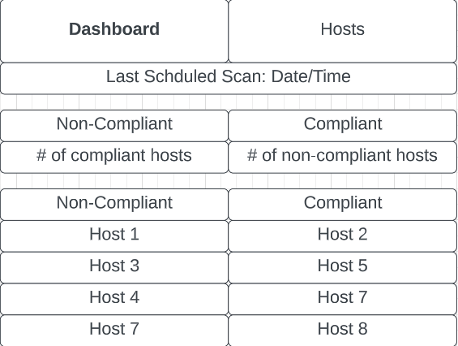
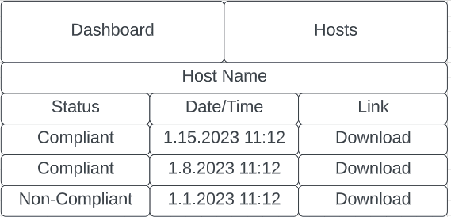
Shell Fortress David Lee
Dr. Walsh
Abstract
Problem: Organizations need an automated tool that can ensure Windows workstations are compliant with security standards.
Features
Measures security compliance
Collects machine security configuration
Compares current security configuration to baseline
Generates PDF Report
Report Downloadable from dashboard
Project Description
What
Shell Fortress monitors security configurations to meet a security baseline. These are completed via scans and the results are stored in the form of reports. These reports can be accessed from a dashboard.
Why
Organizations need to be compliant with government regulations. IT departments benefit from automation as it saves resources. Who
Stakeholders include Legal, IT, and Public Relations Departments.
Lessons Learned
Technological proof of concepts are critical to project success
Leave buffer time in project plans to account for roadblocks
Use the tool that’s right for the job
Technologies
Flask
Python
PowerShell
MongoDB
Process
During the planning phase, Waterfall method was used. For the building phase, the Agile method was used for continuous updating, improvement, and debugging.
Future Work
Expand to Windows Server and Ubuntu Operating Systems
Reconfigure hosts remotely

