Slide 1
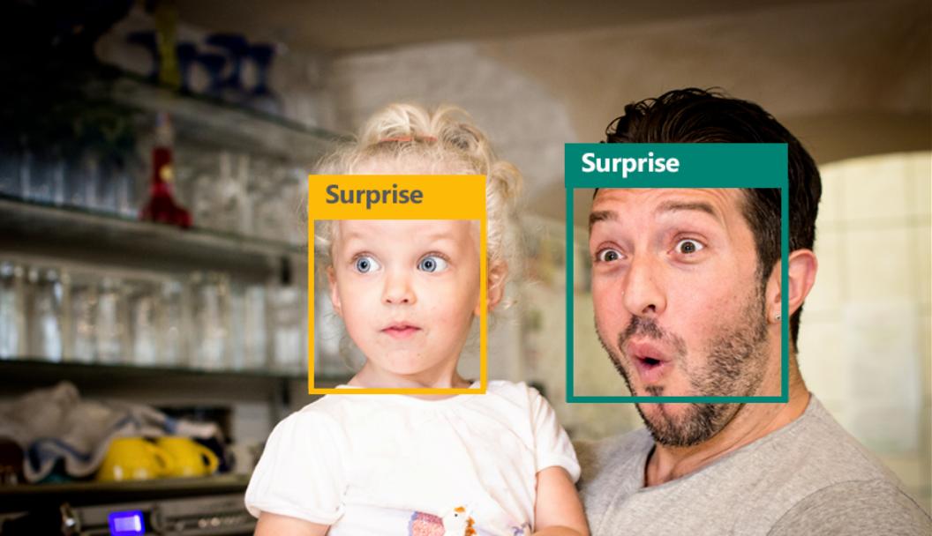
CS639 Project: Facial Emotion Recognition Using Deep CNN
Shanchao Liang, Zhaoyang Li, Qitong Liu, Shirley Liu

Slide 2
Table of content
Introduction
Method
Dataset
Results and Discussion

Slide 3
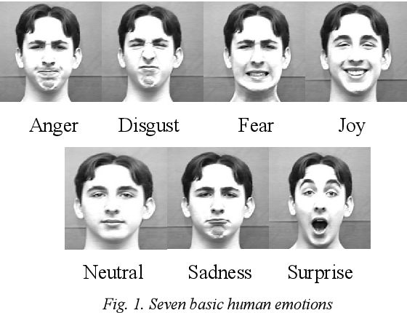
Introduction
Communication:
1/3 Verbal, 2/3 non-verbal
Facial emotion is an important factor to understand other’s intention.
Application:
human-computer interaction (HCI), Virtual Reality, Augment Reality (AR), advanced driver assistant systems (ADASs)
FER
Measure body parameter
Image analysis

Slide 4
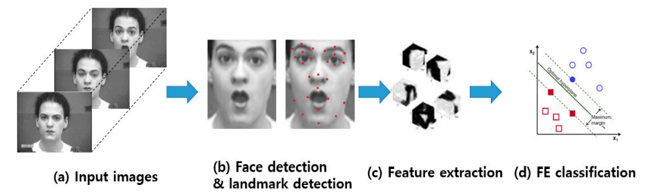
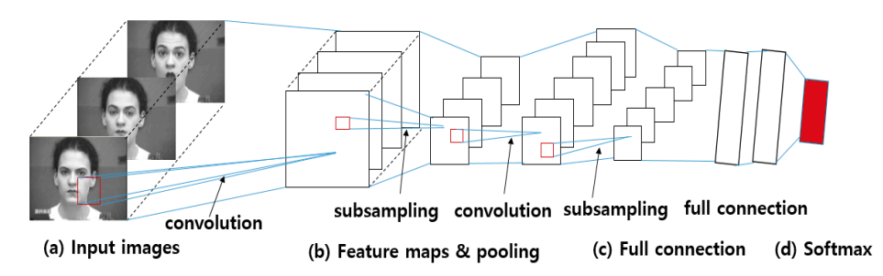
Current state-of-the-art
Traditional Method
Extract feature manually
Classifier: SVM, kNN, etc
Source: BC Ko, 2018
Neuron Network (CNN)
Big data
Enough computational resources
The highest performance: 78% (Naga P et al, 2021)
Source: BC Ko, 2018

Slide 5
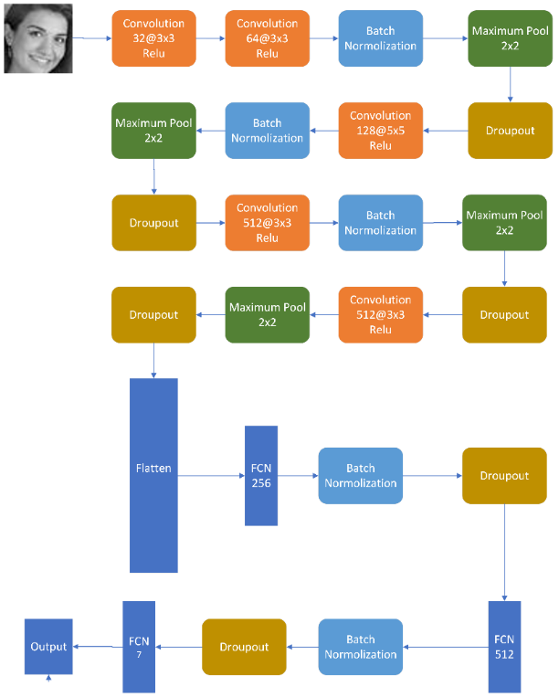
Methods
CNN model from Aayush Mishra.
3 Convolution layers.
Activation function: relu
Another techniques
Pooling
Batch normalization
Dropout
4.5 million parameters

Slide 6
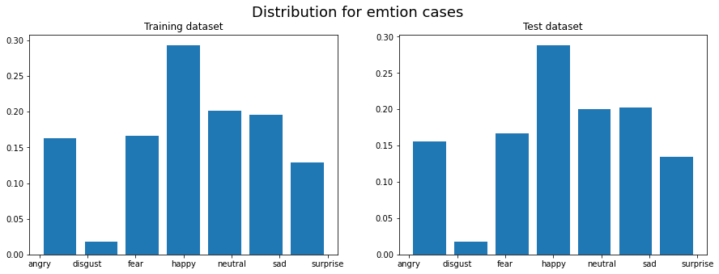
Overview of the dataset
The Facial Expression Recognition 2013 (FER-2013) database was used.
28,709 training samples
3,589 validation samples
Seven class(Angry, Disgust, Fear, Happy, Sad, Surprise, Neutral)
Image size: 48 x 48
Registered image

Slide 7
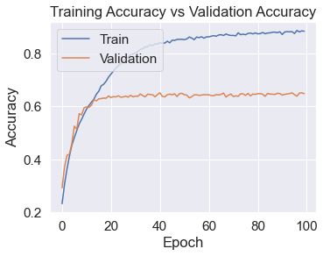
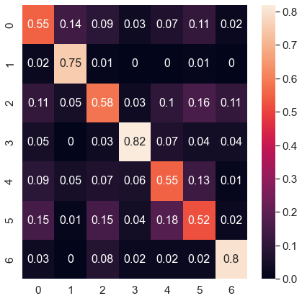
Model trained with the unbalanced image
Training history
Confusion Matrix
10 epochs, Accuracy is about 64%
(0=Angry, 1=Disgust, 2=Fear, 3=Happy, 4=Sad, 5=Surprise, 6=Neutral）

Slide 8
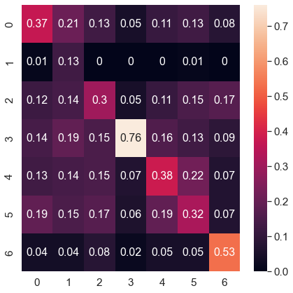
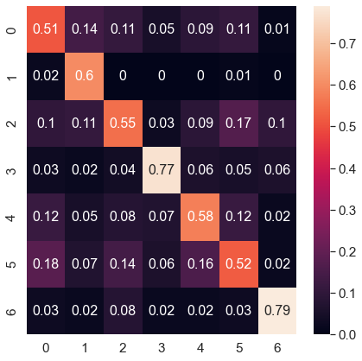
Model trained with the balanced data
Random Undersampling Method
(Accuracy: 40%）
Random Oversampling Method
(Accuracy: 60%)
Bad performance due to lack of training image
Performance is not well improved

Slide 9
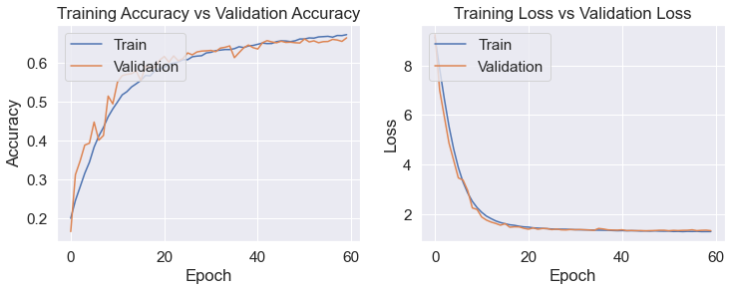
Model trained with the augmented data
Changes are applies to the images randomly in the training dataset in each training epoch.
The changes include shifting or flipping the image horizontally and vertically.

Slide 10
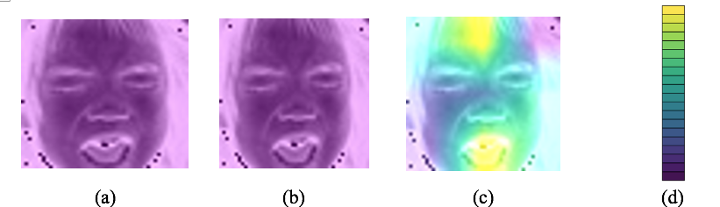
Visualization of the trained CNN model
Visualization of the trained CNN model by Grad-CAM:^{[9]} (a) 1st convolution layer; (b) 2nd convolution layer; (c) 3rd convolution layer; (d) viridis palette colormap
The Gradient-weighted Class Activation Mapping (Grad-CAM)
Colormap: light color is important
Fear emotion image: forehead and mouth are important features.

Slide 11
Q&A

