Slide 1
Project 3

Slide 2
Game developed in swift language
Architecture of the application

Slide 3
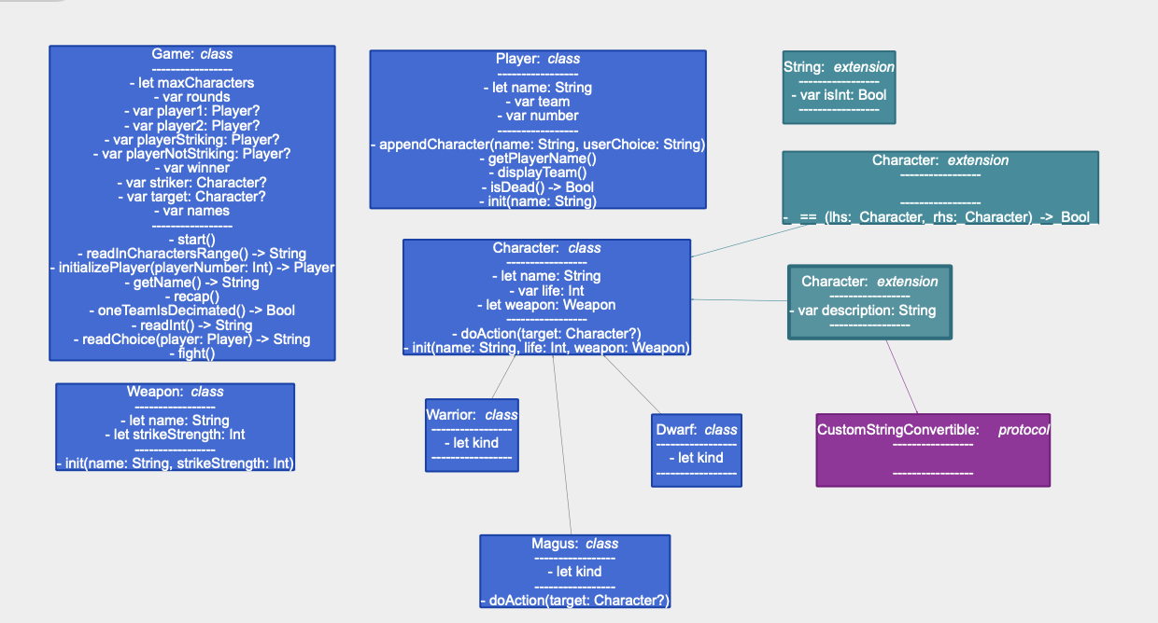

Slide 4
Class Character properties
weapon
Holds the type of weapon
life
Holds the number represwenting sthe life pointds
name
Holds the name of the character

Slide 5
Description
Extension of character as a custunStringConvertible returning the name and the life.

Slide 6
Class Character methods
heal()
Adds the healing power of the Magus to the character's life of the character being healed.
strike()
Removes the striking power of the characters attacking other characters.

Slide 7
Class Dwarf properties
kind
Holds the kind of character: Dwarf.

Slide 8
Class Dwarf methods
None.

Slide 9
Class Game properties
looser
Is set to the name of the player who looses.
maxCharacters
Holds the value of the maximum number of characters in a team.
names
Array holding the names already taken.

Slide 10
heal(character)
Takes in an object character and increments its life by the strikeStrength of the magus.
InitializePlayer()
Gets the name of the player and creates the team of characters.
IsDead()
Takes in a character and returns a boolean. Checks if the life of a character is smaller or equal to zero.

Slide 11
Class Game methods
DisplayTeam(player)
Takes in an object player and displays an numbered list of the team's characters so that the user can choose a striker or a healer by number.
Fight()
Controles the flow of the fight.
GetName()
Checks for the empty string and checks if the name already exists.

Slide 12
ReadInCharactersRange()
Checks if the choice is in the range of the number of characters and returns a string of the number.
start()
Initialises the characters and calls fight() until a team is decimated.
strike()
Removes from the character's life the amount of the strength of the striker.

Slide 13
OneTeamIsDecimated()
Boolean method that check if dthe team counter is at zero and sets the winner or looser.
ReadChoice()Takes in a player object and return a string representing an integer. Checjs and enforces the input of an integer in the range of the left characters in the team.

Slide 14
ReadInt()
Returns a string representing an integer. Makes sure the entered string represents an intefer.
recap()
Displays the teams. When there is a winner displays the winner.
removeIfDead()
Removes dead characters from the team.

Slide 15
Class Magus properties
kind
Holds the kind of character: Magus.

Slide 16
Class Magus methods
None.

Slide 17
Class Player properties
name
Holds the bame of the player.
number
Holds the player number.
team
Holds an array of all the existing names in the game so that there are no duplicates.

Slide 18
saysItsHisTurn
Boolean flag to check whos turn it is.

Slide 19
Class Player methods
appendCharacter()
Adds the nanmes to the array names.
displayTeam()
Displays the characters in a team.
getPlayerName()
Returns the name of the players

Slide 20
Class Warrior properties
ind
Holds the kind of character: Warrior.

Slide 21
Class Warrior methods
None.

Slide 22
Class Weapon properties
name
Holds the name of the weapon: Axe, Sword or Wand.
strikeStrength
Holds the amount by which a strike decreases the life of the opponent.

Slide 23
Class Weapon mkethods
None.

Slide 24
Class Magus properties
Kind
Hods the kind of weapon: Wand.

Slide 25
Class Magus pmethids
None.

