Slide 1
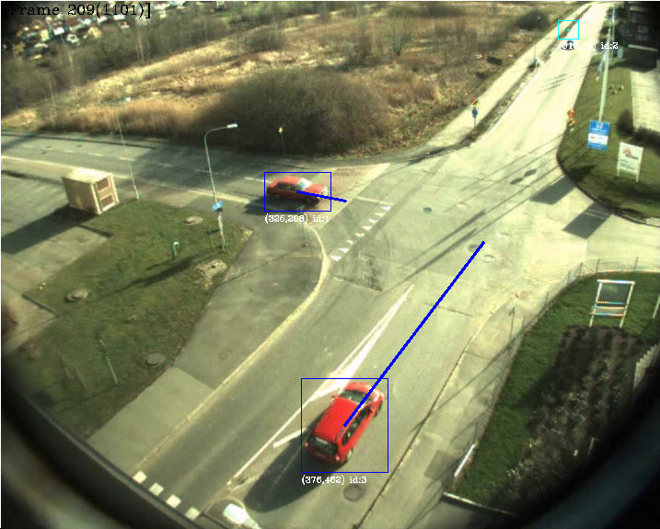
TSBB15 Object Tracking Group 2

Slide 2
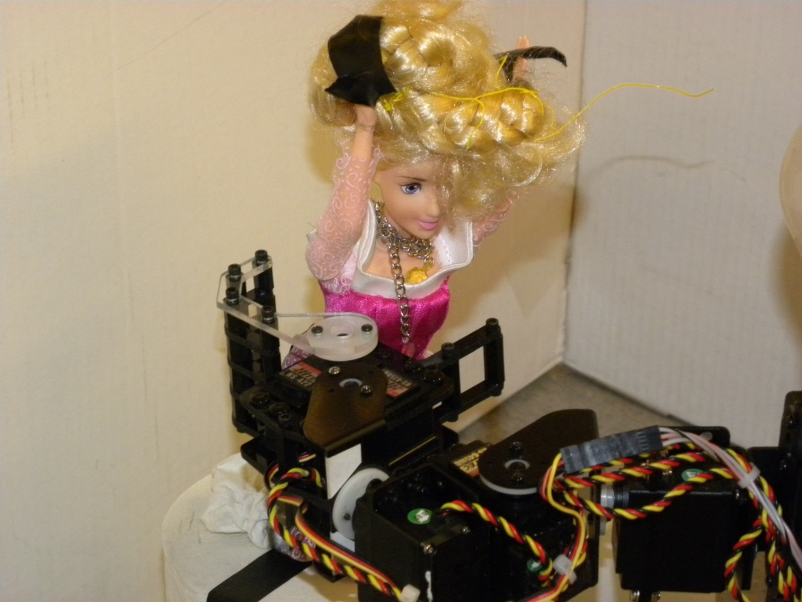
Objectives
Create win.

Slide 3
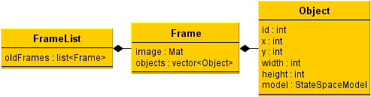
Data Structures
Object
Frame
Framelist

Slide 4
Modules
Background Modeling – Gustav
Foreground Processing – Martin
Object Identification – Mattias
Prediction and Evaluation – Alexander

Slide 5
Background Modeling
Uses a mixture of gaussian model described by Wood.
Update procedure is slow... Close to 1 second per update on a larger image.

Slide 6
Background Modeling
Noisy, lots of false positives.
False positives are mostly isolated.
Easy to handle with later processing steps.

Slide 7
Foreground Processing
Three main objectives:
Suppress shadows
Remove noise
Detect moving regions

Slide 8
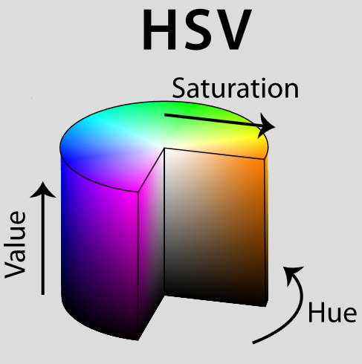
Shadow Suppression
Algorithm implemented as described in the master thesis by John Wood.
HSV mapping:
Easy to implement
Good performance
Few false positives

Slide 9
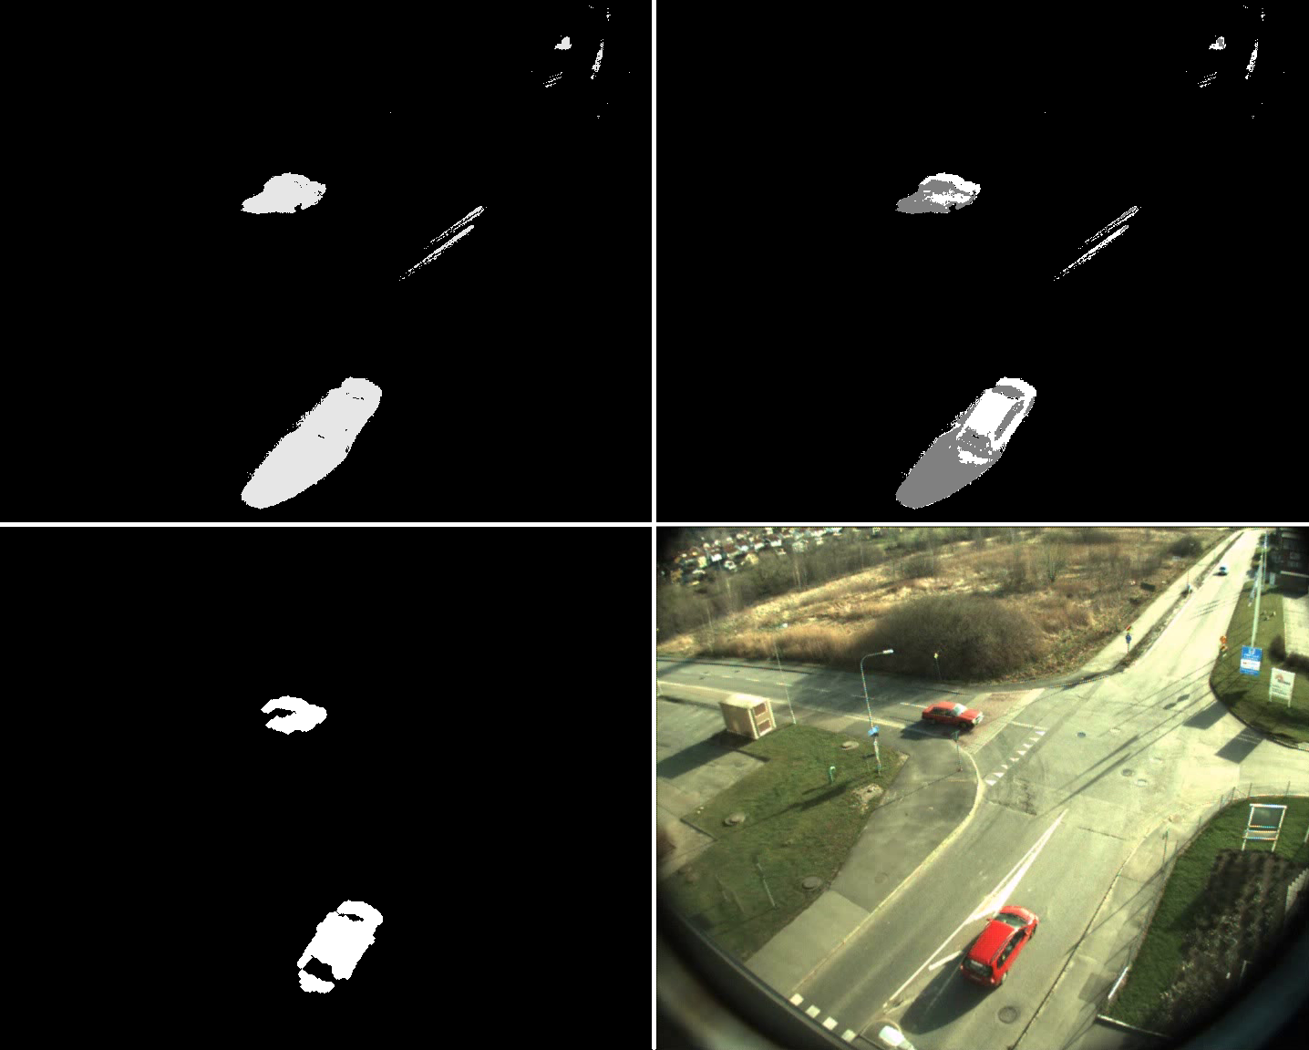

Slide 10
Noise Removal
First approach: “Distance filtering”
Throw away foreground regions not thick enough
Good performance
Slow?
Second approach: Erode/Dilate
Lower performance
Faster?
Which one to choose?

Slide 11
Noise Removal
Distance filtering!
Not slow at all on the real data
Very few false positives.
Implementation
cv::findContours, cv::pointPolygonTest
Iterate over bounding rectangle
Measure distance inside contour only
Final touch: some morphological dilate

Slide 12
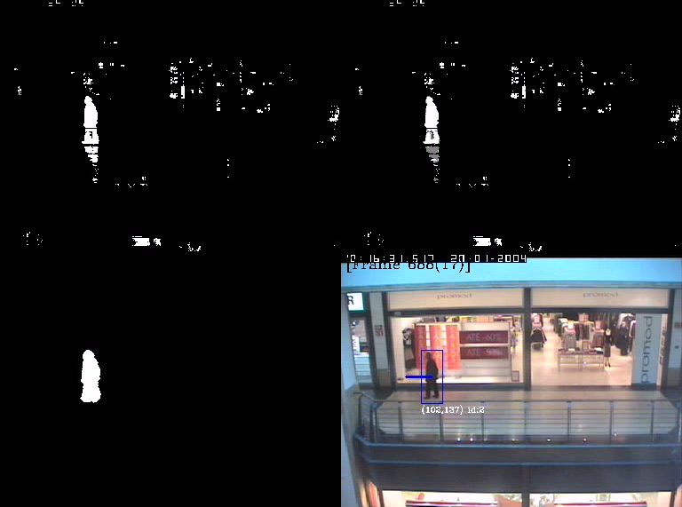
Object Detection
Uses cv::findContours, cv::boundingRect
Find outer contours
Create boundingrect for each contour
Use the bounding rectangle to add objects to the frame’s object list.

Slide 13
Identification
Han har en stor kod, lång kraftig och tung...

Slide 14
Identification
Mer av den stora koden, kanske en stor flowchart

Slide 15
Kalman Prediction
How do i algorithm 8.1??!?

Slide 16
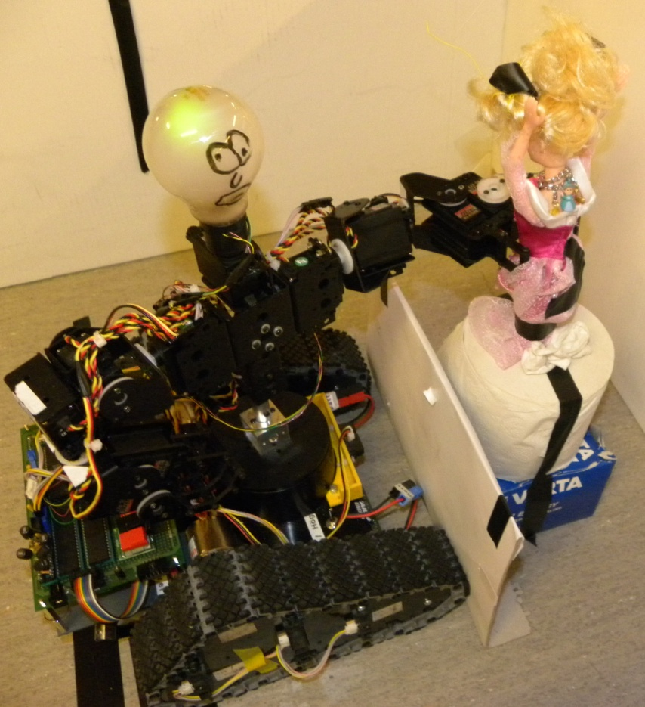
Evaluation
Evaluate THIS!

Slide 17
Results
Lol pwnage

Slide 18
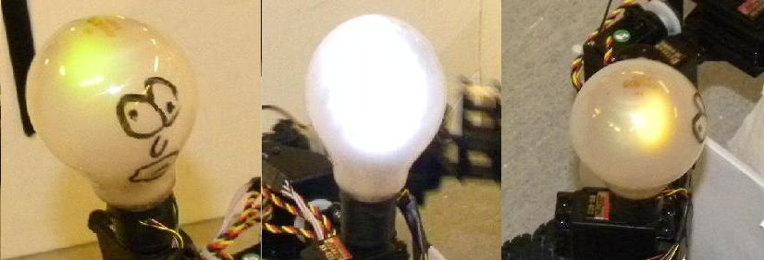
Design
Lampor
Visar vägval

Slide 19
Varför “Bulan”?
Autonom upplockning
Snyggt och tydligt interface
Fail-safe
Vacker design
Kan dansa segerdans

Slide 20
Vad har vi lärt oss?
Det lönar sig att planera
Planera så att flaskhalsar undviks
Jobba så parallellt det går I början
Lagom långa arbetspass
Vira ordentligt
Skriv ordentlig kod
Inse att idéer kan behöva ändras även om de verkar bra

Slide 21
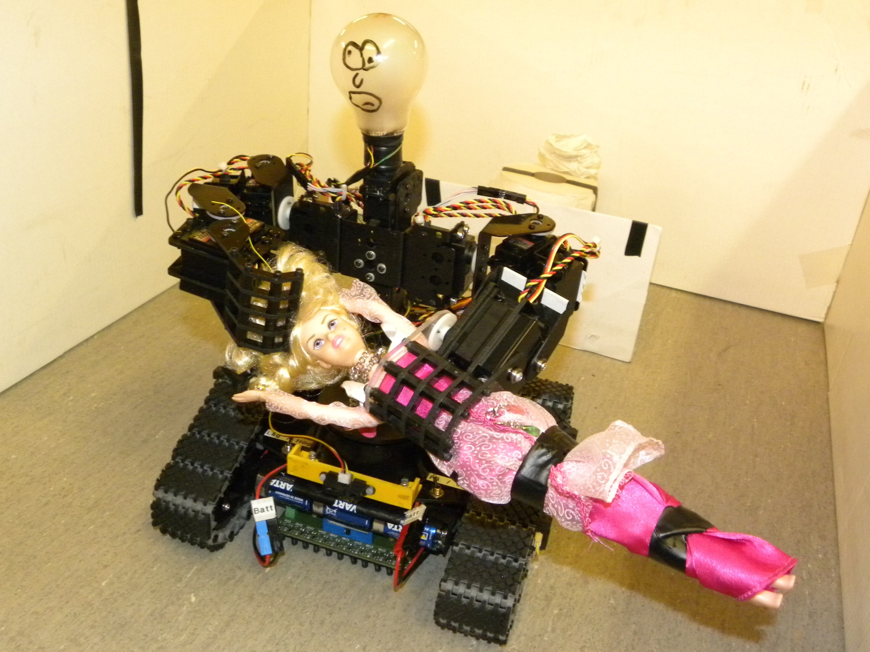
Frågor?

