Slide 1
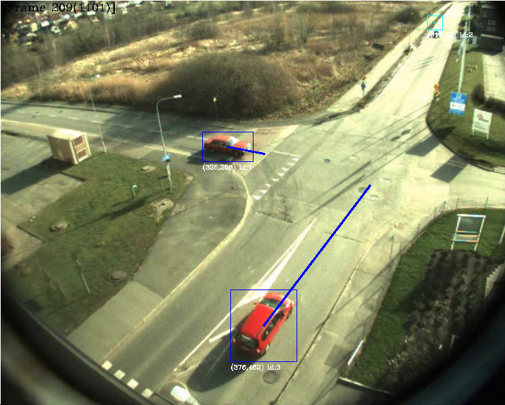
TSBB15 Object Tracking Group 2

Slide 2
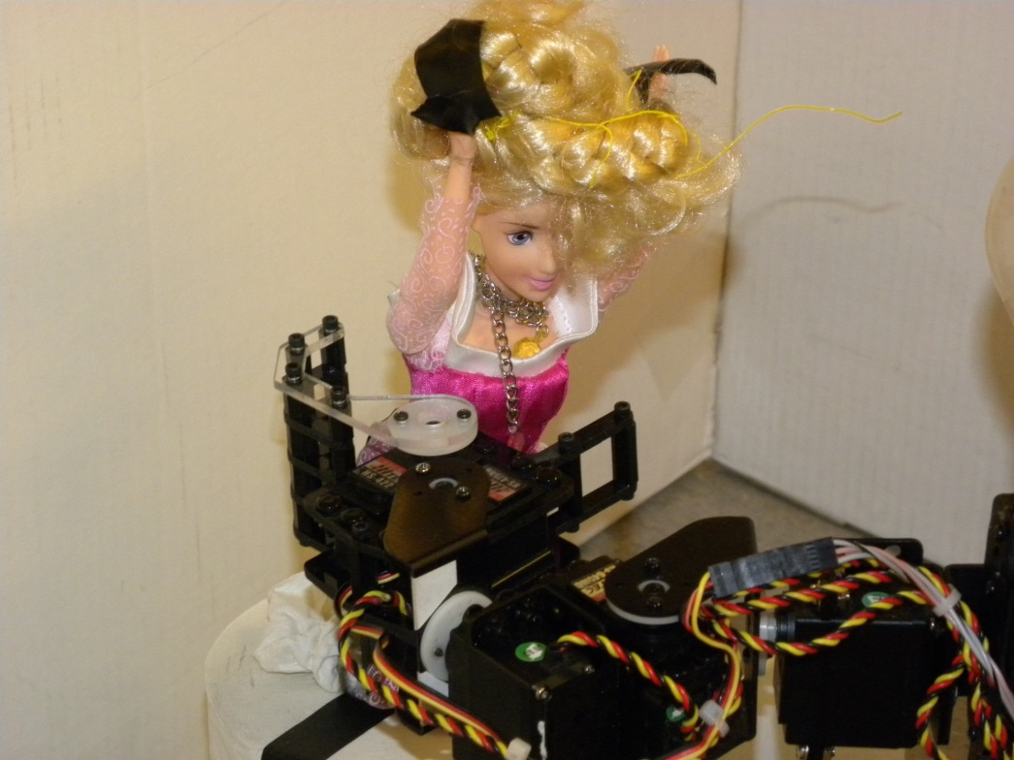
Objectives
Create win.

Slide 3
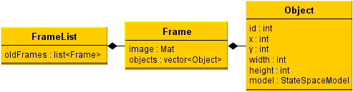
Data Structures
Framelist
Frame
Object
Notes:
The system has a simple structure where each frame is stored in a frame list,.
The framelist then gets passed on to each module .
Once a frame has been completely processed it moves on to the next one.

Slide 4
Modules
Background Modeling – Gustav
Foreground Processing – Martin
Object Identification – Mattias
Prediction and Evaluation – Alexander

Slide 5
Background Modeling
Uses a mixture of Gaussian model described by Wood.
Generates a most likely background.
Notes:
Use mixture of gaussians model for the background, described by Wood…
First updates the model, using the incoming image, compares each pixel in the incoming image with the current model,.
Sufficently adaptable to handle simple outdoor sequences.
Generates a most likely background image for the shadow removal to use.

Slide 6
Background Modeling problems
Noisy, lots of false positives.
False positives are mostly isolated.
Easy to handle with later processing steps.
Update procedure is not optimally implemented.
Notes:
The model contains lots of isolated pixels falsely marked as background.
Handled later by the foreground segmentation.
Updating the background model is slow, so possibly avoid doing it every frame.
Large number of paramaters to tune.

Slide 7
Foreground Processing
Three main objectives:
Suppress shadows
Remove noise
Detect moving regions

Slide 8
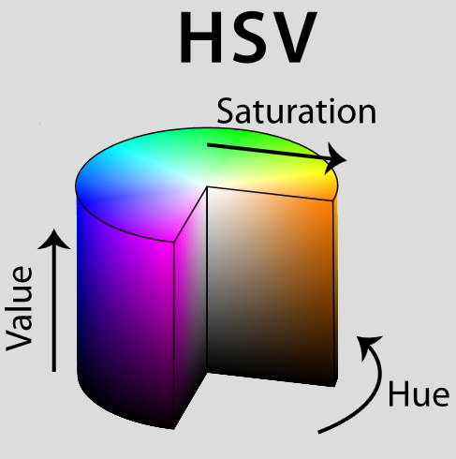
Shadow Suppression
Algorithm implemented as described in the master thesis by John Wood.
HSV mapping:
Easy to implement
Good performance
Few false positives

Slide 9
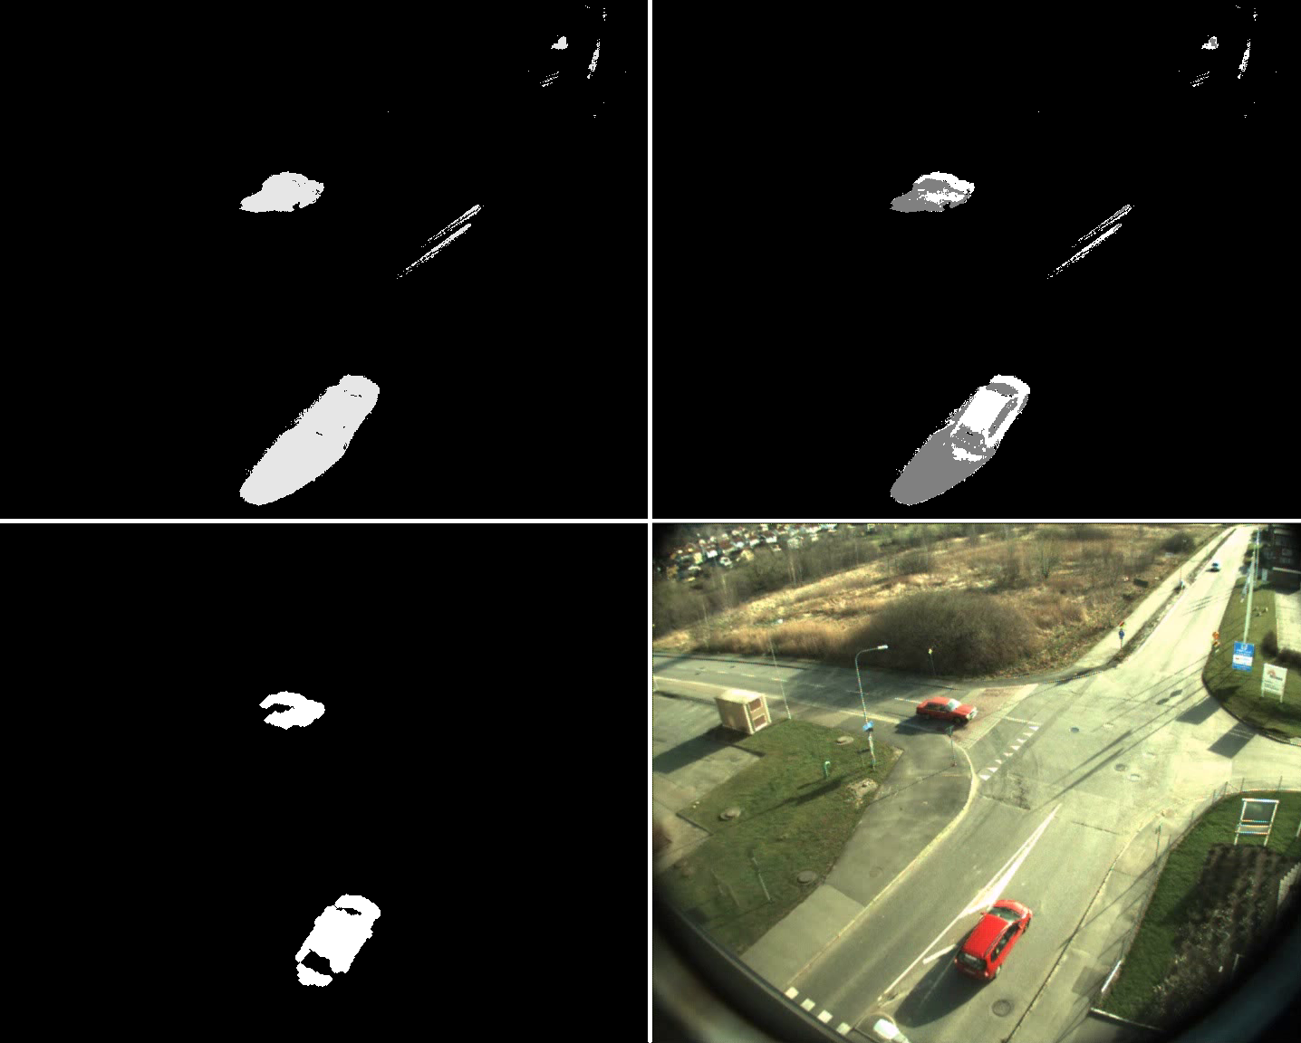

Slide 10
Noise Removal
First approach: “Distance filtering”
Throw away foreground regions not thick enough
Good performance
Slow?
Second approach: Erode/Dilate
Lower performance
Faster?
Which one to choose?

Slide 11
Noise Removal
Distance filtering!
Not slow at all on the real data
Very few false positives.
Implementation
cv::findContours, cv::pointPolygonTest
Iterate over bounding rectangle
Measure distance inside contour only
Final touch: some morphological dilate

Slide 12
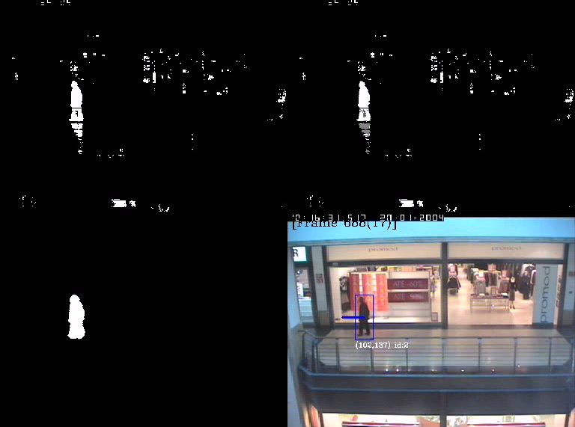
Object Detection
Uses cv::findContours, cv::boundingRect
Find outer contours
Create boundingrect for each contour
Use the bounding rectangle to add objects to the frame’s object list.

Slide 13
Identification
Objectives
Correlate previous objects with current objects
Handle occlusion
Objects <-> Objects
Objects <-> Background
Assign unique ID’s to new objects
Forget objects that leave the screen

Slide 14
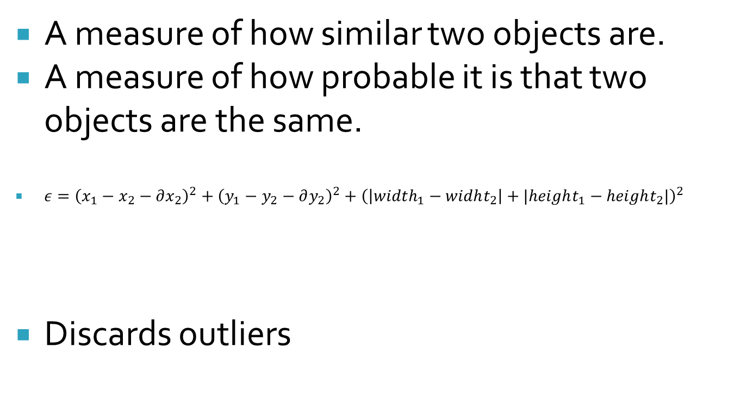
Identification – Error measure
A measure of how similar two objects are.
A measure of how probable it is that two objects are the same.
${ε=\left(x_{1}−x_{2}−∂x_{2}\right)}^{2}+{\left(y_{1}−y_{2}−∂y_{2}\right)}^{2}+{\left(\left|width_{1}−widht_{2}\right|+|height_{1}−height_{2}|\right)}^{2}$
Discards outliers
Squared euclidian distance
Squared size difference

Slide 15
Identification - Occlusion
Overlapping move
Non-overlapping move
1
2
Parent split
Sibling merge
3
4
Lost
Discovered
5
6

Slide 16
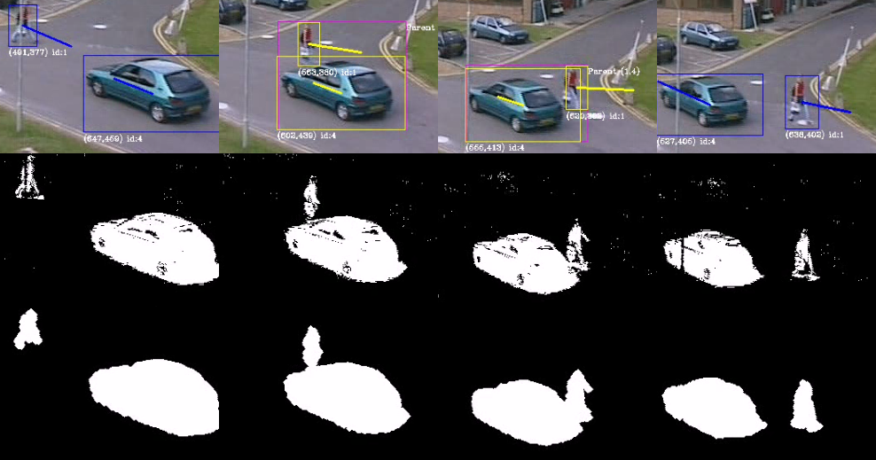
Identification – Occlusion

Slide 17
Identification - Improvements
Assumes all passed objects are ”real”
Large objects tends to collect lost heads, feets...
Width and Height should not change too fast...
The error function isn’t tuned at all: a change in width,height should probably impact more.
Objects should be removed if they have been lost for too long. Use the variance estimate from the kalman filter?

Slide 18
Kalman Prediction
Why Kalman?
How Kalman?
Two phases
Measurement Update
Time Update
Difficulties
Smoothing

Slide 19
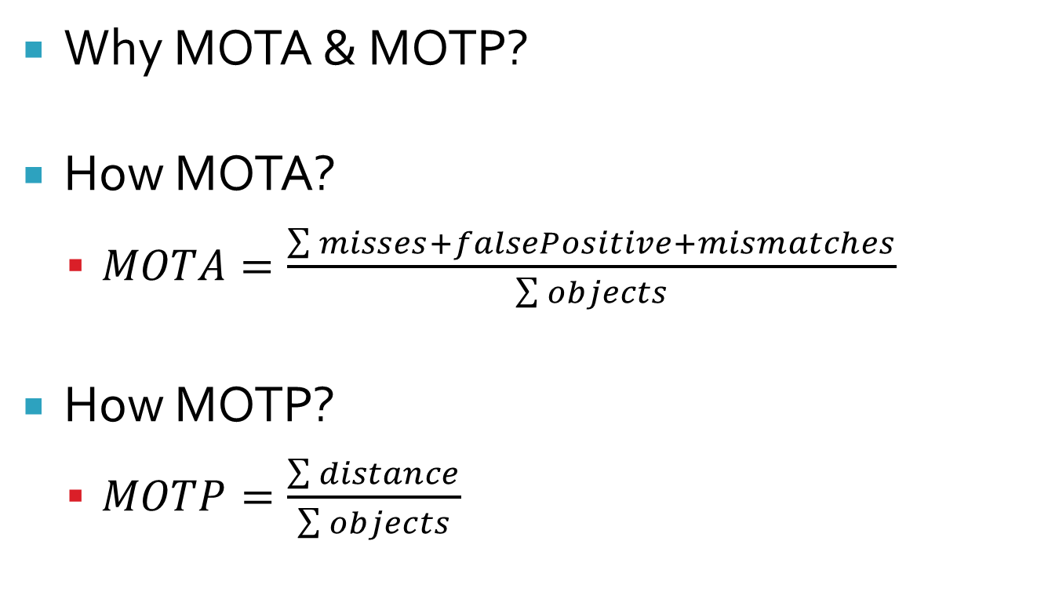
Evaluation
Why MOTA & MOTP?
How MOTA?
$MOTA=\frac{\sum{misses+falsePositive+mismatches}}{\sum{objects}}$
How MOTP?
$MOTP=\frac{\sum{distance}}{\sum{objects}}$

Slide 20
Results
Lol pwnage

Slide 21
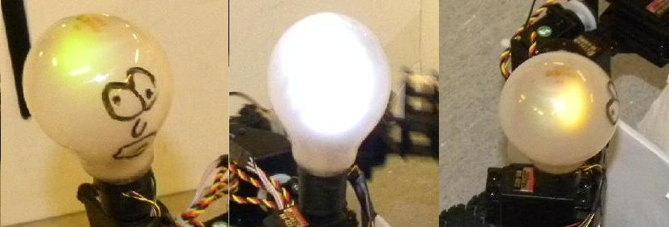
Design
Lampor
Visar vägval

Slide 22
Varför “Bulan”?
Autonom upplockning
Snyggt och tydligt interface
Fail-safe
Vacker design
Kan dansa segerdans

Slide 23
Vad har vi lärt oss?
Det lönar sig att planera
Planera så att flaskhalsar undviks
Jobba så parallellt det går I början
Lagom långa arbetspass
Vira ordentligt
Skriv ordentlig kod
Inse att idéer kan behöva ändras även om de verkar bra

Slide 24
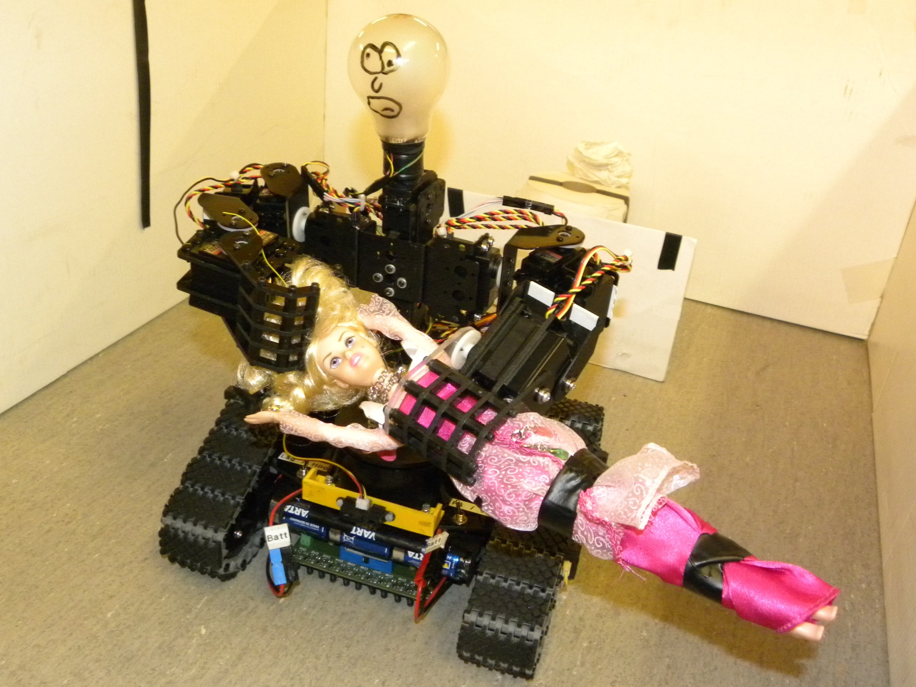
Frågor?

