Slide 1
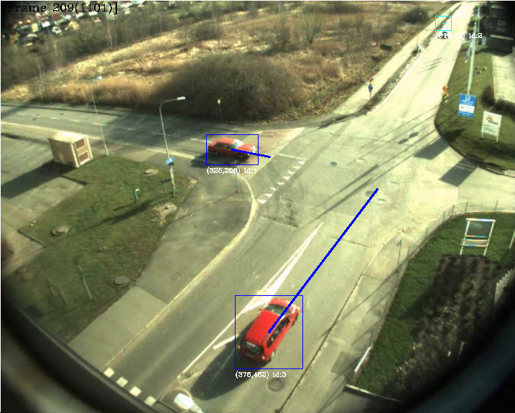
TSBB15 Object Tracking Group 2

Slide 2
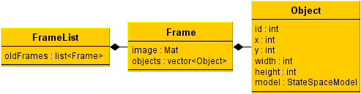
Data Structures
Object
Frame
Framelist

Slide 3
Modules
Background Modeling – Gustav
Foreground Processing – Martin
Object Identification – Mattias
Prediction and Evaluation – Alexander

Slide 4
Background Modeling
Uses a mixture of Gaussian model described by Wood.
Update procedure is slow... Close to 1 second per update on a larger image.

Slide 5
Background Modeling
Noisy, lots of false positives.
False positives are mostly isolated.
Easy to handle with later processing steps.

Slide 6
Foreground Processing
Three main objectives:
Suppress shadows
Remove noise
Detect moving regions

Slide 7
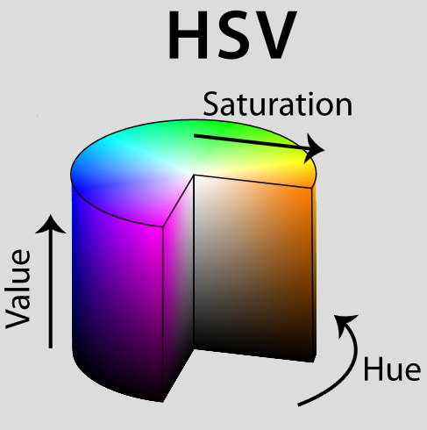
Shadow Suppression
Algorithm implemented as described in the master thesis by John Wood.
HSV mapping:
Easy to implement
Good performance
Few false positives
Problems with gray areas

Slide 8
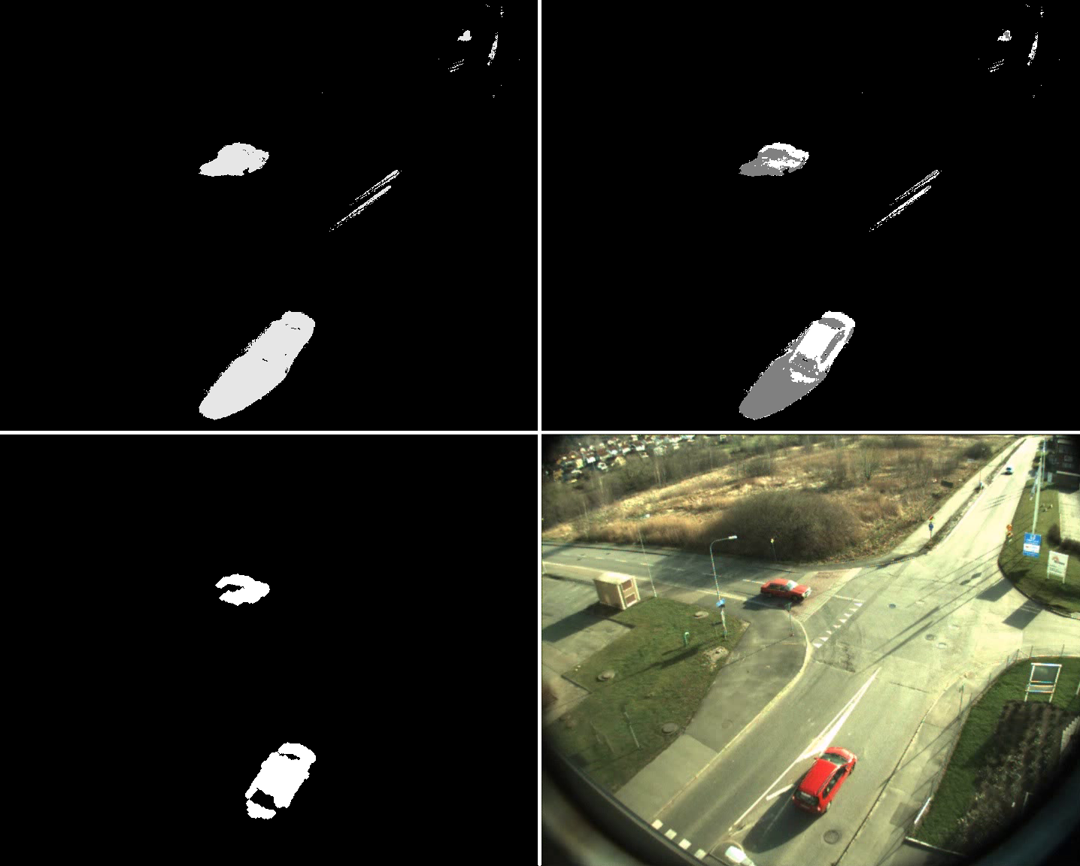

Slide 9
Noise Removal
“Distance filtering”
Throw away foreground regions not thick enough
Good performance
Slow?
Implementation
cv::findContours, cv::pointPolygonTest
Iterate over bounding rectangle
Measure distance inside contour only
Final touch: some morphological dilate

Slide 10
Region labeling
Object creation
Find remaining contours
Create bounding boxes
Calculate positions

Slide 11
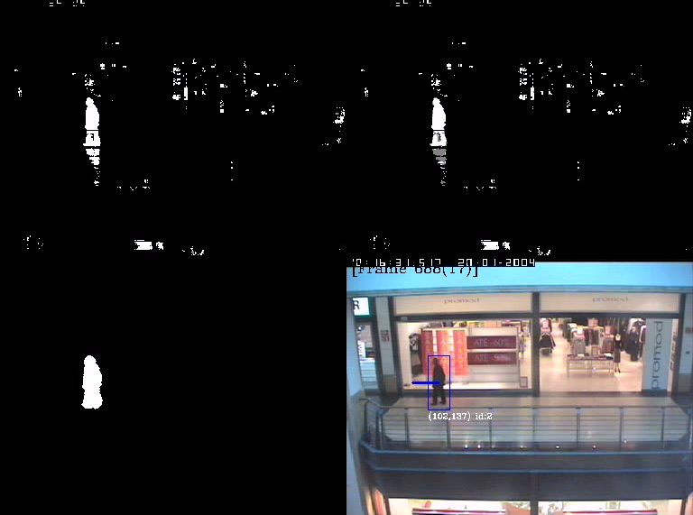
Object Detection
Uses cv::findContours, cv::boundingRect
Find outer contours
Create boundingrect for each contour
Use the bounding rectangle to add objects to the frame’s object list.

Slide 12
Identification
Objectives
Correlate previous objects with current objects
Handle occlusion
Objects <-> Objects
Objects <-> Background
Assign unique ID’s to new objects
Forget objects that leave the screen

Slide 13
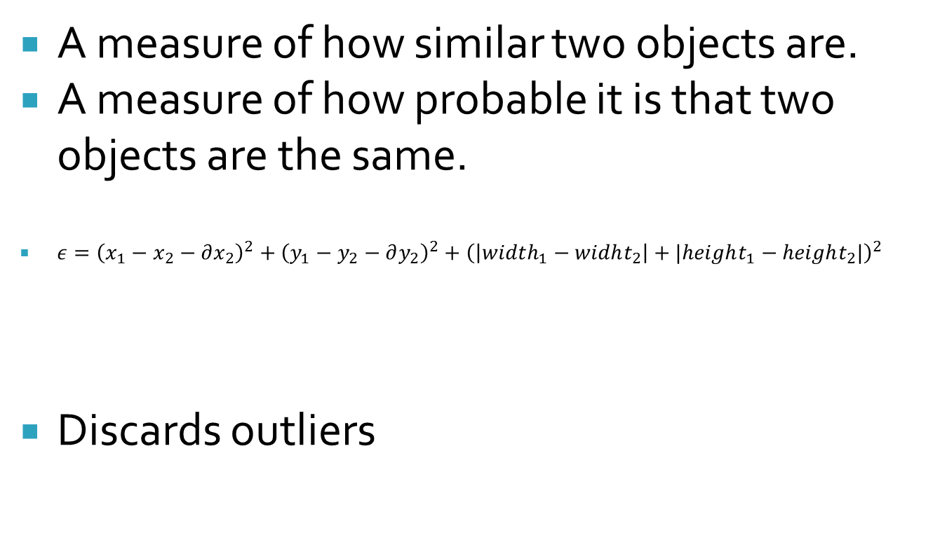
Identification – Error measure
A measure of how similar two objects are.
A measure of how probable it is that two objects are the same.
${ε=\left(x_{1}−x_{2}−∂x_{2}\right)}^{2}+{\left(y_{1}−y_{2}−∂y_{2}\right)}^{2}+{\left(\left|width_{1}−widht_{2}\right|+|height_{1}−height_{2}|\right)}^{2}$
Discards outliers
Squared euclidian distance
Squared size difference

Slide 14
Identification - Occlusion
Overlapping move
Non-overlapping move
1
2
Parent split
Sibling merge
3
4
Lost
Discovered
5
6

Slide 15
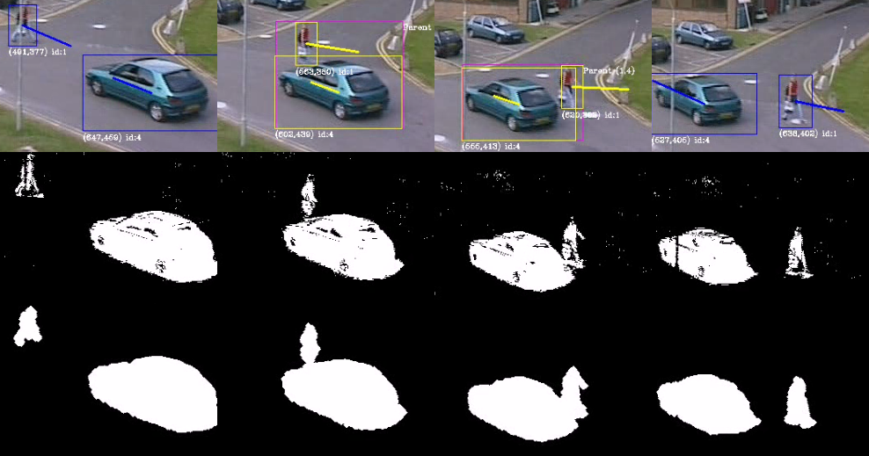
Identification – Occlusion

Slide 16
Identification - Improvements
Assumes all passed objects are ”real”
Large objects tends to collect lost heads, feets...
Width and Height should not change too fast...
The error function isn’t tuned at all: a change in width,height should probably impact more.
Objects should be removed if they have been lost for too long. Use the variance estimate from the kalman filter?

Slide 17
Prediction
Kalman: The optimal linear predictor
Components
State-Space Model
Covariance Matrices
Difficulties
Smoothing

Slide 18
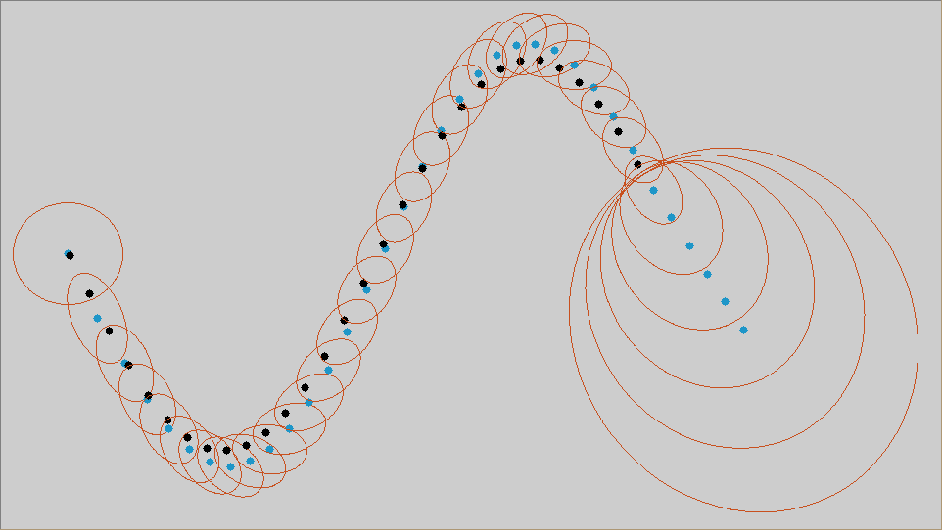
Prediction

Slide 19
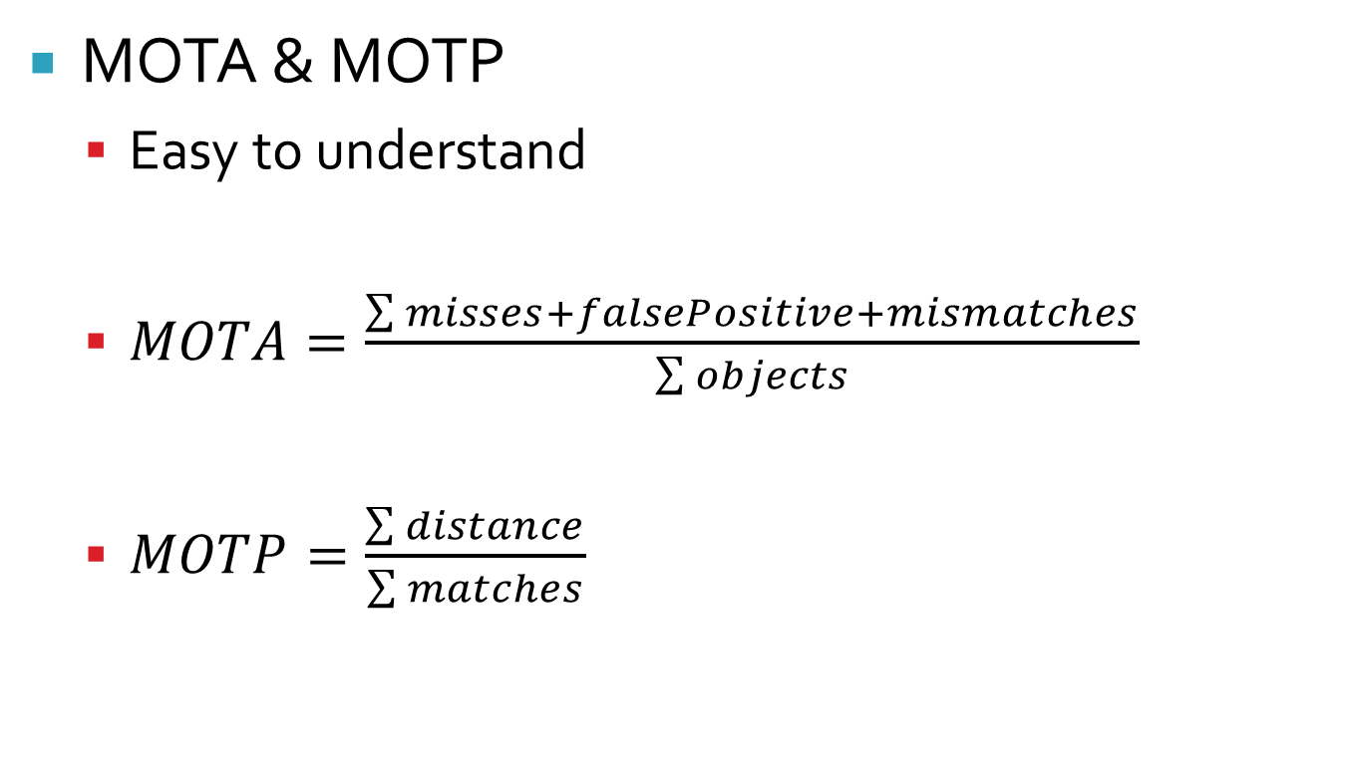
Evaluation
MOTA & MOTP
Easy to understand
$MOTA=\frac{\sum{misses+falsePositive+mismatches}}{\sum{objects}}$
$MOTP=\frac{\sum{distance}}{\sum{matches}}$

Slide 20
Evaluation
Improvement
No area evaluation
Get rid of the threshold

Slide 21
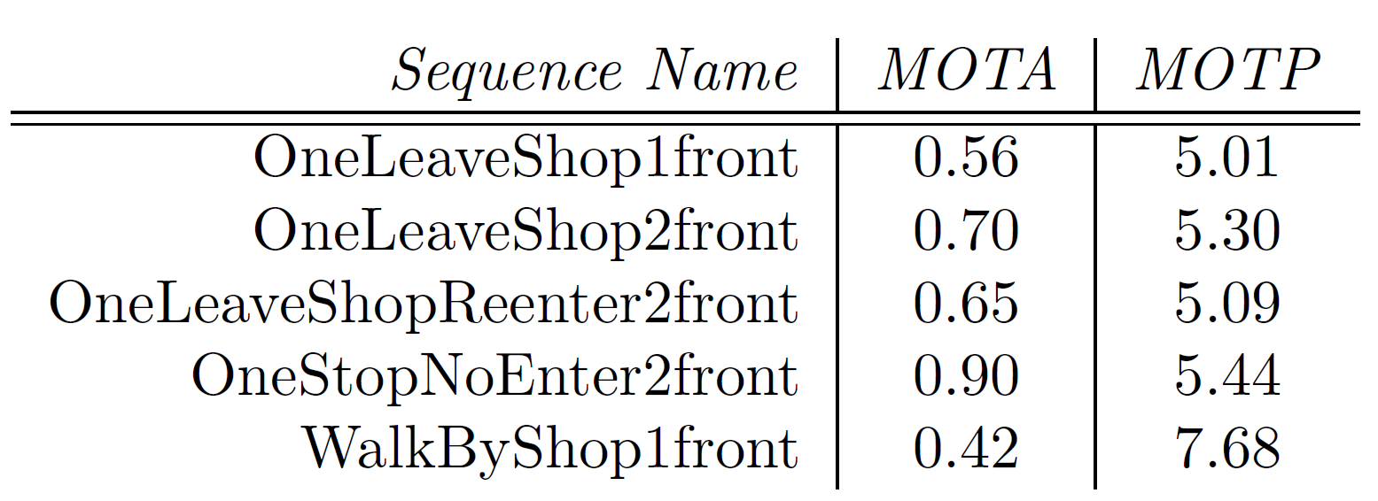
Results

