Slide 1

JS 2016
offirmo.net@gmail.com
Notes:
http://rmurphey.com/blog/2015/03/23/a-baseline-for-front-end-developers-2015
cette article à succès confirme notre plan général :
syntaxe et un peu d'ES6
un framework de test (mocha / chai)
un framework client (angular, react...)
un peu de node
au moins un gestionnaire de module (require...)
un outil d'automatisation (grunt, npm...)
un outil de linting

Slide 2





Intervenant
Jean Dupond
Senior Developer JS full stack
@Le Monde via Omnilog http://www.omnilog.fr/
Notes:
http://www.omnilog.fr/

Slide 3
Prologue
Notes:
https://www.reddit.com/r/javascript/comments/3rb88w/ten_questions_ive_been_asked_most_more_than_once/
https://blog.risingstack.com/history-of-node-js/
https://medium.com/javascript-scene/10-interview-questions-every-javascript-developer-should-know-6fa6bdf5ad95
http://jstherightway.org/
https://developer.mozilla.org/en-US/docs/Web/JavaScript/A_re-introduction_to_JavaScript

Slide 4
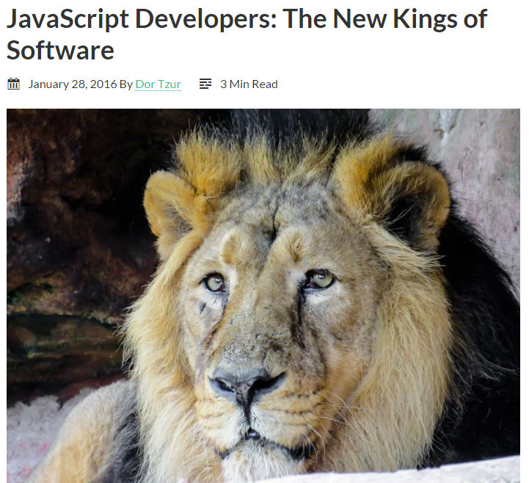
Notes:
http://thefullstack.xyz/javascript-developers/

Slide 5
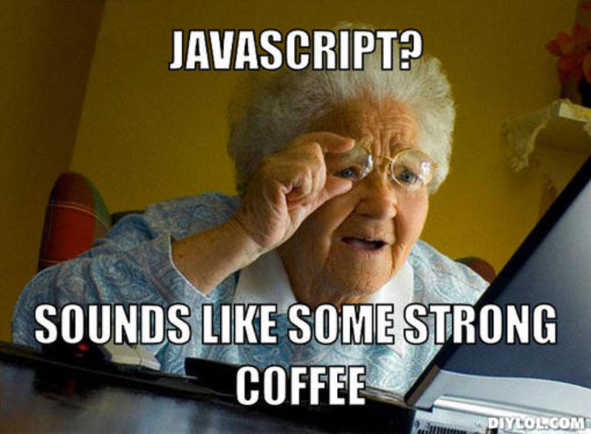
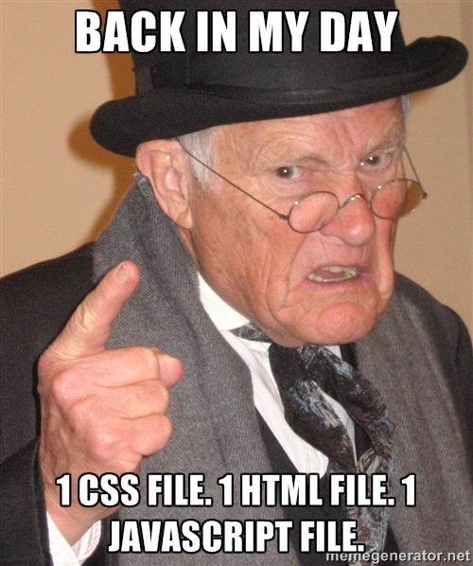
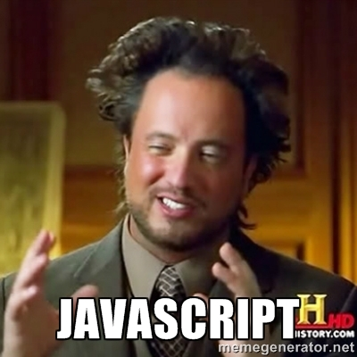
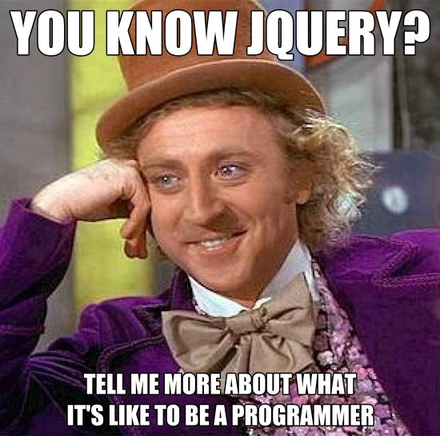
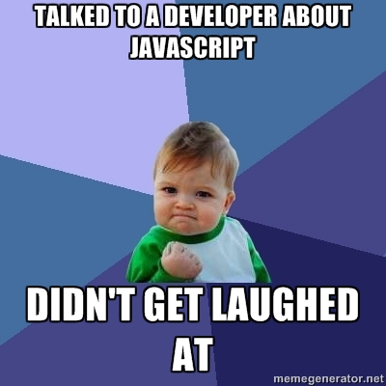
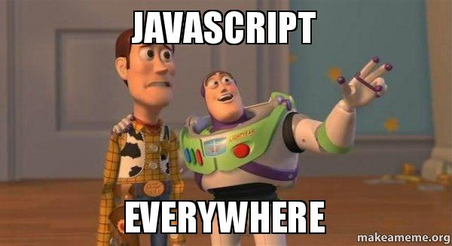
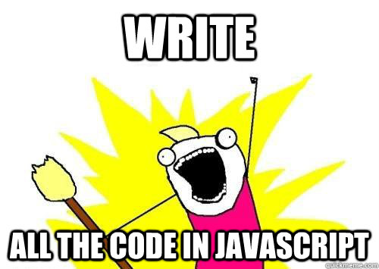
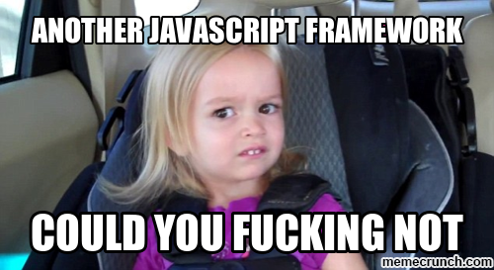
How did we end up here ?
ECMA2015
ES6
early web
Google Chrome
+ v8
Flash
Android
CommonJS
iPhone
ReactJS
Javascript
(netscape)
AJAX
(Microsoft)
AngularJS
JSON
jQuery
asm.js
| | | | | | | | | | | | | | | | | | | | |
1990 1995 1996 1997 1998 1999 2000 2001 2002 2003 2004 2005 2006 2007 2008 2009 2010 2011 2012 2013 2014 2015
REST
node.js
npm
CGI
PHP
nginx
grunt
docker
dotcom bubble crash
Ruby On Rails
Apache HTTP server
express.js
compile-to-Js
express.js
websockets
A history of the dynamic web
http://royal.pingdom.com/2007/12/07/a-history-of-the-dynamic-web/
JavaScript Developers: The New Kings of Software
http://thefullstack.xyz/javascript-developers/
Always bet on Javascript
http://brendaneich.github.io/ModernWeb.tw-2015/#74
Notes:
1990 early web
1995 javascript (netscape)
1995 apache HTTP server
1996 PHP
1999 AJAX (microsoft)
2001 JSON
2004 nginx
2005 ruby on rails
2006 jQuery
2008 google chrome + v8
2009 AngularJS
28 Oct 2009 underscore 0.1.0
2009 node
25 May 2012 lodash 0.1.0 https://github.com/lodash/lodash/releases?after=0.3.0

Slide 6

Real case example : Le Monde
Notes:
https://huit.lemonde.fr/login

Slide 7
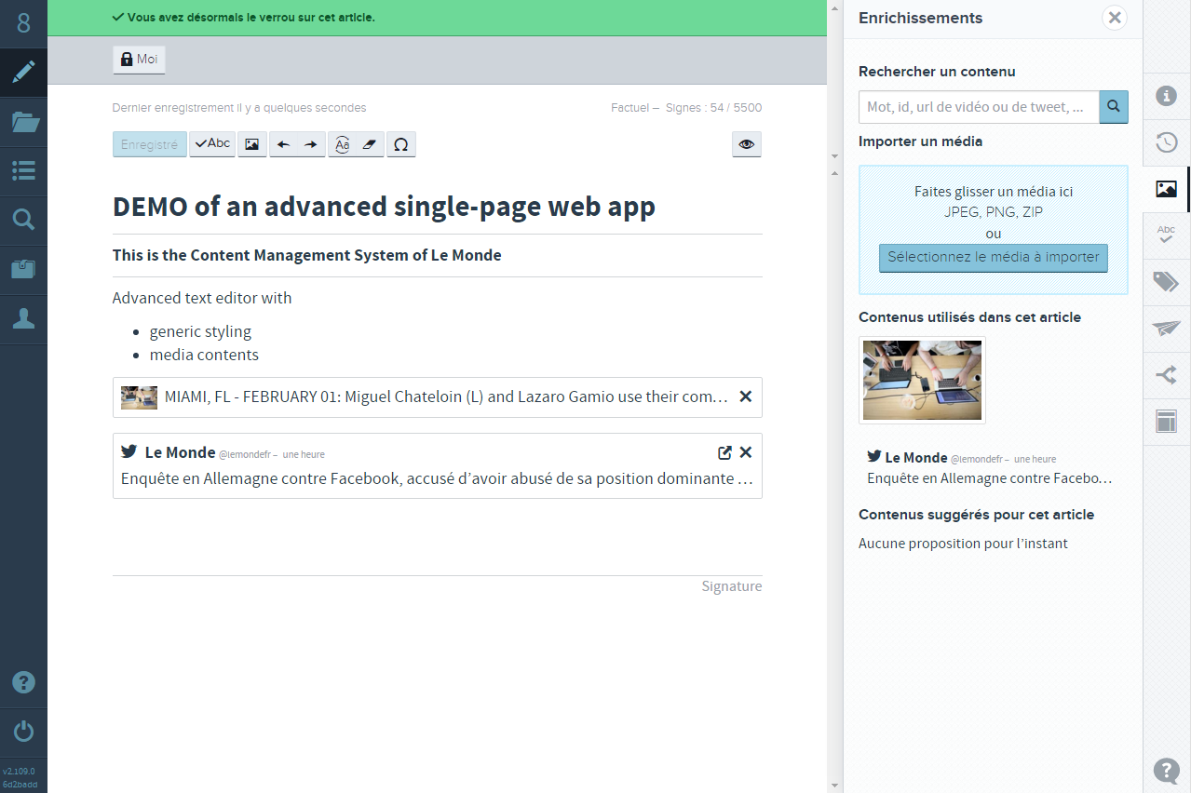

Slide 8

Pitch
accidentally brilliant !
Functional programming, event loop, unicode…
extremely capable
Ubiquitous (browser !!)
Java is WORA
Javascript is WORA++
JavaScript Is Eating The World
http://arc.applause.com/2015/11/06/javascript-is-eating-the-world/
Why JS Will Become The Dominant Programming Language Of The Enterprise
http://readwrite.com/2013/08/09/why-javascript-will-become-the-dominant-programming-language-of-the-enterprise
JavaScript is the lingua franca of the web. Ignore it at your peril.
http://blog.codinghorror.com/javascript-the-lingua-franca-of-the-web/
The JavaScript World Domination
https://medium.com/@slsoftworks/javascript-world-domination-af9ca2ee5070

Slide 9
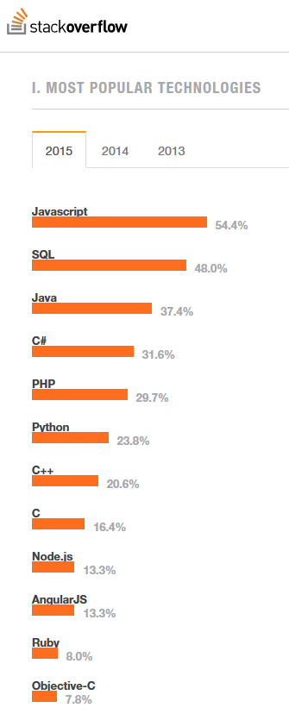
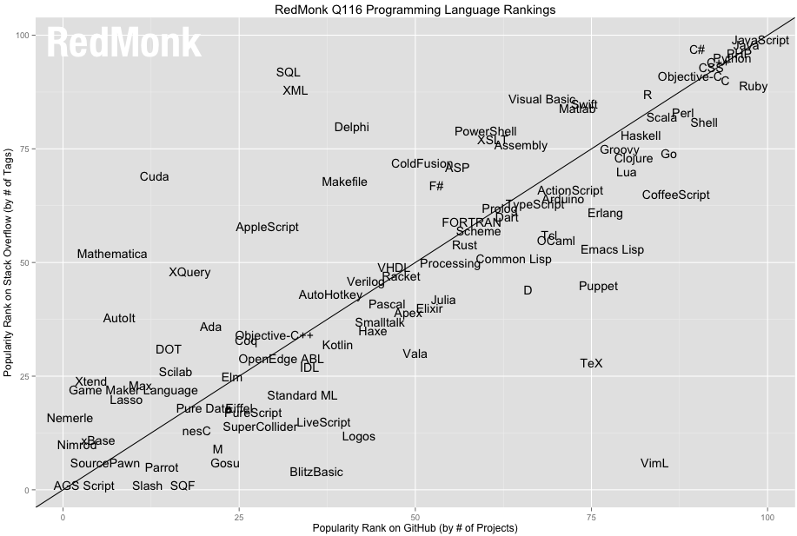
Show me the numbers
The RedMonk Programming Language Rankings: January 2016
http://redmonk.com/sogrady/2016/02/19/language-rankings-1-16/
Stackoverflow 2015 Developer Survey - Most Popular Technologies
http://stackoverflow.com/research/developer-survey-2015#tech-lang
Language Trends on GitHub
https://github.com/blog/2047-language-trends-on-github

Slide 10
References
GAFA
Netflix - Building With Node.js At Netflix
PayPal - Building With Node.js at PayPal
Medium - On Building With Node.js At Medium
LinkedIn - Building With Node.js At LinkedIn
Node.js and ES6 Instead of Java – A War Story
http://www.technology-ebay.de/the-teams/mobile-de/blog/nodejs-es6-war-story
What companies in Silicon Valley are using Node.JS in production?
https://www.quora.com/What-companies-in-Silicon-Valley-are-using-Node-JS-in-production
What companies are using Node.js in production?
https://www.quora.com/What-companies-are-using-Node-js-in-production

Slide 11
A case on ubiquitous JS
SPA
APIs
Native mobile apps
Desktop apps
Internet of things
...

Slide 12



Plan
Baseline JS dev
Not ridiculous in interview
MVP for your angels
10 Interview Questions Every JS Developer Should Know
https://medium.com/javascript-scene/10-interview-questions-every-javascript-developer-should-know-6fa6bdf5ad95
A Baseline for Front-End [JS] Developers, 2015
http://rmurphey.com/blog/2015/03/23/a-baseline-for-front-end-developers-2015
The Two Pillars of JavaScript
https://medium.com/javascript-scene/the-two-pillars-of-javascript-ee6f3281e7f3
How to Become a Better Node.js Developer in 2016
https://blog.risingstack.com/how-to-become-a-better-node-js-developer-in-2016/

Slide 13


Slide 14
Episode 1
Notes:
https://www.reddit.com/r/javascript/comments/3rb88w/ten_questions_ive_been_asked_most_more_than_once/
https://blog.risingstack.com/history-of-node-js/
https://medium.com/javascript-scene/10-interview-questions-every-javascript-developer-should-know-6fa6bdf5ad95
http://jstherightway.org/
https://developer.mozilla.org/en-US/docs/Web/JavaScript/A_re-introduction_to_JavaScript

Slide 15
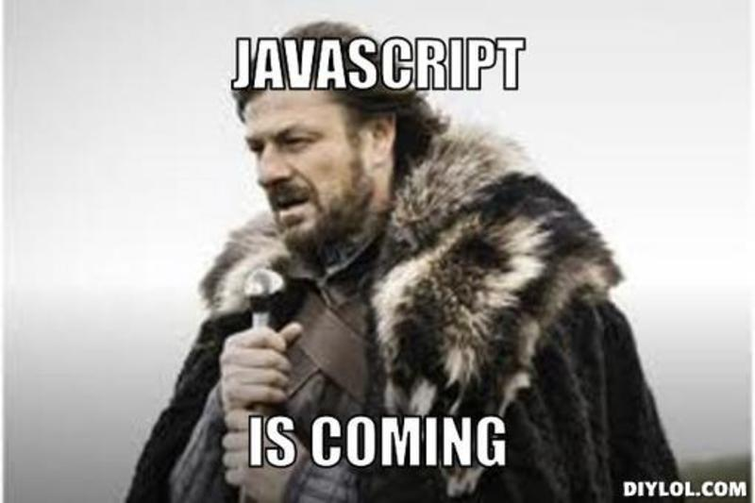
Language : base
/* syntax demo
*/
let demoBool = true;
let demoNumber = 1;
let demoString = "hello";
let demoArray = [];
let demoObject = {};
// greet someone
function hello (name) {
if (!name)
console.log('hello, unknown!');
else if (name === 'internet')
console.log('Meeeooow!');
else
console.log('hello, ' + name + '!');
}
hello('John');
hello('internet');
« JavaScript is the first lambda language to go mainstream. Deep down, JavaScript has more in common with Lisp and Scheme than with Java. It is Lisp in C’s clothing. This makes JavaScript a remarkably powerful language. » (Douglas Crockford)

Slide 16
Language : types
6 data types that are primitives :
Boolean
Null
Undefined
Number
String (immutable)
Symbol (new ES2015)
And others who are NOT :
Object { }
Function
Array [ ]
... (later)
JavaScript data types and data structures
https://developer.mozilla.org/en-US/docs/Web/JavaScript/Data_structures

Slide 17
Unusual
No Integer ==> only Number (double 64 bits)
No Char ==> only String (UTF-16)
String delimiters : 'hello' === "hello"

Slide 18
How to tame your function (1)
'ABCD'.toLowerCase()
--> 'abcd'
[ 1, 2 ].length
--> 2
[ 1, 2, 3, 4 ].slice(2, 3)
--> [3]
Notes:
Note the "

Slide 19
How to tame your function (2)
[ 'Hi', 'World' ].map(function(t) {
return t.toLowerCase();
});
--> [ 'hi', 'world' ]
[ 'Hi', 'World' ].map(
T => t.toLowerCase()
);
--> [ 'hi', 'world' ]
Notes:
Note the switch to '

Slide 20

Hands on !
Go to https://github.com/EpitaJS/js-class-2016
Fork the repo
Clone your fork
  git clone ...
Install dependencies
  npm install
Then...
  npm start

Slide 21
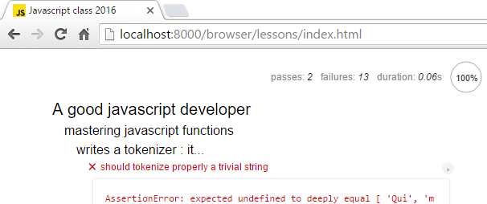
Google Chrome http://localhost:8000/
/browser/lessons/index.html

Slide 22
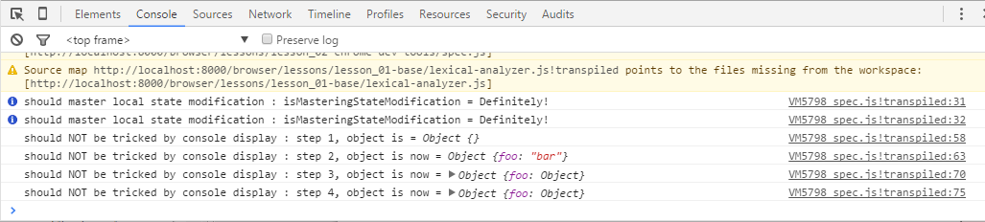
Tools : Chrome Dev Tools
Ctrl + Shift + I --> "Console" tab
console.log(...)
console.info(...)
console.warn(...)
console.error(...)

Slide 23
Fend For Yourself !
http://devdocs.io/
  JavaScript
  Lodash
  Node.js
MDN https://developer.mozilla.org/

Slide 24
Lesson 1
Basics

Slide 25
Modules
import "moduleX";
import <default> from "moduleX";
import _ from "lodash";
import * as name from "moduleX";
export function tokenize(str) {
// ...
}
const defaultLogger = createFancyLogger();
defaultLogger.create = createFancyLogger;
export default defaultLogger;
export { createFancyLogger as create };
The ES6 import statement
https://developer.mozilla.org/en-US/docs/Web/JavaScript/Reference/Statements/import
The ES6 export statement
https://developer.mozilla.org/en-US/docs/Web/JavaScript/Reference/Statements/export

Slide 26

Note about tests
Mocha / chai
context() / describe() / it()
Make a phrase !
.only / .skip

Slide 27
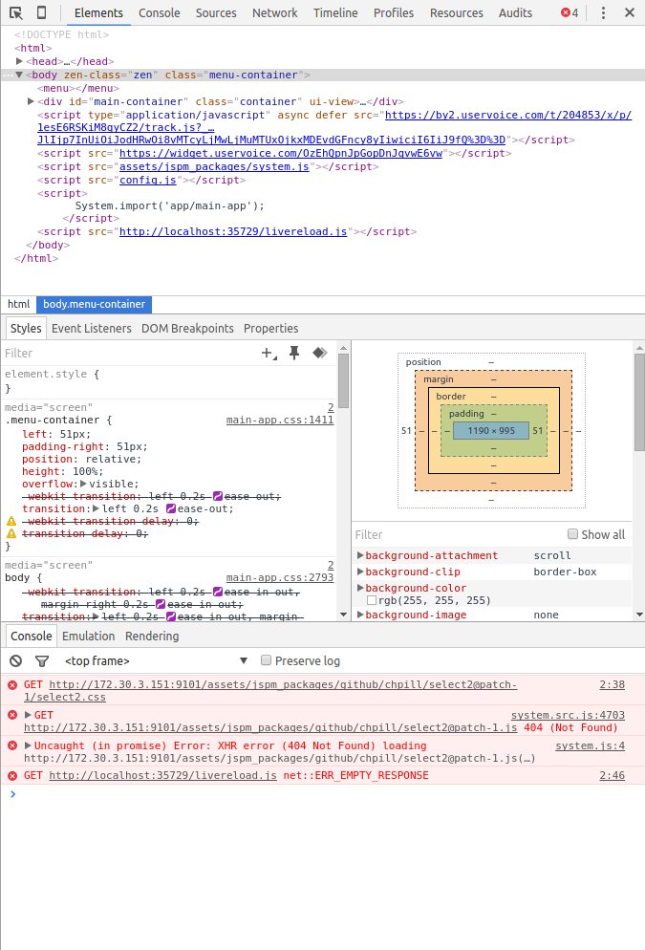
Demo : Chrome Dev Tools
Display mode
Esc
Network
Test responsive design
Simulate low bandwith

Slide 28
Lesson 2
Chrome Dev Tools
+ LocalStorage API
+ "by reference"
Uncomment the line //debugger;
Set breakpoints in tests

Slide 29
Important concepts (1)
ECMASCRIPT 2015
Aka ES6
Transpiling
Module loader

Slide 30

Language : type, casts
typeof 0 // "number"
typeof true // "boolean"
typeof 'foo' // "string"
typeof {} // "object"
typeof undefined // "undefined"
typeof null // "object" <- official bug
typeof function(){} // "function" (object)
typeof NaN // "number" wat ?
typeof [] // "object"
typeof new String("lalala") // "object"
JavaScript tutorial : Type detection
http://javascript.info/tutorial/type-detection

Slide 31
Language : type, casts
'[object Array]'
'[object Boolean]'
'[object Date]'
'[object Function]'
...
{}.toString ------>
== !=
=== !==
+'10.1' -> 10.1
0.1 + 0.2 === 0.30000000000000004;
!!undefined -> false

Slide 32
Lesson 3
Type detection

Slide 33

Javascript : the BAD parts
Type detection :-(
Aggressive type casting + ++ :-(
Var scoping, hoisting (ES5) for ... in ... :-(
No native modules (until ES6) :-( :-( :-( :-(
Automatic comma insertion
'use strict'; (ES5)
...
YourLanguageSucks
https://wiki.theory.org/YourLanguageSucks
Strangest language feature
http://stackoverflow.com/questions/1995113/strangest-language-feature
Semicolons in JavaScript are optional
http://mislav.net/2010/05/semicolons/

Slide 34
Solution (1) tooling !
ESLINT

Slide 35
Lesson 3 bis
npm run lint

Slide 36

Solution (2) : lodash ;-)
« A modern JavaScript utility library delivering modularity, performance, & extras. »
import _ from 'lodash';
https://lodash.com/
http://devdocs.io/
_.isBoolean(foo);
Notes:
https://github.com/lodash/lodash/releases/tag/4.0.0

Slide 37

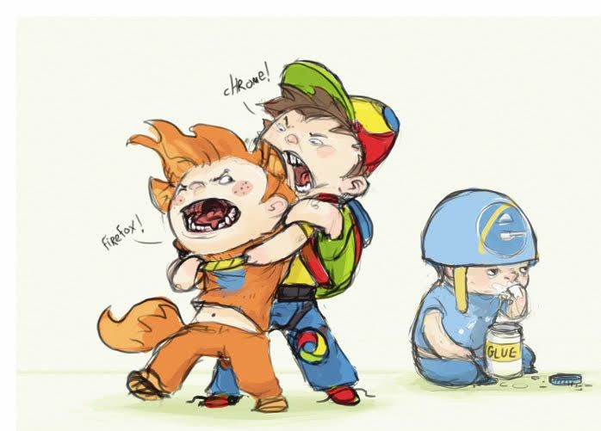
general culture (1)
"The JavaScript engine race"
Chakra (Microsoft Edge)
JavaScriptCore (Apple Safari)
SpiderMonkey (Mozilla Firefox)
V8 (Google Chrome)
http://arewefastyet.com/
Iphone ?

Slide 38
Language : objects
let duck = {
name: 'Bob',
weight: 1.5,
actions: {
eat: () => { duck.weight += 0.1 },
'search-food': () => { duck.weight -= 0.1 },
}
};

Slide 39

Language : functions
« The quality of all code that you'll ever write, in JavaScript, relies upon the realization that JavaScript is a functional language. All functions, in JavaScript, are first-class: They can coexist with, and can be treated like, any other JavaScript object. » (John Resig)
function hello(name) {
console.log('hello, ' + name + '!');
}
hello('John');
var greet = hello;
greet('John');
function greetMultiple(names, greetFn) {
names.forEach(greetFn);
}
greetMultiple([ 'Steve', 'Tony', 'Natasha' ], hello);
greetMultiple([ 'Steve', 'Tony', 'Natasha' ], function (name) {
console.log('Hi ' + name + '!');
});

Slide 40

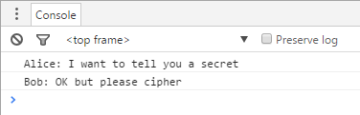
Language : closures
function createActor(name) {
return {
name,
say: text => console.log(name + ': ' + text)
};
}
const Alice = createActor('Alice');
const Bob = createActor('Bob');
Alice.say('I want to tell you a secret');
Bob.say('OK but please cipher');
How do JavaScript closures work?
http://stackoverflow.com/questions/111102/how-do-javascript-closures-work

Slide 41
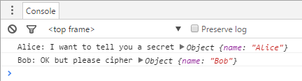
Language : this
function createActor(name) {
return {
name,
say: function(text) {
console.log(name + ': ' + text, this)
}
};
}

Slide 42

Language : this (2)
function createActor(name) {
return {
name,
say: text => console.log(name + ': ' + text, this)
};
}

Slide 43
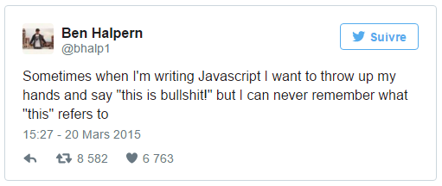


Language : this (3)
Python guys here ?
Default this = global
Bind :
<function>.bind(this[, param1][, param2]...)
const AliceSay = Alice.say.bind(Alice);
AliceSay('I want to tell you a secret');
const BobSayXXX = Bob.say.bind(Alice);
BobSayXXX('OK but please cipher');

Slide 44
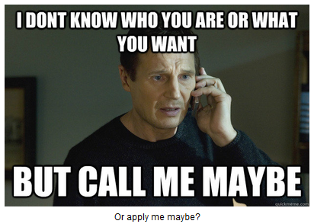
Language : apply / call
fun.call(thisArg[, arg1[, arg2[, ...]]])
fun.apply(thisArg, [argsArray])
The Power of Apply and Call
http://andyjmeyers.blogspot.fr/2015/01/the-power-of-apply-and-call.html

Slide 45
Lesson 4
Advanced functions

Slide 46
Now send me a PR !!!

Slide 47
Episode 2

Slide 48
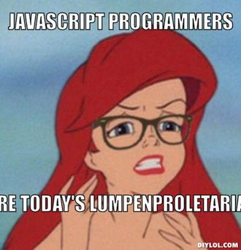
REM
JS = high-level, dynamic, untyped, interpreted
Suitable for nearly everything
Google dev tools !
Functions !
New prerequisites :
http://bit.ly/jsc2-pre

Slide 49
Lesson 6
Wrapping up :-)

Slide 50
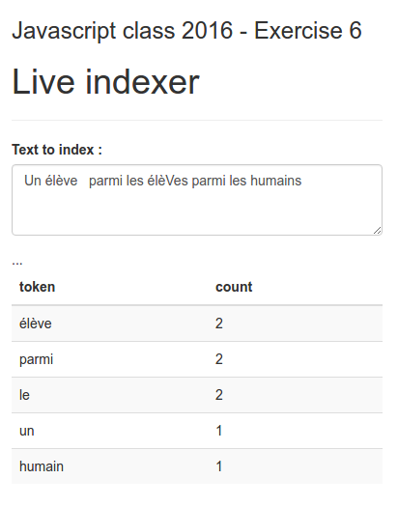



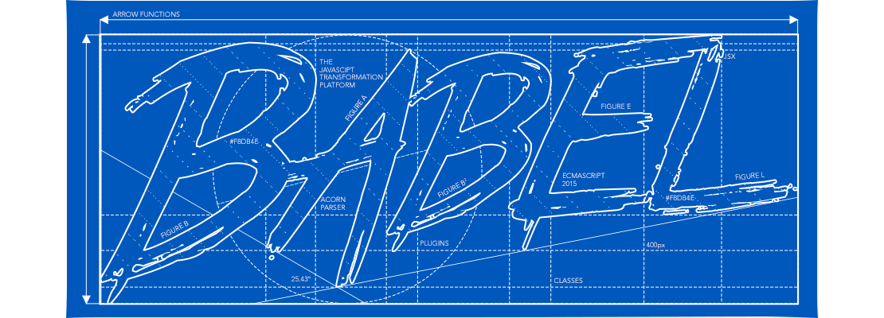

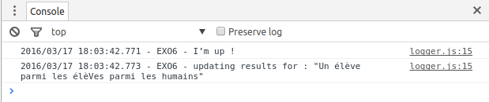
06 – Wrapping up

Slide 51
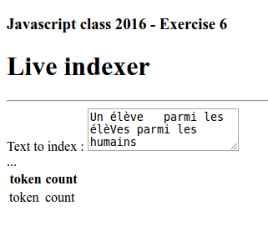
Important concepts (2)
Bootstrap
FOUC

Slide 52
06 – Wrapping up
Jquery
let elements = sortedResults.map(entry => `
<tr>
<td>${entry.token}</td>
<td>${entry.occurrenceCount}</td>
</tr>`);
$('#results tbody').empty();
$('#results tbody:last-child').append( elements );
Using jQuery for direct DOM manipulation
Debounce and Throttle: a visual explanation
http://drupalmotion.com/article/debounce-and-throttle-visual-explanation

Slide 53
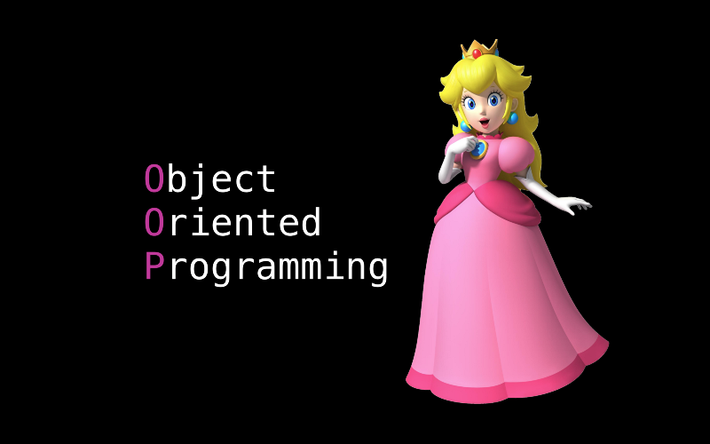
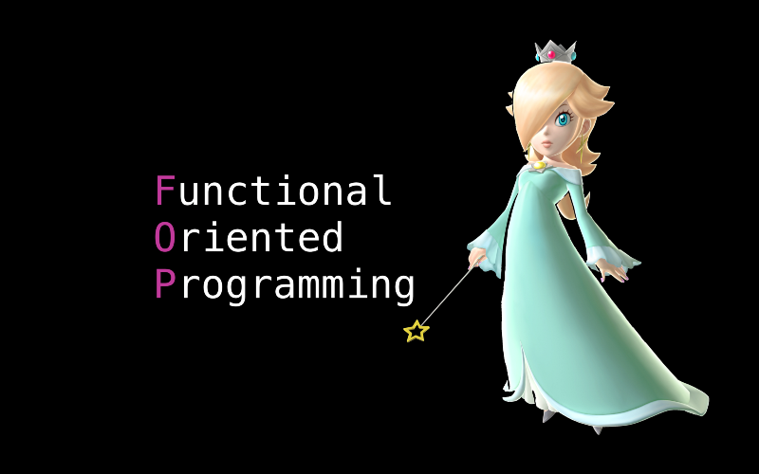

Language : class
The Two Pillars of JavaScript – Pt 1
https://medium.com/javascript-scene/the-two-pillars-of-javascript-ee6f3281e7f3
The Two Pillars of JavaScript – Pt 2
https://medium.com/javascript-scene/the-two-pillars-of-javascript-pt-2-functional-programming-a63aa53a41a4
Notes:
https://medium.com/swift-programming/protocol-oriented-programming-a3e192f6e8f2

Slide 54

Language : duck typing
When I see a bird that
walks like a duck
swims like a duck
and quacks like a duck
I call that bird a duck.
James Whitcomb Riley

Slide 55
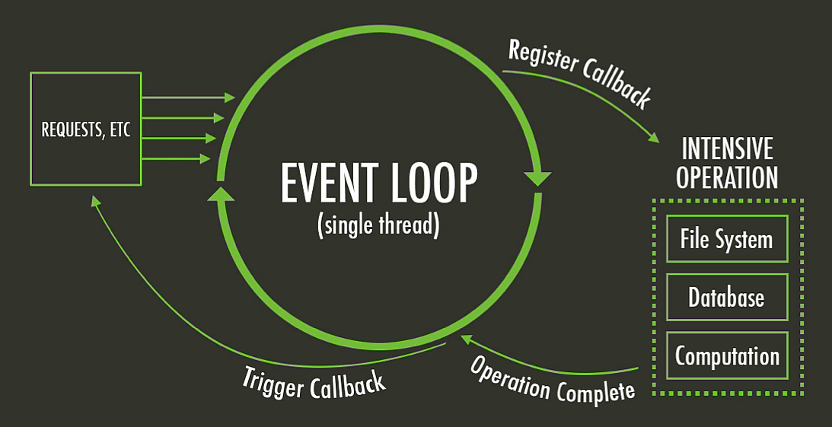
Language : event loop
From UI history = accidental genius
Problems With Node.JS Event Loop
http://www.juhonkoti.net/2015/12/01/problems-with-node-js-event-loop

Slide 56
Hands on !
Go to https://github.com/EpitaJS/js-class-2016-episode-2
Fork the repo
Clone your fork
  git clone ...
Install required node :
  nvm install $(cat .nvmrc)
Install dependencies
  npm install

Slide 57
Node Exercise 1
Hello world
cd exercises/nodejs/01-hello_world
./index.js

Slide 58
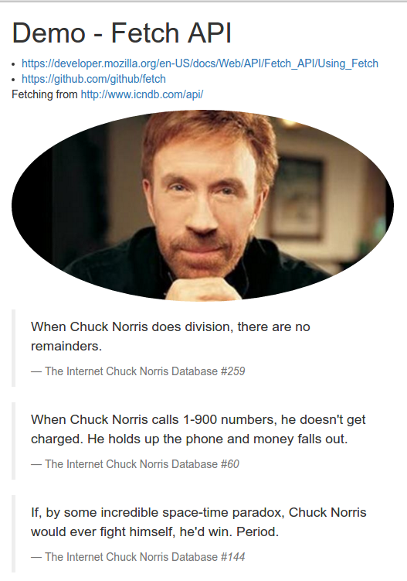
Demos
/demos/browser :
npm run puer
/demos/nodejs :
./index.js

Slide 59
async intro : timeout
console.log('line 1');
setTimeout(function() {
console.log.bind(console, 'line 2'),
}, 1000);
console.log('line 3');
line 1
line 3
line 2

Slide 60
async intro : timeout (continued)
console.log('line 1');
setTimeout(function() {
console.log.bind(console, 'line 2'),
});
console.log('line 3');
line 1
line 3
line 2

Slide 61
async intro : node style
Async function(value, callback)...
"node style callback"
FetchPizza('4 fromages',
function (err, pizza) {
if (err) return console.log(err);
eat(pizza);
}
);
Console.log('Waiting for my pizza...');
Error Handling in Node.js
https://www.joyent.com/developers/node/design/errors

Slide 62
Modules
ES6
import _from 'lodash'
Import {cloneDeep as clone} from 'lodash';
Node.js = CommonJS
const _ = require('lodash');
const clone = require('lodash').cloneDeep;
Node.js Module API
https://nodejs.org/api/modules.html

Slide 63
Node Exercise 2
CLI app + async 1
cd ../02-interactive
./index.js

Slide 64
Node.js : 1st experience
Async is key : built-in ! (vs. Python twisted)
Paypal node.js app :
  Double the requests per second vs. the Java application [even when] using a single core for the node.js application compared to five cores in Java
  35% decrease in the average response time for the same page. This resulted in the pages being served 200ms faster
Twisted is an event-driven network programming framework written in Python
https://en.wikipedia.org/wiki/Twisted_%28software%29
Node.js at PayPal
https://www.paypal-engineering.com/2013/11/22/node-js-at-paypal/

Slide 65
Promises
"Callback hell"
doAsync1(function (err, res) {
doAsync2(function (err, res) {
doAsync3(function (err, res) {
throw new Error(...);
})
})
})
Managing Node.js Callback Hell
https://medium.com/@wavded/managing-node-js-callback-hell-1fe03ba8ba

Slide 66
Promises
let p = Promise.resolve(5);
p.then(data => console.log('Hello ' + data));
p.then(data => console.log('Bonjour ' + data));
p.then(data => data + 5)
.then(data => console.log('+5 gives :' + data))
.catch(err => console.error('something happened !'));
MDN Promise reference
https://developer.mozilla.org/en-US/docs/Web/JavaScript/Reference/Global_Objects/Promise

Slide 67
Promises
let a = Promise.resolve(5);
a.then(() => {
// silly example, of course
return Promise.resolve('hello');
})
.then(msg => console.log(msg));
MDN Promise reference
https://developer.mozilla.org/en-US/docs/Web/JavaScript/Reference/Global_Objects/Promise

Slide 68
Promises
let b = Promise.resolve(5);
b.then(() => {
// silly example, of course
throw new Error('Ouch !');
})
.then(msg => console.log(msg))
.catch(err => console.error(err.message));
MDN Promise reference
https://developer.mozilla.org/en-US/docs/Web/JavaScript/Reference/Global_Objects/Promise

Slide 69

Promises
Interactive demo http://bit.ly/promisesDemoJSC2016
function getUrl () {
return new Promise((resolve, reject) => {
setTimeout(() => resolve("http://swapi.co/people/3"), 1500)
})
}
getUrl()
.then(function fetchData(url) {
return fetch(url)
.then(function onResponse(response) {
if(response.ok)
return response.json();
else
throw new Error('Network response was not ok.');
});
})
.then(function displayResults(data) {
console.log(data)
})
.catch(err => console.error(err));
We have a problem with promises
http://pouchdb.com/2015/05/18/we-have-a-problem-with-promises.html
Promise visualization playground for the adventurous
http://bevacqua.github.io/promisees/

Slide 70
Node Exercise 3
Promises
cd ../03-promise
./index.js
Starwars API https://swapi.co/
Fetch API : go doc yourself...

Slide 71

General Culture : JS Darwinism
The Darwinism of small modules
https://developer.atlassian.com/blog/2015/11/what-the-web-platform-can-learn-from-nodejs/

Slide 72
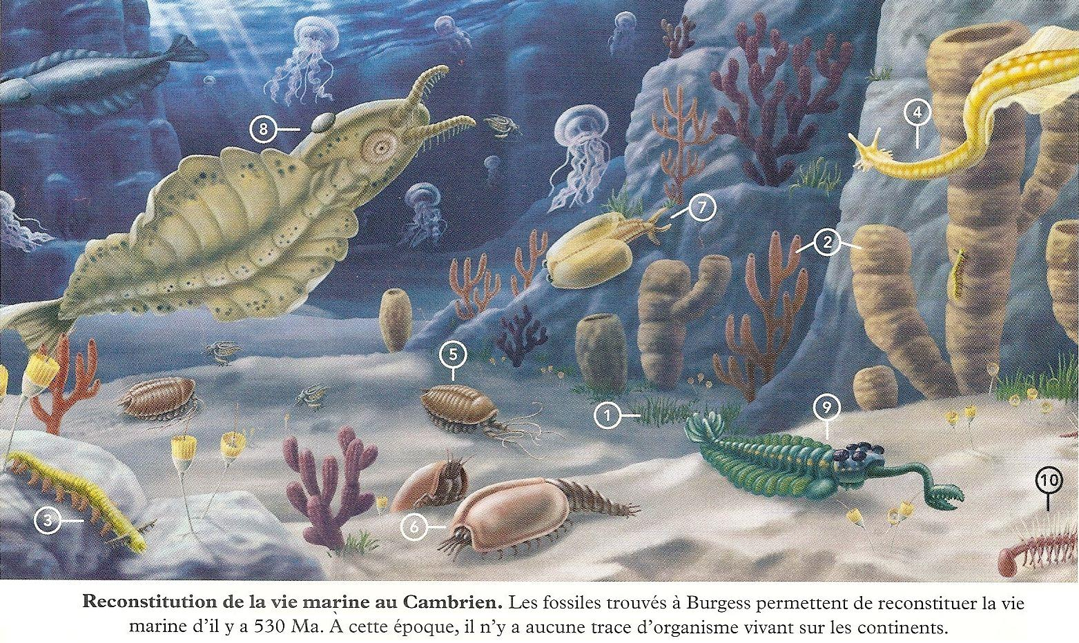
Darwinism : example for Promises
2010
kriskowal/q
2015
Official Promise API
2007
Dojo.deferred
1976
« Promise » term coined
2011
When.js
2009
Promise/A spec
2013
bluebird

Slide 73

Libs
How to choose ??

Slide 74
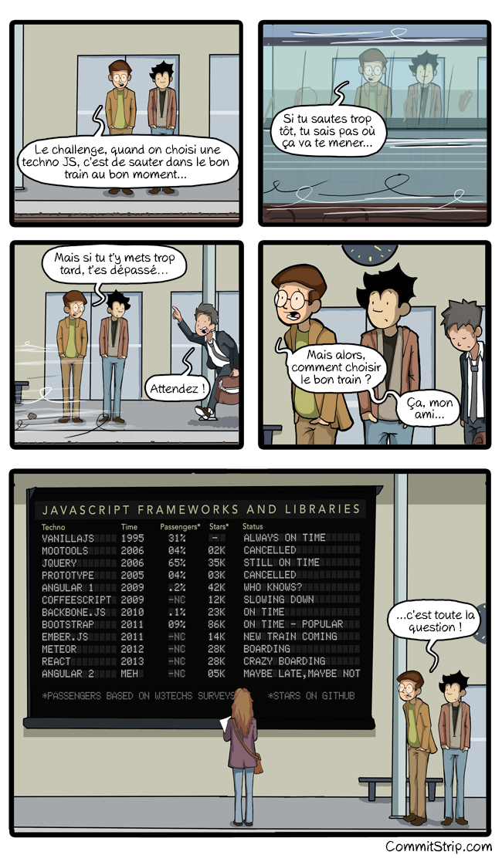
Libs
How to choose the right JavaScript framework ?
http://www.commitstrip.com/en/2015/09/16/how-to-choose-the-right-javascript-framework/

Slide 75
Libs ?
Solid
lodash
moment
mocha + chai
async (if really needed)
Npm - most starred packages
https://www.npmjs.com/browse/star
Npm - most depended-upon packages
https://www.npmjs.com/browse/depended

Slide 76
Exit conditions

Slide 77

Npm = node packet manager

Slide 78
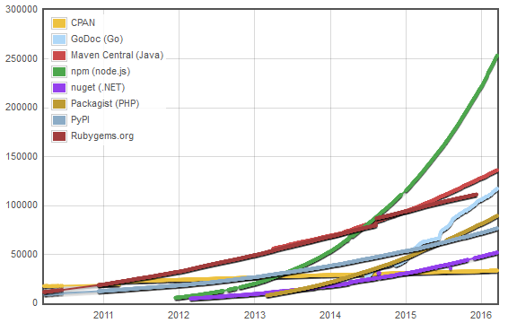
npm
Module Counts
http://www.modulecounts.com/

Slide 79

npm
npm install
npm install --save toto
npm install --global jspm
package.json
npm
https://www.npmjs.com/

Slide 80
npm as an automation tool
Tasks
package.json
npm run xyz
"scripts": {
"start": "node index.js",
"puer": "puer --exclude 'node_modules'",
"lint": "eslint ."
},
"dependencies": {
"amdefine": "^1.0.0",
"async": "^1.5.2",
"body-parser": "^1.15.0",
"chalk": "^1.1.1",

Slide 81
Node http
const http = require('http');
const server = http.createServer((req, res) => {
res.writeHead(200);
res.end('Hello world !');
});
server.listen(8080);
console.log('Listening on 8080...');

Slide 83
Time to early commit !!!

Slide 84
expressJS
const express = require('express');
// http://expressjs.com/4x/api.html
const app = express();
app.get('/', (req, res) => res.send('hello world'));
app.listen(8080);
console.log('Listening on 8080...');
express.js
http://expressjs.com/4x/api.html

Slide 85
Node Exercise 4
Express hello world
cd ../04-express_hello_world
./index.js

Slide 86
More ExpressJS
Routing
Middleware
app.use((req, res, next) => {
// set a custom header
res.header('x-received-at', Date.now());
next();
});
app.get('/', function(req, res) {
res.send('hello from app ! Try /meta /api');
});

Slide 87
Node Exercise 5
Express routing
cd ../05-express_routing
./index.js

Slide 88
Build a simple API
Be creative !
With CORS headers !
Access-Control-Allow-Origin ->
*
Access-Control-Allow-Headers ->
Origin, X-Requested-With, Content-Type, Accept

Slide 89
Time to early commit !!!

Slide 90

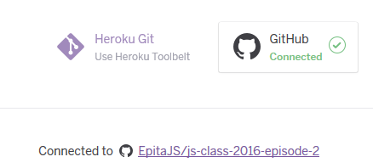
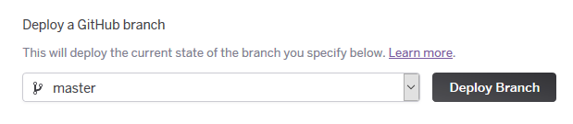
Deploy live at Heroku !!!
https://dashboard.heroku.com/apps
Select your app
Go to deploy tab
Connect to your GitHub fork
Deploy !!

Slide 91
Socket.io

Slide 92
Critical knowledge
No time, you'll have to read yourself about it :
Security
Cluster
Domains
...

Slide 93
Be careful !
Leaks
  Memory
  timeouts

Slide 94
Now send me a PR !!!

Slide 95
Homework
http://brendaneich.github.io/ModernWeb.tw-2015/
Parcourir ces docs :
  https://lodash.com/docs
  https://github.com/caolan/async
  https://dev.windows.com/en-us/microsoft-edge/platform/status/?filter=f2f0000bf

Slide 96
Episode 3

Slide 97
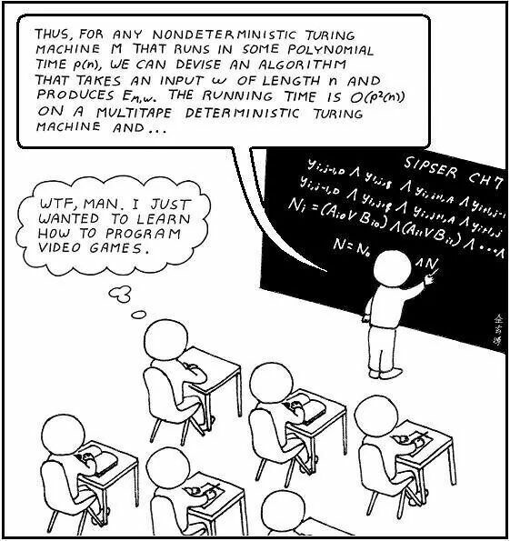
REM : so far...
JavaScript basics
JavaScript browser with jQuery
JavaScrip server with node.js
  CLI tool
  express app : API

Slide 98
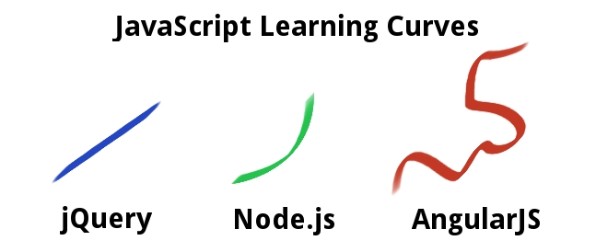
Back to browser
APIs web
API support http://caniuse.com/
Modules
Module loaders
Client frameworks

Slide 99
Hands on !
Go to https://github.com/EpitaJS/js-class-2016-episode-3
Fork the repo
Clone your fork
  git clone ...
Install required node :
  nvm install $(cat .nvmrc)
Install dependencies
  npm install

Slide 100
Démo
AngularJS SPA
npm run dev
Localhost:7000/

Slide 101
Advanced Server
Templating
  Consolidate + dust
Complex pipeline
Auto-restart
Livereload (Hot reload)
...

Slide 102
Advanced express pipeline
src\server\web\express-app\index.js
Assign UUID
// tag the requests with a unique id
app.use(middlewares.assign_uuid);
// identify requests rendering to a page from others (xhr, api...)
app.use(middlewares.identify_page_requests);
app.use(middlewares.log_requests);
// activate compression
app.use(middlewares.compress_response_body);
// then static files which doesn't require special processing.
// Typically this middleware will come very early in the stack
// to avoid processing any other middleware if we already know the request is for a static file
app.use('/', middlewares.serve_static_files( config.web.favicons_dir ));
app.use('/client', middlewares.serve_static_files('src/client'));
app.use('/common', middlewares.serve_static_files('src/common'));
app.use('/jspm_packages', middlewares.serve_static_files('jspm_packages'));
app.get('/config.js', (req, res) => res.sendFile('config.js', { root: process.cwd()}));
// now that we've passed static data which may be CDN'd or served by a reverse proxy,
// add the X-Response-Time header to our responses
app.use(middlewares.add_response_time_header);
// needed to read request params
app.use(middlewares.parse_request.json());
app.use(middlewares.parse_request.urlencoded({ extended: false }));
// detect and pick the best locale
app.use(middlewares.detect_best_locale);
app.use(routes);
// fallback
// 'catch all' = default / 404 for a webapp
app.use(middlewares.handle_unmatched_with_404);
Identify page requests
Log
Activate compression
Serve static files
Add info header
Parse request
Detect best locale
Route...

Slide 103
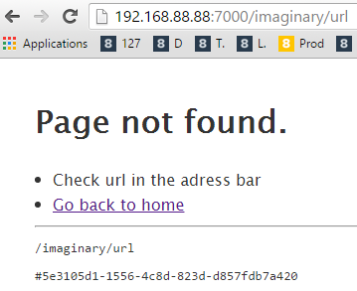
Templating
Dust http://dejanglozic.com/2014/01/27/dust-js-such-templating/
<!DOCTYPE html>
<head>
<title>404 Not found</title>
</head>
<h1>Page not found.</h1>
<li>Check url in the adress bar
<li><a href="/">Go back to home</a>
<hr />
<pre>{url}</pre>
<pre>#{uuid}</pre>

Slide 104
Homework : go see the sources
/src
  /client -> client should be reloaded on change
    /client/common/views
  /server -> server should be restarted on change
    /server/web/express-app
  /common -> both

Slide 105
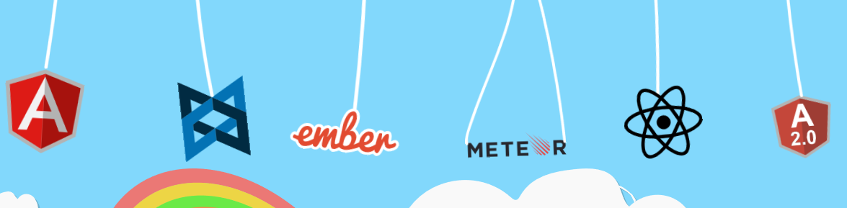
Back to browser : client frameworks
(Debating on merits of frameworks vs. micro-libs)
https://www.reddit.com/r/javascript/comments/3v43qf/im_a_web_developer_who_uses_jquery_to_write_a/cxkl9d1
Which cat is your JavaScript framework ?
http://whichcatisyourjavascriptframework.com/

Slide 106
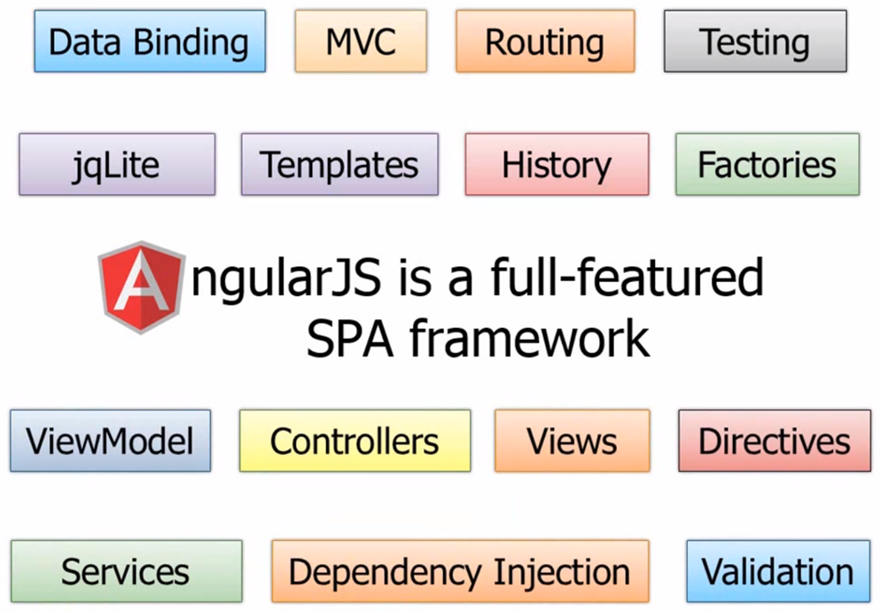
AngularJS

Slide 107
Angular demo 1
Hello word
npm run dev
Localhost:7000/demo-O1

Slide 108
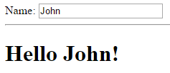
Demo
<label>Name:</label>
<input type="text" ng-model="name">
<hr>
<h1>Hello {{name}}!</h1>

Slide 109
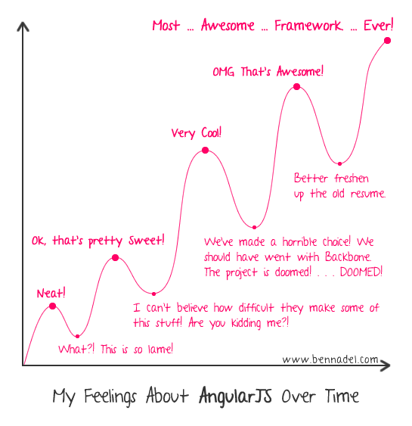
AngularJS

Slide 110
Angular demo 2
ng-repeat
npm run dev
Localhost:7000/demo-O1

Slide 111
ng-repeat
<h1 ng-repeat="name in $ctrl.names">
Hello {{name}}!
</h1>
« directive »
Angular world !
Properly triggers $digest
Angular world !
Properly triggers $digest
Angular world !
Properly triggers $digest
Angular world !
Properly triggers $digest

Slide 112
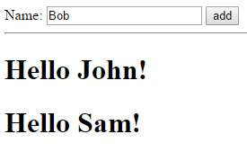
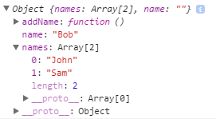

Two-way binding
View
Controller

Slide 113
Nice stuff
ng-if="..."
ng-show="..." ng-hide="..."
ng-click="list.addItem()"
Ng-class="['todo', 'todo-active']"
<a ng-href="foo/{{hash}}">link1</a>
<ANY ng-switch="name">
<ANY ng-switch-when="John">...</ANY>
<ANY ng-switch-when="Sam">...</ANY>
<ANY ng-switch-default>...</ANY>
</ANY>

Slide 114
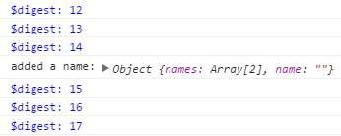
$digest
???

Slide 115
$digest
The $digest :
Is repeated until stabilization
Is automatic as long as we stay in Angular world
Can be triggered manually :
$scope.$applyAsync(() => { .... });

Slide 116
Angular exercise 1
Fix the $digest !
npm run dev
Localhost:7000/exercise-01
???

Slide 117
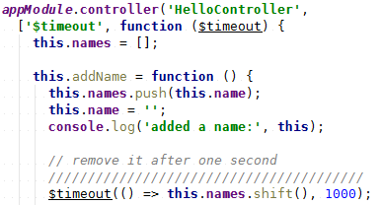
Services
$timeout
Angular world !
Properly triggers $digest

Slide 118
Some services :
$log
$q <-- promises
$timeout
$document
$http $http.get() $http.post()
...

Slide 119
Angular concepts
import 'angular';
import 'angular-ui-router';
const appModule =
angular.module('app_module', [ 'ui.router' ]);
Here we create an Angular module
named « app_module »...
...depending on this other module imported before

Slide 120
Angular concepts
appModule.component('layout', {
template: '<div>Hello world !</div>'
});
Here we create a component
named « layout » inside previously created module (appModule)

Slide 121
Angular concepts
appModule.controller('AppController',
['$scope', function ($scope) {
this.title = 'Demo 01';
$scope.$watch(function() {
console.count('$digest');
})
}]
);
Again, we create a « controller » named AppController
The controller loads something
from currently loaded modules
(dependency injection)

Slide 122
AngularJS

Slide 123
Tricks
Create one only module as a singleton and forget about it
window._app.global_ng_module
.component('toolbar', {
templateUrl: 'toolbar.html'
});

Slide 124
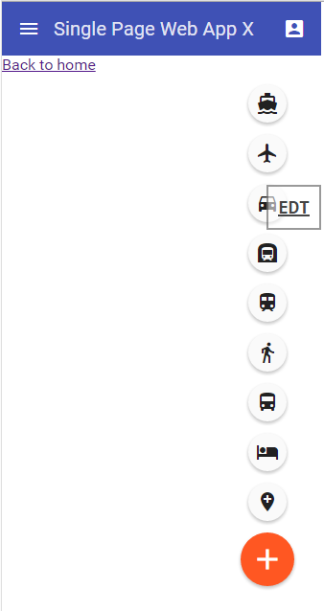
Split an app
Toolbar
content
FAB

Slide 125
Split an app : components
window._app.global_ng_module
.component('toolbar', {
templateUrl: 'toolbar.html'
});
Toolbar.html :
<md-toolbar>
<div class="md-toolbar-tools">
<md-button class="md-icon-button" aria-label="Settings">
<i class="material-icons md-24 md-light">menu</i>
</md-button>
</div>
</md-toolbar>

Slide 126
Angular exercise 2
Using components
npm run dev
Localhost:7000/exercise-02

Slide 127
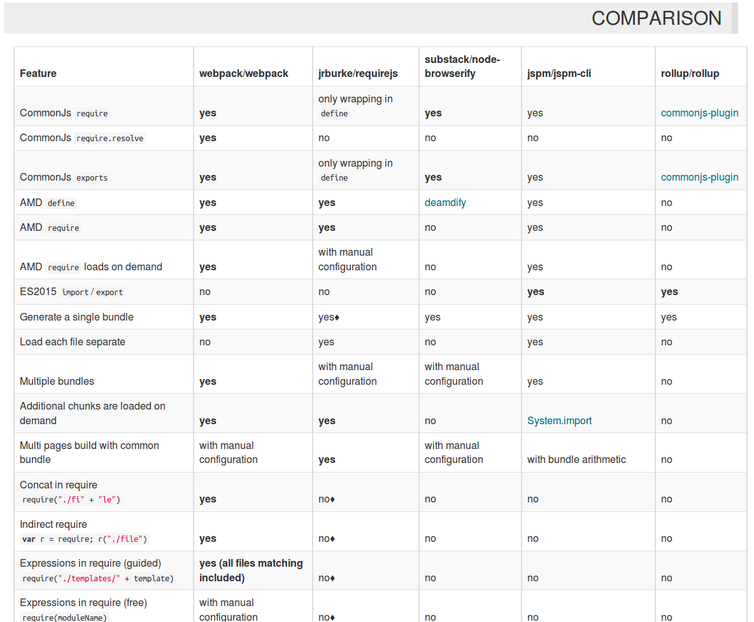
Module loading
Webpack comparison
https://webpack.github.io/docs/comparison.html

Slide 128
Important concepts (4)
Polyfill
Shim

Slide 129
Module loader
Jspm
Bootstraping angular
Angular
Angular material
https://design.google.com/icons/

Slide 130
AngularJS links
Documentation :
guides http://docs.angularjs.org/guide/
API ref http://docs.angularjs.org/api/
wiki github https://github.com/angular/angular.js/wiki/_pages
cheatsheet http://www.cheatography.com/proloser/cheat-sheets/angularjs/
Difference between Service, Factory and Provider in AngularJS https://gist.github.com/Mithrandir0x/3639232

Slide 131
AngularJS Stack
Angular-ui-router
  https://github.com/angular-ui/ui-router
Angular Material
  https://material.angularjs.org/latest/

Slide 132
router
Client routes

Slide 133
$scope
isolated

Slide 134
directives
transclude

Slide 135
Important concepts (5)
Minification
Bundle

Slide 136
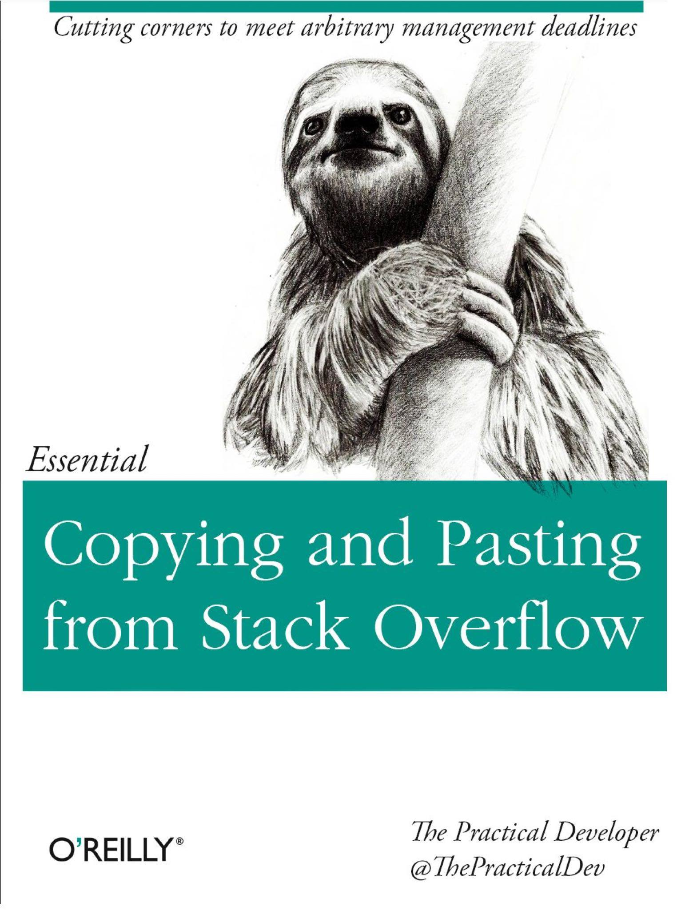

Slide 137
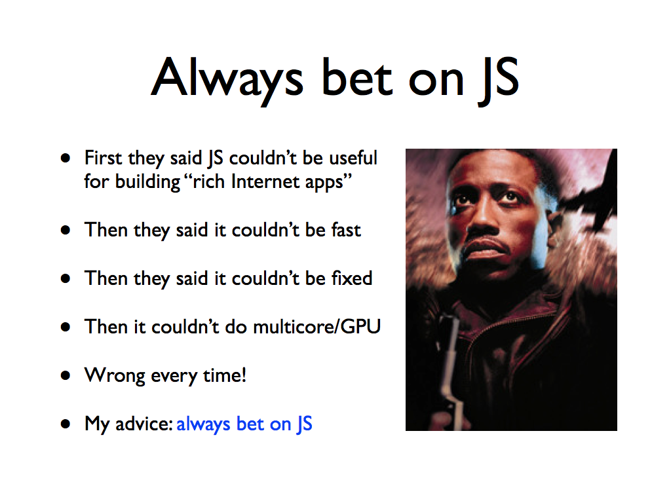

Slide 138
The end

Slide 139
MISC

Slide 140
Dev Skill
5 Principles that will make you a SOLID JavaScript Developer
http://thefullstack.xyz/solid-javascript/
The Difference Between Excellent, Good and Bad JavaScript Developers
http://thefullstack.xyz/excellent-javascript-developer/

Slide 141
Career
[Startups] Reconsider
https://m.signalvnoise.com/reconsider-41adf356857f
What are the growth stages of a programmer ?
https://www.quora.com/What-are-the-growth-stages-of-a-programmer
What are the growth stages of a programmer ?
https://www.quora.com/What-are-the-growth-stages-of-a-programmer
What are the growth stages of a programmer ?
https://www.quora.com/What-are-the-growth-stages-of-a-programmer

Slide 142
Fun
DevOps reactions
http://devopsreactions.tumblr.com/
Dilbert
http://dilbert.com/
CommitStrip
http://www.commitstrip.com/
Les joies du code
https://www.quora.com/What-are-the-growth-stages-of-a-programmer
Les joies du code
http://lesjoiesducode.fr/

Slide 143
TOSORT

Slide 144
Lesson 9
Fetching a public API
Open APIs :
Hacker news https://www.npmjs.com/package/hack-news
Marvel API http://developer.marvel.com/
Starwars API https://swapi.co/
Instagram https://github.com/zzarcon/nodegram
Weather http://openweathermap.org/appid#get

Slide 145
Lesson 5
async (1) : timeouts

Slide 146
Async + exceptions
function find(filter, cb) {
let result;
// look in db.... (async)
if (result) return cb(null, result);
return cb(new Error('Not found !'));
}

Slide 147
Inheritance : prototypal !
const actor = {
say: function(text) {
console.log(this.name + ': ' + text);
}
};
function createActor(name) {
return Object.assign(Object.create(actor), { name });
}
const Alice = createActor('Alice');
const Bob = createActor('Bob');
Common Misconceptions About Inheritance in JavaScript
https://medium.com/javascript-scene/common-misconceptions-about-inheritance-in-javascript-d5d9bab29b0a

Slide 148

Inheritance : prototypal !

Slide 149
Inheritance ?
const actor = {
say: function(text) {
console.log(this.name + ': ' + text);
}
};
function createActor(name) {
return {
name,
say: actor.say
};
}
const Alice = createActor('Alice');

Slide 150
Composition
function say(named, text) {
console.log(named.name + ': ' + text);
}
const Alice = {name: 'Alice'};
const Bob = {name: 'Bob'};
say(Alice, 'I want to tell you a secret');
say(Bob, 'OK but please cipher');

Slide 151
pitch
GAFA
http://pennystocks.la/internet-in-real-time/
http://pennystocks.la/battle-of-internet-giants/

Slide 152
Tooling
http://javascriptplayground.com/blog/2016/02/the-react-webpack-tooling-problem

Slide 153
Security
http://blog.gemnasium.com/post/131740585210/security-one-issue-many-packages

Slide 154
Handy links
DejaVu sans Mono powerline https://github.com/powerline/fonts/tree/master/DejaVuSansMono
Linux
  nvm https://github.com/creationix/nvm
Windows :
  cmder http://cmder.net/
  nvm-windows https://github.com/coreybutler/nvm-windows

