Slide 1














Decoding human brain activity with deep learning
Presented by Epochs Hunters
SUBMITTED BY:
MANEESH PULIDINDI 12241380
ANSHAL KHATRI M24DS002
BYOMAKESH PANDA M24DS004
CHINMAY BAKHALE M24DS005
RAGHAV BORIKAR M24DS010

Slide 2

Problem Statement
Developing a deep learning model to decode and classify visual stimuli from EEG signals and generate corresponding images, overcoming limitations in accuracy and realism in current EEG-based visual reconstructions.

Slide 3
01.
fMRI-based Decoding: Shen et al. and Du et al. demonstrated initial successes using fMRI for visual decoding, yet faced limitations due to cost and temporal constraints​
Previous works
02.
Transition to EEG: With EEG, the PeRCeiVe Lab’s research showed that neural networks could classify visual stimuli but with limitations in image sharpness and fidelity​
03.
Recent Deep Learning Methods: Efforts using VAEs and GANs have shown EEG data can be used for image generation, though with challenges in achieving high visual quality due to noise and spatial resolution constraints in EEG signals​

Slide 4
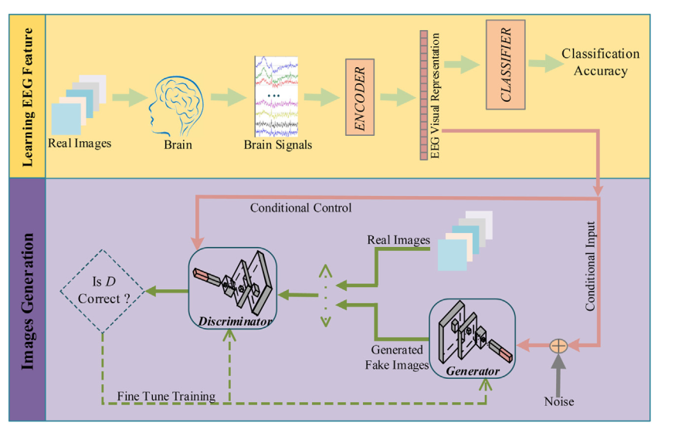
Methodology
EEG Data
outputs of Temporal and Spatial Block
EEG Data
Temporal Block
SpatialBlock
ResidualBlocks
Probabilities and Embeddings

Slide 5
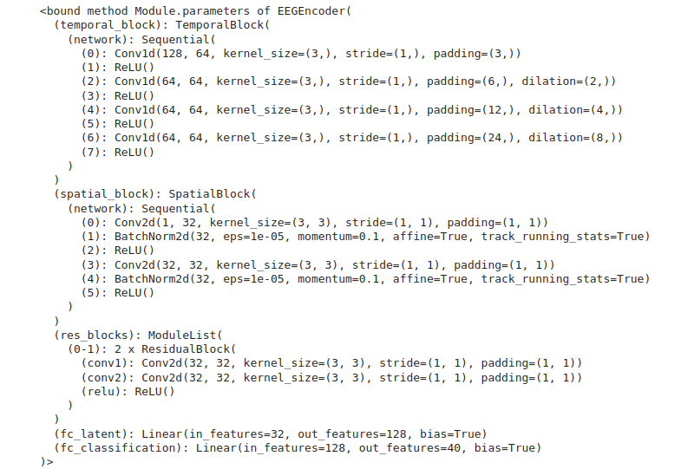
EEG Encoder Classification Model

Slide 6
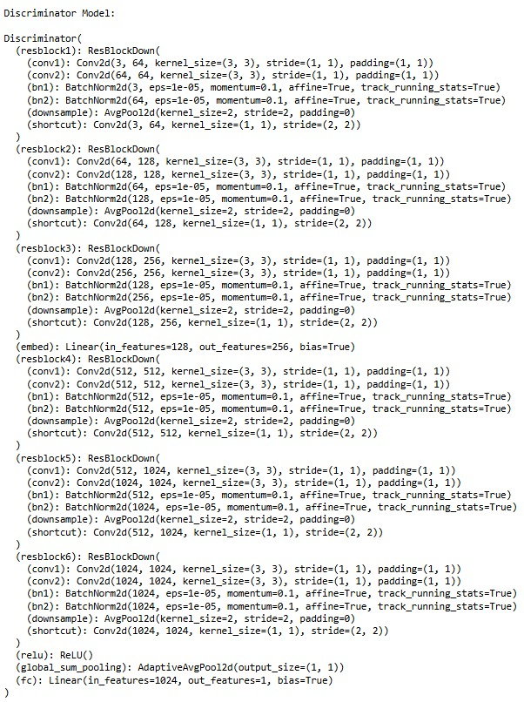
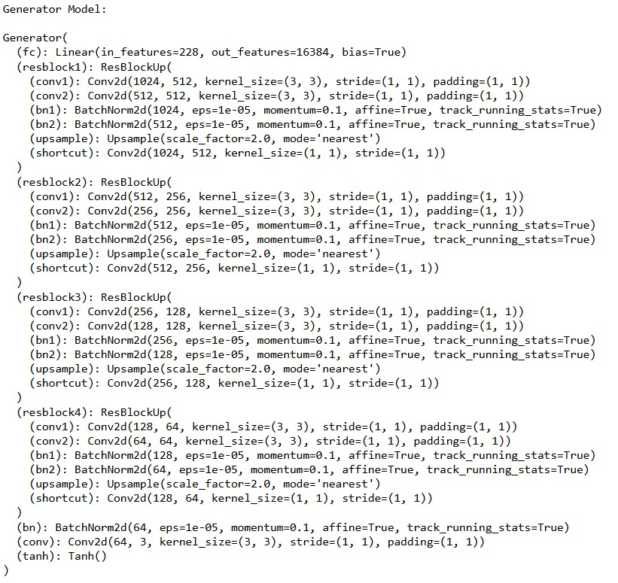
SNGAN Model

Slide 7

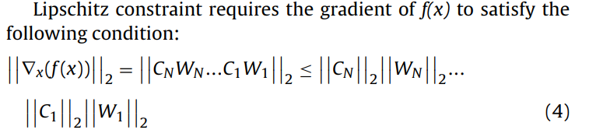


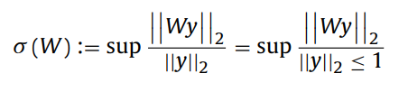
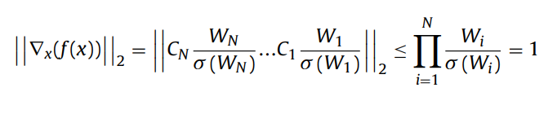
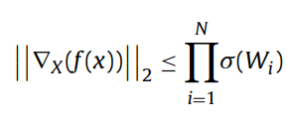
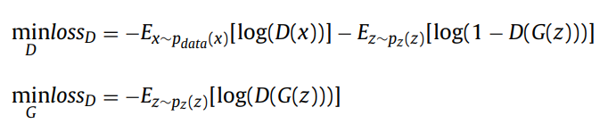
Mathematical Formulations
Loss Functions

Slide 8
Results
Feature Extraction and Classificaion:
Achieved an accuracy of up to 93% after feature extraction and classification improvements, which is at par with the current State of the Art Models. (Achieved in only 60 epochs whereas the models in the research paper took around 200 epochs)
Image Generation:
Attempted various models for image generation, including:
GANs (Generative Adversarial Networks)
Spectrally Normalized GAN
CGANs (Conditional GANs)
State Diffusion Models
Challenges Faced:
The results were not satisfactory, with generated images lacking quality and consistency.
In all of GAN, SNGAN & CGAN models, we found that the weights were not updating properly.
Due to 2 reasons, while using Spectral Normalization, The Discriminator is losing it’s strength & performing poorly. & without spectral normalization, it is getting too confident & it’s training is not in line with the Generator.
Limited time constrained our ability to train more epochs, fine-tune the models or address the stability issues, preventing us from achieving desirable outputs.
Observations with GANs:
GANs require careful balancing between the generator and discriminator; in our case, they may not have been properly synchronized, leading to poor image quality.
Tuning hyperparameters, such as learning rates and batch sizes, could have helped stabilize the training, but time restrictions prevented further experimentation.

Slide 9
Contributions
Maneesh Pulidindi
(12241380)
Anshal Khatri (M24DS002)
Byomakesh Panda (M24DS004)
Chinmay Bakhale (M24DS005)
Raghav Borikar (M24DS010)
Worked on Preprocessing & State Diffusion Models, Fine tuned it, but instead of text, used EEG embeddings.
Bi-LSTM-CNN-GAN was the approach he worked on & created the documentation of the project.
Worked on Simultaneous Generation & Classification using 2 Headed Model using LSTM and GANs.
Also worked on extracting image feature vectors by applying Transfer Learning using ResNet18 model and using it as latent vector for GAN.
Worked on a new approach which uses images to generate latent vector for training GANs.
Improvised the Classification Step & worked on SNGAN with Ready Embeddings fine tuned for each person. This was done to ensure that training time was reduced & more epochs could be run.

Slide 10
Thank you very much!
https://github.com/EpochHunters/ML_Project/tree/main

