Slide 1






EXOVISION
Hunting for Exoplanets with ML
EPOCH DEV - ComV
Dhruv Waghela
Pawan Badsewal
Anujin Aruinbol
Manisha Mani
Deepak Nallamothu
Johnpaul Ajuzie
NASA Hackathon Space Apps

Slide 2
Motivation
Fascination with the possibility of discovering new worlds.
Opportunity to apply AI/ML to a high-impact real-world scientific problem.
Chance to make a tool that can assist astronomers and researchers worldwide.
Fits into the broader vision of exploring habitable planets and advancing space science.

Slide 3


Why hunt for exoplanets:
Identifying habitable-zone planets
Understanding planetary formation
Guiding future exploration
XGBoost Model – trained on NASA’s Kepler dataset
Why Finding Exoplanets Is So Hard
NASA’s Kepler & TESS missions have collected millions of light curves.
Each dip in brightness could be a planet transit — or noise.
Manual analysis is slow and error-prone.
FastAPI Backend : Real-time inference
React – interactive UI
The Solution: ExoVision
ML That Detects Exoplanets in Seconds
ExoVision transforms raw NASA light curve features into instant exoplanet predictions — powered by machine learning and an intuitive web interface.

Slide 4

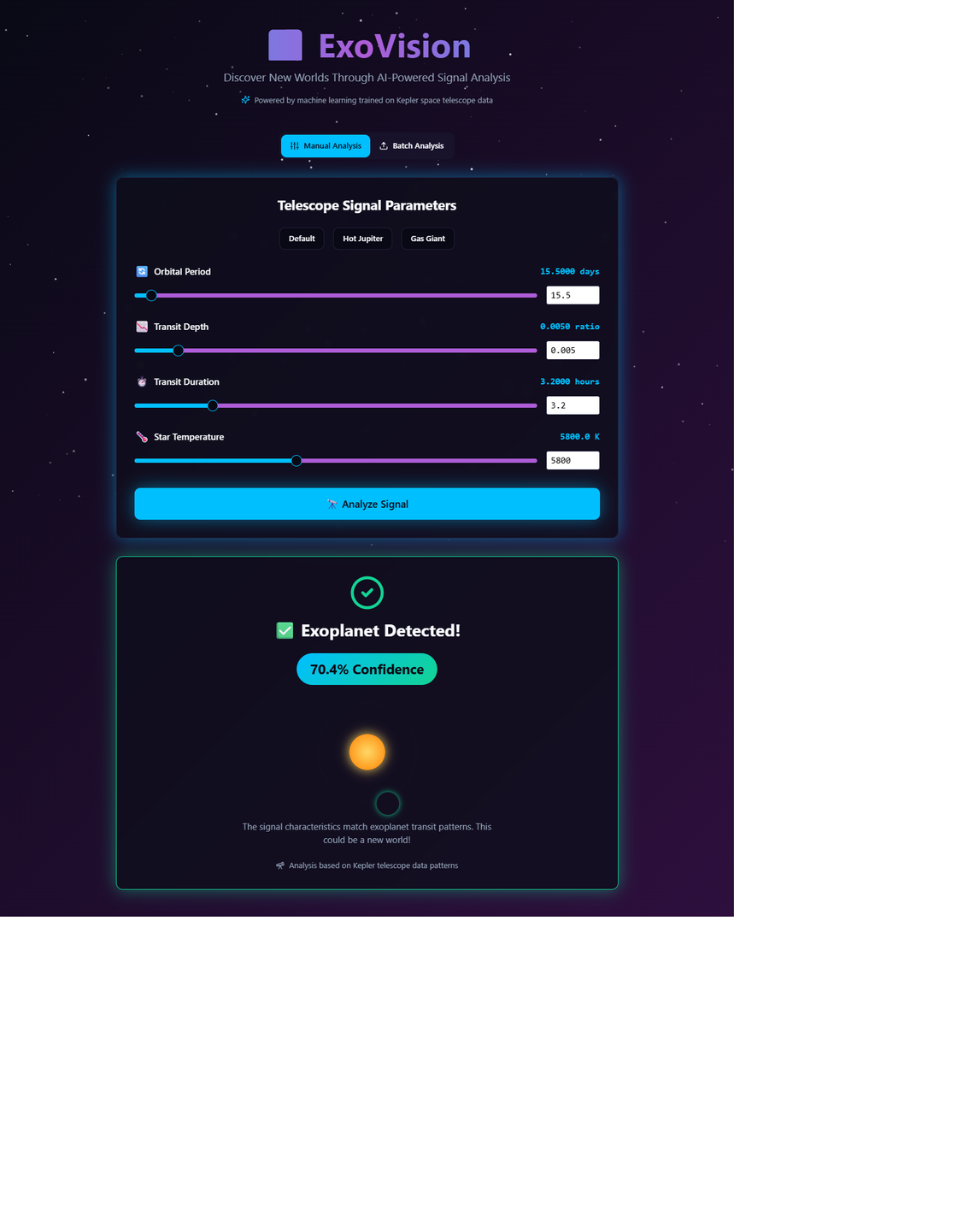

Project Walkthrough
One-off Analysis
Batch analysis
Custom Input
The input from the web UI is sent to a Python script, which processes the data using a machine learning model to classify whether the eco-plant is determined or not
Analysis Result

Slide 5
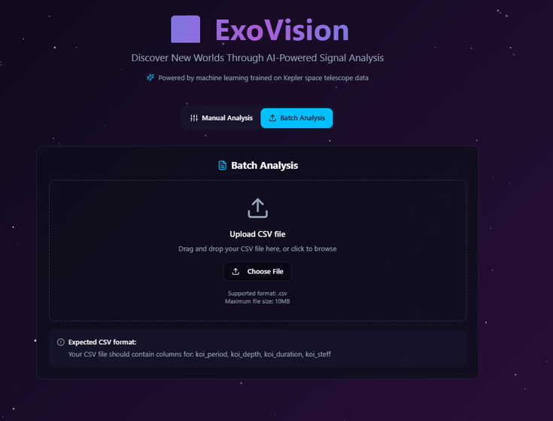
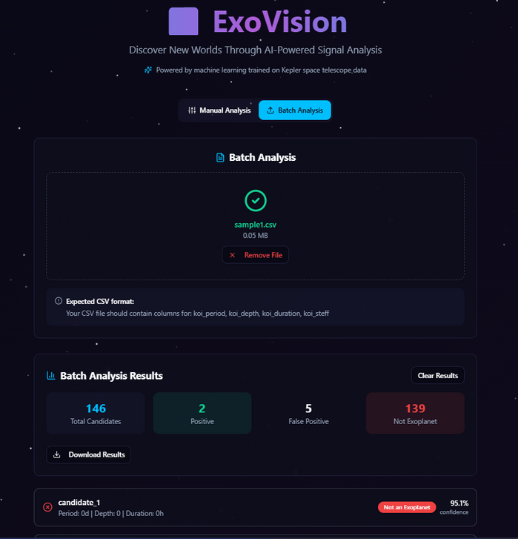
Project Walkthrough
Upload a CSV file for batch processing classify multiple data points at once.
The batch analysis feature allows users to upload data in CSV format. The model processes the uploaded data and automatically provides the results as a downloadable CSV file. Additionally, a summary and detailed results are displayed on the page for quick insights.

Slide 6
Sustainability
Open-Source & Accessible: Built on NASA datasets and open ML libraries, enabling global use without proprietary restrictions.
Resource Efficiency: Automating classification reduces manual labor and repetitive computations.
Using optimized ML models like XGBoost lowers energy consumption compared to heavier models.
Cloud-based batch processing reduces the need for redundant local computations, saving power.
Encourages responsible use of computational resources, minimizing the carbon footprint of large-scale data analysis.
Scientific Advancement: Supports discovery of potentially habitable planets, contributing to the long-term sustainability of scientific exploration.

Slide 7
Upcoming update
Integration of Deep learning: Implementing deep learning for analyzing complex patterns.
Enhanced interactivity with automation: Enable real time model updates as new observations come in. Develop APIs to connect with other telescopic systems.
Global collaboartion: Crowdsourced data can help retrain and improve the model

