Slide 1

Senior Project
By: Ethan Powell

Slide 2

What’s the problem?
In Dungeons and Dragons, everyone involved must keep track of statistics, modifiers, hp values, and more, erasing and re-writing values constantly. The creation of a Dungeons and Dragons utilities tool is necessary to ensure smooth gameplay, relieve stress, and prevent errors when calculating values.

Slide 3
Motivation
I enjoy tabletop role-playing games and have played fifth edition Dungeons and Dragons for nearly 4 years now.
Previous tools I have used never felt quite right, having problems such as:
Difficult interface
Felt Clunky
Lacked functionalities I thought obvious
Paid to use
The desire to create something I felt was my own project
Personal use

Slide 4
Research and Background
Deciding a language
C++?
C#?
Python?
How GUI’s work in these languages
Availability of libraries
C++ is built for more “low-to the ground” applications, offering control
Python is intended for high level projects; is more user friendly
Documentation
Python seems more robust in its library documentation because of the userbase
C++ and C# felt lacking in usability without a strong understanding of many base tools and libraries
Notes:
Benefits and detriments (don’t do a narrative)

Slide 5
Hardware/Software Requirements
Hardware
Software
An intel I3 processor or above (or it’s AMD equivalent)
1GB Ram
Secondary Storage (size depends on amount of data wanting to be stored)
Keyboard for input
A Linux based operating system
Python3
SQLite/SQL Alchemy
Pandas
Orator
Notes:
Spend little time on this

Slide 6
Demo
Notes:
Load from PDF – Test.pdf (MAKE SURE TO SHOW IF PDF CAN’T BE FOUND)
Edit a statistic
View the character
Restart program to show it is saved

Slide 7
Functional Requirements
Allow the storing and loading of character data for later reference
Allow for modification of character data
Allow for the creation of new character data
Allow for the importing of character data from a standardized PDF
Allow for the viewing of character data
Notes:
Spend little time. Note documentation.

Slide 8
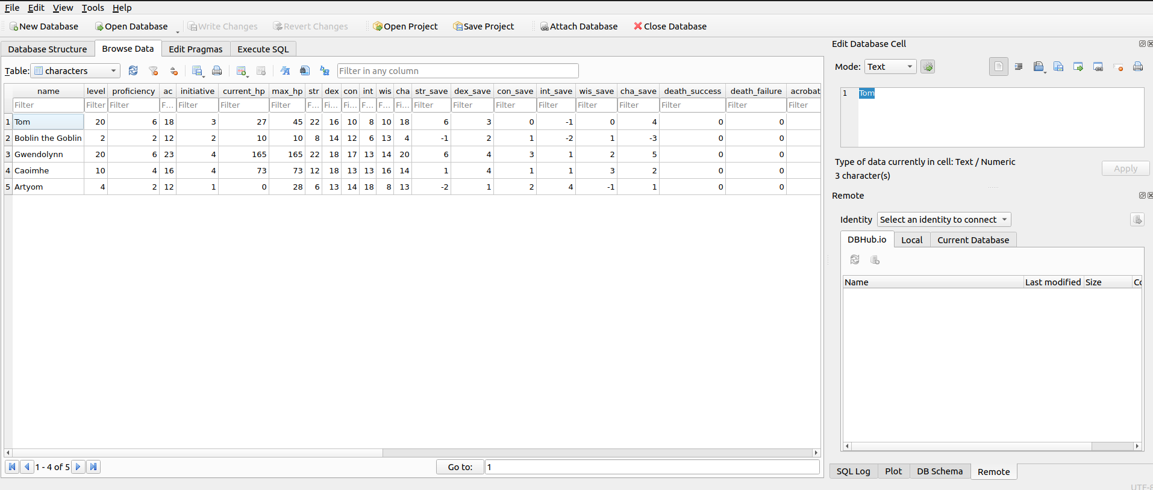
Database
This displays the database functionality, showing stored characters from the program.

Slide 9
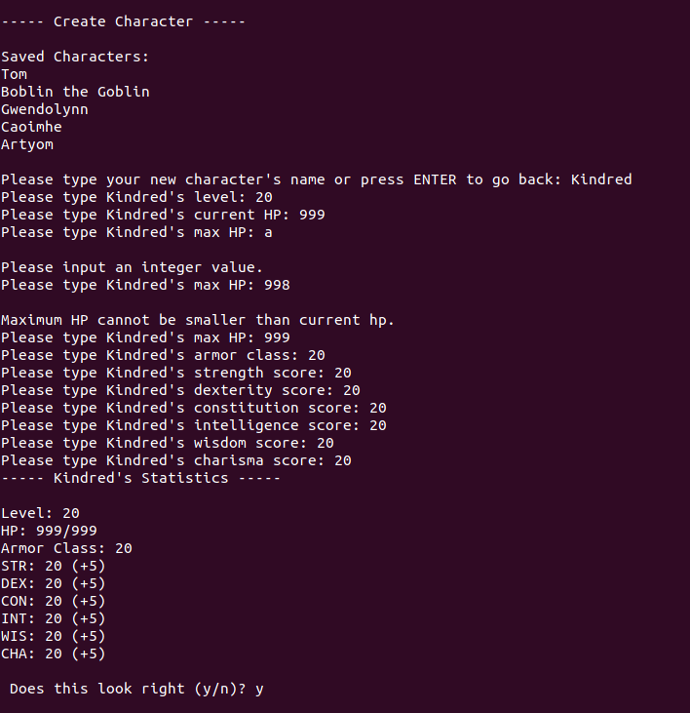
Character Data Creation
This displays the process of character creation with error messages

Slide 10
High-Level Test Plan
Ensure the product can run on the specified hardware without interruption
Ensure each functional requirement is met
Data viewing
Data creation
Data storage
Data editing
Ensure input validation to prevent improper data entry
Ensure integrity of the database

Slide 11
Test Results
Project runtime performance
While running with only 1 thread, no performance issues were detected
Functional requirement testing
Data viewing – The data is displayed accurately and without error
Data creation – The data is created without improper input
Data editing – The data is able to be edited without improper input
Data saving/loading – The data is able to be saved and loaded from the database file
Graphical user interface
No graphical user interface was implemented

Slide 12
Challenges Overcome
Language decisions and implementation method
Interacting with a PDF
Understanding program to database interaction
How to properly write documentation

Slide 13
Challenges Not Overcome
Time constraints and full implementation
Utilizing a fully graphical user interface
Implementing a way to interpret Dungeons and Dragons spells and abilities

Slide 14
Future Enhancements
Implement full functionality
Create a graphical user interface for use with mouse pointer and buttons
Web hosting/mobile app production
Clean and optimize code for functionality and speed

Slide 15
Questions?

