Slide 1
AI for Modern Board Games
Eugene Kramskoi, Mira Jacobs
Mentor: Sean McCulloch

Slide 2
Outline
What are we doing?
We’re building an AI for a board game
Why? Haven’t there been tons of board game AIs?
Notes:
What is the research about?

Slide 3

European Style Board Games are Different
Most Board Game AIs:
Most board game AIs have a relatively simple approach
They usually rely on tree search - just try all the possible moves a few steps ahead
With many European-style games, that approach just isn’t possible
There haven’t been much work done on these kinds of games
Notes:
With a lot of game AIs, such as Chess and Checkers, the general approach is to just try every possible move and pick the best one.
However, with a lot of European style games, this approach just isn’t feasible -- which is the case with the game we’re working on
That’s what this research is about: figuring out interesting ways to do ai when the brute force approach doesn’t work

Slide 4
European Style Board Games
Many of these games are shorter than games like The Game of Life, Monopoly, etc.
These games emphasize player interaction and strategy
There is a lot of hidden information during the game
A well-known example would be Settlers of Catan
There are cooperative games and non-cooperative games

Slide 5
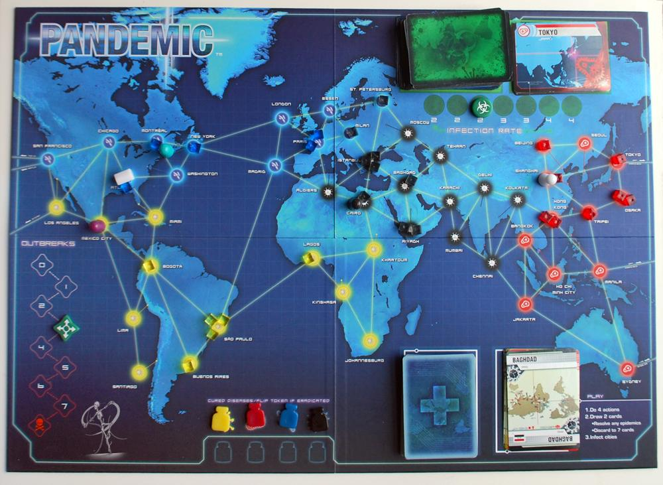
Notes:
This is a coperative game game represents 48 cities

Slide 6
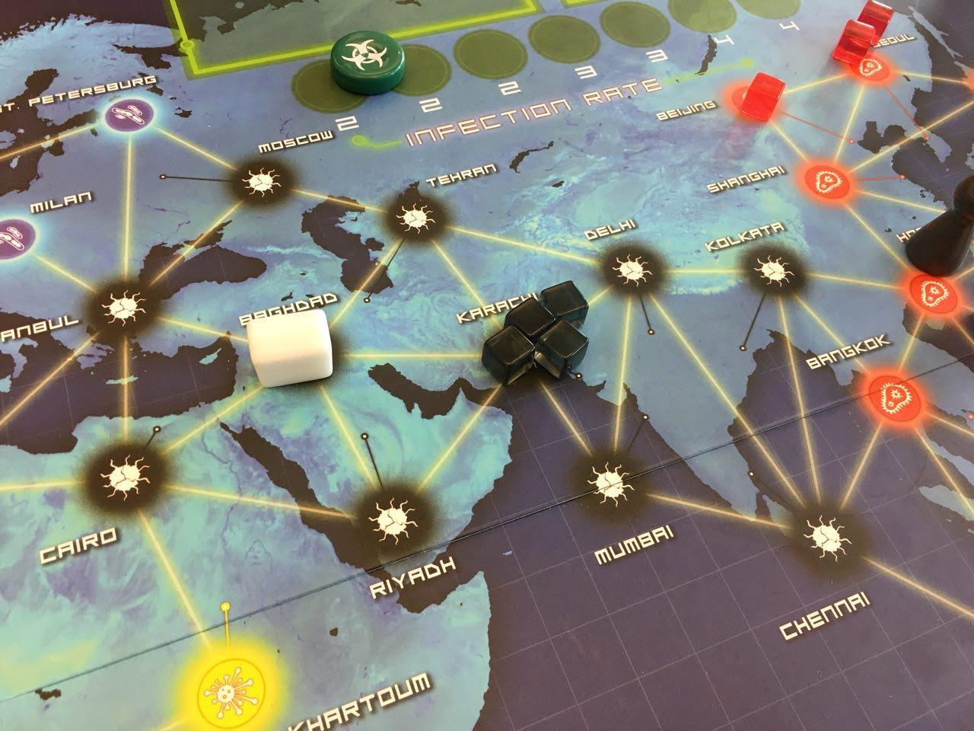
Outbreaks happen after 4 cubes are in a city

Slide 7
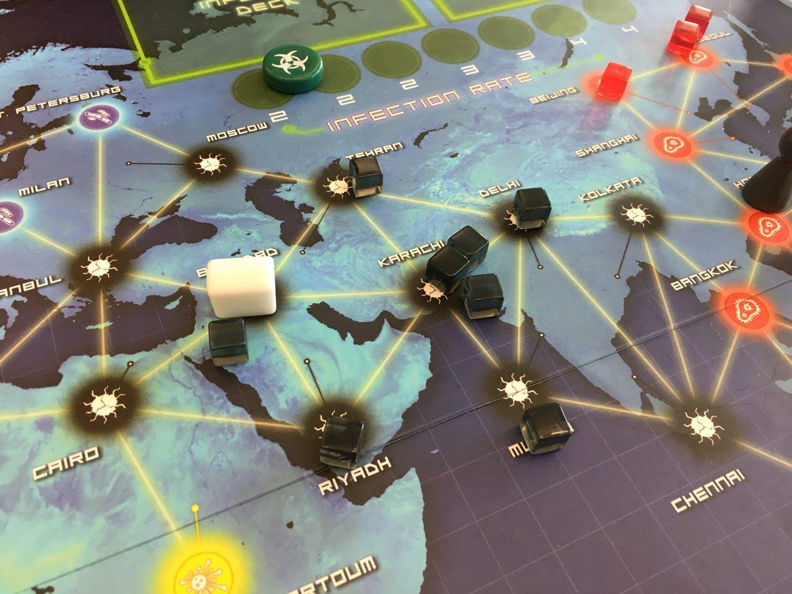
After an outbreak cubes are added to every adjacent city
Notes:
Push back diseases of the cities but still trying to cure them at the same time they are constantly being infected
Talk about reshuffling!

Slide 8
Pandemic
Cooperative game where players work to beat the game
The goal of the game is to cure all four diseases and prevent outbreaks
There are different ways of losing
A. Outbreaks reaches 8
B. Running out of cubes
C. Running out of player Cards
There are 48 cities with cubes to represent infections

Slide 9
Epidemic Card
There are 6 Epidemic cards in the player deck that add 3 cubes to the city pulled from the infection deck
Once an epidemic card is pulled the discard pile is shuffled and put on top of the infection deck
Cities in the discard pile have a high chance of outbreaking because of this
The infection rate is increased (determines how many cards are pulled)
Notes:
One of the things that make outbreaks hard to deal with is epidemic card...

Slide 10
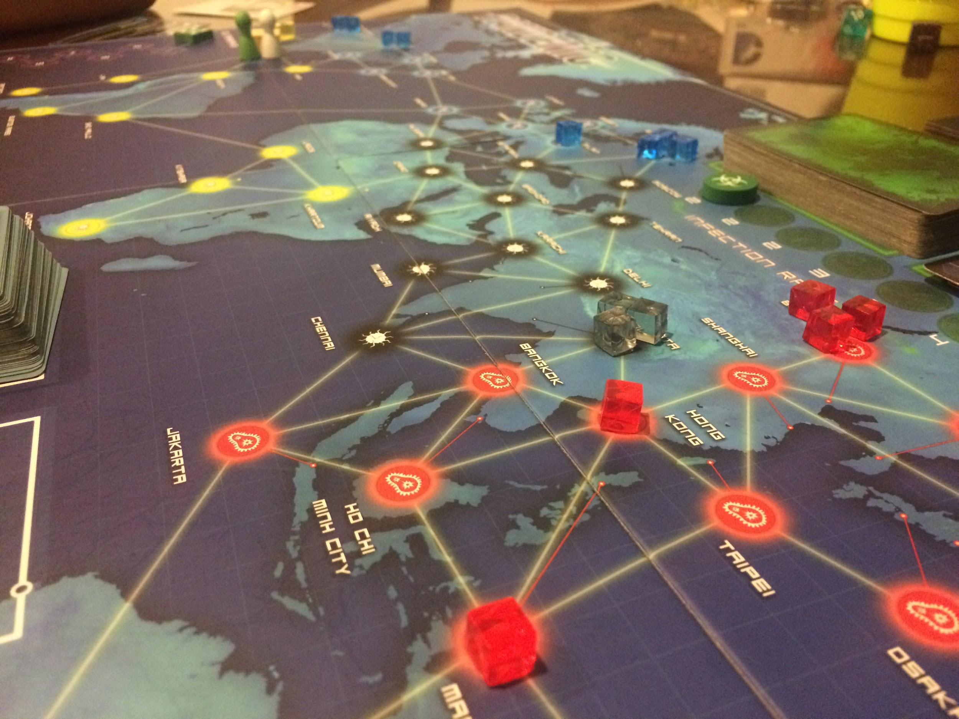
Players have 4 actions every turn
Actions are used to treat cubes, share player cards, and move about the board
A player has to have 5 cards of one color to cure a disease
During the game you can set up research stations at cities to make it easier to move around

Slide 11
Types of Actions
Some actions help the players win:
Trading cards
Curing diseases
Some actions delay outbreaks:
Treating diseases
Moving towards congested areas
Every turn players are trying to balance both types of actions

Slide 12
Why the normal approach to AI won’t work
There are way too many moves to consider
There are over 40 cities, each with many possible actions to do there
A player has 4 actions per turn
Chess has only 30 to 40 possible moves per turn
Go is around 250 possible moves per turn
Pandemic has around 10,000 possible moves per turn
Too much random chance involved
Which cards we draw can completely change the optimal move
We need to be able to predict possible outbreaks

Slide 13
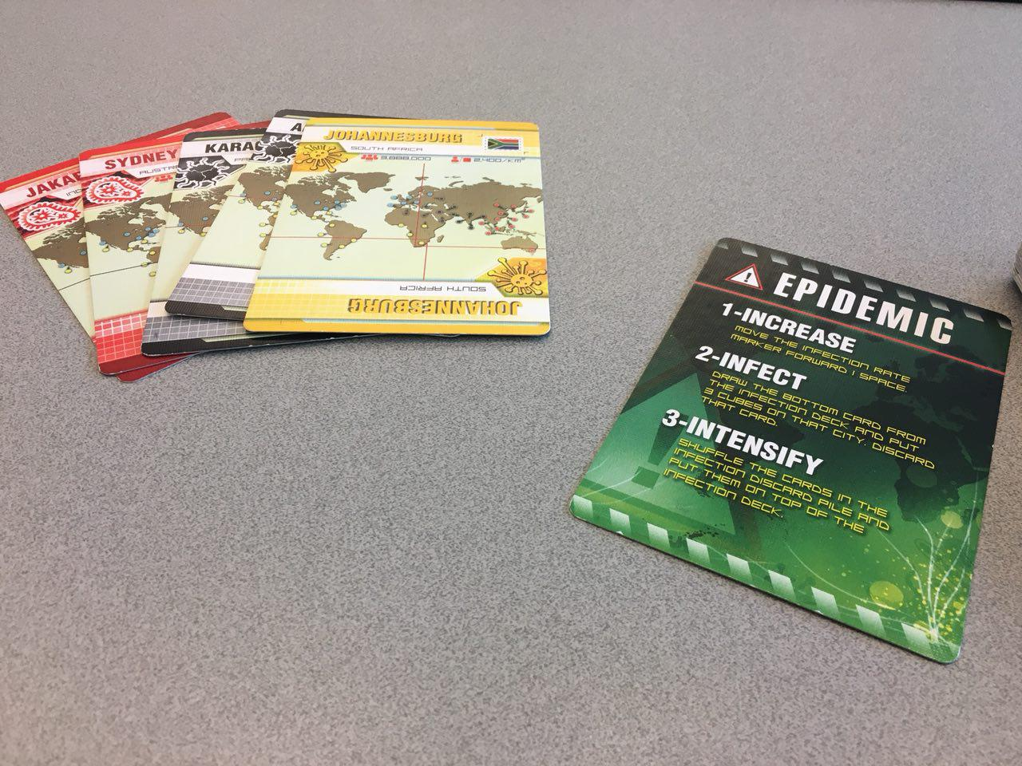
General Approach for the AI
Step 1: Abstract the moves into Plans
Instead of:
“Drive from Chennai to Mumbai”
“Give the Mumbai card to Player 2”
We can combine several moves into plans such as:
“Get to Lima and treat the disease there”
“Trade with all the players to get 5 red cards”
This way, there are much less branches to consider
Notes:
Instead of looking at each possible city and action, we think of abstract moves, such as “Go to Lima and treat a cube” or “trade with player 2 to get 5 red cards”
Rather than “drive from Chennai to Mumbai” and “give the mumbai card to player 2”

Slide 14
General Approach for the AI
Step 2: Rate each abstract plan
Time to lose:
How many actions until we lose the game?
Time to win:
How many actions until we win the game?
From all our abstract plans, pick the one that:
Minimizes time to win while at the same time,
Keeps time to lose large
Notes:
What we do is we generate a bunch of possible abstract plans and and then pick the best ones.
So we need to be able to somehow rate each possible move on how good it is.
We use this
With this information for each move, we want to pick the one that..

Slide 15
How do we balance TTW and TTL?
Two main cases:
All the plans have TTW > TTL
We’re doomed
Just pick the one with the smallest New TTW - New TTL and hope for the best
2) At least one plan has TTW < TTL
One of the plans predicts that we win before we lose
Pick the one with the largest cushion: New TTL - New TTW

Slide 16
How do we get the TTL?
For time to lose, we use simulation:
We simulate the game and count how many turns it is till we lose if we didn’t do anything
Simulate new turns until we lose
Run the simulation a few hundred times and average out the result
For each turn:
We do the simulation before and after completing the plan to see what the TTL delta of that plan is

Slide 17
How do we get the TTW?
TTW is based upon how long it takes to cure all of the diseases
In order to cure the disease you have to:
Have 5 cards of a color in a player’s hand
Meet and exchange these cards with players
Go to a research station
The previous can be thought of as individual plans that we use for estimates
Notes:
Which might mean having to exchange cards with other players

Slide 18
Current Progress
We built a program that enforces the rules of the game:
Supports a combination of both human and AI players
Can do everything that you can do in the physical game
We also have:
We have a time to lose simulation
We can calculate time to win with a discover cure simulation
As well as...

Slide 19
Current Tools
We built a set of tools that help the players (AI and human) to make decisions:
A tool that figures out the shortest path from A to B, with or without using cards to fast-travel
A tool that calculates the probability of drawing a certain Infection card
A tool that calculates the probability of drawing a certain Player card
A tool that calculates the probability of drawing an Epidemic Card
Probabilities are really complex because of the Epidemic shuffle-back mechanic
A lot these are used in TTW and TTL calculations

Slide 20
This is hard; Pity me
The infection deck has a discard pile
After drawing an Epidemic card, the discard pile gets shuffled and then put back on top of the normal deck
This makes calculating the chance of drawing a certain infection card annoying

Slide 21
Current AI
We have an AI for treating cubes, and we’re working on adding more types of plans
The AI will go around and treat cities that have a lot of cubes or that are likely to be infected
Relies on time to lose
We’re currently trying to add:
More possible plans, such as trading and curing
Other plans that rely on TTW
Just added Curing!

Slide 22
Curing Diseases!
This plan is only available only certain conditions
When one player has 5 cards in their hand of the same color
We calculate a new TTW and compare this to our old TTW
It produces a plan that gives the path to the closest research station and what color to cure

Slide 23
Thank you!!!

