Slide 1
COMP3888_M17_03_ZL | Project 31
Longitudinal PET/CT Lesion Quantification and Treatment
Team members
Qiang Li
SID: 540788868
Unikey: qili0179
Linkang Wen
SID: 540276619
Unikey: lwen0131
Week 4 Project Proposal & Roles Allocation
Yuqi Wu
SID: 540035669
Unikey: yuwu0501
Client: Zilin Zhang
Tutor: Zhenlin Liu
Tutorial: M17(5:00-7:00)
Submission date: 23 Aug 2026
Haoxiong Pan
SID: 530425128
Unikey: hpan0285
1
Notes:
Good morning everyone. Our project is Project 31,Longitudinal PET/CT Lesion Quantification and Treatment.
Our team members are Qiang Li, Linkang Wen, Yuqi Wu, and Haoxiong Pan.

Slide 2
Project proposal
The problem is longitudinal review, not segmentation
PSMA PET/CT can show PSMA-positive lesions related to prostate cancer across the body. When a patient has multiple scans, researchers need a clear way to compare lesion burden and activity over time.
Users
Researchers and supervisors reviewing longitudinal imaging results.
Need
A reproducible way to measure, validate, match, and summarise lesions.
Manual review becomes harder when lesions are numerous, appear in different regions, or change in different directions.
Guardrail
Research review only. No clinical diagnosis or treatment advice.
2
Notes:
This project focuses on PSMA PET/CT scans. These scans are often used for prostate cancer related imaging. They can show PSMA-positive lesions in different parts of the body, such as bone, organs, or soft tissue.
The problem is that one patient may have many lesions. These lesions may not all change in the same way over time. Some lesions may become smaller. Some may grow. Some may disappear. New lesions may also appear.
Because of this, manual review can be difficult and slow. A simple total number may not show the full picture.

Slide 3
Project proposal
The aim is a reproducible research review tool
SMART objectives
Aim
• Identify patients with two or more scans.
Build a Python pipeline and Streamlit dashboard to measure and review lesion changes between baseline and follow-up PET/CT scans.
• Extract volume, SUVmax, SUVmean, centroid, and region.
• Match likely corresponding lesions across scans.
• Calculate lesion and patient level change metrics.
• Present results through a clear dashboard and report.
3
Notes:
Our aim is to build a research review tool. The tool will help users measure and compare lesions between a baseline scan and a follow-up scan.
The project will not train a new segmentation model. It will use existing lesion masks from the datasets. This makes the project more focused and realistic.
Our main objectives are: first, identify patients with two scans. Second, extract lesion features such as volume, SUVmax, SUVmean, centroid, and region. Third, match lesions across scans. Fourth, calculate changes. Finally, show the results in a Streamlit dashboard.
Now Yuqi will explain our project scope and data plan.

Slide 4
Project proposal
The scope keeps the project feasible
In scope
Out of scope
• Data indexing and cohort selection
• Training a new segmentation model
• Feature extraction from existing masks
• Autonomous clinical response classification
• Basic rigid alignment
• Treatment recommendations
• Transparent lesion matching
• Complex deformable registration
• Plots, dashboard, and technical report
• Forced detailed lymph-node labelling
4
Notes:
Thank you, Linkang.
Our project scope is clear and limited. In scope, we will do data indexing, lesion feature extraction, basic image alignment, lesion matching, change analysis, visualisation, dashboard development, and the final report.
There are also things that are out of scope. We will not train a new segmentation model. We will not provide clinical diagnosis. We will not give treatment recommendations. We will also not do complex deformable registration, because that would make the project too large for this semester.

Slide 5
Project proposal
The technical solution is transparent by design
Data
Features
Alignment
Matching
Analysis
Dashboard
->
->
->
->
->
Parse patient and scan date
Volume and SUV metrics
Rigid PET/CT alignment
Region, distance, overlap
Change and heterogeneity
Review and summary
Why this approach fits the project
• It uses existing masks, so the work focuses on quantification and review.
• Matching rules are interpretable and can be explained during assessment.
• The dashboard makes progress visible to the client and teaching team.
5
Notes:
Our technical solution is designed to be transparent. The workflow starts with data preparation. We parse patient information and scan dates, then load the PET/CT scans and existing lesion masks.
After that, we extract lesion features, including volume and SUV measurements. Then we align the baseline and follow-up PET/CT scans.
After alignment, lesions are matched based on anatomical region, distance, and overlap. The matched results are then used for change and heterogeneity analysis, and finally displayed on the dashboard.
This approach uses existing masks, keeps the matching rules interpretable, and makes the results easy for the client and teaching team to review.

Slide 6
Project proposal
Two cohorts make the matching plan stronger
Cohort A: calibration
Cohort B: target analysis
autoPET-IV Task 2 Longitudinal-CT
autoPET-III PSMA subset
• Expert BL-FU lesion correspondence
• PET/CT scans already in SUV units
• Used to test matcher precision and recall
• Provided lesion masks for each scan
• Freezes matching parameters before deployment
• Patient pairs recovered from hash and date
Development starts with 10-15 cases, then scales after registration and matching are stable.
6
Notes:
We will use two cohorts. Cohort A is from autoPET-IV Task 2 Longitudinal-CT. This cohort has expert-confirmed lesion correspondence. We will use it to test and validate our lesion matching method.
Cohort B is the autoPET-III PSMA subset. This is our main target dataset. It includes PET/CT scans, SUV images, and lesion masks. We will recover patient pairs by using patient hash and scan date.
To reduce risk, we will start with about 10 to 15 cases. Once the pipeline is stable, we can apply it to more cases.
Next, Haoxiong will explain the lesion matching method and how we measure success.

Slide 7
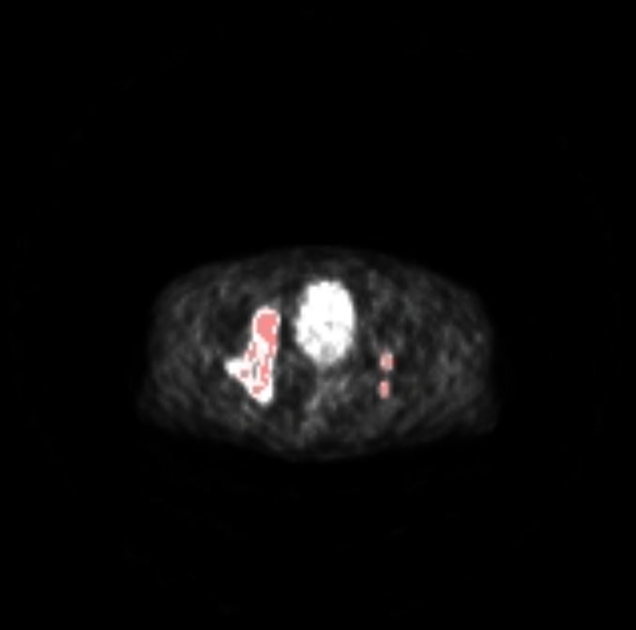
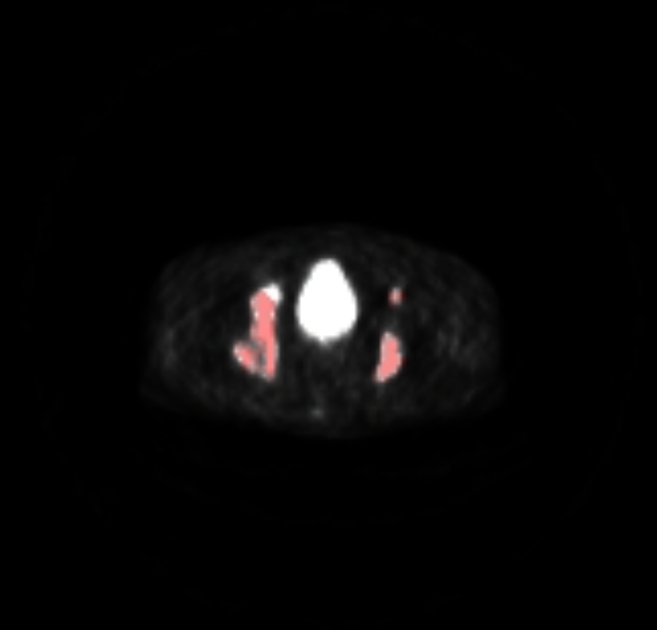
Project proposal
Lesion matching turns scans into trajectories
Baseline scan
Follow-up scan
Matching rules
1. Same broad region
2. Short centroid distance
3. Mask overlap after alignment
Labels: persistent, newly detected, no longer detected
7
Notes:
Thank you, Yuqi.
The main algorithmic part of this project is lesion matching. This means we try to decide whether a lesion in the baseline scan is the same lesion in the follow-up scan.
This is not always easy. A lesion may move slightly because the patient position is different. A lesion may grow, shrink, split, or disappear. New lesions may also appear.
To keep the method clear, we will use simple rules. First, we compare broad anatomical region. For example, a bone lesion should be matched with another likely bone lesion.
Second, we use centroid distance. The centroid is the centre point of a lesion. If two lesions are close after alignment, they are more likely to match.
Third, we use mask overlap after rigid alignment. If the baseline lesion and follow-up lesion overlap in space, this gives stronger evidence.
Using these rules, each lesion can be labelled. If a baseline lesion matches a follow-up lesion, it is called persistent. If a follow-up lesion has no baseline match, it is newly detected. If a baseline lesion has no follow-up match, it is no longer detected.
These labels are descriptive only. They are not clinical conclusions.

Slide 8
Project proposal
Success is measured by usable outputs
Deliverables
Success criteria
• Reproducible Python pipeline
• Processes selected multi-timepoint patients
• Lesion and patient CSV tables
• Produces clear lesion and patient summaries
• Matching and change outputs
• Shows plots and matched lesions
• Waterfall and region-level plots
• Includes tests and validation checks
• Streamlit dashboard and final report
• States research-only guardrails
8
Notes:
Success will be measured by clear outputs. We will produce a reproducible Python pipeline, lesion-level tables, patient-level summary tables, matching results, waterfall plots, region-level plots, a Streamlit dashboard, and a final report.

Slide 9
Project proposal
The schedule follows the course assessment checkpoints
1
2
3
4
5
6
7
8
9
10
11
12
13
Scope & proposal
Data and image prototype
Features and matching
Dashboard prototype
Validation and refinement
Final delivery and report
Key class checkpoints: proposal in Week 3, progress demo in Week 7, client deployment around Week 8, final delivery in Week 12, final report and demo in Week 13.
9
Notes:
Our schedule follows the course timeline. In Weeks 1 to 3, we work on project scope and proposal. In Weeks 3 to 5, we work on data and image loading. In Weeks 5 to 7, we work on feature extraction and matching. In Weeks 8 to 10, we develop the dashboard and improve the analysis. In Weeks 11 to 13, we finalise the product, report, and demo.
Now Qiang will explain our team roles, risks, and final plan.

Slide 10
Project proposal
Roles are allocated around the pipeline
Linkang Wen
Project / Data Lead
Yuqi Wu
Imaging Lead
Timeline, meetings, scan manifest, dashboard integration.
PET/CT loading, mask checks, overlays, dashboard support.
Qiang Li
Feature / Metrics Lead
Haoxiong Pan
Algorithm / Evaluation Lead
Volume, SUV, centroid, region, patient summaries.
Lesion matching, parameter testing, validation metrics.
Each role has a lead, but implementation and testing will be reviewed by at least one other member.
10
Notes:
Linkang is the Project and Data Lead. He will manage the timeline, meetings, scan manifest, and dashboard integration.
Yuqi is the Imaging Lead. he will work on (PET/CT) image loading, mask checking, image overlays, and dashboard support.
I am the Feature and Metrics Lead. My main responsibility is to extract and analyse key lesion features, I will also create patient-level summaries to clearly present changes over time.
Haoxiong is the Algorithm and Evaluation Lead. He will work on lesion matching, parameter testing, and validation metrics.
And we will review each other’s work.

Slide 11
Project proposal
The main risks are known early
Risk 1
Dataset pairing
Confirm hash and date parsing in the first data audit.
Risk 2
Large image files
Start with 10-15 cases and cache intermediate CSVs.
Risk 3
Image alignment quality
Use rigid alignment plus distance and region rules.
Risk 4
Matching uncertainty
Validate on autoPET-IV before applying to PSMA cases.
Risk 5
Dashboard workload
Prioritise tables and plots before advanced viewers.
Feedback requested: Are the matching rules and success criteria appropriate for a first client demo?
11
Notes:
There are several risks in this project.
1. The first risk is dataset pairing. We need to correctly parse patient hash and scan date. We will check this early.
2. The second risk is large image files. Medical images can take a lot of space and time to process. We will start with 10 to 15 cases and save intermediate results.
3. The third risk is image alignment quality. Rigid alignment may not be perfect. To reduce this risk, we will combine alignment with region and distance rules.
4. The fourth risk is matching uncertainty. Lesion matching may be difficult when lesions split or disappear. We will test the method on autoPET-IV before applying it to the PSMA cohort.
5. The last risk is dashboard workload. If time is limited, we will first build tables and plots, then add more advanced image viewers.
To conclude, our project is feasible because it uses existing lesion masks and established Python tools. The main value is a clear and reproducible way to measure, match, and review lesion changes over time.

Slide 12
Project proposal
References used for the proposal
1. autoPET III Grand Challenge. https://autopet-iii.grand-challenge.org/
2. autoPET IV Grand Challenge. https://autopet-iv.grand-challenge.org/
3. TCIA PSMA-PET-CT-Lesions collection. https://www.cancerimagingarchive.net/collection/psma-pet-ct-lesions/
4. autoPET-III PSMA-FDG-PET-CT-Lesions v3. https://fdat.uni-tuebingen.de/records/rdkqd-wdh87
5. autoPET-IV Task 2 Longitudinal-CT. https://fdat.uni-tuebingen.de/records/75kj1-64747
6. SimpleITK documentation. https://simpleitk.org/
7. Streamlit documentation. https://docs.streamlit.io/
Internal course sources: P31 project brief, W3 scope template, and Week 4 presentation marking sheet.
12

Slide 13
Prepared for discussion
Questions
Project proposal, scope, roles, and next two-week implementation plan
13
Notes:
Thank you. We are happy to answer questions.

