Slide 1
COMP3888_M17_03_ZL | Project 31 | Client Deployment Demo
Longitudinal PET/CT Lesion Quantification and Treatment
Team members
Qiang Li
SID: 540788868
Unikey: qili0179
Linkang Wen
SID: 540276619
Unikey: lwen0131
Client: Zilin Zhang
Tutor: Zhenlin Liu
Tutorial: M17(17:00-19:00)
Submission date: 10 Sep 2026
Yuqi Wu
SID: 540035669
Unikey: yuwu0501
Haoxiong Pan
SID: 530425128
Unikey: hpan0285
Notes:
Hi everyone. We are team P31, and our project is a longitudinal PET/CT lesion tracking prototype. In the next eight minutes, we will explain the problem, our system design, the current pipeline, and the main results. After that, our recorded demo will show the prototype running on real data.

Slide 2
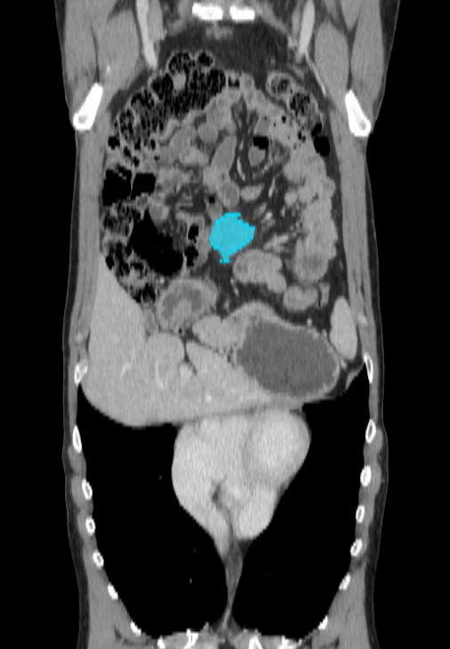
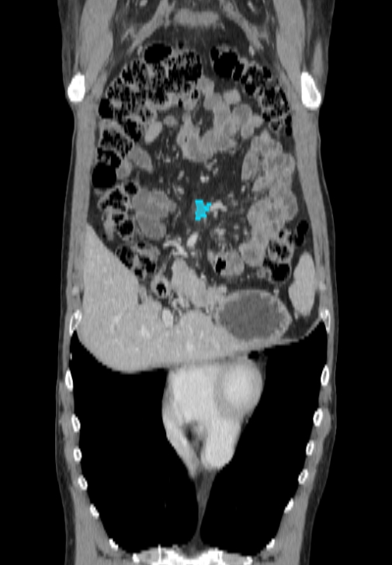
What you can use today
A working prototype for end-to-end research review of longitudinal lesions.
Organise
Align
Track
Review
BL/FU scan pairs, masks, and references are loaded through reproducible manifests.
Baseline imaging and masks are mapped into follow-up space for fair comparison.
Candidate costs and min-cost flow produce explicit lesion correspondence outputs.
Dashboard shows images, masks, matches, evaluation, and patient summaries.
Client-facing value
one launch path for the demo workflow
transparent intermediate outputs, not a black box
clear patient-level results and limitations
same viewer supports CT/PET and three anatomical planes
BL
FU
Notes:
Speaker: Y
This slide is client-oriented. Avoid detailed implementation; focus on what is usable today.
Mention that the prototype is not a diagnostic system, but it can support research review and inspection.

Slide 3
Delivered user stories and acceptance evidence
Each item maps to a visible result in the prototype or a reproducible output file.
User story
Acceptance result
Live / file evidence
Data setup
BL/FU CT, PET where available, masks, and references are discoverable through manifests.
selected_pairs_11.csv; scan manifest; launcher paths
Alignment
Registered BL and FU are compared in a shared follow-up coordinate space.
Original BL / Registered BL / FU viewer
Multiplanar review
CT/PET and masks can be viewed in axial, coronal, and sagittal planes.
slice sliders + physical aspect correction
Lesion matching
Matched, merging, new, and disappearing events are reported explicitly.
lesion_matches.csv; correspondence table
Evaluation & summary
When expert GT exists, accuracy and per-patient summaries are shown.
tracking summary cards; subset summary
Deployment goal: demonstrate the functional workflow, then collect client feedback on polish, usability, and remaining reliability priorities.
Notes:
Speaker: Y
Walk through the user stories quickly. Do not read every cell.
Emphasise that each story has acceptance evidence either in the live dashboard or in generated files.

Slide 4
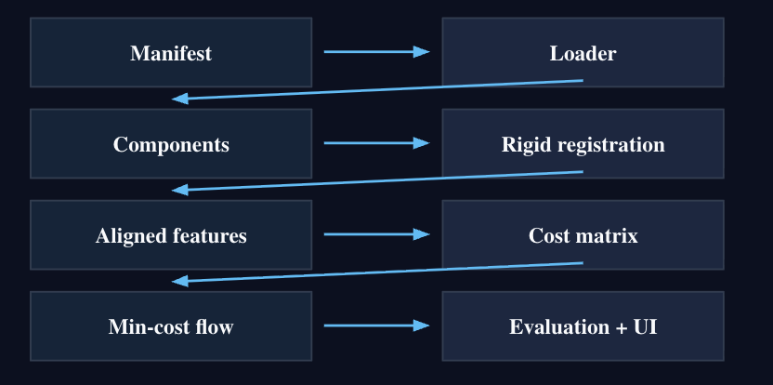
How the delivered workflow fits together
A modular pipeline makes each stage inspectable and reusable.
Manifest
patient pair table
Loader
NIfTI + metadata
Components
individual lesions
Rigid registration
BL → FU space
Aligned features
centroid + volume
Cost matrix
candidate pairs
What the client gets
repeatable demo launcher
intermediate CSVs for audit/debugging
dashboard separated from processing modules
Min-cost flow
global matching
Evaluation + UI
review + summary
Notes:
Speaker: L
Explain the architecture at a high level: data preparation, registration, features, matching, evaluation, dashboard.
Client point: modular structure makes it easier to verify and polish rather than being a black box.

Slide 5
Deployment setup: one repeatable demo path
The latest launcher reduces manual configuration and prevents common setup errors.
Demo launch command
Live deployment checklist
PowerShell: .\run_demo.ps1 -Cohort A -Patients 2 -Mode dashboard
✓
Data root
Cohort A/B folder present
auto-fills dashboard paths
detects Cohort A vs Cohort B
reuses generated outputs for demo mode
prevents non-ASCII path problems on Windows
✓
Generated files
matches, features, costs, summary
✓
Dashboard
paths auto-filled
✓
Client review
live test + feedback
Acceptance: client can reproduce the same two-patient workflow without manually typing every CSV path into the UI.
Notes:
Speaker: L
Client focus: the launcher is a deployment aid. It reduces setup friction and path mistakes.
Mention that it supports demo mode so the live presentation does not wait for registration during the meeting.

Slide 6
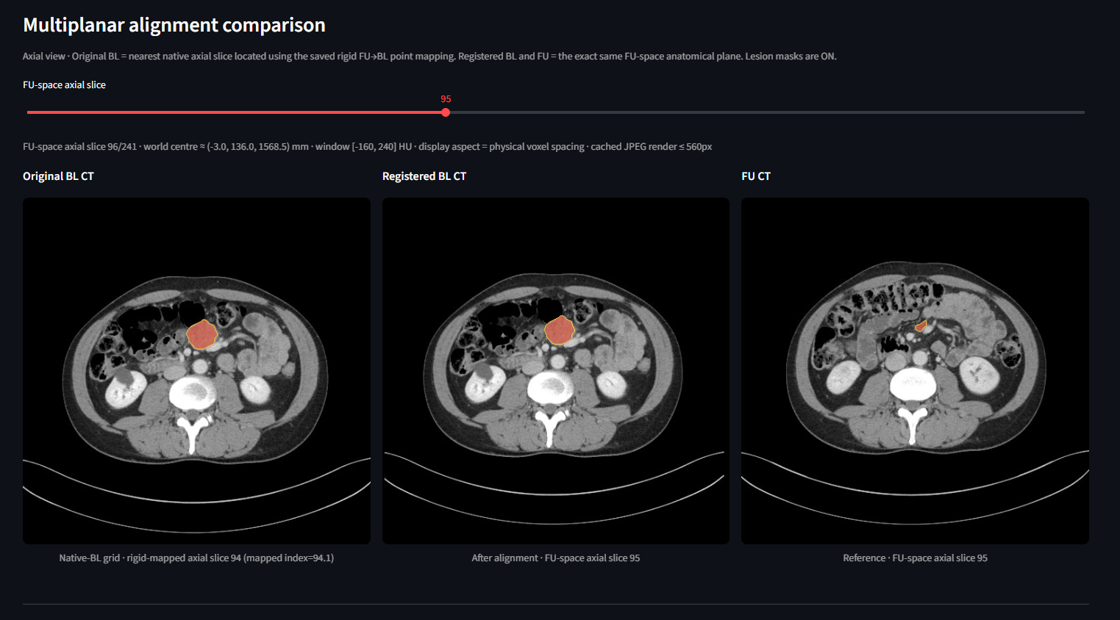
Result: interactive scan review
Original BL, registered BL, and FU can be inspected side by side with masks.
Accepted viewer capabilities
Original BL, registered BL, and FU panels
CT and PET modes when data is available
lesion-mask overlays
axial, coronal, sagittal slice sliders
physical aspect-ratio correction
cached slice rendering for responsive review
Live test: toggle masks and move through each plane.
Notes:
Speaker: H
Explain what will be shown in the live demo: axial, coronal, sagittal; masks; CT/PET if available.
Client point: this is the main review interface, and it now responds quickly on real Cohort A data.

Slide 7
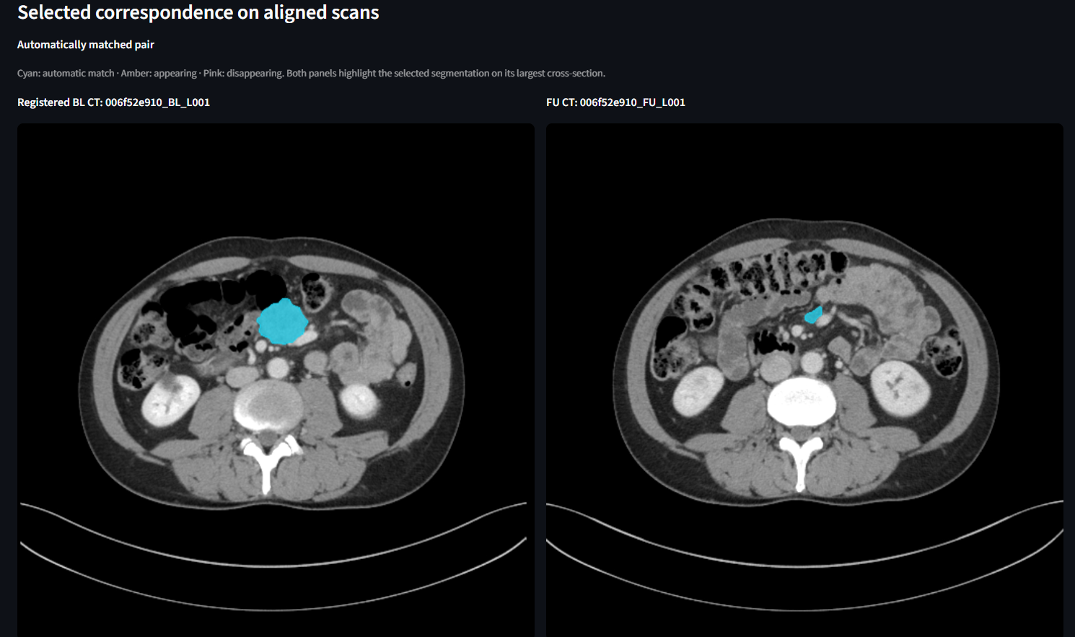
Result: lesion correspondence is explicit
The matcher reports what changed, not just a hidden score.
MATCHED
persistent lesion correspondence
MERGING
many-to-one correspondence supported
NEW
follow-up lesion with no BL match
DISAPPEARING
baseline lesion with no FU match
Acceptance: the user can inspect not only the final correspondence but also the lesion IDs, cost details, and outcome category.
Notes:
Speaker: H
Explain outcomes in simple client language: matched, merge, new, disappearing.
Do not over-explain the algorithm; focus on interpretability and review.

Slide 8
Result: quantitative evaluation when ground truth is available
Expert correspondence is kept separate from prediction and used only for evaluation.
91.0%
90.4%
91.0%
tracking accuracy
precision
recall
90.7%
88.5%
88.2%
F1 score
topology accuracy
topology F1
Current baseline: 11 evaluable Cohort A patients; 4 cases excluded due to known rigid-registration initialization issues.
Notes:
Speaker: Y
Tell the client these are baseline evaluation results, not a final clinical benchmark.
Emphasise that ground truth is not used by the matcher; it is only used after prediction for evaluation.

Slide 9
Live demo: user stories and quick acceptance tests
We will demonstrate results directly in the prototype.
1
Open selected patient
dashboard loads auto-filled paths and patient list
2
Inspect alignment
Original BL, Registered BL, and FU are visible side by side
3
Toggle masks
lesion overlays appear without losing slice consistency
4
Change plane
axial / coronal / sagittal sliders update correctly
5
Review match
correspondence row shows outcome and cost evidence
6
Check summary
BL/FU, matched, appearing, disappearing, and accuracy are shown
If a failure appears during live demo, we will show the generated outputs and status logs rather than hide the failed case.
Notes:
Speaker: Y
Use this slide to set expectations for the live demo. The live test sequence is short and client-focused.
This is a bridge from slide presentation to dashboard demo.

Slide 10
Quality and non-functional requirements
The prototype is designed for reproducibility, interpretability, and review.
Reproducible
Modular
Interpretable
launcher + fixed outputs for demo mode
CSV outputs at each stage can be inspected
costs and match outcomes are visible
Responsive
Testable
Transparent
viewer cache + direct slice extraction
unit tests, CLI smoke tests, real-data checks
failed cases are reported, not hidden
Example integration finding: real Cohort A slider latency was reduced from seconds per slice to tens of milliseconds after profiling and slice-extraction changes.
Notes:
Speaker: Q
Clients may care less about docs and more about confidence. Explain quality in terms of what protects their workflow.
Mention performance fix briefly as evidence of real integration testing.

Slide 11
What is not fully covered in today’s live demo
Known limits are reported transparently so that next-step decisions are clear.
Outside today’s demo time
Current technical limits
Next engineering priorities
full long-form test logs
every patient and every slice
all failure cases one by one
rigid registration baseline
some hard registration cases
PET/GT availability varies by dataset
registration reliability review
larger evaluation coverage
parameter sensitivity testing
Notes:
Speaker: Q
Client-oriented transparency slide. Do not over-apologise; show that the team knows limits and next steps.
Clarify that the prototype is useful for research review, not clinical diagnosis or treatment decisions.

Slide 12
Feedback we want from the client
Your feedback will guide polish and prioritisation before final delivery.
1
Review workflow
Is the BL → registered BL → FU layout useful for your inspection workflow?
2
Result language
Are MATCHED / MERGING / NEW / DISAPPEARING the right categories for review?
3
Summary level
Do patient-level summaries provide enough information for quick triage?
4
Priorities
Should we focus next on registration robustness, evaluation coverage, or UI polish?
After these slides, we will move into the live dashboard and run the acceptance checks.
Notes:
Speaker: Q
Close the spoken section by inviting targeted client feedback.
Then hand over to the live demo operator.

Slide 13
Thank you
Notes:
Speaker: Q
Thank the client and transition directly into the live dashboard demonstration.

