Slide 1
COMP3888_M17_03_ZL | Project 31
Longitudinal PET/CT Lesion Quantification and Treatment
Team members
Qiang Li
SID: 540788868
Unikey: qili0179
Linkang Wen
SID: 540276619
Unikey: lwen0131
Client: Zilin Zhang
Tutor: Zhenlin Liu
Tutorial: M17(17:00-19:00)
Submission date: 10 Sep 2026
Yuqi Wu
SID: 540035669
Unikey: yuwu0501
Haoxiong Pan
SID: 530425128
Unikey: hpan0285

Slide 2
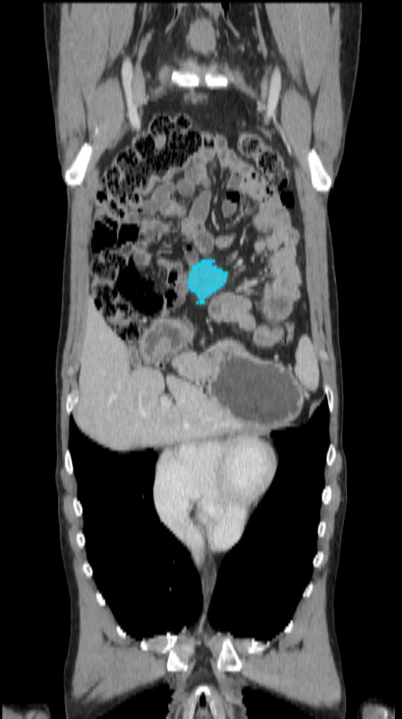
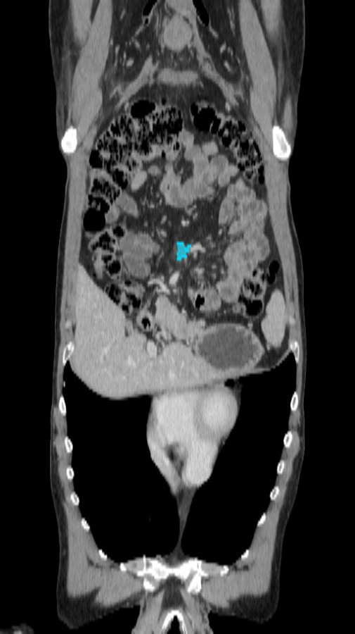
Why this problem matters
Longitudinal lesion review is hard when scans and lesions change over time.
Manual review becomes slow and inconsistent when:
patients have many lesions baseline and follow-up scans use different geometry lesions can persist, disappear, newly appear, or merge voxel indices cannot be compared directly across scans
Goal: organise, align, match, evaluate, and visualise lesion-level change.
BL FU
Different planes make lesion location easier to inspect visually.

Slide 3
Project scope and stakeholders
A research-review tool, not a diagnostic or treatment system.
Client
requirements & feedback
COMP3888
development team
Researchers /
clinical-domain users
In scope
Out of scope
descriptive lesion tracking
baseline-to-follow-up comparison
visual inspection and quantitative evaluation
reproducible Python pipeline
clinical diagnosis
automatic treatment decisions
autonomous response classification
complex deformable registration baseline

Slide 4
Representative requirements
User stories define a chain from raw data to interpretable tracking results.
Data access
Generate patient manifests for BL/FU scans and masks.
Inspection
View CT/PET scans and lesion masks in axial, coronal, and sagittal planes.
Tracking
Calculate lesion pair costs and solve lesion correspondence globally.
Evaluation
Compare predicted matches with expert ground truth when available.
Non-functional focus: reproducible, modular, interpretable, testable.

Slide 5
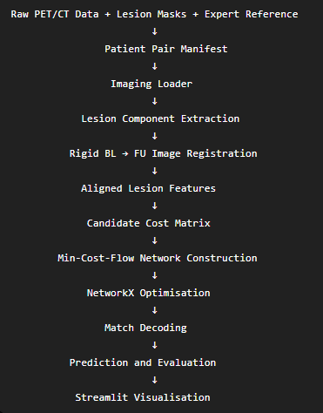
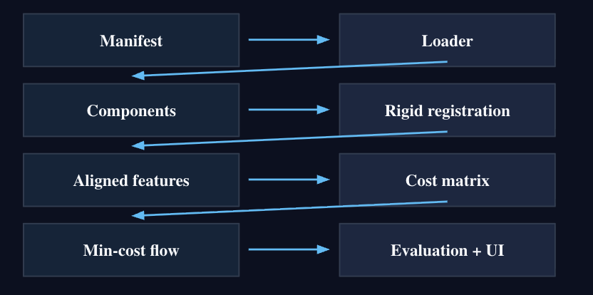
System architecture
Each stage produces intermediate outputs that can be inspected and reused.
Why this structure helps
debugging can stop at any stage
CSV outputs support independent testing
UI is separated from processing modules

Slide 6
Data representation: more than pixels
Spatial metadata is preserved before any distance-based comparison.
NIfTI volume
Lesion mask
Structured tables
voxel array
spacing
orientation
affine/world coordinates
3D connected components
temporary lesion IDs
volume and centroid
empty/invalid mask checks
scan manifest
aligned features
candidate costs
match/evaluation outputs
Key idea: compare lesions using physical coordinates after alignment, not raw voxel indices.

Slide 7
From candidate costs to matching
The matcher is global, not just nearest-neighbour.
Candidate cost uses:
Why min-cost flow?
supports persistent, new, and disappearing lesions
keeps many-to-one merge candidates
optimises patient-level correspondences globally
outputs explicit MATCHED / MERGING / NEW / DISAPPEARING rows
1
2
3
spatial distance
size difference
optional PET difference
The cost table and matrix are interpretable inputs for downstream matching.

Slide 8
Alignment and feature generation
Baseline is transformed into the follow-up coordinate system before matching.
Baseline CT
(moving)
Rigid BL → FU
ITKElastix
Follow-up CT
(fixed)
Common FU
world space
Aligned features
BL mask is resampled with nearest-neighbour interpolation
features include centroid, volume, and optional PET measurements
registration outputs are reusable for batch experiments

Slide 9
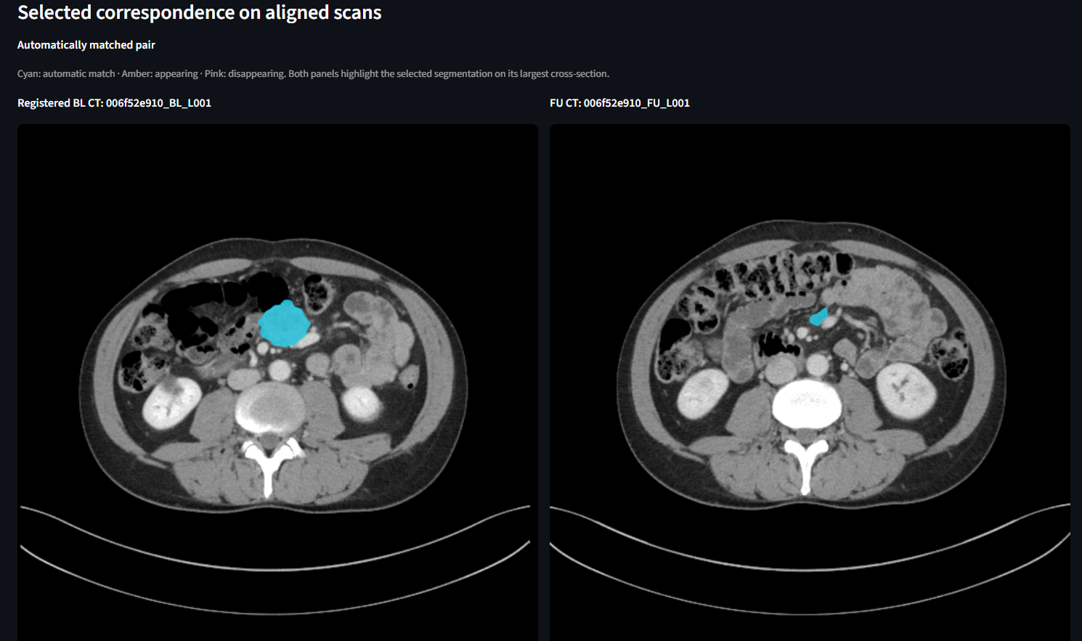
Evaluation against expert correspondence
Ground truth is kept separate from the matcher and used only after prediction.
91.0%
90.4%
91.0%
tracking accuracy
precision
recall
90.7%
88.5%
88.2%
F1 score
topology accuracy
topology F1
Current baseline: 11 evaluable Cohort A patients;
4 cases excluded due to known rigid-registration initialization issues.

Slide 10
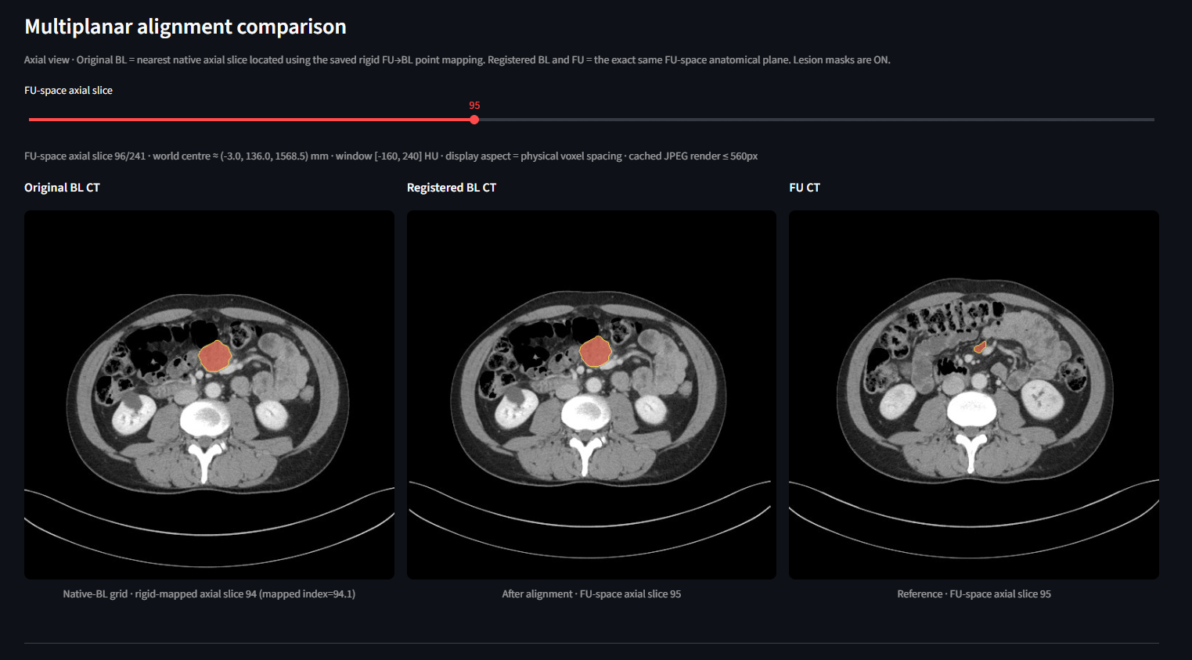
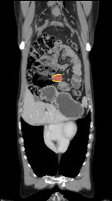
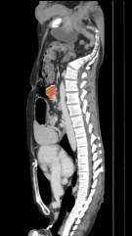
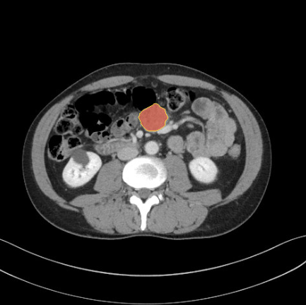
Interactive prototype
Main viewer capabilities
Streamlit supports visual inspection of registration, masks, matches, and summary outputs.
Original BL, registered BL, and FU displayed side by side
CT and PET modes
lesion-mask overlays
axial, coronal, and sagittal slice sliders
matched correspondence details and patient-level summary
Axial
Coronal
Sagittal
Multiplanar views use physical aspect ratio correction.

Slide 11
Quality, teamwork, and risk management
The project uses testing and intermediate outputs to reduce integration risk.
Quality techniques
Collaboration
Remaining risks
pytest unit tests for core modules
CLI smoke tests on real data subsets
intermediate CSVs for inspection
visual checks in the dashboard
Jira user stories and acceptance criteria
GitHub branches and commits
shared docs for each iteration
rotating PM, tracker, doomsayer, and client-liaison roles
registration failures
ambiguous merging or splitting cases
small mask components
PET availability and grid consistency
Current strategy: keep the pipeline modular and report both successful and failed cases transparently.

Slide 12
Remaining plan and video demo
After this spoken section, the video will demonstrate the prototype workflow.
8-minute recorded demo plan
Next project stage
0:00-1:00
Open dashboard and select patient
improve registration reliability
expand full-cohort evaluation
validate matching parameters
stabilise final client-facing interface
1:00-2:30
Inspect CT/PET in axial, coronal, sagittal
2:30-4:00
Show registration and masks
4:00-5:30
Open matched correspondence details
5:30-7:00
Show patient summary and accuracy
Demo message:
the prototype is already usable for end-to-end research review, while final delivery will focus on reliability and polish.
7:00-8:00
Known limitations and next steps

Slide 13
Thank you

