Slide 1
Epilux The more you see the more you learn.
Unofficial Codechef Android app for notifying upcoming challenges, browsing all problems and profile of coders .

Slide 2
App Introduction
Epilux is an Unofficial Android app for Codechef. This app provides various features to coders like notification of new upcoming challenges, previous contest problems and ratings.
With this app one can easily explorer and search various contest details and subscribe to get notification of the events.
Our Tagline “The more you see the more you learn” emphasis on the learning and viewing problems anywhere and at any time.
With the era of mobile apps , we think that a portable and fast version of codechef android app will surely help coder and programmer community to enhance their skills and schedule themselves for the challenges.

Slide 3
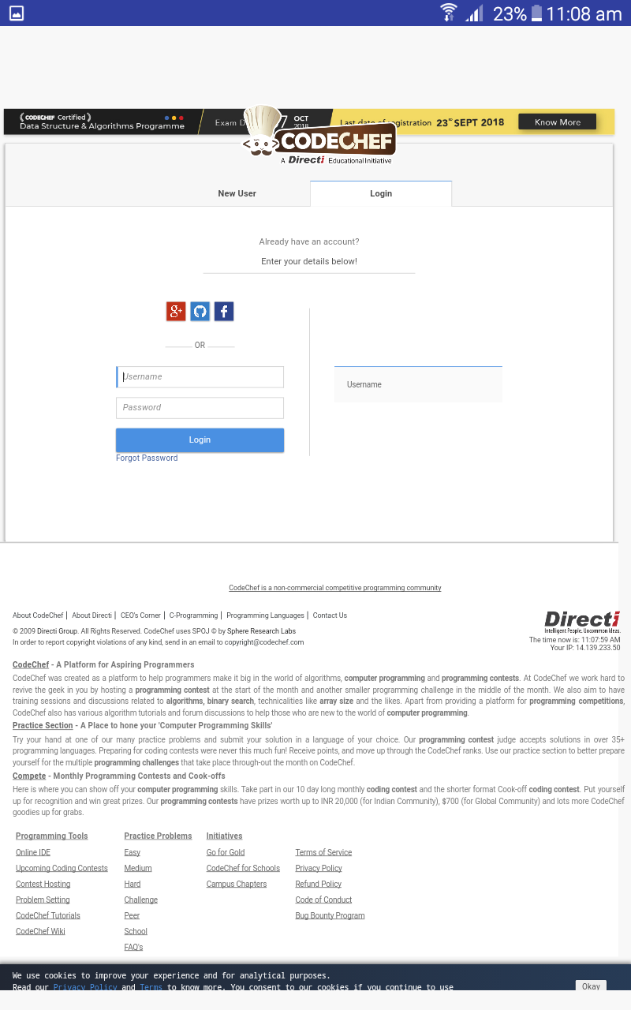
Instructions/functionality
Step 1: Create a Codechef account using loginID and Password(Google , facebook and git authentication are currently not acceptable in the app).
Step 2: Login to Our app using your credentials.

Slide 4
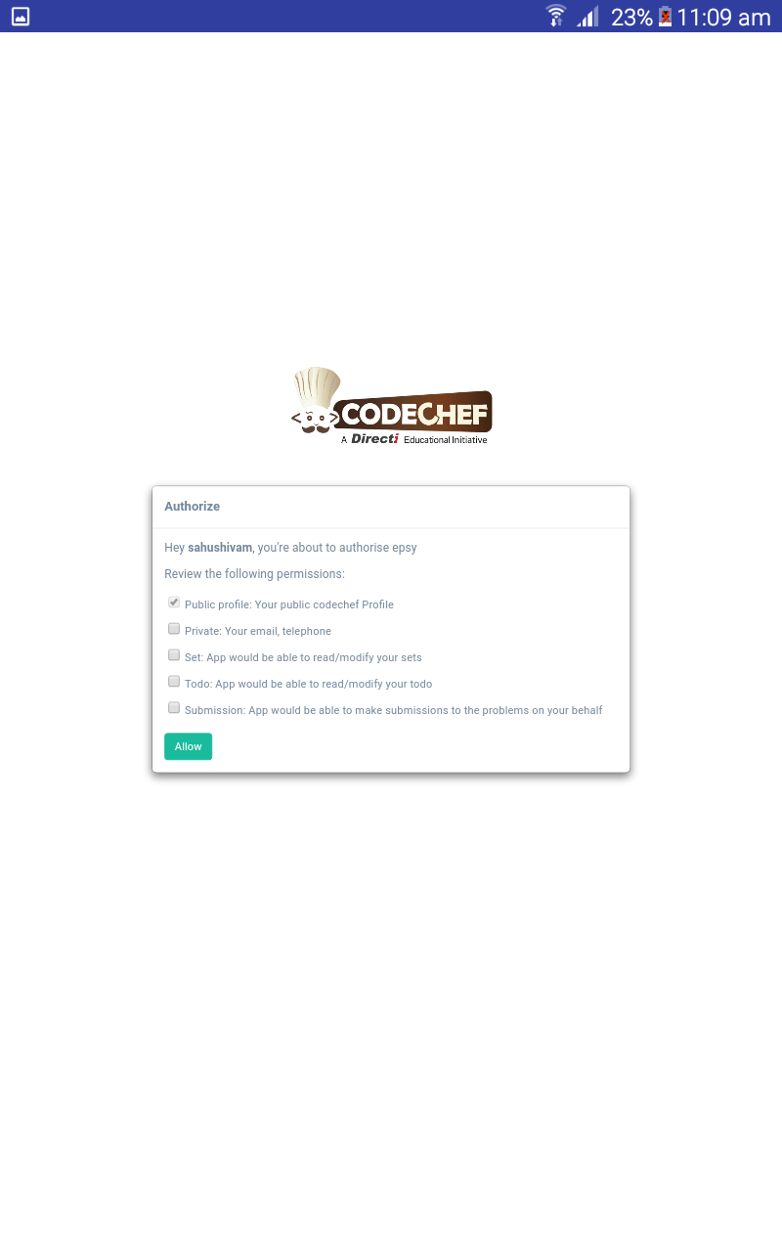
Instructions/functionality
Step 3 : Allow your profile values like name , email , college and submission. Currently our app wants only your username only.

Slide 5
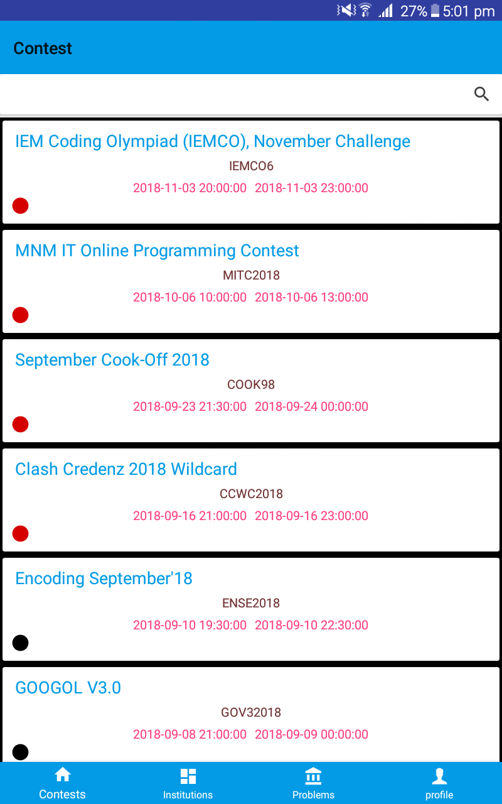
Instructions/functionality
Step 4 : Now your are at the Contest Home Page.
Here you can view all contest list.
A small colour indicator is present on every contest part which indicate contest status.
Red : Upcoming Contests and Challenges.
Green : Current Contest ongoing.
Black : Previous contests.

Slide 6
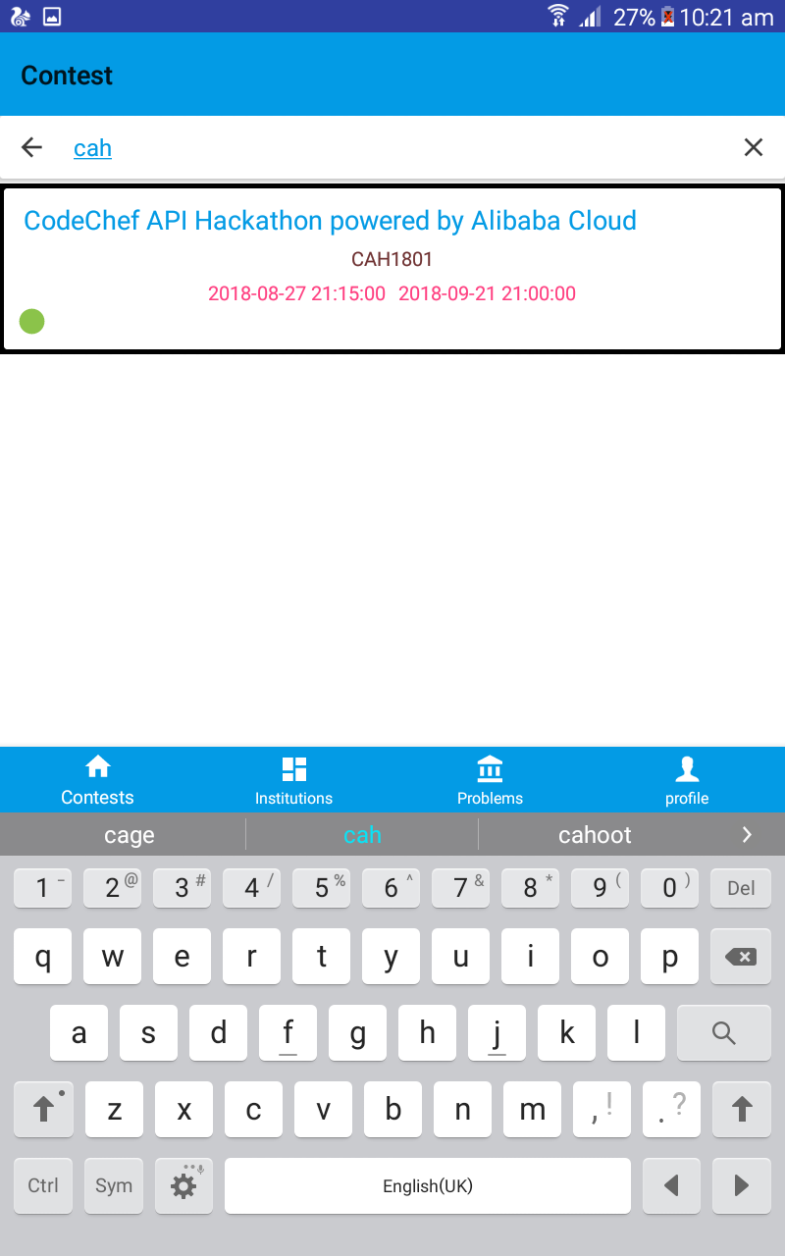
Instructions/functionality
Step 5 : There is a search bar on top of contest page where you can search and get information of particular contest.

Slide 7
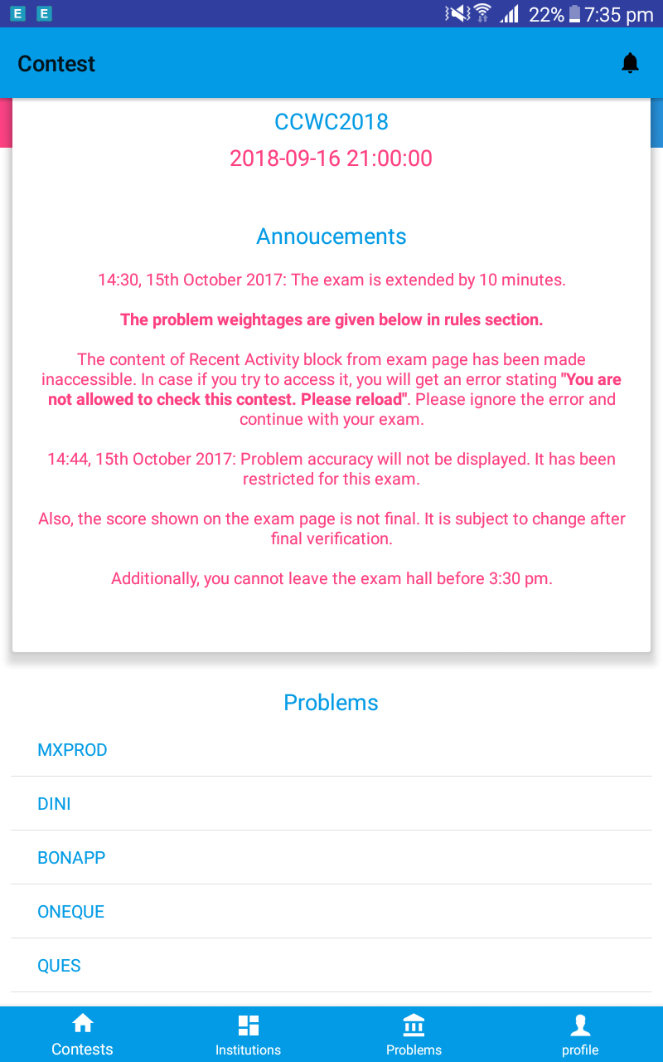
Instructions/functionality
Step 6 : Onclicking the contest you can get the detail of the it and if you want the notification you can click on the bell icon on top.

Slide 8
Instructions/functionality
Step 7 : On institution tab you can search ranking of coder by country and institution.

Slide 9
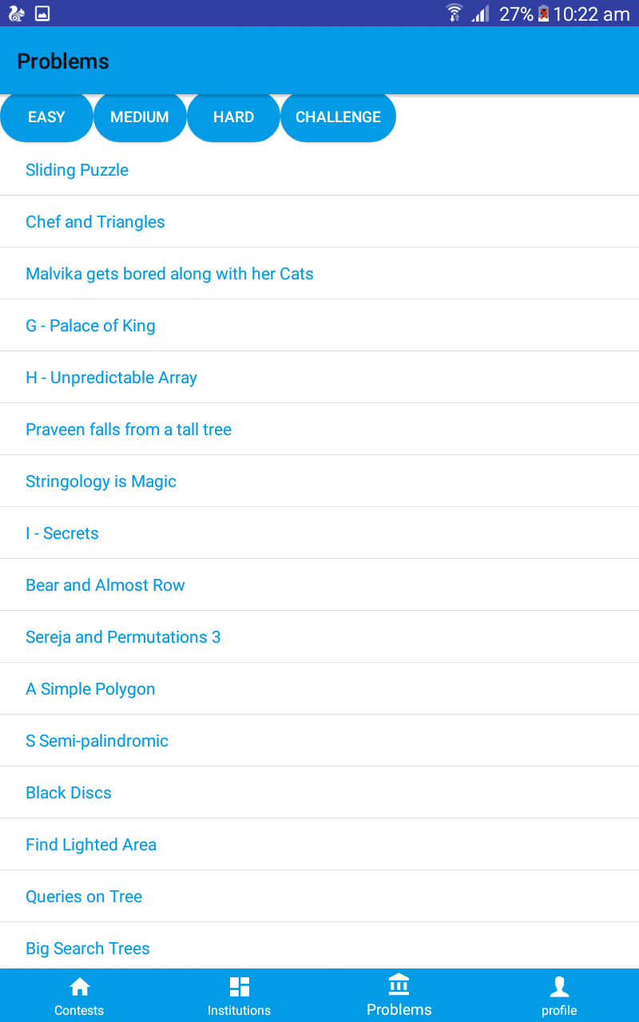
Instructions/functionality
Step 8 :On problems tab you can view the problem by easy , medium and hard tags.

Slide 10
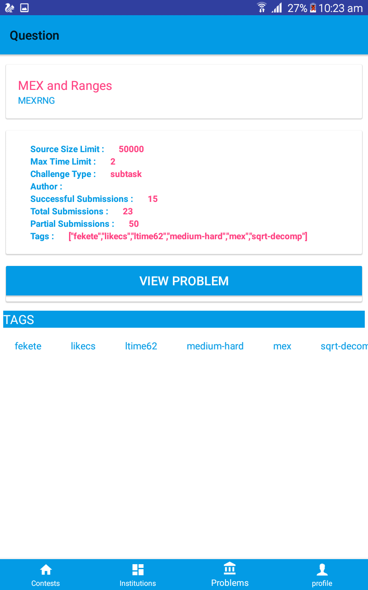
Instructions/functionality
Step 9 : Question tab will describe the questions and here you can search other questions by tags.

Slide 11
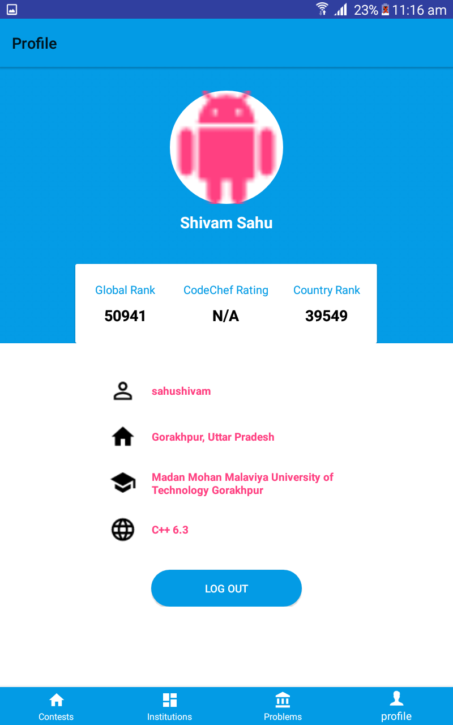
Instructions/functionality
Step 10 : On profile tab you can view and log out from your account.

Slide 12
App Features
Very Easy to use
Secure, as your credential will be locally store in your phone and everything will call from your phone only.
Portable and light weight (less than 10 mb) and no extra permission required except internet use.
Notification of upcoming events.
Browse contest.
Ranking and rating by country and institution.
Search problems by tags.
Track your and other coder profiles.

Slide 13

Screen Shots

Slide 14
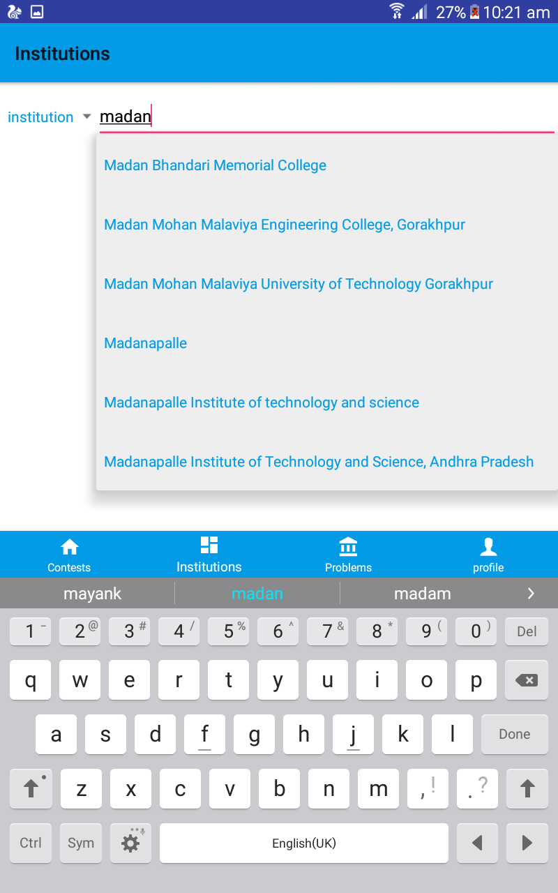
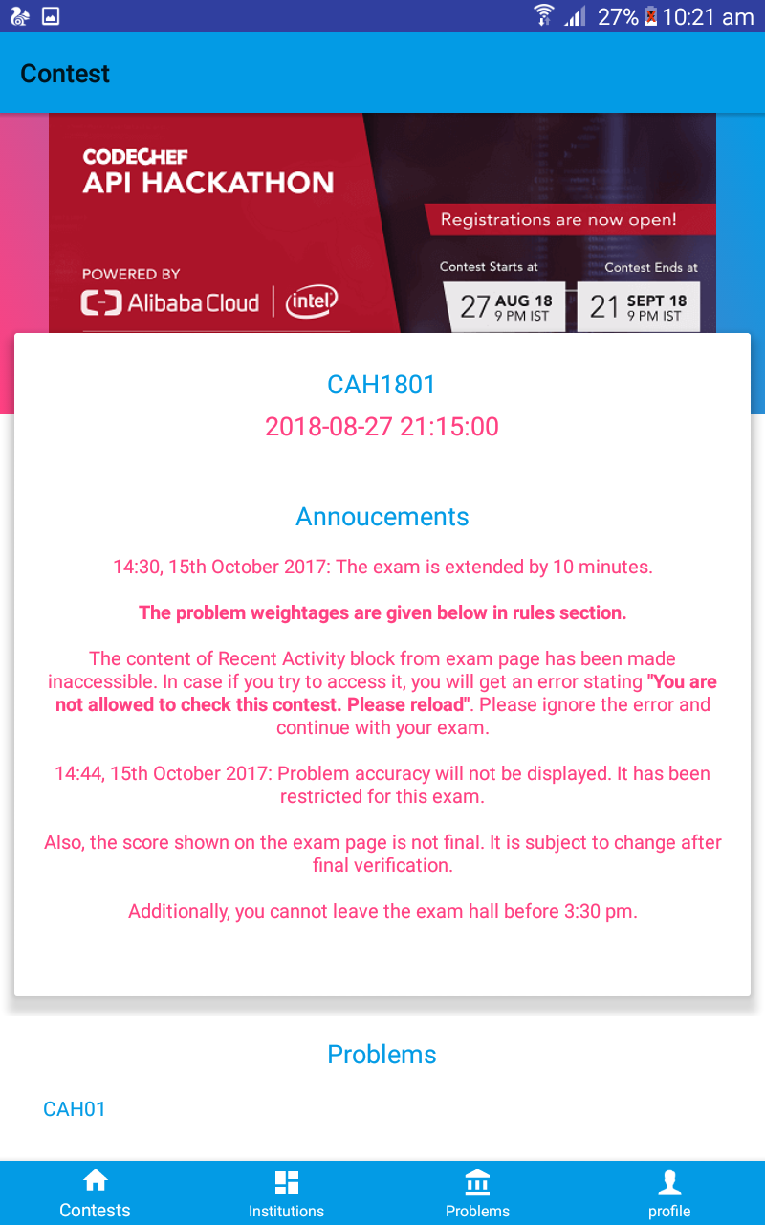
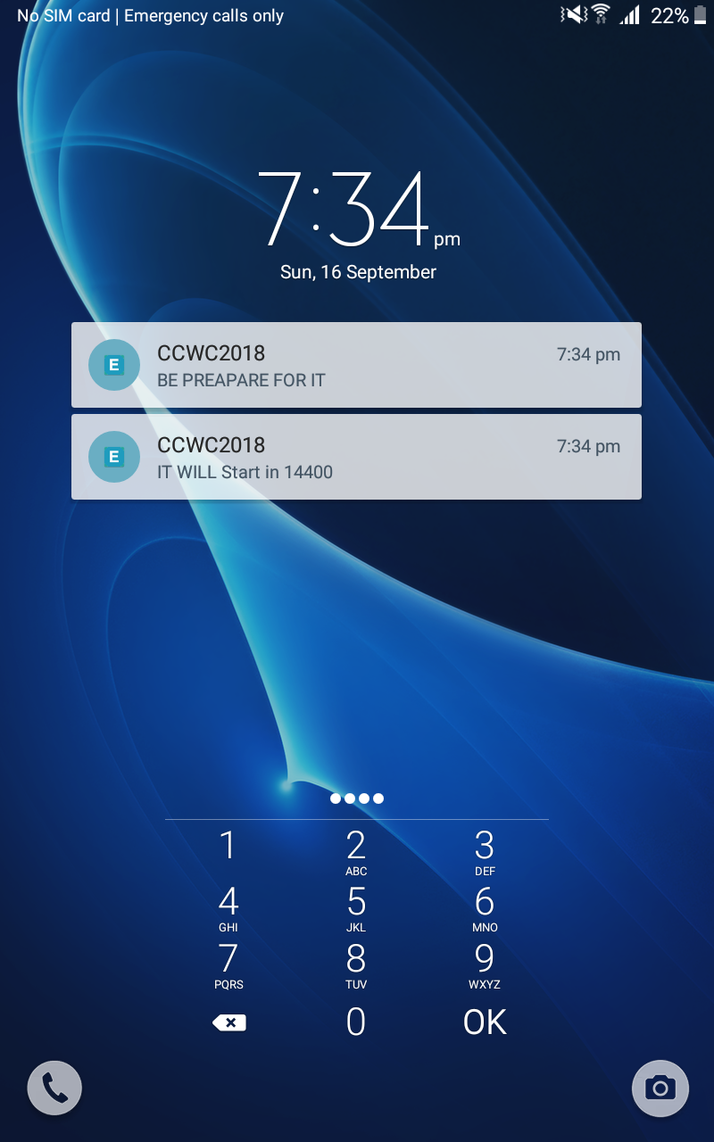
Screen Shots

Slide 15
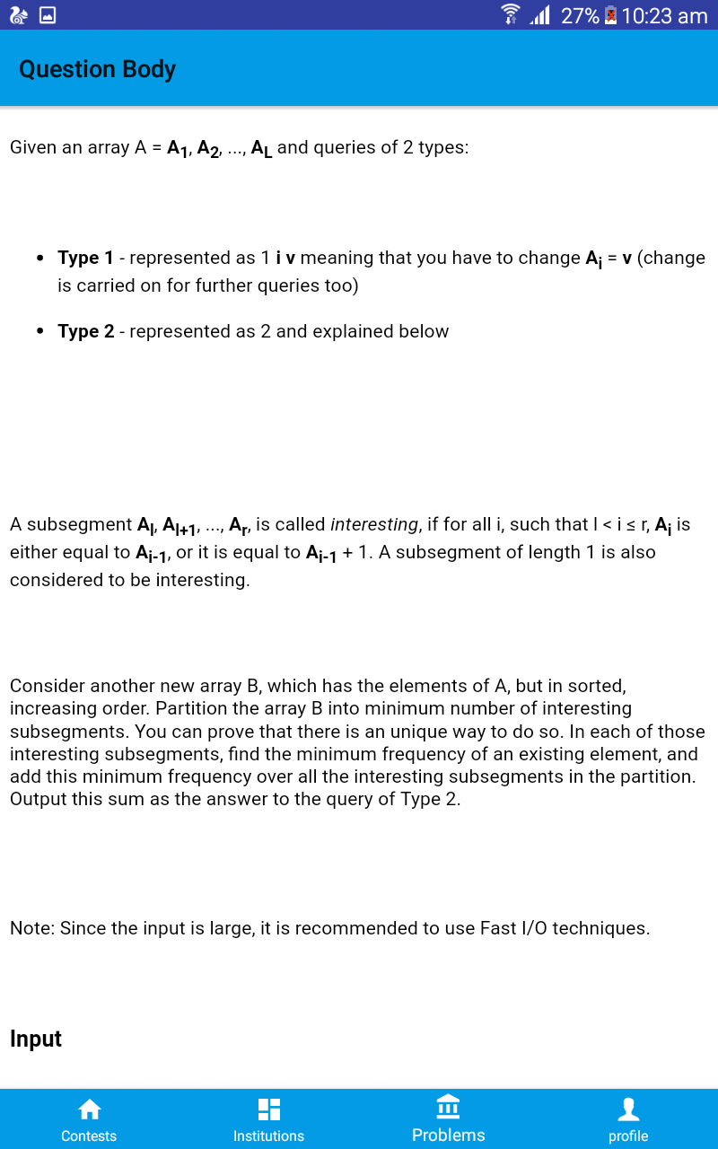
Screen shots

Slide 16
App Architecture
Android App

Slide 17
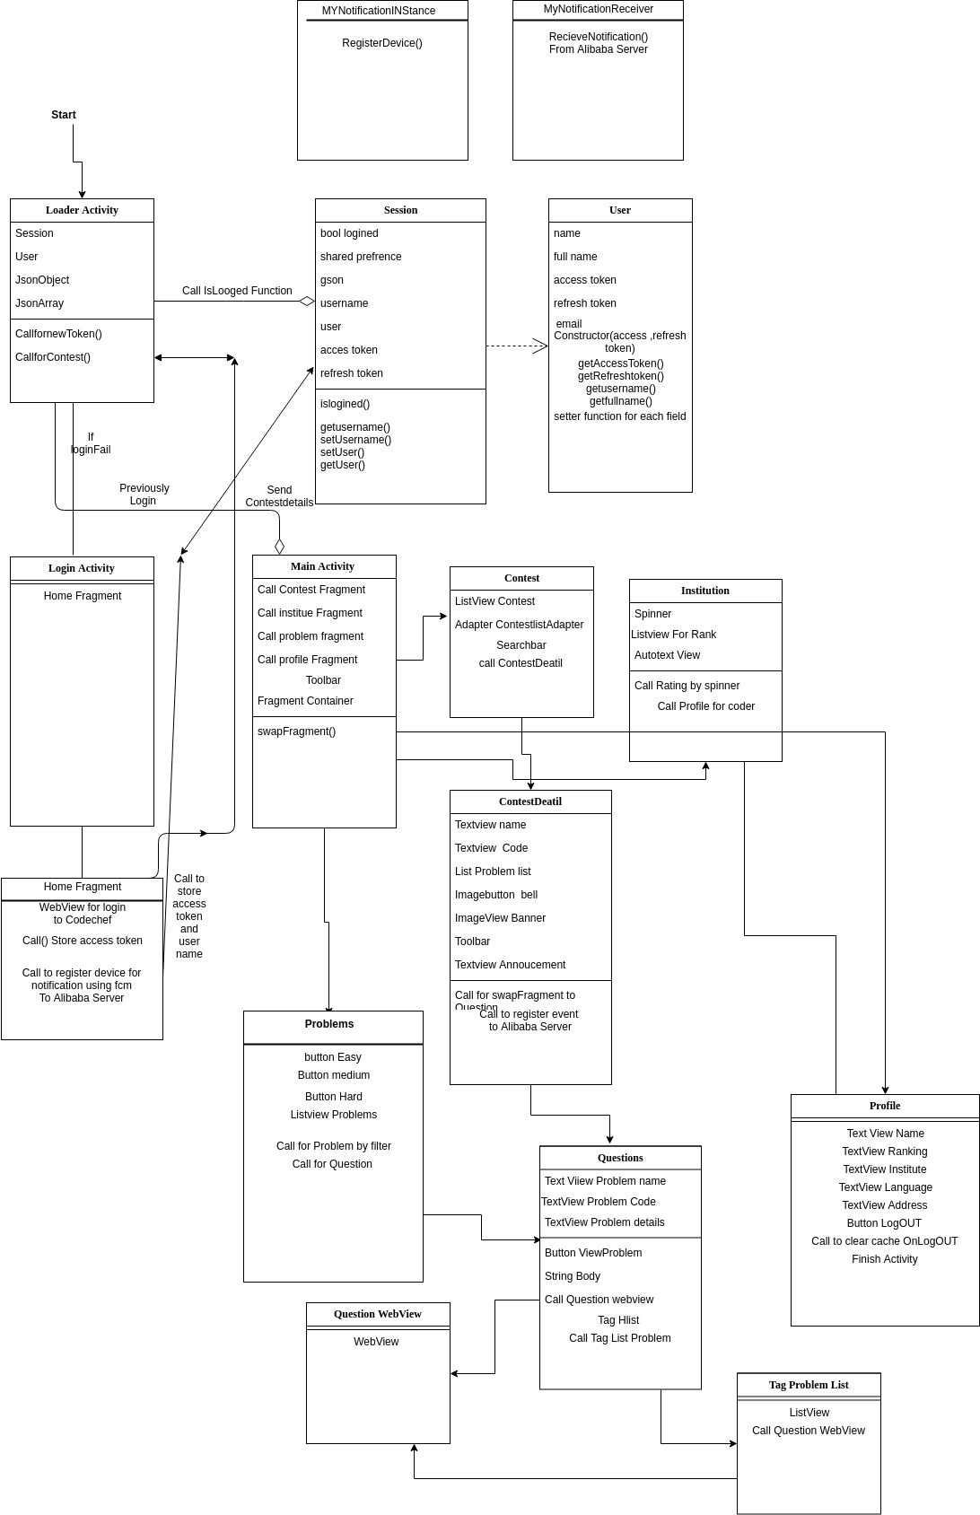

Slide 18
App Architecture
On Alibaba Elastic Server
149.129.135.60/server

Slide 19
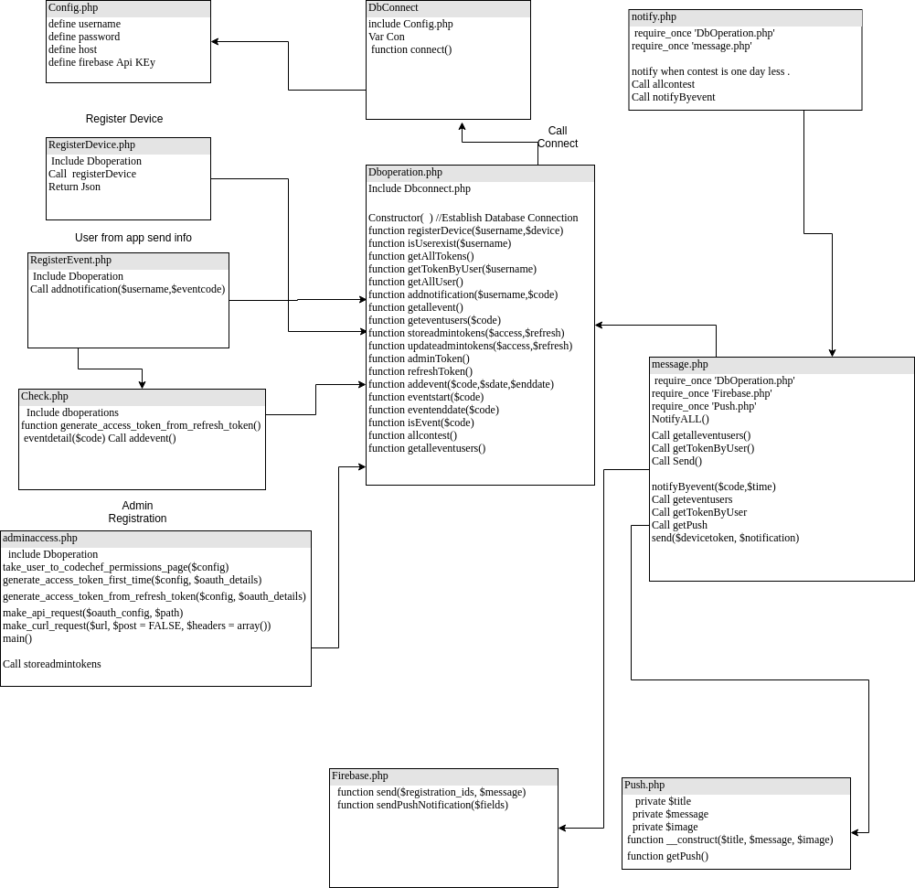

Slide 20
Alibaba Services
Elastic Computer
MongoDb

Slide 21
Alibaba Elastic Computing Server
Install apache server, php , MySQL and sftp
Use to host php script for registering device and send notification
Sftp server use transferring data
MySQL is used for storing local admin tokens and refresh tokens.
Cron job for scheduling the notification on every 1 hour.

Slide 22
MongoDb
Use to store data of client username
Use to store information of events.

