Slide 1
ShiftBridge
A learning decision
an inspector can explain
Four study hours a week. A next action the worker chooses.
Console
Tan King Yang, UTAR
Domain 1 AIVERSECITY
SDG 4 Quality Education
ShiftBridge / Console
01 / 08
Notes:
Console is a solo participant: Tan King Yang, UTAR. ShiftBridge is a working prototype for manufacturing quality inspectors. The four-hour case is synthetic. The public Replit prototype and seven patched-v3 RunPod GPU jobs are verified. This pitch does not claim validated user demand, employment outcomes or general model accuracy. Codex assists the participant; it is not the competition host or entrant. Source: docs/submission/01_PRELIMINARY_PROPOSAL.md and current app catalogue.

Slide 2
Inspection work is changing
TalentCorp E&E study
Intel deployment account
2024 copyright edition
December 2023
Evolving QA roles include
automated monitoring skills.
Computer vision supports
inline inspection.
Which learning deserves a worker’s limited study time?
The planning difficulty and intended-user demand still need independent validation.
ShiftBridge / Console
02 / 08
Notes:
Sources: TalentCorp Impact Study, Volume 2 Electrical and Electronics, copyright 2024, printed pages67 and70: https://www.talentcorp.com.my/images/uploads/publication/195/Impact-Study-of-Artificial-Intelligence-Digital-and-Green-Economy-on-the-Malaysian-Workforce-Volume-2-Sector-Electrical-and-Electronics-1747879257.pdf . Intel account: https://www.intel.com/content/www/us/en/it-management/intel-it-best-practices/smart-mfg-computer-vision-ai-inspection.html . Its linked paper is dated December2023. These sources establish task context, not Malaysian vacancy growth or the specific worker pain hypothesis. No worker interviews or buyer validation are claimed.

Slide 3
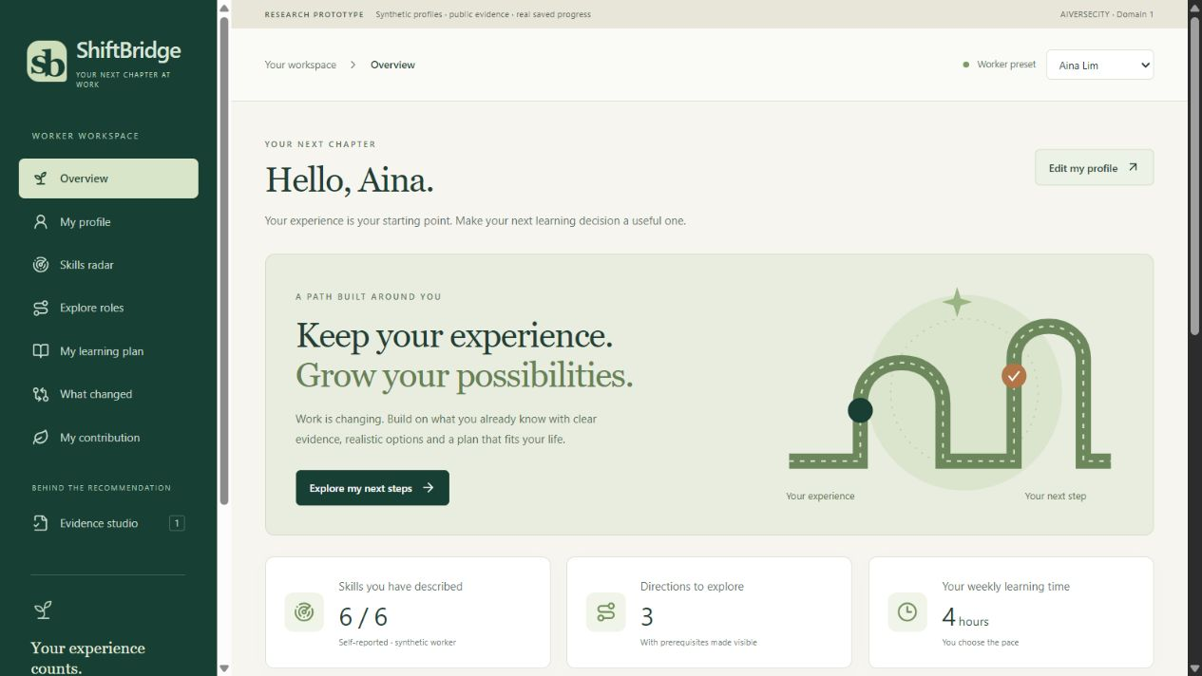
One connected learning decision
01 Skills and constraints
02 Dated evidence
03 Roles and missing skills
04 Ordered learning
05 SDG contribution
06 Future scenarios
Synthetic profiles. Six selected skills. Explicit worker adoption.
ShiftBridge / Console
03 / 08
Notes:
Actual application screenshot: outputs/ShiftBridge_App_Overview.png. Current UI has eight pages and an isolated guided rehearsal. Required journey is covered by current skills intake, a real arXiv refresh connector, explainable role alignment, prerequisite-aware planning, SDG mappings and moderate/faster scenarios. A screenshot alone does not prove the interactions. Show the real application in the recorded demo. Source: src/shared/types.ts, catalogue.ts, engine.ts and docs/submission/03_REQUIREMENTS_TO_PROOF.md.

Slide 4
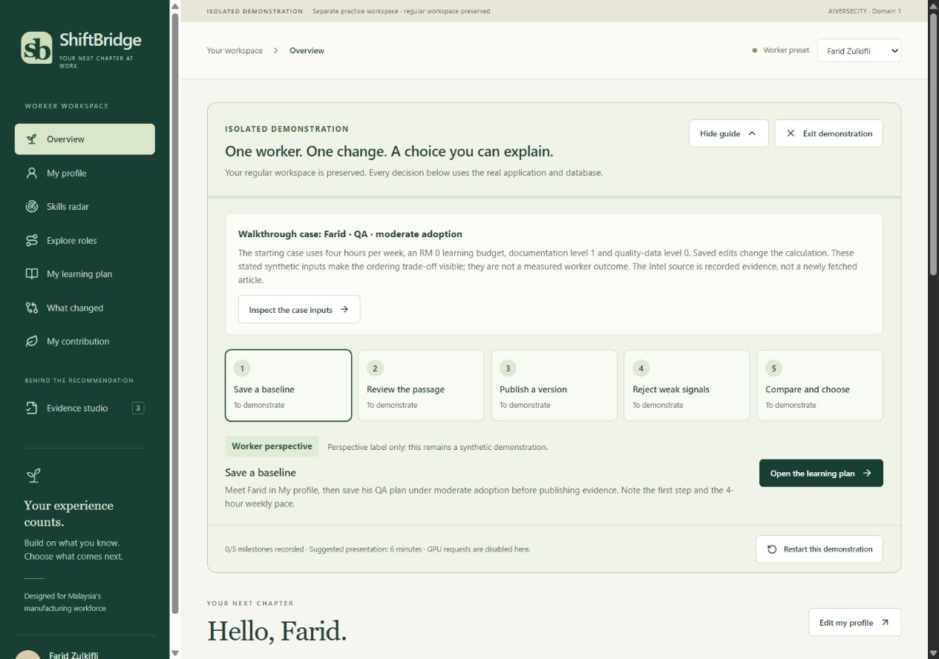
Evidence review and publication
1
Inspect the passage
2
Explain the task implication
3
Choose the affected role
4
Approve, then publish
Weak evidence leaves the accepted plan intact.
ShiftBridge / Console
04 / 08
Notes:
Actual screenshot: outputs/ShiftBridge_Release_Demo.png, cropped in PowerPoint only to focus the real rehearsal. The image shows the rehearsal workflow and does not pretend every milestone is complete. The reviewer inspects Intel’s exact passage, records an interpretation, selects QA scope, approves and separately publishes. Numeric 20%/50% skill-weight changes are team scenario assumptions, not Intel measurements. Reject the synthetic retail chatbot and related-but-insufficient paper. Source: src/server/app.ts and seedMappings. Runtime evidence mapping is manual today.

Slide 5
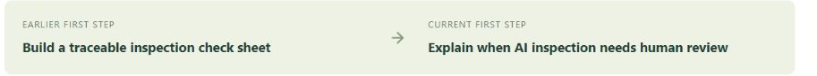
The next learning action changes
Constructed Farid case, with the same profile and study allowance
Before publication | After reviewed QA update
1 Documentation | 1 AI-inspection literacy
2 Quality data | 2 Documentation
3 AI-inspection literacy | 3 Quality data
4 Root-cause reasoning | 4 Root-cause reasoning
Actual application comparison
16 estimated hours / 4 weeks / RM 0 reading and practice access
ShiftBridge / Console
05 / 08
Notes:
Actual engine1.1.0 output, reproduced21October2026. Constructed Farid: records1/4, quality_data0/4, weeklyHours4, budgetRM0. Baseline QA score52.13, revised moderate51.02, revised fast49.48. Baseline steps data-foundations, quality-data-practice, inspection-evidence, root-cause-practice; revised steps inspection-evidence, data-foundations, quality-data-practice, root-cause-practice. Same16 planned hours,4weeks,RM0 access. No skill loss or saved study hours are asserted. New Intel scope is QA-only. Accepted baseline persists until explicit adoption. Screenshot source: outputs/ShiftBridge_Plan_Comparison.png. Table is editable. Source: src/shared/engine.ts and docs/submission/03_REQUIREMENTS_TO_PROOF.md.

Slide 6
Learning produces an inspectable output
20 synthetic inspection cases
Exercise reference | AI flag: defect | AI flag: clear
Defect present | 6 | 2
No defect | 3 | 9
2 missed defects
3 false alarms
The worker explains
when human review
is needed.
Q07 has a missing measurement. Keep uncertainty visible.
Synthetic practice. A voluntary return to the accepted plan.
ShiftBridge / Console
06 / 08
Notes:
Source: public/practice/qa-inspection-cases.csv and docs/EXERCISES.md. Hypothetical reference_defect and ai_flag values produce6 true positives,2 false negatives,3 false positives,9 true negatives, total20. Q07 lacks a measurement. These invented flags were not generated by RunPod. RunPod performs bounded text relevance triage, not image defect classification. Show the in-app exercise and its voluntary Review my plan action. Browser verification moved focus to Your learning steps on #pathway while preserving 25% completion, one of four steps. Feedback does not adopt a plan, raise proficiency or certify competence. Output: confusion table, exact error case IDs and a human escalation explanation. Reading sequence: basic maths, Microsoft Learn ML foundations, then computer vision. URLs: https://learn.microsoft.com/en-us/training/modules/fundamentals-machine-learning/ and https://learn.microsoft.com/en-us/training/modules/introduction-computer-vision/ . Finishing a checkbox records activity only.

Slide 7
Working software and real GPU triage
React and TypeScript interface
257
Fastify API and PostgreSQL persistence
local suite tests passed
arXiv refresh and bounded GPU triage
7 v3 jobs completed on CUDA
3 optional DB checks skipped locally
Human review controls every published change.
Six synthetic cases support a limited ranking check. Wider quality remains unmeasured.
ShiftBridge / Console
07 / 08
Notes:
23 October 2026 checkpoint: 257 application tests passed and three optional real-PostgreSQL checks skipped locally and at Replit f056cef. Production build and built-app smoke passed. Thirteen offline Python worker checks passed. All seven public CI jobs passed at 45bfed5, including a separate PostgreSQL integration job and strict worker dependency audits; individual counts were not extracted from those CI logs. Published 45bfed5 (r4) passed 24 HTTPS checks and the complete five-milestone guided walkthrough with reload. Patched worker 383eabc release 4 executed BAAI/bge-large-en-v1.5 at revision d4aa6901d3a41ba39fb536a557fa166f842b0e09 under preprocessing bge-cls-l2-512-bounded2000-v3. The hosted app accepted the TalentCorp-passage result, cosine 0.5877708196640015, after all nine provenance checks. Provider delay was 304704 ms and execution 4053 ms, individual observations rather than typical latency. Six declared synthetic cases then completed. Both direct inspection passages ranked above both unrelated passages, four of four comparisons. The keyword-negation case scored 0.621195 despite denying deployment, so similarity cannot establish workforce impact. These are repeated smoke fixtures, not classification accuracy or calibration. Seven historical v2 jobs are separate evidence. No 0.65 cutoff is applied. Public passages only are sent. GPU output cannot publish a rule or replace a plan. Public prototype verified. Sources: docs/BUILD_STATUS.md, docs/RUNPOD_VERIFICATION.md and docs/evidence/.

Slide 8
Relevant learning is the next test
SDG 4.4
30%
Relevant technical skills
Draft pilot target
Lower median planning time
without lower task correctness.
SDG 4.3
Affordable learning access
Baseline and user validation
remain unmeasured.
Demo: https://shift-bridge-kingyang3096.replit.app
Codex provided major development assistance. Gemini supplied strategic critique.
ShiftBridge / Console
08 / 08
Notes:
UN SDG4: https://sdgs.un.org/goals/goal4 . Relevant technical/vocational skills and affordable learning access describe intended contribution, not measured official SDG indicators. Draft target is30% lower median task time with no loss of correctness in a planned counterbalanced study using equivalent synthetic cases. No measured baseline, participant experiment or workforce outcome exists yet. Intended users/advisers still need to validate the problem. Team Console, solo Tan King Yang of UTAR, owns the submission after human review. OpenAI Codex assistance is major. Gemini provided strategic critique; exact underlying model remains unverified. No phone/email or unverified public link is included. Source: proposal impact framework and technical declaration.

