Slide 1
Mockup tools
Research between 10 Best App Mockup Tools, what is best to use.

Slide 2
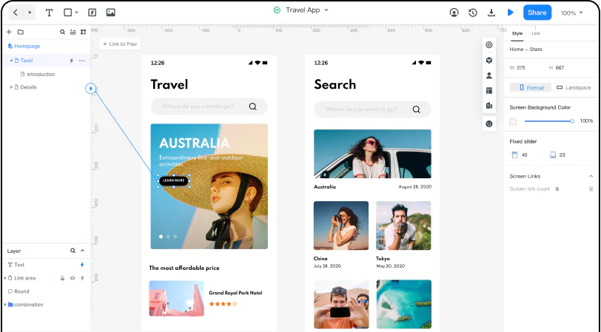
1. Wondershare Mockitt
Wondershare Mockitt is an industry-leading design prototype and wireframe tool. With this free mockup app, you can make designs faster. It has an exhaustive library of widgets and icons and more.
Pros
Free and easy to use.
Drag and drop interface.
Make mockups for iPad, Mac, Windows, Smart Watch, TV, and so on.
Inspect codes and "hand-off mode."
Build-in widget/icon library and templates.
Multiple wireframes and a massive visual interface library.
Real-time co-editing facility across teams.
Many enterprise solutions, project, and team management authorization levels with access controls.
Cons
None to mention

Slide 3
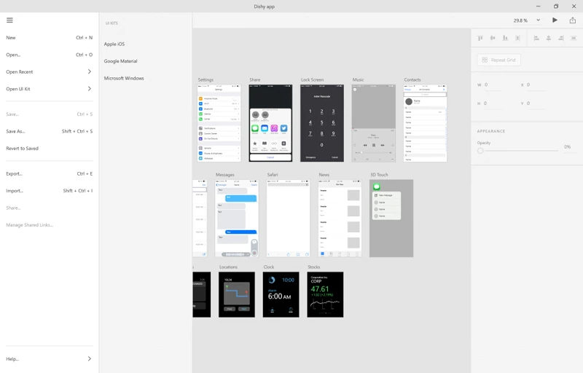
2. Adobe XD
Adobe is also a helpful mobile app mockup tool. Adobe is also a reliable free app mockup tool after Wondershare Mockitt. You can create websites, apps, video games, and voice-controlled mobile app mockups. There are a lot of free icons in the library. However, to find the cream of the crop, you might have to shed more than 10 dollars monthly.
Pros
A few free sets of services.
Create visual interfaces and wireframes.
Multiple levels of detailing can be achieved.
Cons
A limited 2 GB cloud storage.
Access to every feature is not free.
Difficult for users who aren't familiar with the Adobe ecosystem.

Slide 4
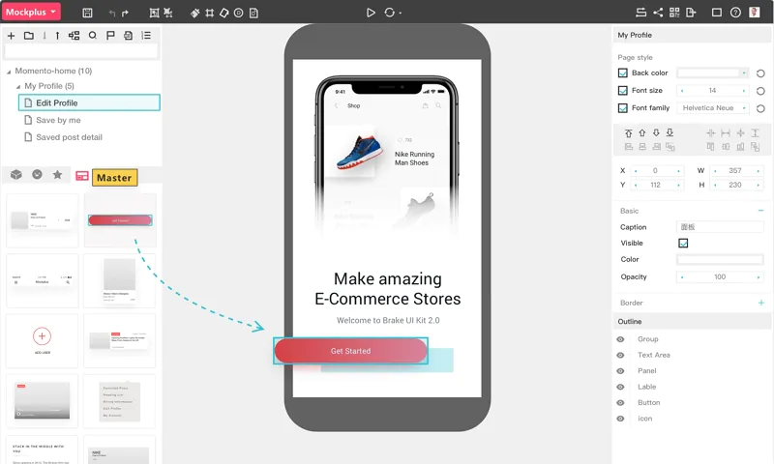
3. Mockplus
With Mockplus, designers can get access to more than 300 icons. Moreover, one can check their app mockup for free.
Pros
Create visual mockups quickly.
Real-time co-editing features.
Interactive prototypes.
Cons
Enterprise solutions are expensive compared to other mockup apps free for use.
Remote collaboration features lag occasionally.

Slide 5
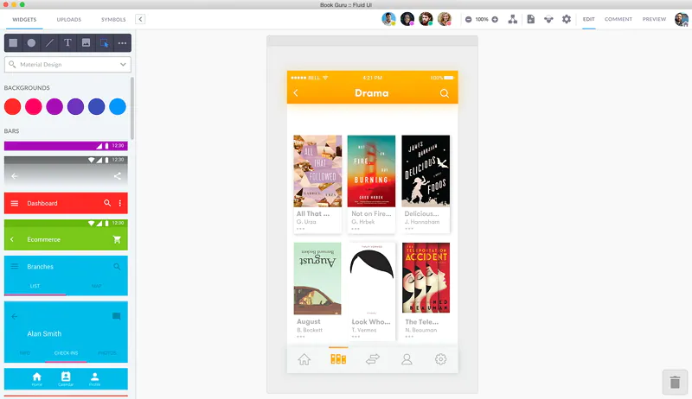
4. Fluid UI
Fluid UI is one of the many available mobile apps mockup tools. You can get access to create interactive prototypes.
Pros
Multiple device previews.
Cloud access.
Prototype in high and low fidelity.
Cons
Navigation is not user-friendly.
Pricing is expensive compared to other available options.

Slide 6
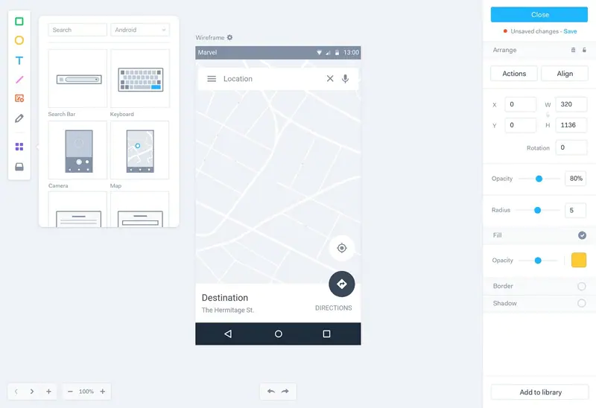
5. Marvel App
Marvel is a free mockup app for mobile devices. It comes with intuitive design elements that also offer user testing features.
Pros
Create prototypes without code.
Feedback is centralized across teams.
Create scalable designs.
Cons
Confusing screen-navigation.
No animation support.
No comment feedback option.

Slide 7
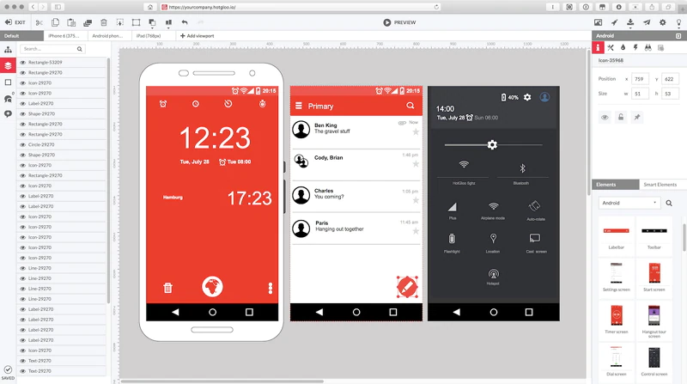
6. HotGloo
HotGloo offers multiple tutorials to create free mockups app design. The user interface is easy and is mobile-friendly.
Pros
A full-stack tool.
Interactive wireframing tool.
Freelancer friendly.
Relatively affordable and cheaper than others.
Cons
Limited elements library.

Slide 8
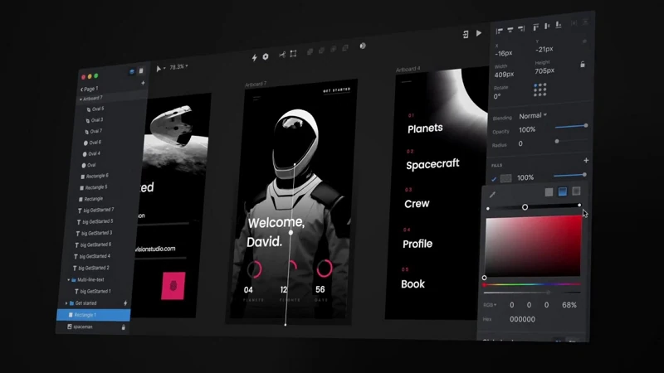
7. InVision
InVision is on our list of mobile app mockup tools for its social platform. Brainstorming with other creators and exchanging ideas is easy here.
Pros
Strong community
Fine detailing options.
Cons
Sharing design with clients is difficult.
No advanced features like animation in the free version.

Slide 9
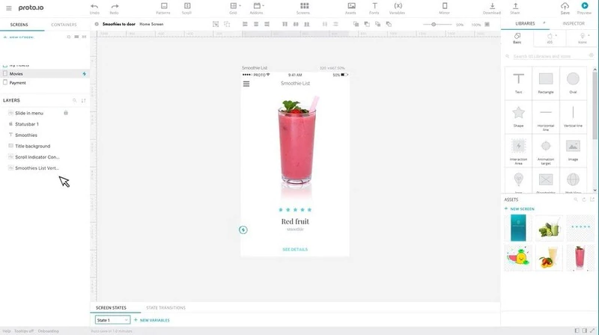
8. Proto.io
Proto.io lets users create high-fidelity prototypes. It allows users to create only mobile apps mockup.
Pros
Free for 15 days.
Advanced animations support.
Developer and programmer collaboration support.
Cons
All features are unavailable on a free trial.
It's a web-based tool only.
Project navigation absent.

Slide 10
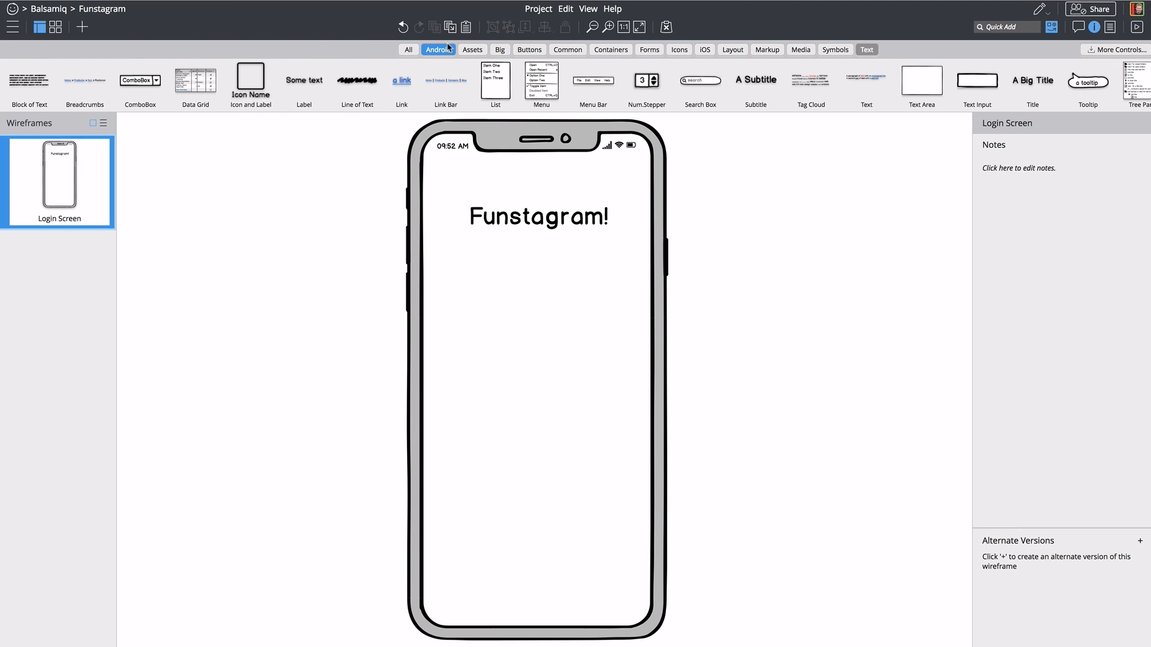
9. Balsamiq
Balsamiq is the perfect tool between sketching on paper and Sketch (the UI designing tool). It is actually meant for “Rapid Prototyping” which means too much feature would be redundant.
Pros
Rapid Prototyping with cool components
Cool shortcuts and other feature to quickly create wireframes
Clickable PDFs export
Online/Cloud version
Cons
Better collaboration
Better integration with other tools like InvisionApp etc
Tends to get slow when the wireframes are complex

Slide 11
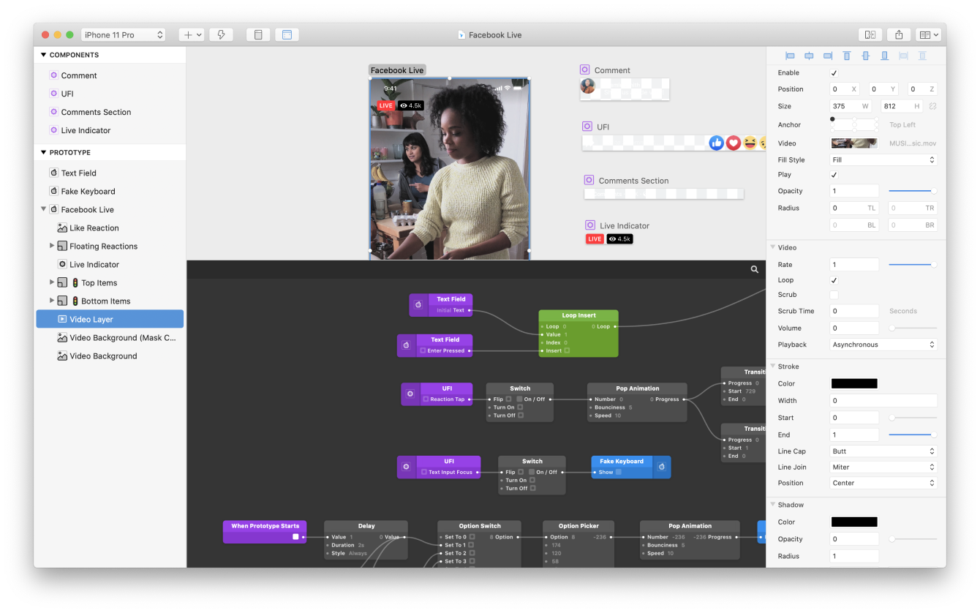
10. Origami Studio
Facebook built this prototyping tool, with a full-screen presentation view. It supports sketch integration in the project.
Pros
Import photoshop elements.
Comment features.
Free to use.
Cons
Can't build anything beyond micro-designs.
The functional view of the page unavailable.

Slide 12
Summary
 | Wondershare Mockitt | Adobe XD | Mockplus | Fluid UI | Marvel App | HotGloo | InVision | Proto.io | Balsamiq | Origami Studio
Pros | Free and easy to use. Drag and drop interface. Make mockups for iPad, Mac, Windows, Smart Watch, TV, and so on. Inspect codes and "hand-off mode.« Build-in widget/icon library and templates. Multiple wireframes and a massive visual interface library. Real-time co-editing facility across teams. Many enterprise solutions, project, and team management authorization levels with access controls. | A few free sets of services. Create visual interfaces and wireframes. Multiple levels of detailing can be achieved. | Create visual mockups quickly. Real-time co-editing features. Interactive prototypes. | Multiple device previews. Cloud access. Prototype in high and low fidelity. | Create prototypes without code. Feedback is centralized across teams. Create scalable designs. | A full-stack tool. Interactive wireframing tool. Freelancer friendly. Relatively affordable and cheaper than others. | Strong community Fine detailing options. | Free for 15 days. Advanced animations support. Developer and programmer collaboration support. | Rapid Prototyping with cool components Cool shortcuts and other feature to quickly create wireframes Clickable PDFs export Online/Cloud version | Import photoshop elements. Comment features. Free to use.
Cons | None to mention | A limited 2 GB cloud storage. Access to every feature is not free. Difficult for users who aren't familiar with the Adobe ecosystem. | Enterprise solutions are expensive compared to other mockup apps free for use. Remote collaboration features lag occasionally. | Navigation is not user-friendly. Pricing is expensive compared to other available options. | Confusing screen-navigation. No animation support. No comment feedback option. | Limited elements library. | Sharing design with clients is difficult. No advanced features like animation in the free version. | All features are unavailable on a free trial. It's a web-based tool only. Project navigation absent. | Better collaboration Better integration with other tools like InvisionApp etc Tends to get slow when the wireframes are complex | Can't build anything beyond micro-designs. The functional view of the page unavailable.

Slide 13
Conclusion
Based on our needs and the simplicity of our project, we decided to use Balsamiq tool. As we said, it is meant for “Rapid Prototyping” and it covers perfectly the simple features we want to add.

