Slide 1
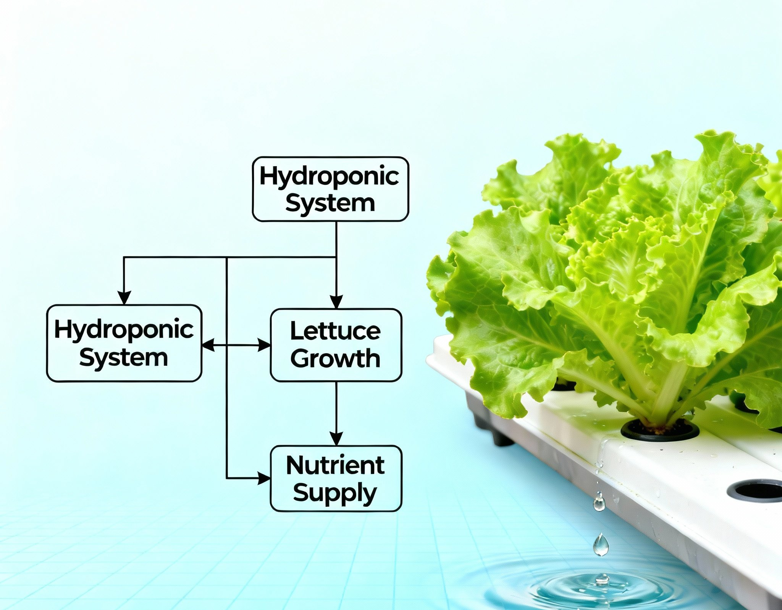
ERD For Hydroponic System PART #3

Slide 2
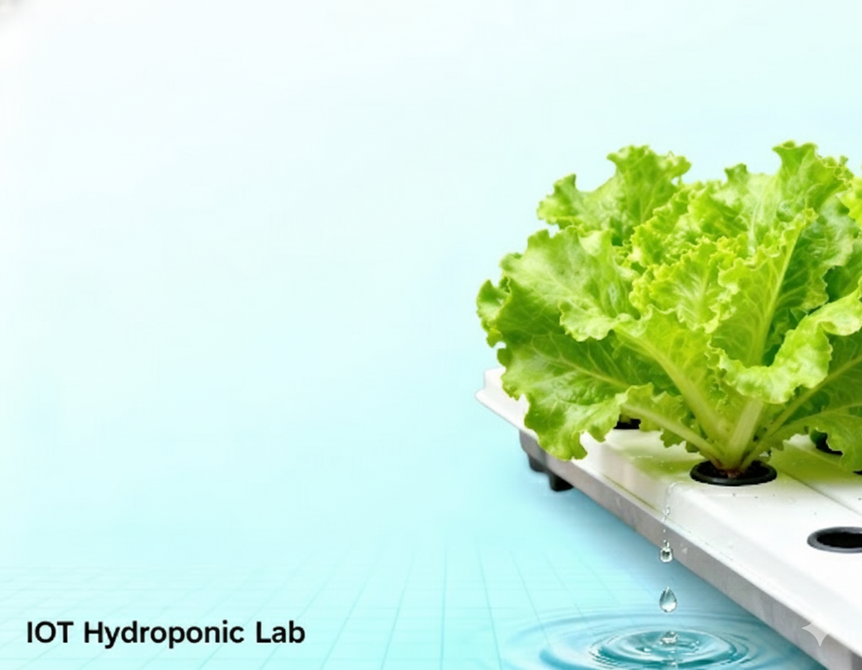

DB Setup For Hydroponic System PART #3

Slide 3

Backend Go For Hydroponic System PART #1

