Slide 1
Heart Disease Analysis Using Machine Learning (Classification)

Slide 2
Objective
This project aims to analyze a dataset that indicates important information about heart diseases.
The tables we have in our dataset are: age, sex, cp (type of chest pain), trestbps (resting blood pressure), chol (serum cholesterol), fbs (fasting blood glucose), restecg (resting electrocardiogram), thalach (maximum heart rate achieved), exang (exercise-induced angina), oldpeak (exercise-induced ST depression relative to rest), slope (the slope of the ST segment at maximal exercise), ca (number of major vessels), thal (a blood disorder called thalassemia), target.
The next objective is to see which classification model is better at predicting the "target" variable.

Slide 3
Dataset Features
Statistical Summary of Table
Number of records: 303 patients.
Main columns:
age: Age of patient.
sex: Sex.
cp: Type of chest pain.
trestbps: Resting blood pressure.
chol: Cholesterol level.
fbs: Fasting blood sugar.
restecg: Resting electrocardiographic results.
thalach: Maximum heart rate achieved.
exang: Exercise-induced angina.
oldpeak: Exercise-induced ST segment depression.
slope: Exercise ST segment slope.
ca: Number of major vessels.
thal: Thiamine test result.
target: Presence of heart disease.
Key Statistics:
Age: Average 54.37 years, minimum 29, maximum 77.
Resting blood pressure: Average 131.62 mm Hg, minimum 94, maximum 200.
Cholesterol: Average 246.26 mg/dl, minimum 126, maximum 564.
Maximum heart rate: Average 149.65, minimum 71, maximum 202.
oldpeak: Average 1.04, with values ​​between 0 and 6.2.
target: Average 0.54, indicating a distribution close to 50% in each class.
Table Structure:
The table contains 14 columns covering clinical and demographic characteristics relevant to assessing the presence of heart disease.
Memory Usage:
The dataset occupies 33.3 KB of memory. Most columns are of type int64, except "oldpeak", which is float64.

Slide 4
Data analysis
The average age of individuals is 54 years, suggesting that most cases of heart problems occur around the age of 50. Although this age is not considered advanced, such problems may be related to additional factors, such as habits, lifestyle or genetic predisposition. It is worth noting that the minimum age recorded is 29 years and the maximum is 77 years.
Regarding the variable “sex”, coded as 1 for men and 0 for women, the average close to 0.7 reveals that most records correspond to men. This could indicate a greater predisposition of men to suffer heart problems, possibly influenced by biological factors or by the physical demands of certain work activities. However, a larger number of records is needed to confirm this trend accurately.
The “cp” column (type of chest pain) is classified into four categories: 0 for typical angina, 1 for atypical angina, 2 for non-anginal pain and 3 for asymptomatic. The mean value, close to 1, shows that most patients have atypical angina, that is chest pain that doesn’t fit the classic patterns of typical angina.

Slide 5
The “trestbps” column, which measures resting blood pressure in millimeters of mercury (mmHg), reveals an average value of approximately 131 mmHg. This indicates that, on average, patients have a pressure slightly above the normal range (120 mmHg), although it is within acceptable limits. It is observed that the minimum value is 94 mmHg —suggestive of hypotension—, while the maximum reaches 200 mmHg, which corresponds to a state of hypertension.
As for the “chol” column, which represents serum cholesterol in milligrams per deciliter (mg/dl), the average recorded is around 246 mg/dl. This result shows that most patients have cholesterol levels above the normal threshold of 200 mg/dl. Factors such as genetic predisposition, poor diet, physical inactivity, obesity or even conditions associated with diabetes could be influencing these levels. It is noted that the minimum value is 126 mg/dl, considered normal, and the maximum value reaches 564 mg/dl, indicating extremely high levels.
The “fbs” column (fasting blood glucose >120 mg/dl) uses binary coding (0 for “true” and 1 for “false”). With a mean close to 0, it can be deduced that most patients have fasting blood glucose above 120 mg/dl. Since normal values ​​are between 70 and 100 mg/dl, these data suggest that most patients in the dataset show signs of diabetes.

Slide 6
The “restecg” column classifies the results into three categories: 0 indicates the presence of probable or definite left ventricular hypertrophy, 1 represents a normal electrocardiogram, and 2 indicates abnormalities in the ST-T wave. With a mean value close to 0.5, it can be inferred that a considerable part of the patients show a normal result, while another group presents signs of left ventricular hypertrophy.
The “thalach” column, which reflects the maximum heart rate achieved, has an approximate mean value of 149. According to the general formula (220 minus the patient's age), this average would suggest an age of around 71 years (220 – 149 = 71); however, since most of the patients in the dataset are around 50 years old, it follows that the maximum heart rate is significantly lower than expected. This finding could be related to the presence of heart disease, which limits the ability to perform physical activity. In addition, there is a minimum value of 71, which for a healthy person would be unusually low and could reflect a serious heart problem, while the maximum value of 202 could correspond to both good physical fitness and responses to high levels of stress or anxiety.
The “exang” column uses binary coding (1 for “no” and 0 for “yes”) to indicate the presence of exercise-induced angina. With a mean value of approximately 0.3, it is concluded that most patients experience exercise-induced angina.

Slide 7
In the “oldpeak” column (ST depression induced by exercise relative to rest), the mean value is 1 mm. Since normal values ​​range from 0 to 1 mm, most patients are within the expected range. However, a minimum value of 0 mm and a maximum of 6.2 mm are recorded, the latter being potentially indicative of significant coronary dysfunction.
In the “slope” column (the slope of the ST segment during maximal exercise), three categories are distinguished: 0 for increasing slope, 1 for flat slope, and 2 for decreasing slope. With a mean value of 1.4, it is inferred that most patients have a flat or decreasing slope. It is important to note that a flat slope may reflect an insufficient response or the presence of underlying myocardial ischemia, while a decreasing slope is considered an abnormal finding and could indicate significant coronary dysfunction or myocardial ischemia.
In the “ca” column (number of main vessels) values ​​are recorded that vary between 0 and 3.
In the “target” column, two values ​​are distinguished: 0, which indicates the absence of disease, and 1, which indicates its presence. The average value of 0.54 suggests that just over half of the individuals in the dataset have some form of heart disease. The remaining cases, in which atypical pain or symptoms occur, could be associated with other conditions or factors other than heart disease.

Slide 8
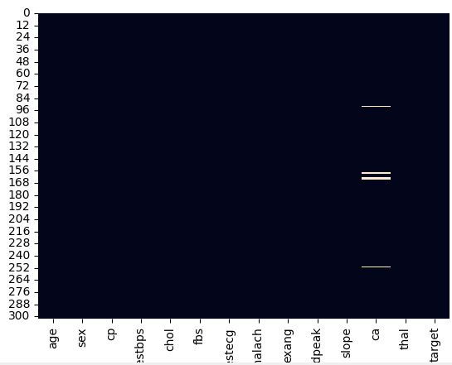
Deleting erroneous data
In the “ca” column a maximum value of 4 is displayed, when this column should only have a maximum value of 3.
A total of 5 records were removed, which is favorable for future analysis.
In addition, it is observed that the mean value is approximately 0.7, indicating that most patients in the dataset have a CA1. They have a main coronary artery that shows stenosis or significant narrowing.
This finding may constitute a risk factor for cardiac problems, such as myocardial infarction.

Slide 9
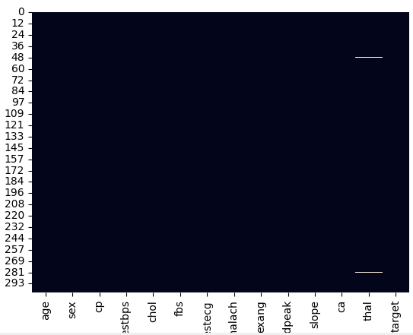
In the “thal” column a minimum value of 0 is displayed, when this column should only have a minimum value of 1.
Only 2 records were removed from the dataset, which is considered a highly acceptable result for analysis.
In addition, it is observed that the average value of the variable “thal” is 2.3, indicating that most patients have a reversible defect.
This suggests the existence of areas in the heart where blood flow decreases during stress situations, such as in a stress test, but normalizes when the stress ceases.
This finding could be indicative of inducible myocardial ischemia, areas of the heart that, although experiencing a reduction in flow during physical activity or stress situations, recover adequate perfusion when stress is relieved.

Slide 10
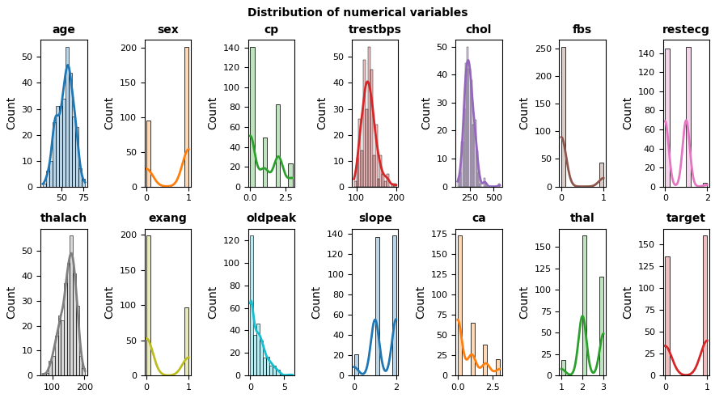
Distribution of numerical variables

Slide 11
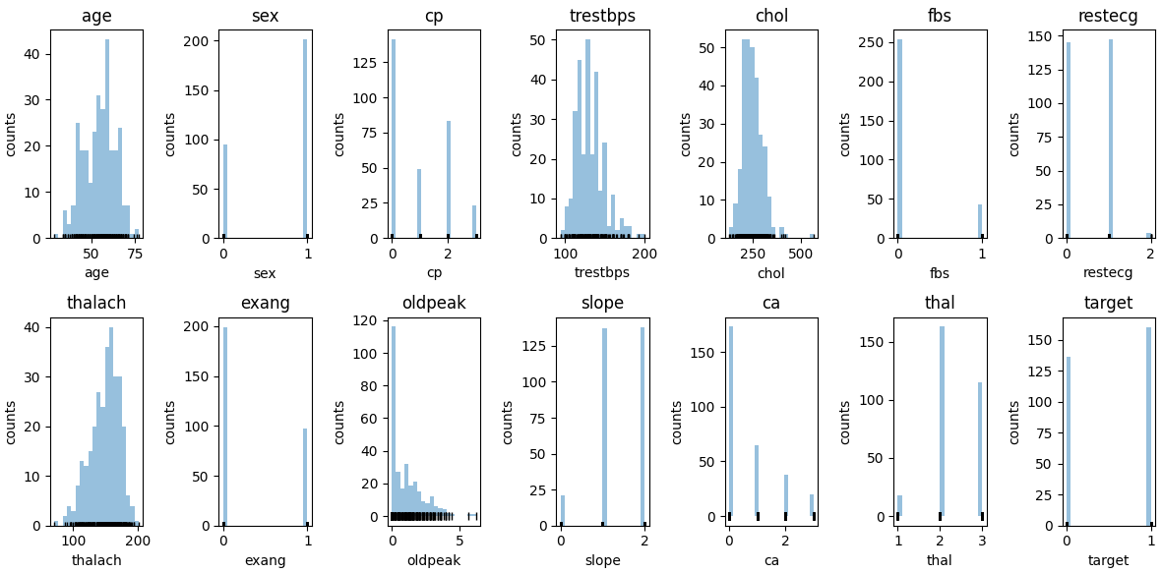

Slide 12
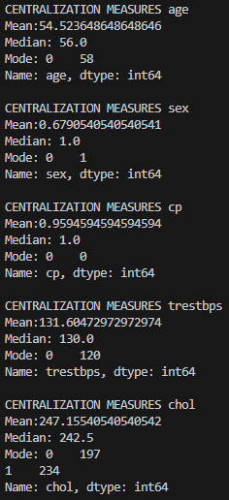
Univariate analysis
Measures of centralization: mean, median and mode.
In age we have MEAN < MEDIAN < MODE, this means that there is a negatively skewed distribution of the data.
In sex we have MEAN < MEDIAN = MODE, this means that there is a negatively skewed distribution.
In cp we have MEAN = MEDIAN > MODE, this means that there is a positively skewed distribution.
In trestbps we have MEAN > MEDIAN > MODE, this means that there is a positively skewed distribution.
In chol we have MEAN > MEDIAN > MODE, this means that there is a positively skewed distribution.

Slide 13
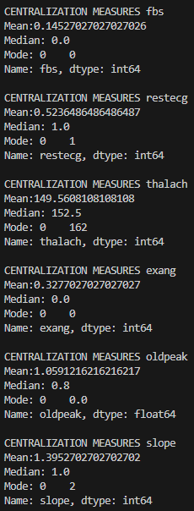
In fbs we have MEAN > MEDIAN = MODE, this means there is positively skewed distribution.
In restecg we have MEAN < MEDIAN = MODE, this means there is negatively skewed distribution.
In thalach we have MEAN < MEDIAN < MODE, this means there is negatively skewed distribution.
In exang we have MEAN > MEDIAN = MODE, this means there is positively skewed distribution.
In oldpeak we have MEAN > MEDIAN > MODE, this means there is positively skewed distribution.
In slope we have MEAN > MEDIAN < MODE and MODE > MEAN, this means there is negatively skewed distribution.

Slide 14
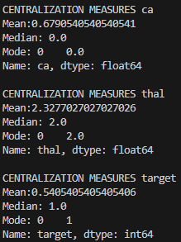
In ca we have MEAN > MEDIAN = MODE, this means that there is a positively skewed distribution.
In thal we have MEAN > MEDIAN = MODE, this means that there is a positively skewed distribution.
In target we have MEAN < MEDIAN = MODE, this means that there is a negatively skewed distribution.

Slide 15
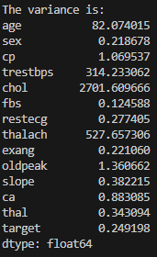
Measures of dispersion: standard deviation, range, IQR, coefficient of variation, mean deviation
The analysis of the dataset shows that the columns “sex”, “cp”, “fbs”, “restecg”, “exang”, “oldpeak”, “slope”, “ca”, “thal” and “target” have a low variance, which translates into a reduced dispersion of their data. This behavior is due, in part, to the nature of these variables, since some, such as “sex”, only admit two values ​​(0 and 1).
In contrast, the columns “age”, “trestbps”, “chol” and “thalach” show a high variance, indicating a greater dispersion of the data in these variables.

Slide 16
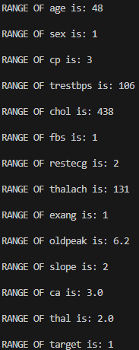
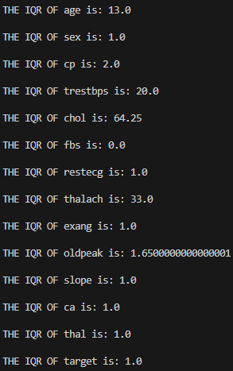
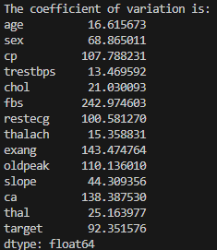
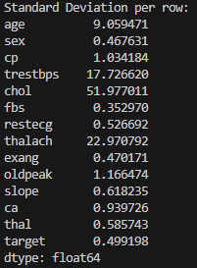
The above can be verified with the values ​​of standard variation, the coefficient of variation, the range and the IQR.

Slide 17
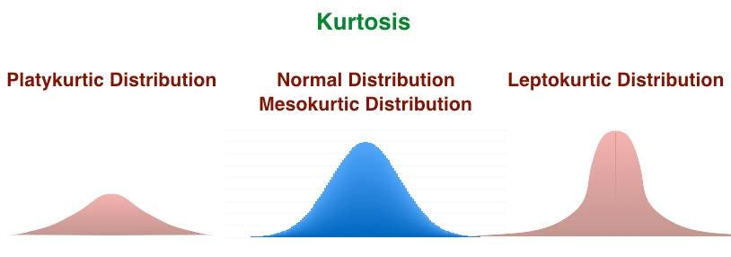
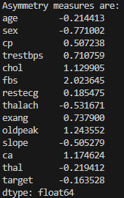
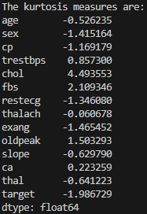
Measures of asymmetry
Analysis of the asymmetry measures reveals that all columns present values ​​close to zero, indicating approximately symmetrical distributions with slight inclinations towards positive or negative asymmetries.
Regarding kurtosis, the columns "age", "sex", "cp", "restecg", "thalach", "exang", "slope", "thal" and "target" exhibit a platykurtic distribution, characterized by thinner tails and a lower concentration of data at the extremes. On the other hand, the remaining columns show a leptokurtic distribution, with thicker tails and a greater propensity to extreme values, being especially notable in "chol" and "fbs".
Most columns present kurtosis values ​​close to zero, suggesting a mesokurtic distribution, similar to the normal.

Slide 18
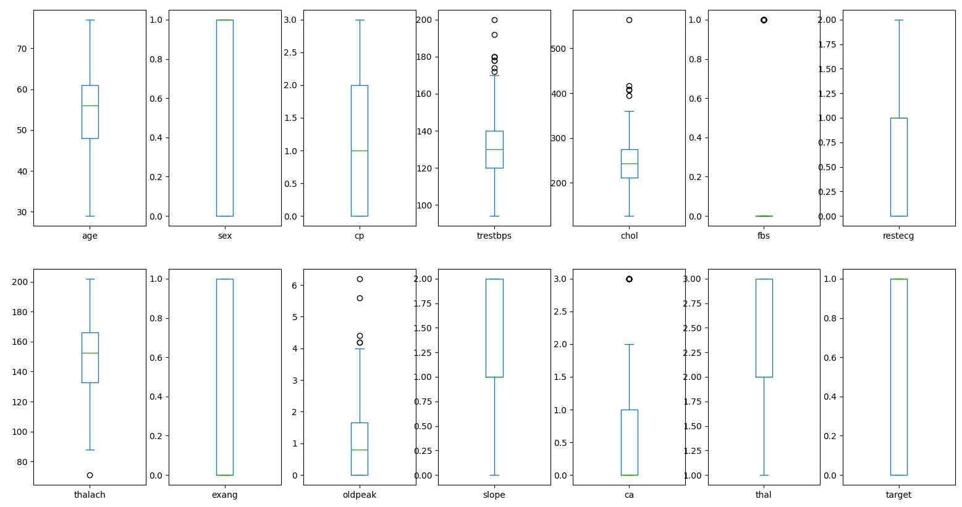
Detection and elimination of outliers

Slide 19
Analysis of the data reveals the presence of several outliers in multiple columns; fortunately, most columns do not have outliers.
After removing these outliers, the data set was reduced from 303 to 226 records. Although we have most of the information, this reduction could introduce bias in future analyses.
In addition, because several columns contain numerically coded categorical variables, replacing outliers with the mean could distort the results.
Two data sets have been generated: one that includes all outliers and one in which they have been removed.

Slide 20
Categorical data analysis
Next, a graphical analysis of all columns in the dataset without outliers will be performed. However, some columns must be converted to categorical variables to facilitate the interpretation of their values.
Once the dataset has been transformed into its categorical format, the corresponding visualizations will be generated. In addition to analyzing the individual graphs of each column, the percentages of the categorical variables will also be presented in order to improve the understanding of the distribution of the data.

Slide 21
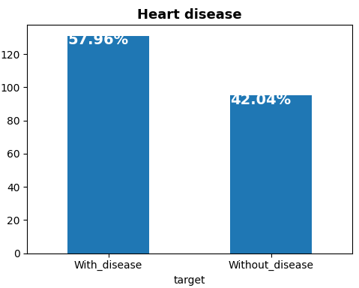
We can see that there is a majority of people with heart disease, exceeding the number of healthy people by 16%.

Slide 22
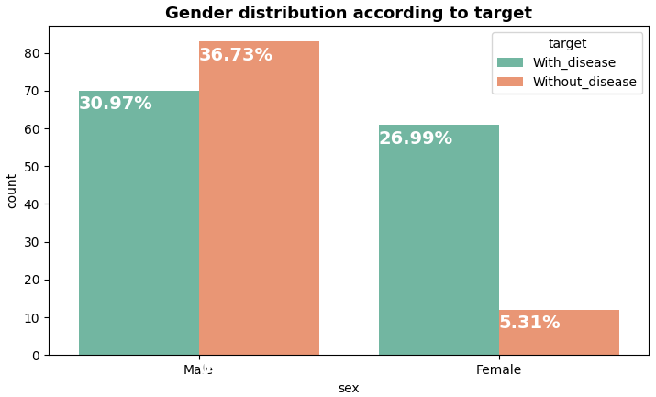
It is observed that the prevalence of heart disease is higher in men than in women.
However, within the dataset, the majority of men don’t have heart disease, while the majority of women do.
In particular, only 5.31% of women in the dataset don’t have heart disease.

Slide 23
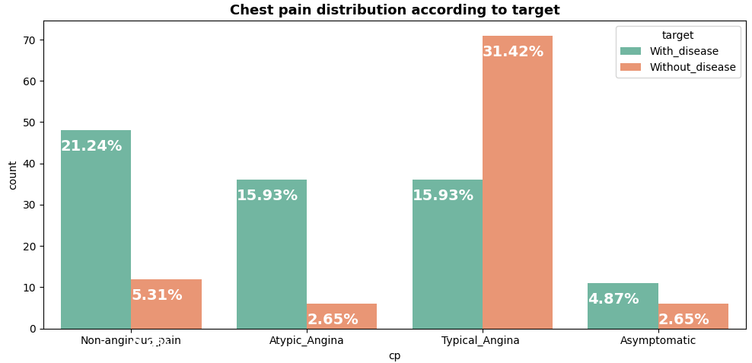
When looking at the chart on types of chest pain, it can be seen that most asymptomatic patients have heart disease.
In the case of those with atypical angina, a large proportion also have the disease. Most people with non-anginal pain have heart disease.
In contrast, most patients with typical angina do not have the disease.
It should be noted that chest pain may have a subjective or psychological component in some cases, such as in situations of excessive stress or intense physical activity.

Slide 24
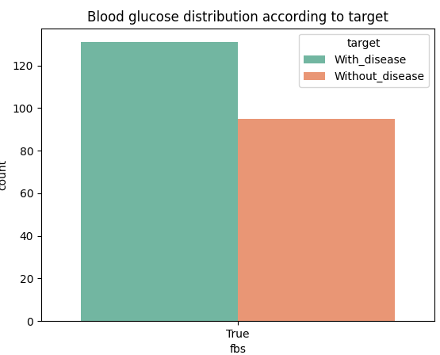
When analyzing the distribution of blood glucose according to the variable fbs (fasting glucose level), it is observed that only data with the category "True" are found.
This indicates that, during the elimination of outliers, records in which this value was "False" were also discarded.
To resolve this situation, the original dataset, which includes the outliers, will be used in order to analyze this case in detail.

Slide 25
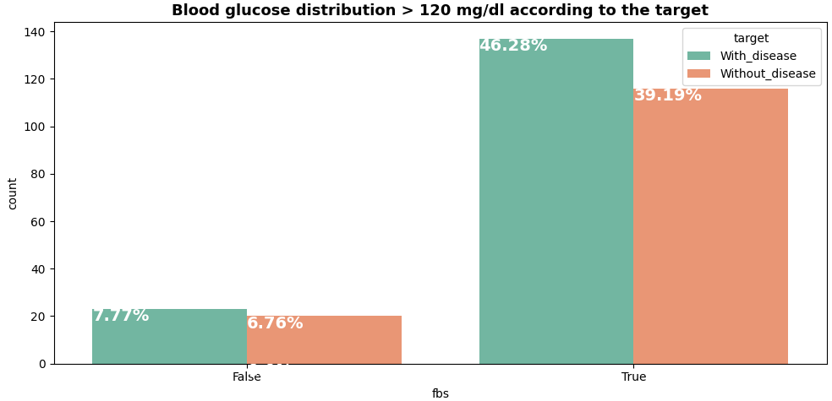
We can now visualize the data more clearly. We see that a large number of people have blood glucose levels above 120 mg/dL, and within this group, the proportion of individuals with heart disease is higher than that of those without the disease. In contrast, people with glucose levels below 120 mg/dL have a significantly lower percentage of heart conditions.
This analysis suggests that diabetes could be a relevant factor in the predisposition to cardiovascular diseases.
In the data set, most people without diabetes have a lower incidence of heart disease.

Slide 26
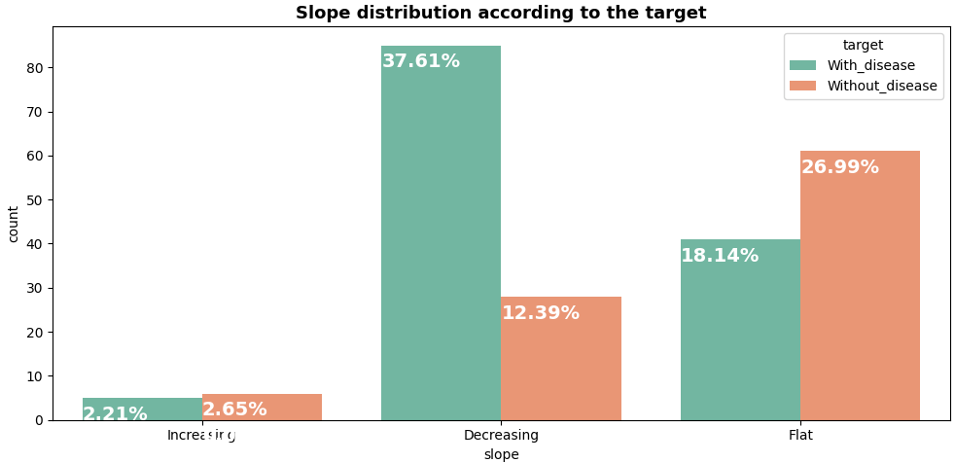
When analyzing the distribution of ST-segment slope during maximal exercise, it is observed that the majority of patients exhibit a decreasing slope.
Of this group, approximately 37.61% have heart disease, compared to 12.39% of patients without heart disease.
On the other hand, although a significant proportion of patients show a flat slope, the majority of these don’t have heart disease.

Slide 27
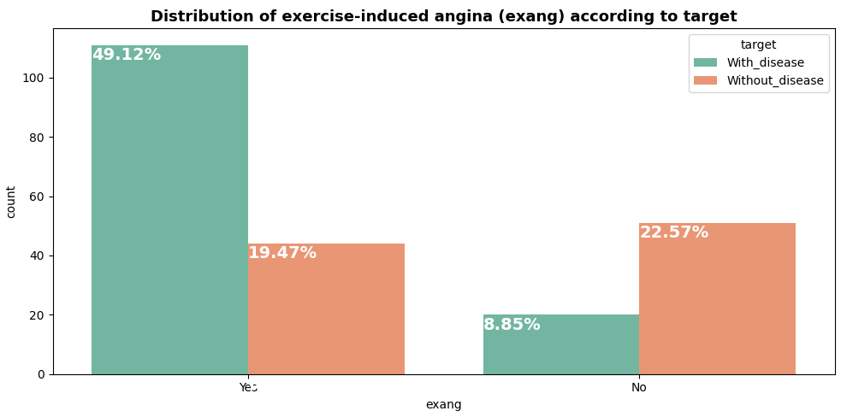
When looking at the relationship between exercise-induced angina and the presence of heart disease, it is observed that a significant proportion of patients with exercise-induced angina have heart disease.
In contrast, the majority of patients without exercise-induced angina do not have heart disease. This suggests that the presence of chest pain during exercise is associated with heart problems.

Slide 28
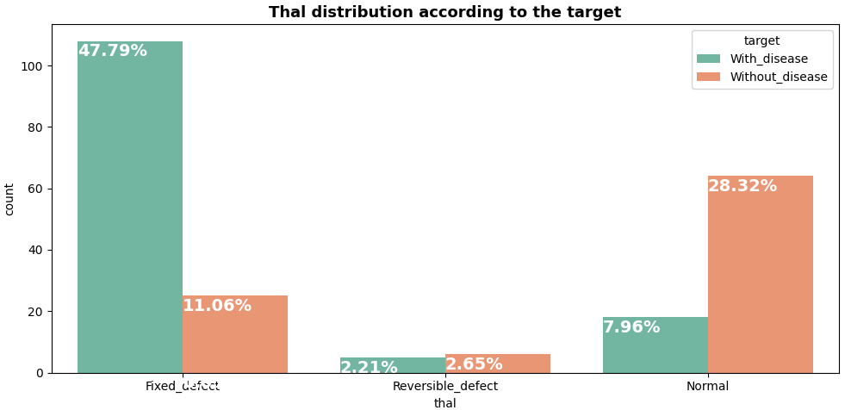
When analyzing the distribution of myocardial perfusion defects, it is observed that the majority of patients have fixed defects, of which a significant proportion have cardiac disease.
In contrast, patients with reversible defects show a more balanced distribution between those with and without heart disease.
The majority of patients without myocardial perfusion defects don’t have heart disease.

Slide 29
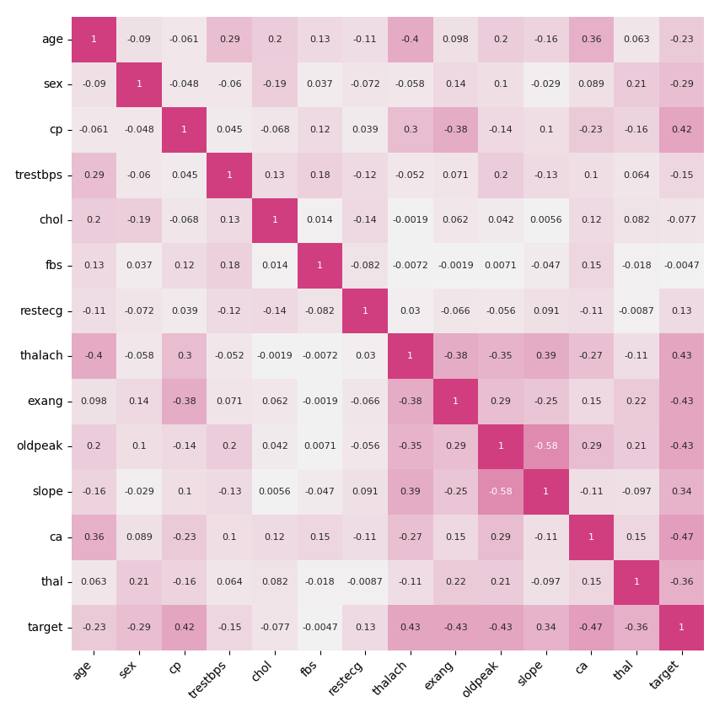
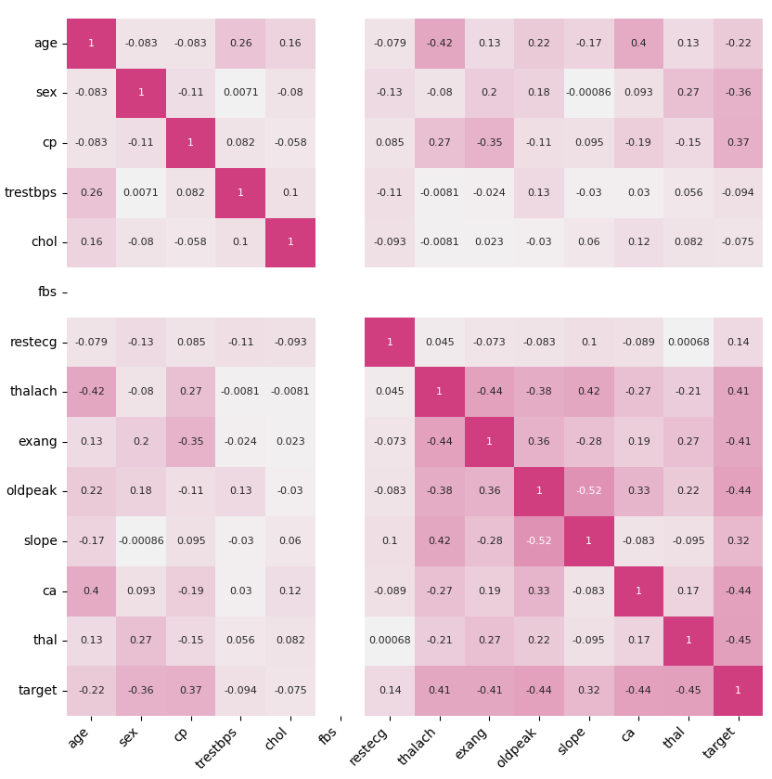
Correlation matrix
Dataset with outliers
Dataset without outliers

Slide 30
Statistical analysis
Due to the large number of variables in X, graphing them all is complicated. For practical purposes, we will choose to visualize only those non-categorical variables that show the highest correlation with the target variable.
In both data sets, it has been identified that the non-categorical variables with the highest correlation with target are age and oldpeak.
From now on, 2 models are compared: Dataset with categorical data and Dataset with non-categorical data.

Slide 31
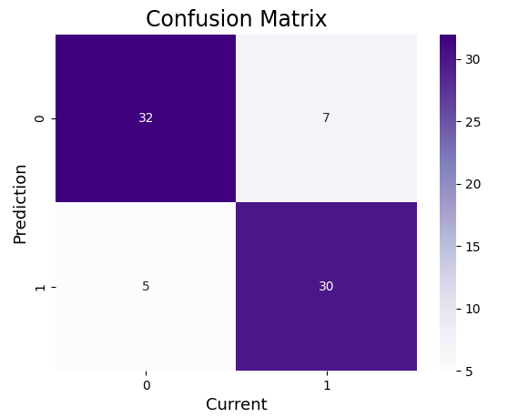

Linear logistic regression
Categorical dataset with outliers:
The confusion matrix plot for the dataset with outliers shows a total of 5 false negatives and 7 false positives, which is relatively low compared to the number of true positives and true negatives.
This indicates that the model's predictions are quite accurate.
Specifically, the model achieves a precision of 81%, an accuracy of 84%, a sensitivity of 86%, an F1 score of 83%, and an area under the ROC curve of 84%, supporting the robustness and reliability of its predictions.

Slide 32
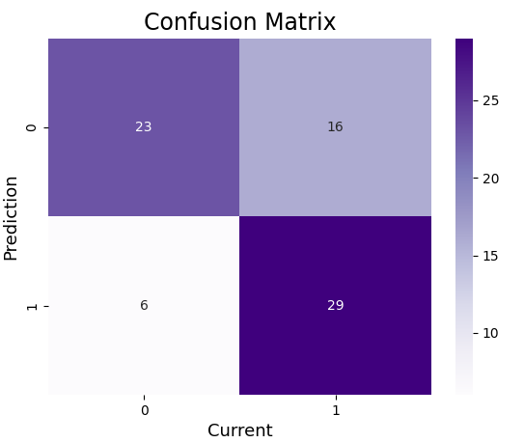
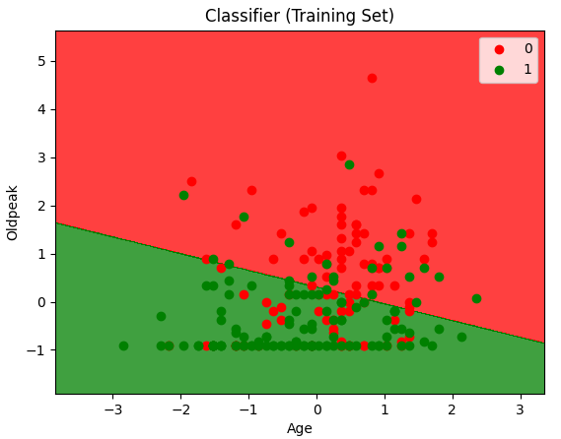
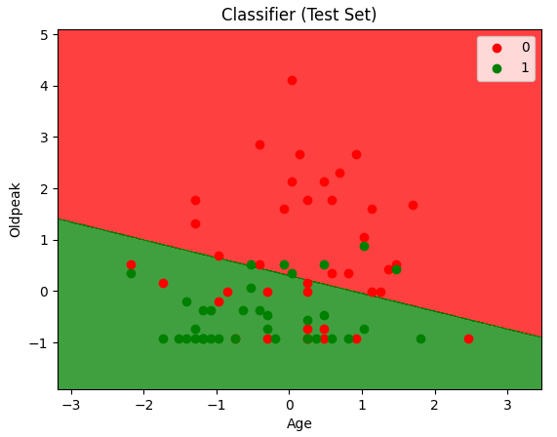

The confusion graph shows 16 false positives and 6 false negatives, indicating a high number of errors in the predictions.
Compared to the model that uses the 9 variables with the highest correlation with the target variable, this model performs worse, with a precision of 64% and an accuracy of 70%.
Although the sensitivity is relatively high (83%), the F1 score (73%) and the area under the ROC curve (71%) don’t compensate for the number of misclassifications.
The distribution of the points in the graph (where numerous misclassified points are evident, with green in areas of wrong classification and vice versa) reinforces the conclusion that this model is not recommended for use.
Non-categorical dataset with outliers:

Slide 33
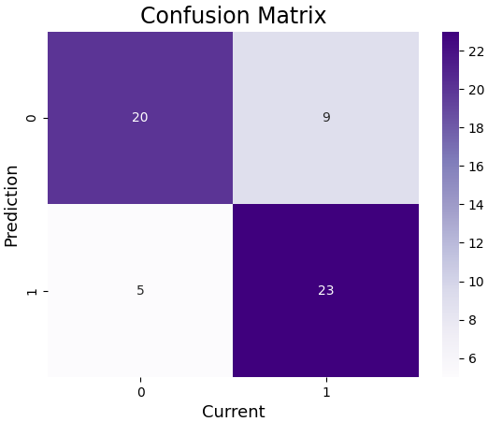

Categorical dataset without outliers:
Analysis of the confusion matrix of the dataset without outliers reveals 9 false positives and 5 false negatives, which translates into a higher number of errors compared to the dataset with outliers.
With a precision of 72% and an accuracy of 75%, the model exhibits moderate performance; although more correct predictions are obtained than incorrect ones, its performance is lower than that observed in the dataset with outliers.
This could be explained by the reduction in data volume, suggesting that some records discarded as outliers contained relevant information for the analysis.

Slide 34
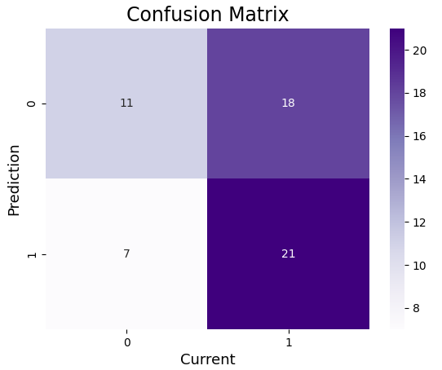
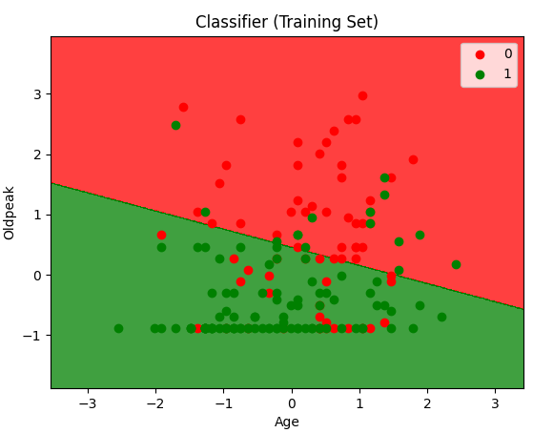
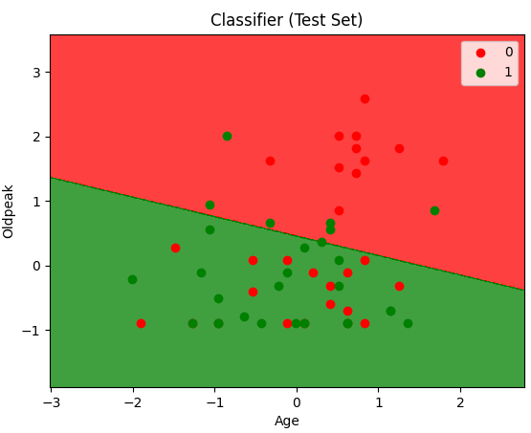

The confusion graph shows that the model has 18 false positives and 7 false negatives, which indicates low precision.
With a precision of 54% and an accuracy of 56%, the model's performance is inadequate to generate reliable predictions, being considerably lower than that obtained with the data set that includes outliers.
In addition, a marked overlap of misclassified points is observed, with numerous false positives in areas expected for true negatives and vice versa.
Non-categorical dataset without outliers:

Slide 35
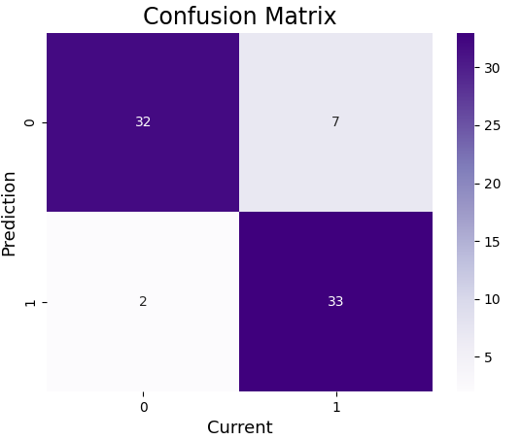

Logistic regression with KNN
Categorical dataset with outliers (K = 9):
The analysis of the KNN model applied to the normal dataset reveals a precision of 82% and an accuracy of 88%.
The low number of false positives and false negatives indicates that the model is capable of generating very reliable predictions.
These results are complemented by a sensitivity of 94%, an F1 score of 88% and an ROC - AUC of 88%, which confirms the robustness and effectiveness of the model for the analysis of this dataset.

Slide 36
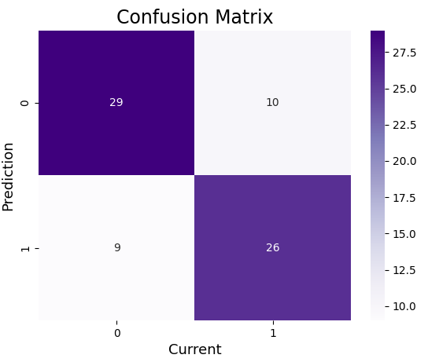
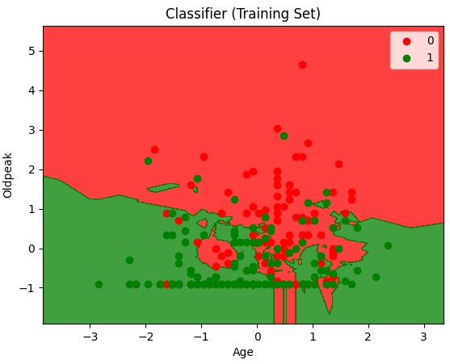
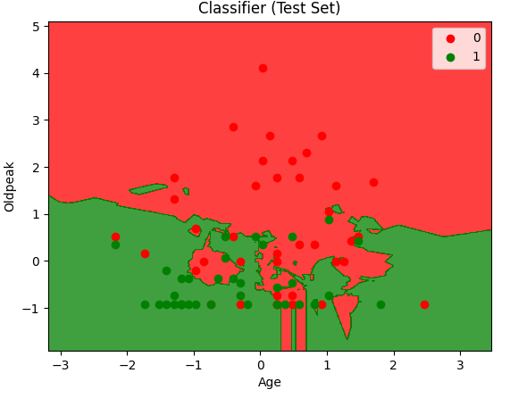

The graph shows a considerable number of false positives and false negatives, suggesting that the model isn’t particularly accurate.
With a precision of 72% and an accuracy of 74%, the results aren’t deplorable, but an error rate close to 30% advises against its use.
In addition, the graphical representation doesn’t show a clear separation between the classes, which reinforces the recommendation to look for a model with a higher performance.
Non-categorical dataset with outliers
(K = 6):

Slide 37
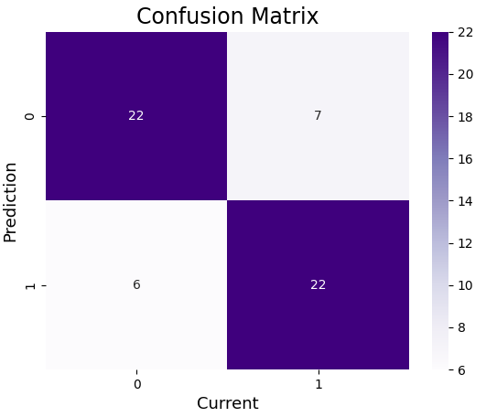

Categorical dataset without outliers (K = 4):
The confusion matrix of the dataset without outliers shows a relatively low number of false positives and false negatives, indicating that the model could achieve good accuracy.
However, it is important to note that this dataset has a lower number of records. In this case, the model obtains an precision of 76%, an accuracy of 77%, a sensitivity of 79%, an F1 score of 77% and an ROC-AUC of 77%.
Although these results show that more correct predictions are recorded than errors, the performance is lower than that observed in the dataset that includes outliers.

Slide 38
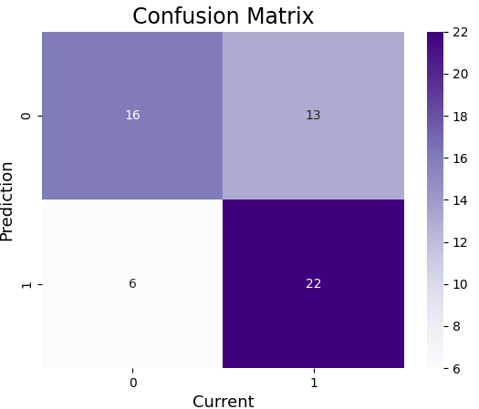
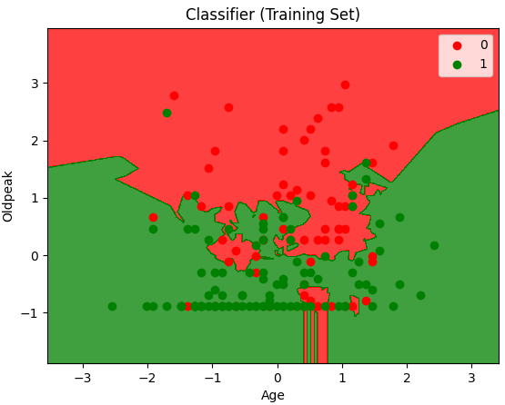
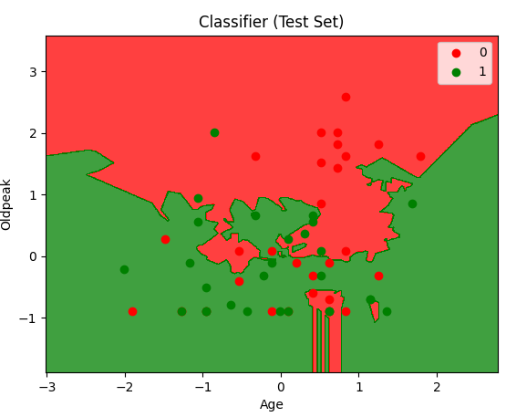

Non-categorical dataset without outliers
(K = 5):
The graph reveals that the model has a considerable number of false positives and false negatives, which is reflected in a precision of 63% and an accuracy of 67%.
These results indicate unsatisfactory performance, since the model isn’t able to generate reliable predictions, which makes its use inadvisable.
The graphical representation clearly emphasizes the inaccuracy of the model.

Slide 39
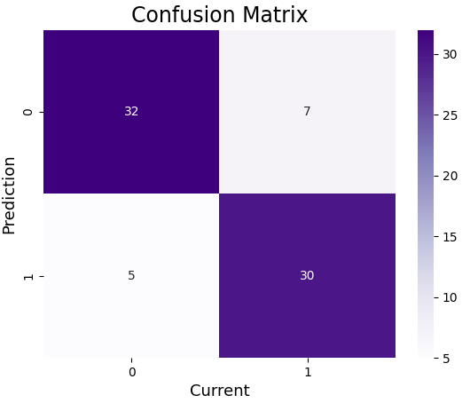
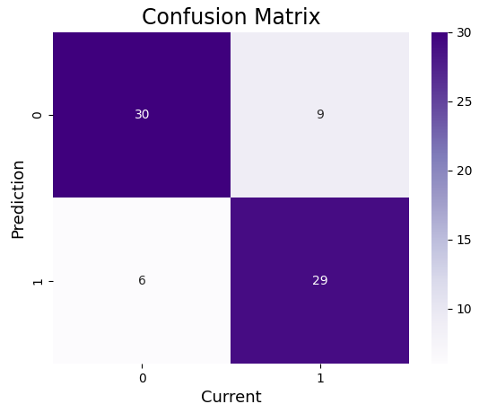
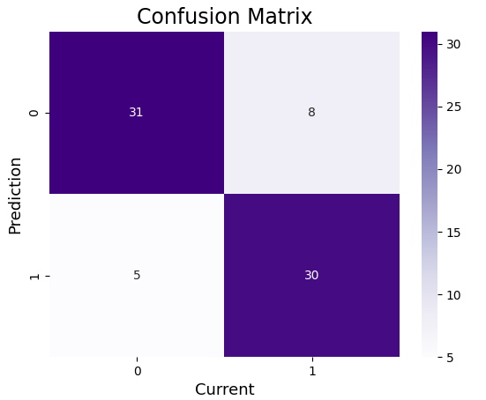
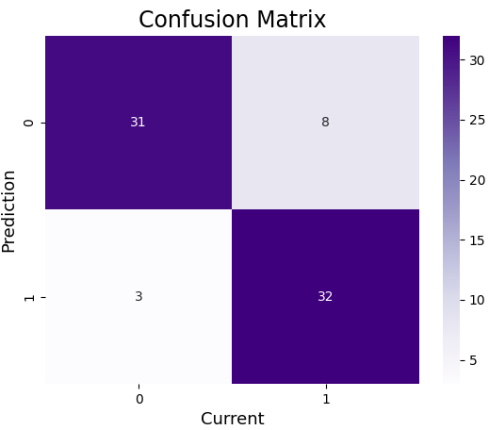




Support vector machines
Categorical dataset with outliers
(kernel = “linear”):
Categorical dataset with outliers
(kernel = “poly”):
Categorical dataset with outliers
(kernel = “rbf”):
Categorical dataset with outliers
(kernel = “sigmoid”):

Slide 40
“linear”: The model shows a low number of false positives and false negatives, suggesting a good level of accuracy. It has an accuracy of 81% and an accuracy of 84%, indicating that it is capable of generating reliable and quality predictions.
“poly”: This model presents a higher number of false positives and false negatives compared to the linear SVM. With an accuracy of 76% and an accuracy of 80%, its performance is lower than that of the linear SVM, indicating a lower ability to make accurate predictions.
“rbf”: This model presents a similar number of false positives and false negatives to that of the linear SVC. With an accuracy of 79% and an accuracy of 82%, its results are comparable to those of the linear SVM and higher than those of the SVM with a polynomial kernel, indicating good prediction performance.
“sigmoid”: This model presents a similar number of false positives and false negatives to that of the linear SVM. With a precision of 80% and an accuracy of 85%, it is more accurate than SVM with RBF kernel, although slightly less accurate than linear SVM. Overall, it offers good prediction performance.
The best model is Logistic Regression with SVM Sigmoid, as it has the highest precision (80%), accuracy (85%) and sensitivity (91%), as well as having the best ROC-AUC (85%). This indicates that the model has a good balance between precision and sensitivity, as well as a good ability to discriminate between classes.
The worst model is Logistic Regression with SVM Poly, with the lowest values.

Slide 41
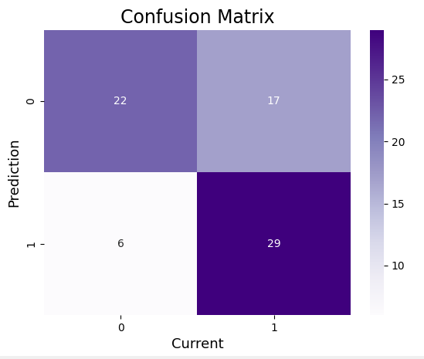
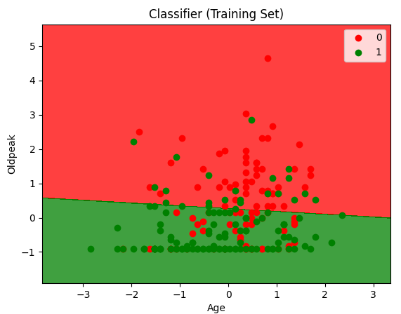
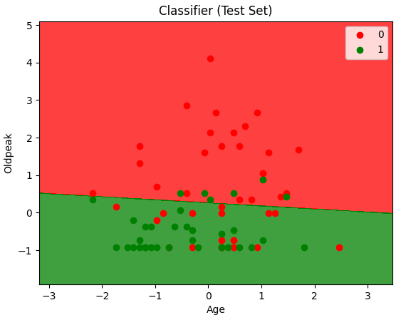

Non-categorical dataset with outliers
(kernel = “linear”):
A significant number of false positives and false negatives are observed, indicating low model accuracy.
It has a precision of 63% and an accuracy of 69%, suggesting that its ability to make reliable predictions is limited.
Due to its poor performance, this model is not recommended for use.

Slide 42
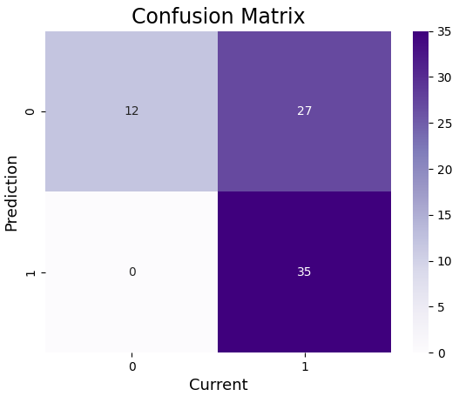



Non-categorical dataset with outliers
(kernel = “poly”):
This model has significantly more false positives and false negatives compared to linear SVM.
With a precision of 56% and an accuracy of 64%, it underperforms linear SVM, indicating a lower ability to make accurate predictions.

Slide 43




Non-categorical dataset with outliers
(kernel = “rbf”):
This model exhibits fewer false positives and false negatives compared to SVM poly.
With a precision of 61% and an accuracy of 68%, it shows better performance than SVM poly and similar results to linear SVM.

Slide 44




Non-categorical dataset with outliers
(kernel = “sigmoid”):
In this model, the number of false positives and false negatives is higher compared to SVM RBF.
With a precision of 55% and an accuracy of 59%, it underperforms SVM poly.

Slide 45
The best model is:
Logistic regression with “linear” SVM:
Precision: 0.63
Accuracy: 0.69
Sensitivity: 0.83
F1 score: 0.72
ROC - AUC curve: 0.70
This model has the highest precision, accuracy and F1 score compared to the others, indicating better balance between classes and higher overall performance.
The worst model is:
Logistic regression with SVM “sigmoid”:
Precision: 0.55
Accuracy: 0.59
Sensitivity: 0.83
F1 score: 0.66
ROC - AUC curve: 0.61
This model has the lowest precision, accuracy, and ROC - AUC curve, making it less reliable for predictions. Although it has acceptable sensitivity, its overall performance is not as robust as the other models.

Slide 46








Categorical dataset without outliers
(kernel = “linear”):
Categorical dataset without outliers
(kernel = “poly”):
Categorical dataset without outliers
(kernel = “rbf”):
Categorical dataset without outliers
(kernel = “sigmoid”):

Slide 47
“linear”: The model has a low number of false positives and negatives, suggesting reasonably accurate performance. With a precision of 75% and an accuracy of 79%, the model has the potential to generate good predictions. However, since the accuracy is not within optimal levels, it is not recommended for use in environments where a high degree of precision is required.
“poly”: The model has a considerable number of false positives and negatives, indicating limited precision. With a precision of 63% and an accuracy of 68%, this model is less accurate compared to linear SVM. Given its performance, it isn’t suitable for generating reliable predictions.
“rbf”: The model has a lower number of false positives and negatives compared to poly SVM, achieving a precision of 69% and an accuracy of 72%. Although it is more accurate than poly SVM, its performance is still inferior to linear SVM. Due to its limited performance, it isn’t suitable for generating reliable predictions.
“sigmoid”: The model shows a slight reduction in the number of false positives and negatives, with a precision of 71% and accuracy of 77%. Although it outperforms rbf SVM, its performance is still inferior to linear SVM. Since it does not meet acceptable standards for generating accurate predictions, it is not recommended for use.
The best model is the linear SVM, this model has the best combination of precision, accuracy, sensitivity, F1 score and ROC-AUC curve.
The worst model is the poly SVM, this model has the lowest precision and accuracy, although it has a relatively high sensitivity. However, the combination of other metrics indicates that this model isn’t as effective compared to the others.

Slide 48




Non-categorical dataset without outliers
(kernel = “linear”):
The model exhibits a significant number of false positives and false negatives, indicating low accuracy.
With a precision of 53% and an accuracy of 54%, it isn’t able to generate reliable predictions.

Slide 49




Non-categorical dataset without outliers
(kernel = “poly”):
The model has fewer false positives and false negatives, but still exhibits limited accuracy.
With 59% precision and 65% accuracy, it is superior to linear SVM, but is still not suitable for generating reliable predictions.

Slide 50




Non-categorical dataset without outliers
(kernel = “rbf”):
The model has a considerable amount of false positives and false negatives.
With a precision of 54% and an accuracy of 56%, the results are similar to those of the linear SVM, but lower than those of the poly SVM. It isn’t considered suitable for generating accurate predictions.

Slide 51




Non-categorical dataset without outliers
(kernel = “sigmoid”):
The model presents a considerable amount of false positives and false negatives.
With a precision of 45% and an accuracy of 44%, it is considered the worst model among those evaluated, since it isn’t capable of generating reliable predictions.

Slide 52
The best model is:
Logistic Regression SVM poly for the dataset with non-categorical data without outlier, as it has the highest precision (59%), accuracy (65%), sensitivity (96%) and F1 score (73%). Its overall performance is the strongest and, despite its ROC - AUC of 0.65, it is still the most robust model in this set.
The worst model is:
Logistic Regression SVM sigmoid for the dataset with non-categorical data without outlier, with a precision of 45%, accuracy of 44% and a ROC - AUC of 44%. This model shows considerably poor performance compared to the other models, suggesting that it isn’t suitable for this dataset.

Slide 53


Naive Bayes
Categorical dataset with outliers:
Analysis of this model reveals a low number of false positives and false negatives, indicating a high degree of accuracy.
With a precision of 81%, an accuracy of 82%, a sensitivity of 83%, an F1 score of 82%, and an ROC-AUC of 82%, the model is expected to provide reliable and quality predictions.

Slide 54




Non-categorical dataset with outliers:
The analysis of this model shows a considerable number of false positives and false negatives, which translates into limited precision.
With a precision of 61% and an accuracy of 68%, the model isn’t capable of generating reliable predictions and is therefore not recommended for use in applications where high predictive performance is required.
Although the sensitivity is relatively high (86%) and the F1 score reaches 71%, these indicators do not compensate for the low precision and accuracy, and the ROC-AUC of 68% reinforces the conclusion that the overall performance of the model is insufficient for practical applications.

Slide 55


Categorical dataset without outliers:
It is observed that this model presents a slightly higher number of false positives and negatives compared to the normal dataset.
With a precision of 70% and an accuracy of 74%, the performance of the model is lower than that obtained with the normal dataset, indicating that its predictions aren’t reliable enough for critical applications.

Slide 56



Non-categorical dataset without outliers:
The model presents a considerable amount of false positives and false negatives, which translates into limited precision.
With a precision of 54% and an accuracy of 56%, its results are inferior to those obtained with the normal dataset, which makes it unsuitable for critical applications.
In addition, the ROC-AUC of 56% and an F1 score of 63% reinforce the conclusion that the overall performance of the model is poor.

Slide 57


Decision trees
Categorical dataset with outliers:
The analysis of the model reveals a moderate amount of false positives and false negatives.
With a precision of 74% and an accuracy of 77%, the performance of the model is acceptable but not optimal.
This could be because the decision tree requires a larger volume of data to improve its accuracy and robustness in prediction.

Slide 58




Non-categorical dataset with outliers:
The analysis of the model shows a significant number of false positives and false negatives, which translates into limited precision.
With a precision of 52%, an accuracy of 55%, a sensitivity of 63%, an F1 score of 57% and an ROC-AUC of 56%, the overall performance of the model is insufficient to generate reliable predictions.

Slide 59


Categorical dataset without outliers:
The analysis of the model reveals a moderate amount of false positives and false negatives, suggesting acceptable performance.
With a precision of 70% and an accuracy of 74%, the model performs worse than the one trained with the normal dataset, probably due to the smaller amount of data available in this set.

Slide 60




Non-categorical dataset without outliers:
The analysis reveals a high number of false positives and false negatives.
The model has a precision of 57% and an accuracy of 56%, with a sensitivity of 46% and an F1 score of 51%, as well as an ROC-AUC of 56%.
Although its performance is slightly higher than that obtained with the normal dataset, these results don’t allow for generating reliable predictions, so its use isn’t recommended.

Slide 61


Random Forest
Categorical dataset with outliers
(depth = 3):
The optimal depth for this dataset is observed to be 3, and the false positive and false negative graph reveals a reduced number of errors.
The model achieves a precision of 81% and an accuracy of 82%, complemented by a sensitivity of 83%, an F1 score of 82% and an ROC-AUC of 82%.
These results indicate that the model is robust and capable of generating reliable predictions.

Slide 62


Categorical dataset without outliers (depth = 6):
On the other hand, in the dataset without outliers, the optimal depth was determined to be 6.
This suggests that, despite the smaller number of records, the model requires a higher level of complexity to adequately capture the characteristics of the data.
However, a considerable number of false positives and false negatives are observed, which translates into a precision of 65% and an accuracy of 68%.
Consequently, the performance of the model isn’t optimal and its ability to generate reliable predictions is limited.

Slide 63




Non-categorical dataset with outliers
(depth = 1):
For this model, the optimal depth is 1, indicating a limited ability to capture complex patterns in the data.
This is reflected in the high number of false positives and false negatives.
With a precision of 61% and an accuracy of 68%, the model underperforms and isn’t suitable for generating reliable predictions.

Slide 64




Non-categorical dataset without outliers
(depth = 2):
In this model, the optimal depth is 2, slightly higher than in the previous case.
However, a high number of false positives and false negatives are observed, which affects its performance.
Despite achieving a precision of 55% and an accuracy of 58%, the model performs poorly and isn’t suitable for making reliable predictions.

Slide 65
Conclusions

Slide 66
Best model
The Logistic Regression with KNN for the normal dataset is the best model according to the results. Its metrics are the highest in almost all aspects:
Precision: 0.82
Accuracy: 0.88
Sensitivity: 0.94
F1 Score: 0.88
ROC-AUC: 0.88
This model outperforms the logistic regression and SVM versions in terms of accuracy and balance between precision and sensitivity.
Worst model
The SVM sigmoid logistic regression with non-categorical data and no outliers is the worst model evaluated. Its metrics are remarkably low:
Precision: 0.45
Accuracy: 0.44
Sensitivity: 0.64
F1 Score: 0.53
ROC-AUC: 0.44
This model has the worst accuracy and ROC-AUC, indicating low discrimination ability.

Slide 67
Analysis by technique
Logistic Regression
The metrics are better with normal data, but its performance decreases with non-categorical data or removing outliers.
The version with the normal dataset had a solid performance (Accuracy: 0.84, F1: 0.83).
It is negatively affected by the removal of outliers and the loss of categorical information.
KNN
It outperforms logistic regression in almost all cases with the categorical dataset.
K=9 for the normal dataset was the best fit, reaching 0.88 accuracy.
It has better generalization capacity, although its performance drops with non-categorical data.
SVM
The sigmoid kernel was the best overall on the categorical dataset with outliers (Accuracy: 0.85, F1: 0.85).
The linear kernel performed similarly to logistic regression.
It suffers when used with non-categorical data or removing outliers.
Decision Trees
They work well with normal data, but their performance drops significantly on datasets without categories or outliers.
The combination with logistic regression achieved 0.77 accuracy and F1-score on normal data, but dropped to 0.55 on non-categorical data.
It is more sensitive to outliers than other models, which affects its stability.
Random Forest
It was the most robust model in the presence of outliers, achieving 0.82 accuracy and F1-score with the original dataset.
Without outliers, its performance dropped to 0.67 accuracy and F1-score, suggesting that it was exploiting useful information in extreme values.
Its generalization ability is affected in non-categorical data, obtaining 0.58 accuracy in this case.
Cross-validation determined that max_depth=6 was optimal without outliers, but max_depth=2 on non-categorical data without outliers, which may explain the drop in performance.

Slide 68
Final Conclusion
KNN (K=9) is still the best model, especially with the normal dataset.
Random Forest is the best choice if outliers are present, but its performance drops without them or with non-categorical data.
Decision Trees work well on normal data, but lose performance without outliers.
Logistic Regression and SVM are solid options, but less effective with non-categorical data or without outliers.
Removing outliers and losing categorical information reduces the predictive ability of most models, except in specific cases.

Slide 69
Thank you for your attention and for accompanying us on this journey of knowledge. Until next time!

