Slide 1
Communication protocols 2
Daniel Martínez
I7266 - Programación de Sistemas Embebidos
CUCEI - UDG

Slide 2
I2C
eye-squared-see

Slide 3
Team work

Slide 4
How does I2C work?

Slide 5
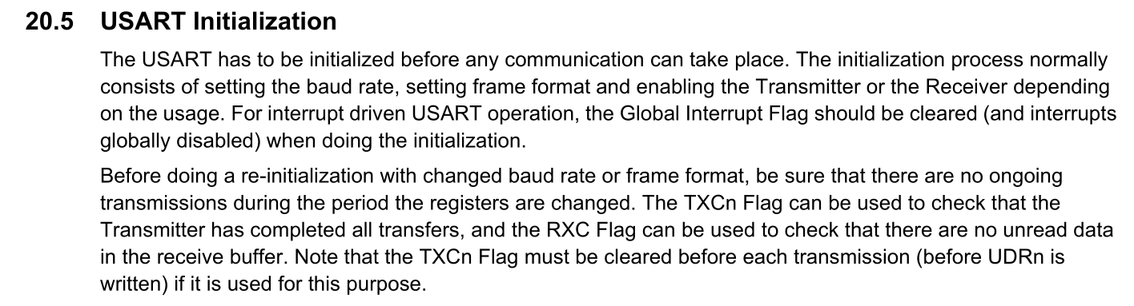

Slide 6
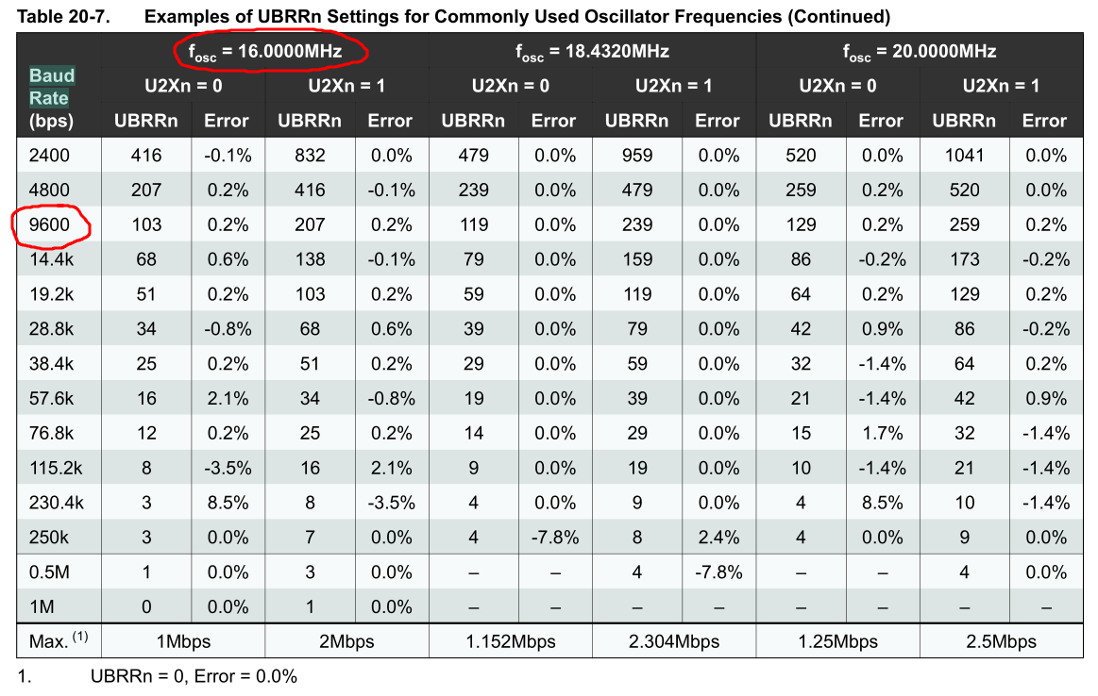

Slide 7
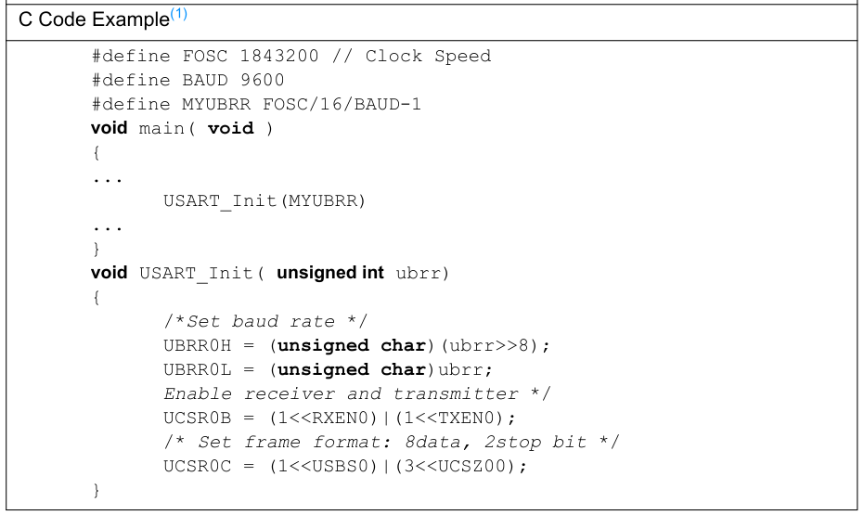

Slide 8
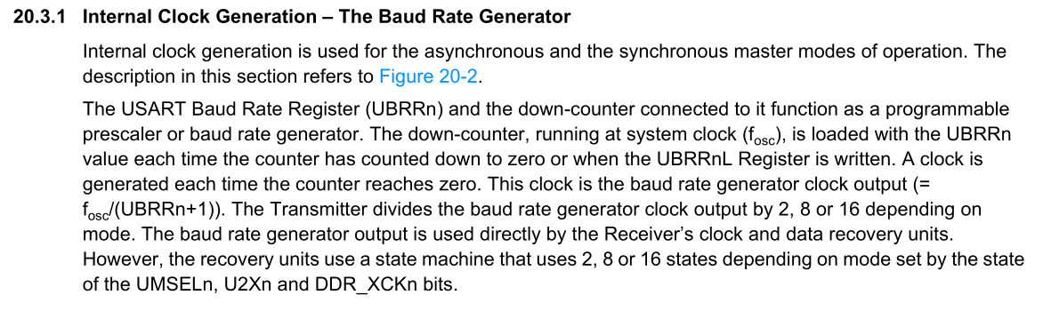

Slide 9
USART “Library”

Slide 10
There are various kinds
Libraries, in the context of programming, might mean multiple things
Mainly, there are pre-compiled static libraries and dynamic libraries
However, we usually call “library” to a C software module containingone or multiple header files (.h) and, optionally, one or multiple source files (.c)
  That is not a library, but we are going to create one of these

Slide 11
How to create a C Module
The ingredients and recipe

Slide 12
Step 1
Create the folder structure for a new project

Slide 13
Create the folder structure
Choose the path of your preference and create a new folder for your project
  I created one called “dummy_module”. In this folder, I will create my main.c file
Inside it, create another folder for your module
  Mine is called “includes” since I will use it to store multiple modules that I will include into my main program

Slide 14
Step 2
Create the header file

Slide 15
Inside the “includes” folder, create a new file with the name of your module and the extension “.h”
  In my case: usart.h
Before writing anything else, create the ifndef wrapper or once-only conditional.
  This is to avoid including the same header file multiple times, it is done as follows in the next slides

Slide 16
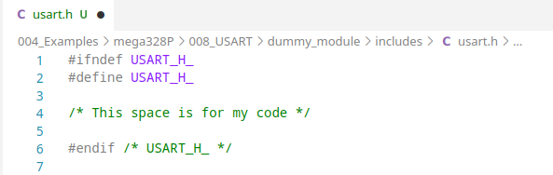
Since my header is called usart.h, my wrapper will evaluate if USART_H_ is defined or not

Slide 17
The wrapper does the following:
  In the first line, the directive #ifndef USART_H_ checks if the macro USART_H_ has not been defined before, being that the case, the following lines are evaluated.
  In the second line, the directive #define USART_H_ sets the macro USART_H_, so the preprocessor knows for the rest of the code that the file usart.h has been used already.
  At the end of the file, the directive #endif /* USART_H_ */ signals the end of the #ifndef from the first line. The comment is just a good way of telling other people “this #endif corresponds to the one where USART_H_ is evaluated”.
In other words:
  The wrapper, well, wraps all the code inside the header file, so the contents of the file are not evaluated (i.e., they are ignored) if they have already been added before.
More info here:
GCC - Once Only Headers

Slide 18
Step 3
Populate the header file

Slide 19
Rembemer what the preprocessor does to the includes?
  Wherever an #include is present, the file provided to the directive is “pasted” in that place.
  This means that if I want to add my USART functions to any other file, all I need to do is define my functions in the usart.h header file and include it wherever I want to use it.
Now I will populate my header file

Slide 20
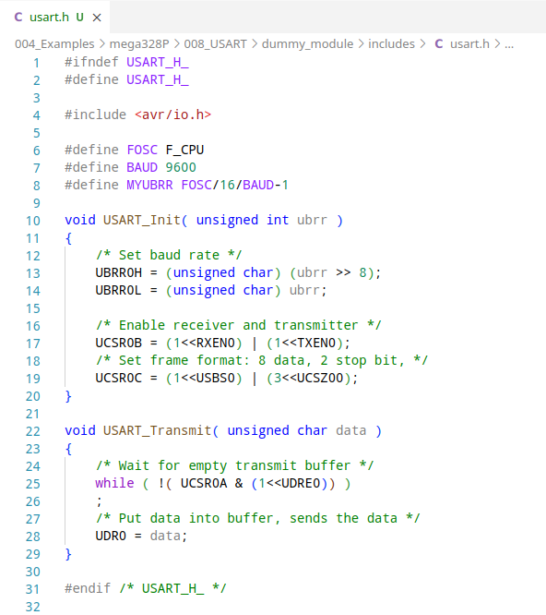

Slide 21
Step 4
Add it to my main file and compile

Slide 22
Now I should be ready to use my module
  I just need to add #include with the path to my header file between quotes. In my case: “includes/usart.h”
  (remember, local includes are wrapped inside double quotes)
When I want to use a function or a macro defined in that header file, I can use it just like if it was declared in my main file

Slide 23
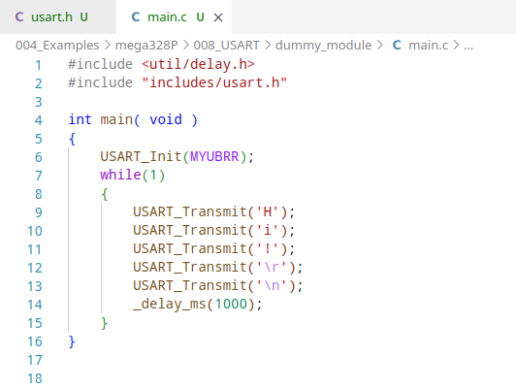

Slide 24
As you might see, this comes with a great advantage:
  The code looks clean and it is easy to understand.
  Since there are no declarations in the main file, it is easy to understand its purpose.
  The code is still there. When I want to see what is going on in the USART functions, I can just go to the header file.
Let us see if it works
  I will compile like it any other program and I expect to see no errors, I will use the following command:
avr-gcc -mmcu=atmega328p -g -Wall -Os -D F_CPU=16000000 main.c -o main.elf

Slide 25
Just so you remember, this is what each part of the command does.
  avr-gcc: this is the compiler command
  -mmcu=atmega328p: defines the microcontroller we are using
  -g: this argument enables some debugging options
  -Wall: enables all the compiler warnings
  -Os: enables optimization for size
  -D F_CPU=16000000: Sets the clock frequency as a global constant
  main.c: is the input source file
  -o main.elf: defines our desired output file
These are my personal preferences and the arguments -g -Wall are not mandatory.

Slide 26
Step 5
Upload the program and test it

Slide 27
Once I compiled my code, and prior to uploading it to the microcontroller, I have to convert the .elf file to an .hex file in intel hex format using the following command:
  avr-objcopy -O ihex main.elf main.hex
And then upload it with the following command:
  avrdude -p atmega328p -c usbasp -v -U flash:w:main.hex
Once the program has been uploaded, I use the screen command to read the serial output from my microcontroller.

Slide 28
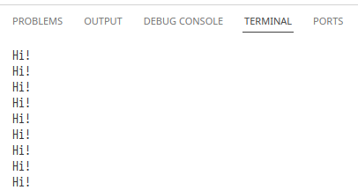

Slide 29
How to create a C Module V2
Corrected and improved

Slide 30
Works, but can be better
C modules can provide some options that we couln’t see in this last example.
From Harvey Mudd College:
A large C or C++ program should be divided into multiple files. This makes each file short enough to conveniently edit, print, etc. It also allows some of the code, e.g. utility functions such as linked list handlers or array allocation code, to be shared with other programs.

Slide 31
ChatGPT explains it just fine:
Splitting a C program with many functions into multiple C files is generally a good practice for multiple reasons:
  Modularity: Each file can focus on a specific aspect of the program. This makes the code easier to understand, maintain, and modify.
  Readability: Developers can quickly locate relevant functions and understand their purpose without having to sift through a large monolithic file.
  Encapsulation: Allows to encapsulate related functions together, as well as limiting the scope of variables.
  Compilation Efficiency: You don't need to recompile the entire program, just the modules you modify. Works best in large projects.
  Reusability: Modularizing your code makes it easier to reuse functions in other projects.
  Collaboration: Different developers can work on different modules concurrently without interfering with each other's code.

Slide 32
How can we make it better?
In the last example we defined a header file containing the functions we wanted.
That means, the code in the header file was integrated into our main file before compiling.
While this is okay, we can also create multiple C files, each one containing a set of related functionalities.

Slide 33
My take
A simple USART module

Slide 34
I will repeat the steps and populate my new header file, but this time it will only contain declarations and prototypes and it will be in the folder usart
I will include the following functions:
  USART_init: to initialize USART communication
  USART_putc: to send a character
  USART_puts: to send a string
  USART_getc: to receive a character
  USART_getl: to receive a string ended in “\r”

Slide 35
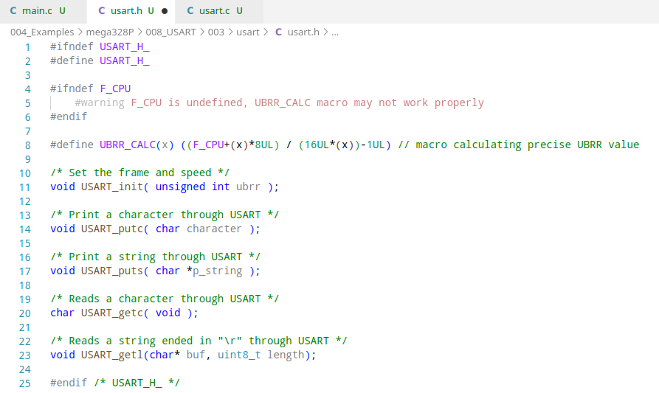

Slide 36
Now I will define my functions in a C source file with the same name (usart.c)
  And I have to add #include with the path to my header file between quotes. In this case: “usart.h” since it is in the same folder as my usart.c file.
The reason to add it to the C file is because that is where the definitions exist for the functions I will be defining

Slide 37
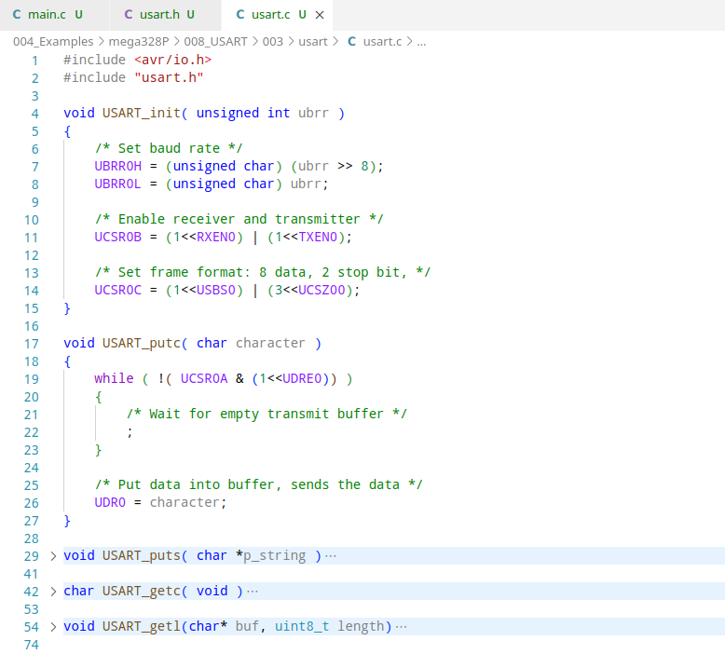

Slide 38
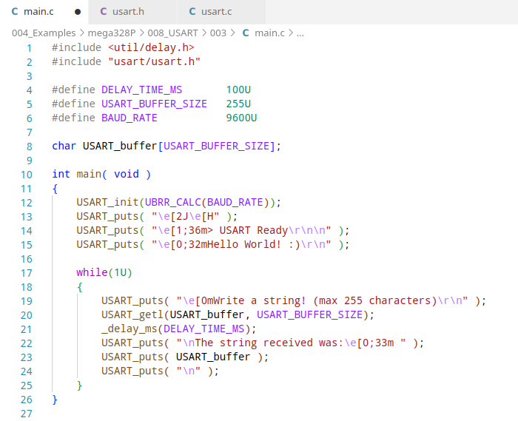
Finally, my main file:

Slide 39
It asks for a string. After you enter it, it is printed back.

Slide 40
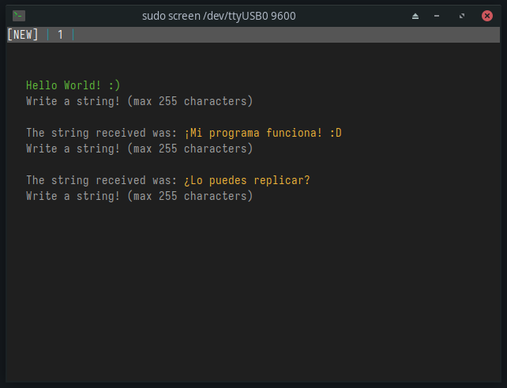

Slide 41
Can you do I2C?

Slide 42
Notices:

Slide 43
Thanks!
Please feel free to ask any related questions at any time.

