Slide 1
01010010 01100101 01100001 01101100 01101100 01111001?
What happens when you program in C?
How does a processor do what I want?
What does “instruction” mean?
What is assembly and machine code?
What happens when you program a microcontroller?
How does a microprocessor execute a program?

Slide 2
What have we learned so far?

Slide 3
What is an embedded System?
How many examples can you list?

Slide 4
What is an embedded System architecture?
What is important to know about it and why?

Slide 5
What do embedded systems do?
How do they do it?

Slide 6
What is an ALU?

Slide 7
Microprocessor Instructions
Daniel Martínez
I7266 - Programación de Sistemas Embebidos
CUCEI - UDG

Slide 8
2 double western bacon with fries and coke!
Interpreting instructions

Slide 9
Burgers (Again) (Yes. I’m hungry)
When we ask for a burger, in the outside we just see an order appearing on the screen, a minute after, it’s done.
On the inside, when we order a burger, a series of steps is followed so the burger can be made.

Slide 10
Adding two numbers v3
ALU operation selection and execution example

Slide 11
Abstraction levels

Slide 12
Python
Abstraction Level: High-level language.
Readability: High; Python emphasizes readability and simplicity.
Portability: Generally portable, but Python interpreters are required on target systems.
Syntax: Clear and concise, using indentation for code blocks.
Memory Management: Automatic memory management (garbage collection).
Execution: Interpreted language, but can be compiled to bytecode for improved performance.

Slide 13
C
Abstraction Level: Mid-level language.
Readability: Moderate; C provides a good balance between abstraction and control.
Portability: Highly portable, but code may need adjustments for different architectures and depends on the compiler used.
Syntax: Uses a more explicit and traditional syntax.
Memory Management: Manual memory management (malloc/free).
Execution: Compiled language, resulting in machine-specific executable code.

Slide 14
Assembly
Abstraction Level: Low-level language.
Readability: Lower than C; involves mnemonics and symbols.
Portability: Not portable; assembly code is architecture-specific.
Syntax: Directly corresponds to machine instructions, involving registers and memory addresses.
Memory Management: Direct control over memory, registers, and hardware resources.
Execution: Assembled into machine code; specific to the target CPU architecture.

Slide 15
Machine code
Abstraction Level: Lowest-level language.
Readability: Extremely low; consists of binary instructions directly executed by the CPU.
Portability: Not portable at all; machine code is specific to the CPU architecture.
Syntax: Comprises binary instructions understood by the CPU.
Memory Management: Direct manipulation of hardware resources.
Execution: Directly executed by the CPU.

Slide 16
ISA
Instruction Set Architecture

Slide 17
At the lowest level…
We have a set of instructions that our microcontrollers will follow.
Just as in our language we use syntax, semantics, grammar and other linguistic resources to understand what we say, and just as that makes it difficult to understand other languages, each ISA describes (for one or a group of microarchitectures) how it will process what we want it to do, and at the same time, it makes it different from other instruction sets.
Understanding machine code is a little hard, but we have different levels of abstraction that we can use to program a microcontroller. However, we will now see why it is important to understand about computer architectures.

Slide 18
atmega328p

Slide 19
microarchitecture

Slide 20
Clock speed

Slide 21
Memory

Slide 22
Peripherals

Slide 23
Programming the atmega328p

Slide 24
What we need:

Slide 25
List of requirements to program an atmega328p
Microchip Studio:
https://www.microchip.com/en-us/tools-resources/develop/microchip-studio
USBASP

Slide 26
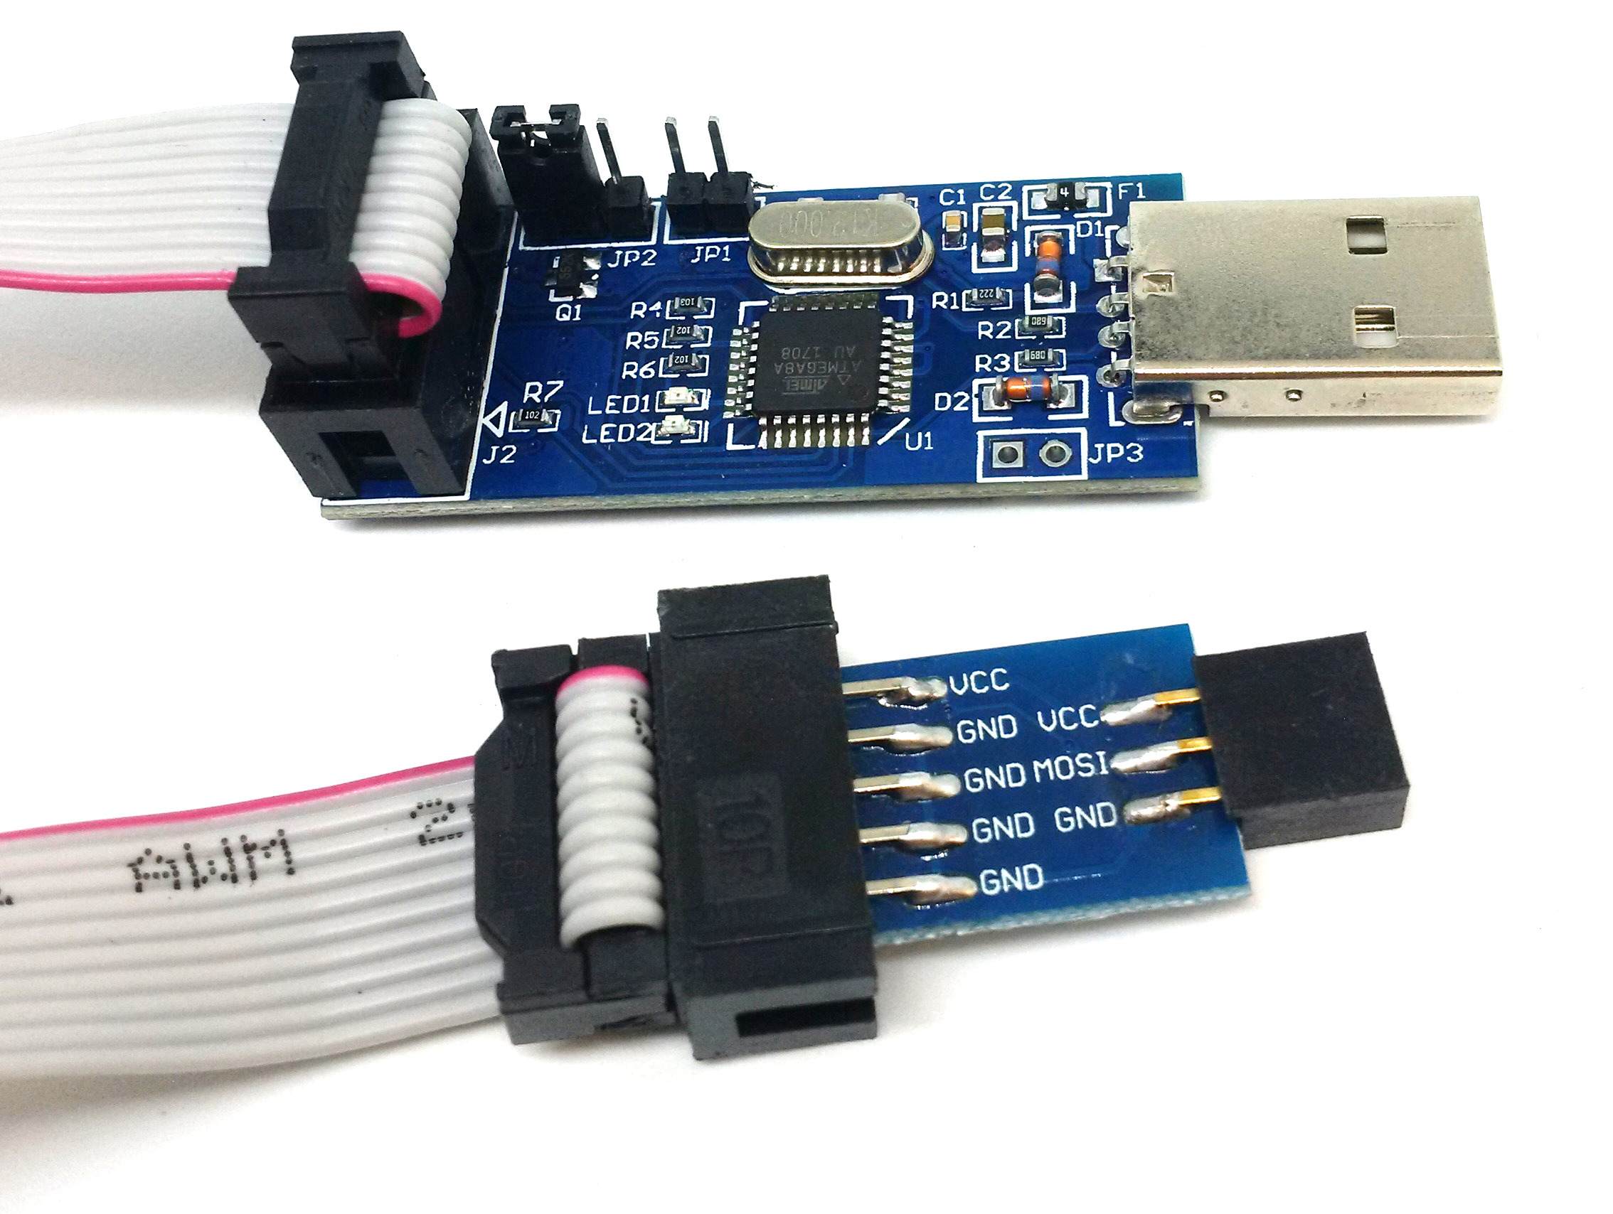

Slide 27
List of requirements to program an atmega328p
ATmega328p
Microchip Studio or avr-gcc and avrdude:
https://www.microchip.com/en-us/tools-resources/develop/microchip-studio
USBASP
16MHz Crystal Oscilator
2x 12-22pF Ceramic Capacitors
10k Resistor
Breadboard/Protoboard, wire and jumpers
(OPTIONAL) Buttons, resistors, LEDs and a 5V power supply

Slide 28
What will we do with that?

Slide 29
Knowledge check!

Slide 30
Embedded systems
Embedded systems are computing systems that are integrated into larger devices, products, or machinery to perform specific functions. They are designed to operate within the constraints of the system they are embedded in and are often dedicated to a single task or a narrow range of tasks.
Applications: automotive systems, medical systems, personal health systems, smartphones and mobile devices, manufacturing devices, flight control systems, home appliances, network switches and routers, robots, public transportation, gaming, RFID devices, weather stations, agriculture monitoring systems, surveillance systems, Internet of Things, measuring devices, onboard computers, lighting, energy, musical instruments or devices, etc.

Slide 31
Computer architecture
This refers to the elements and its organization inside a computer system, encompassing structure and functionality.
It is comprised, mainly, of the ISA design and the microarchitecture design.
The ISA is the set of instructions that a system can execute, the data types it can work with, the addressing modes and other stuff related to how we can describe what we can ask a processing unit to do.
The microarchitecture describes how a particular processing unit implements an ISA.
Knowing about computer architectures allows us to design safer, faster, simpler, and overall, more efficient embedded systems.

Slide 32
ALU
It is a combinational digital circuit that performs arithmetic and logic operations on binary integers.
They usually have two data inputs, or operands.
They usually have an opcode input to select the desired operation to execute.
They usually connect to external status registers, at their input and their output, that contain useful information about the last operation performed.

Slide 33
NoticeS!
Homeworks, whatsapp and classroom groups, missing data and stuff.

Slide 34
Thanks!
Please feel free to ask me any related questions at any time

