Slide 1
Where is my program?
Does my microcontroller run C language code?
Where does it store its instructions?
How does the microcontroller know where to begin?
What happens during a reset?
How does a computer program a microcontroller
Are there going to be burgers in today’s class?

Slide 2
Microcontroller programming
Daniel Martínez
I7266 - Programación de Sistemas Embebidos
CUCEI - UDG

Slide 3
Memory
Do you remember?
The 21st night of September?
Love was changing the minds of pretenders
While chasing the clouds away

Slide 4
Memory classifications
Volatility
Access method
Read/write characteristics
Physical location
Functionality
Technology
Usage in CPU
Data organization

Slide 5
Volatility
Volatile Memory:
Loses its stored information when power is turned off. Examples include RAM (Random Access Memory).
Non-Volatile Memory:
Retains data even when power is turned off. Examples include CDs, flash memory, and hard drives.

Slide 6
Access method
Random Access:
Allows data to be accessed in any random order. (RAM)
Sequential Access:
Requires accessing data in a sequential manner. Examples include tape drives and optical drives.

Slide 7
Read/write characteristics
Read-Only:
Typically used for storing permanent or semi-permanent data, and the data cannot be easily modified. Examples include some optical drives.
Read/Write:
Allows both reading and writing of data. Examples include RAM and Flash memory.

Slide 8
Physical location
Internal Memory:
Embedded within the microprocessor or closely connected to it. Examples include Cache memory or SRAM.
External Memory:
Separate from the microprocessor and connected via buses. Examples include EEPROM, hard drives, etc.

Slide 9
Functionality
Primary Memory:
Fast and used for temporary storage (e.g., RAM).
Secondary Memory:
Slower but provides larger storage capacity (e.g., hard drives).

Slide 10
Technology
Dynamic Random Access Memory (DRAM):
Requires periodic refresh to maintain data integrity.
Static Random Access Memory (SRAM):
More stable and does not require frequent refreshing.
Electrically Erasable Programmable ROM (EEPROM):
Non-volatile but needs UV light to be erased.
Flash Memory:
Non-volatile memory commonly used in storage devices.

Slide 11
Usage inside CPU
Cache Memory:
High-speed memory used by the CPU to store frequently accessed instructions and data.
Registers:
Fast, small, and internal memory locations within the CPU.

Slide 12
Hello WORLD!
Our first program

Slide 13
Not so fast…

Slide 14
The minimal system
What is needed for a microcontroller to work?

Slide 15
A minimal system refers to the basic set of components required to create a functional electronic system.
The components in a minimal system may vary depending on the specific application, for embedded systems, some common elements include:
Microcontroller or Microprocessor:
The central processing unit responsible for executing instructions and controlling the overall operation of the system.
Clock Source:
A clock oscillator or crystal to provide the system with a timing reference, ensuring synchronization of operations.

Slide 16
Memory: This includes both volatile memory (RAM) and non-volatile memory (ROM, Flash), for storing data and program instructions, respectively.
Input/Output (I/O) Components: These could be sensors, actuators, communication interfaces, or other peripherals that allow the system to interact with its environment.

Slide 17
Power Supply: A source of electrical power to provide the necessary voltage levels for the components in the system.
Basic Support Components: Resistors, capacitors, and other passive components that are necessary for circuit stability and functionality.

Slide 18
ATmega328p Minimal system

Slide 19
Power supply
VCC
GND
AVCC
AREF

Slide 20
Clock source
Low Power Crystal Oscillator
Full Swing Crystal Oscillator
Low Frequency Crystal Oscillator
Internal 128kHz RC Oscillator
Calibrated Internal RC Oscillator
External Clock

Slide 21
Reset

Slide 22
Hello WORLD!
No BS this time!

Slide 23
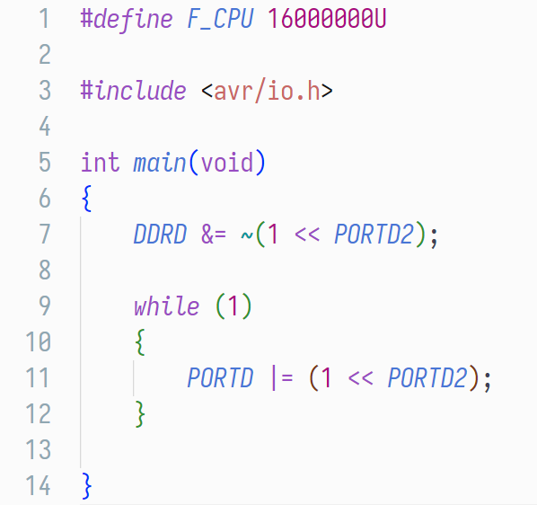
Hello world!
whut???

Slide 24
Talking computer languge

Slide 25
Hexadecimal
The hexadecimal numbering system (hex for short) is used to represent nibbles.
Knowledge check:
A bit is a binary digit, i.e., 1 or 0.
A nibble is a group of four bits, e.g.,1011.
A byte is a group of two nibbles (or eight bits), e.g., 11001111
Hexadecimal uses the first ten digits, plus, A, B, C, D, E and F to represent quantities. Let’s see how it is used.

Slide 26
Hexadecimal
In hex after the first ten numbers (from 0 to 9), the decimal values 10, 11, 12, 13, 14 and 15 are represented by A, B, C, D, E and F, respectively.
Since four digits in binary can represent up to 15 (the binary number 1111) then a single hex character can represent four bits.
For example, the binary number 1100, (a.k.a. 12 in decimal) is represented by the character C.
This means we can represent a full byte with just two hex characters!

Slide 27
Hexadecimal
To represent a byte in the common computer science slang, for example, 10100101 in binary (or 165 in decimal) we use the hexadecimal notation 0xA5, where:
“0x” means “we are talking hexadecimal”
“A” represents the first four bits (from left to right) in binary:
1010 in binary is 10 in decimal. Since it is in the second character position, its value in decimal is multiplied by 16. (10·16=160)
“5” represents the last four bits (least significative) in binary:
0101 in binary is, unsurprisingly, 5 in decimal.

Slide 28
Memory
One more time…

Slide 29
We already know… Don’t we?
We have already seen different types of memory used in computer systems, however, we have yet to learn the uses for these kind of memory.
Of all the classifications we explored, there are four key memory types:
ROM
RAM
Registers
Cache

Slide 30
ROM
In our “big company” examples, we know we must follow certain steps to achieve a desired output, these steps usually don’t change. In computer systems, the place where we store our instructions is called ROM or Program Memory.
ROM, in embedded systems, is located inside the microcontroller and it is not usually updated. It is intended to be programmed once and to need the very least number of updates possible.
ROM is a type of non-volatile memory, since we need it to keep its contents for a long time.
Back to the burgers…

Slide 31
RAM
RAM is our temporary storage; in our “big company” we need places to do what we are doing.
We cannot prepare a burger on our hands, (and if we can, we should not), we need at least a table where we can place our ingredients.
RAM, in embedded systems, is also located inside the microcontroller and it is written all the time while the microcontroller is working, it stores the data we need during the execution of a program.
RAM is a usually a kind of volatile memory.
More RAM, more FPS.

Slide 32
Registers
The registers inside a microcontroller or microprocessor are small memory cells that are meant to hold some very important data that is useful for general purposes.
In our “big company” these are like the boards where we place important company updates.
Registers are usually implemented with some special logic cells like latches or flip-flops.
When using the microcontroller, we will understand better how these registers are used and why.
More RAM, more FPS.

Slide 33
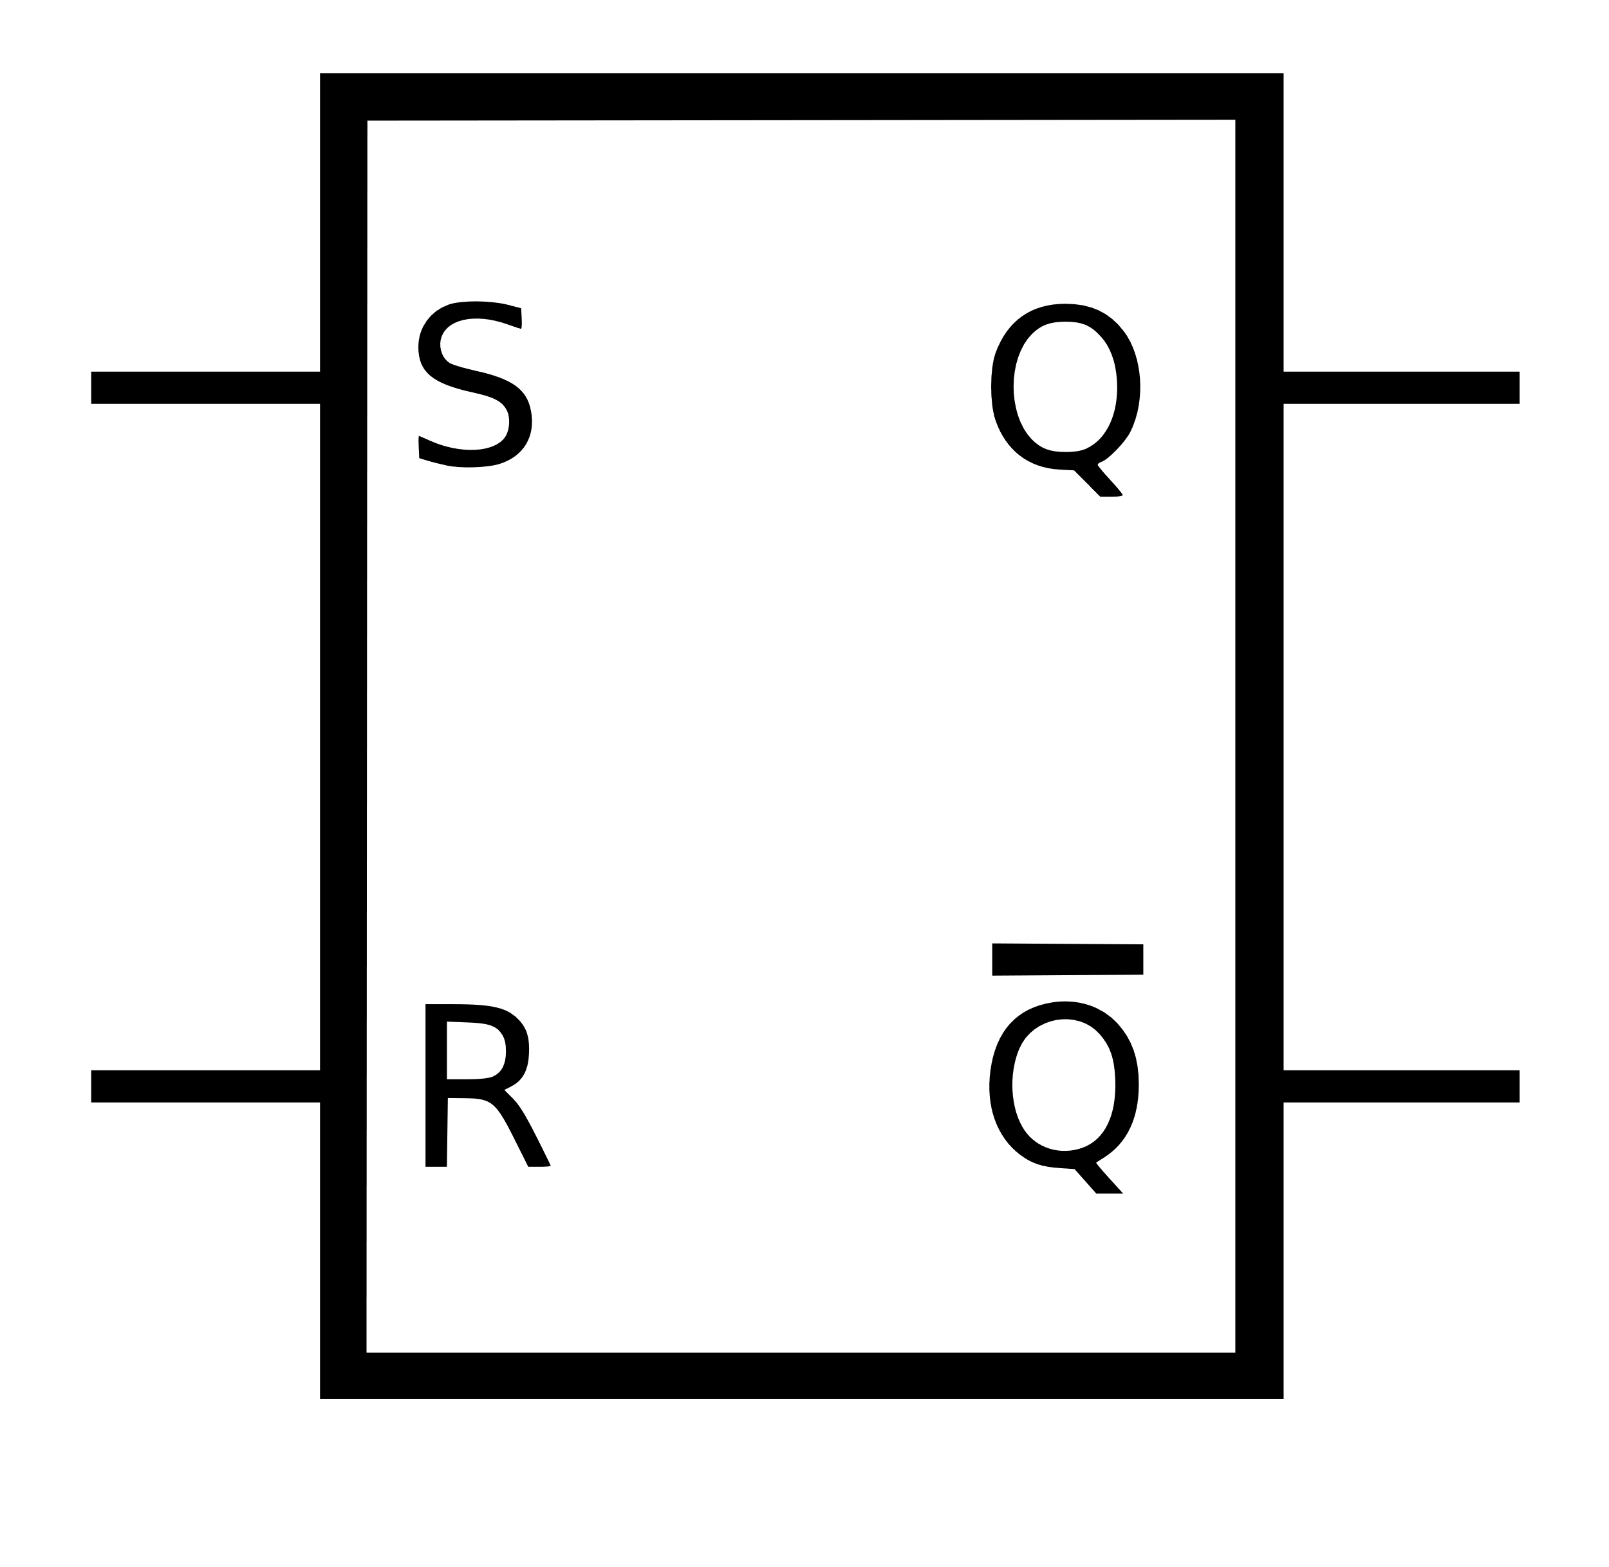
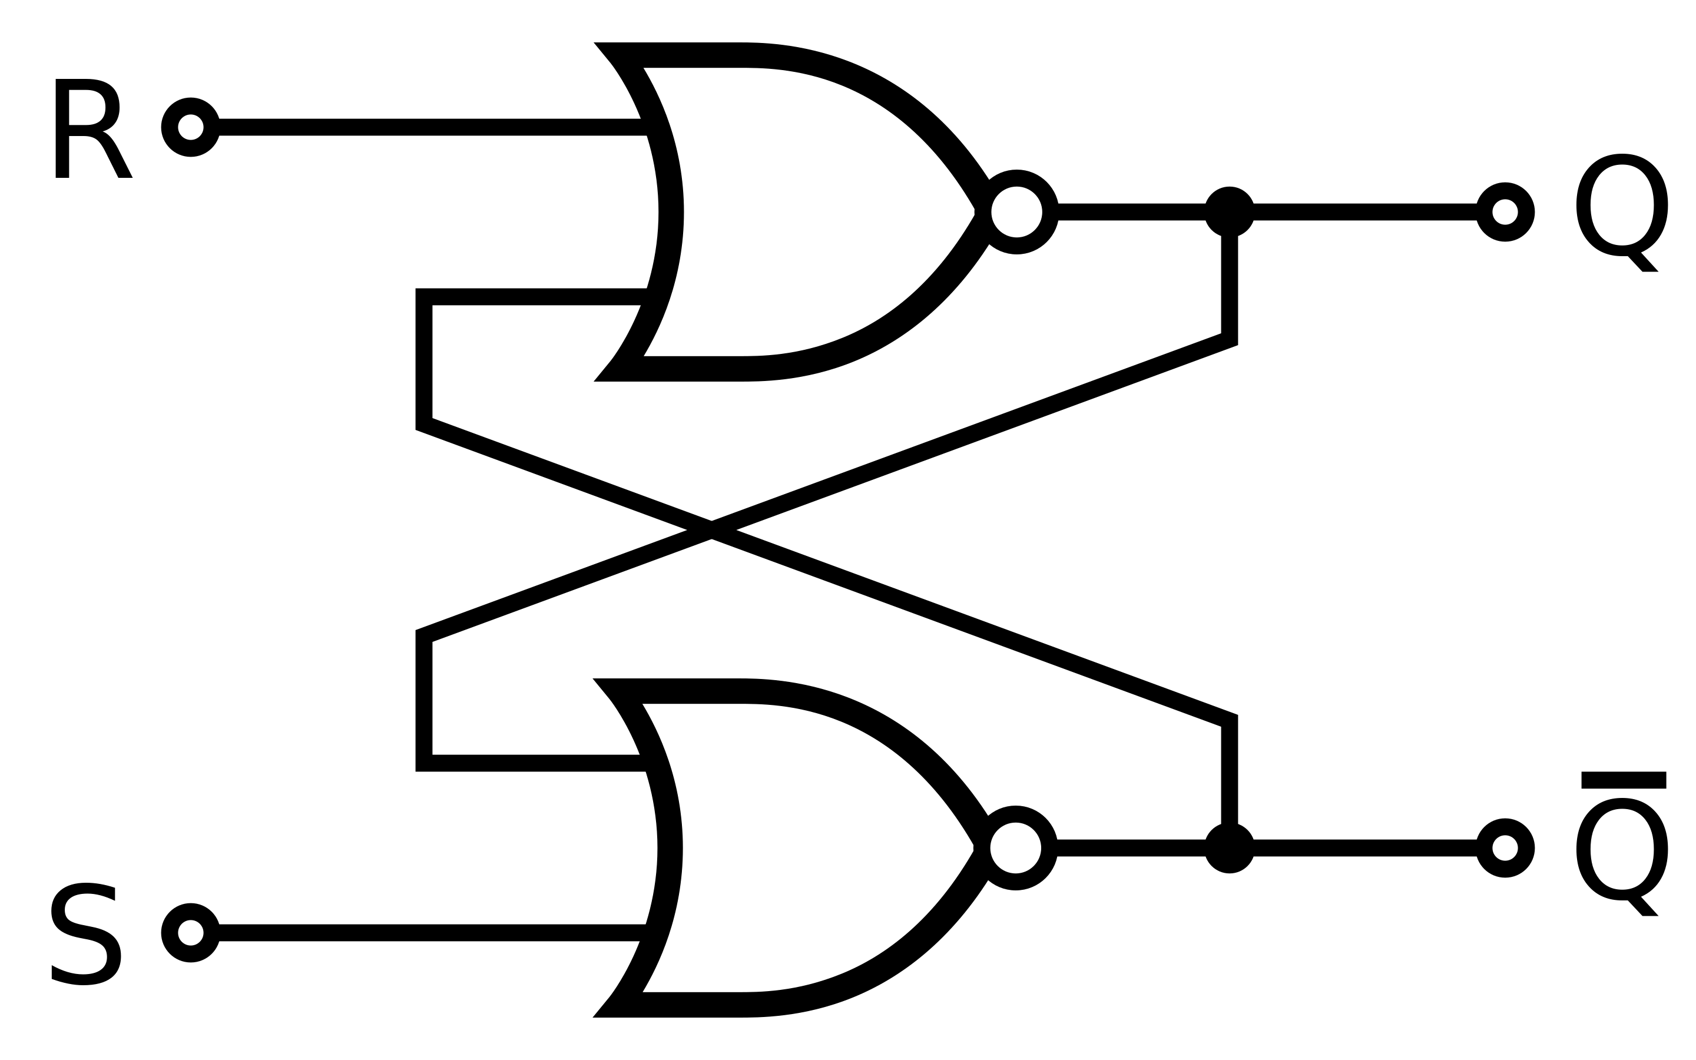
SR Latch

Slide 34
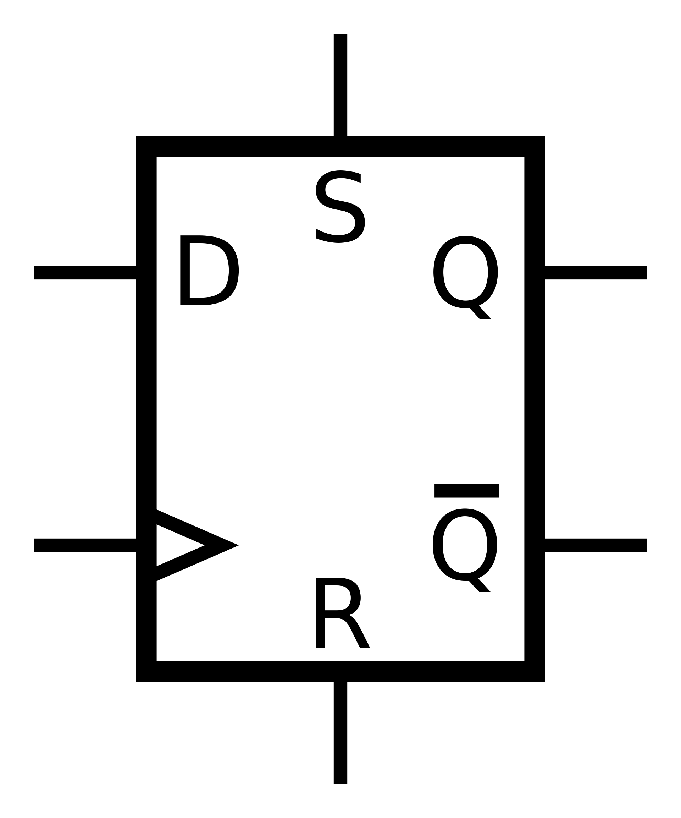
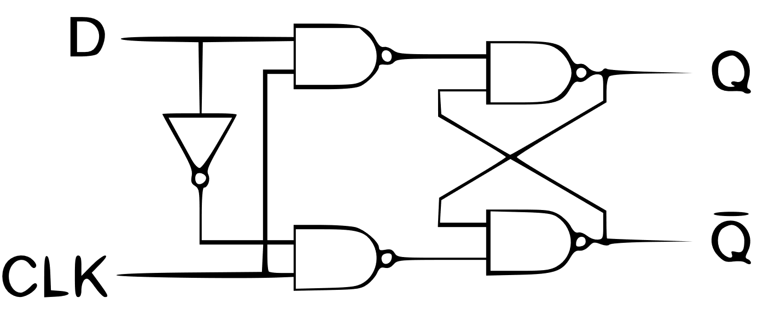
D flip-flop

Slide 35
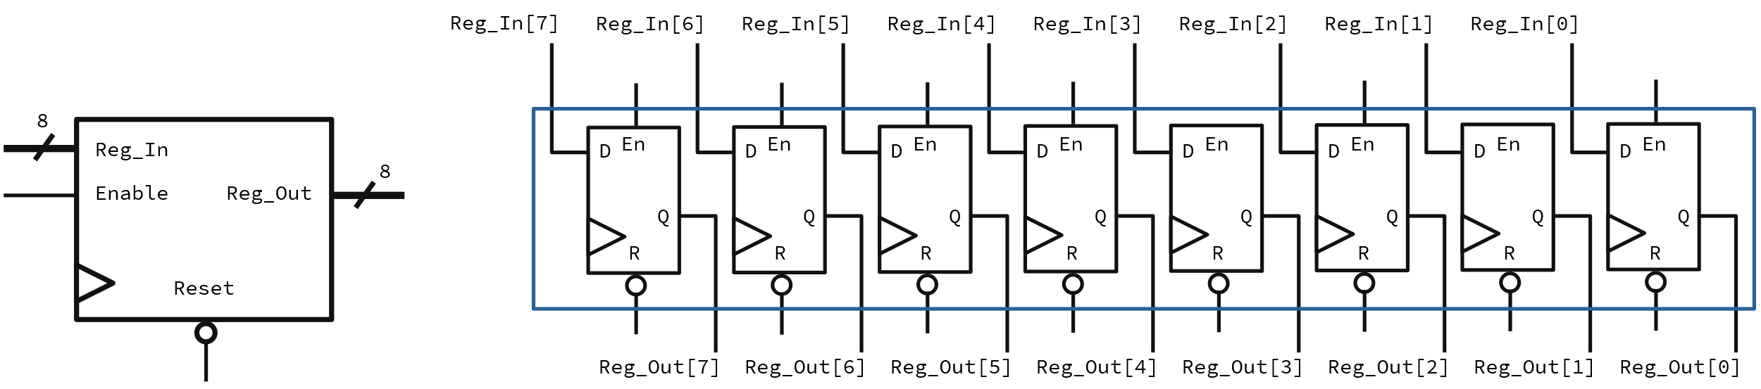
8-bit registers

Slide 36
Addresses
Where you at rn?

Slide 37
Addresses and related concepts
A memory address is a unique identifier for a specific location in the microcontroller’s memory.
We use addresses to identify addressable units. In most systems the smallest addressable unit is the byte, so, each memory cell can store a byte.
The address space is the range of possible memory addresses that out control unit can generate.
Word Addressing is accessing to memory with the addresses for words, this means, groups of bytes of a predefined size.
Endianness refers to the order of multi-byte datatypes. We have Little-Endian and Big-Endian.

Slide 38
The memory map

Slide 39
What is a memory map?
A memory map is the way a to describe how a computing system has its memory organized.
It can represent different physical memory devices into one single address space.
It can also represent multiple regions of a single memory device into the address map.
We usually care about certain special memory regions that we will cover in detail later, this is the overview:

Slide 40
Memory regions
Program memory
This is the region where the code is stored, this refers to the ROM device.
Data memory
This is the region where variables and constants are stored, this is usually in the RAM device.
Registers
These are also mapped here.

Slide 41
ARM Cortex-M Memory Map

Slide 42
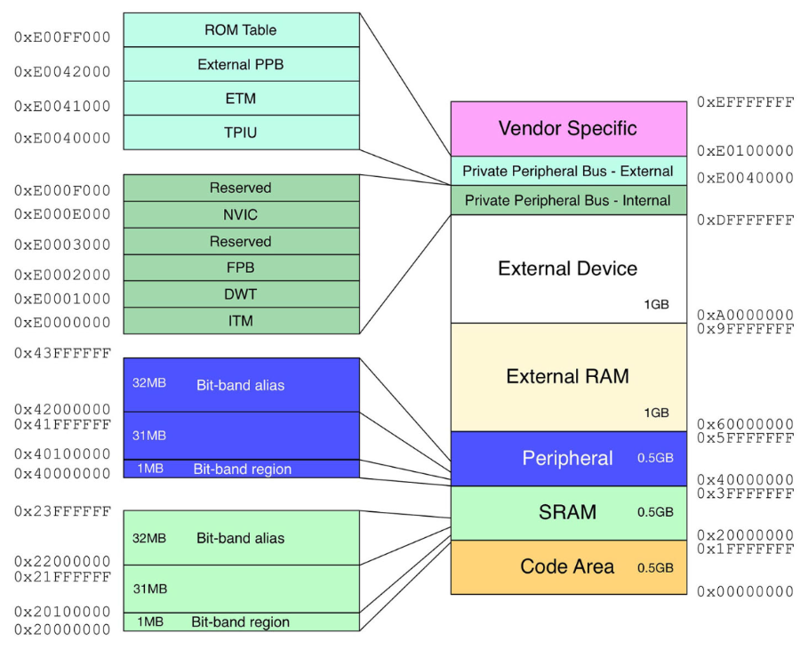

Slide 43
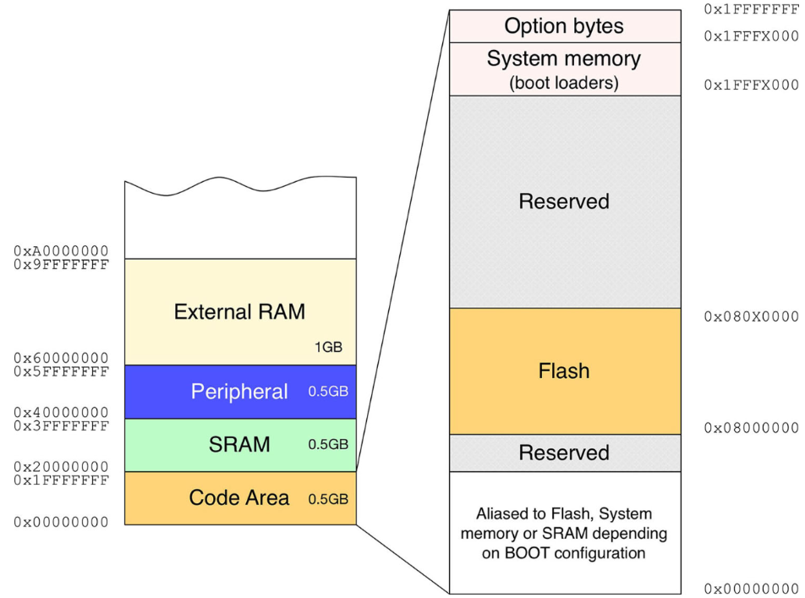

Slide 44
Avr Memory Map

Slide 45
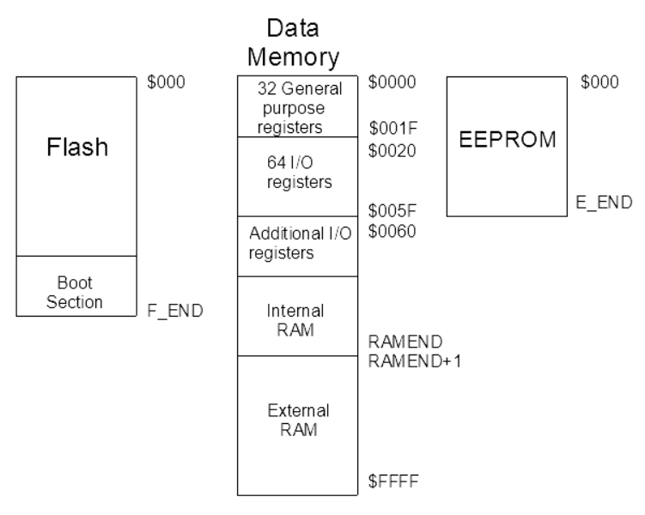

Slide 46
Avr Memory Map

Slide 47
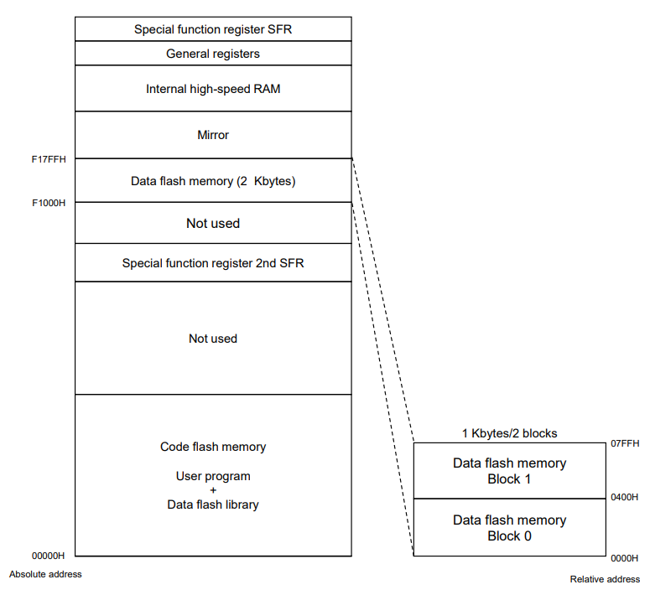

Slide 48
NoticeS!
WhatsApp and classroom groups, missing data, class formality.

Slide 49
Thanks!
Please feel free to ask any related questions at any time.

