Slide 1
What is an embedded system?
Wikipedia
Chat gpt (gpt3.5)
An embedded system is a computer system, this is, a combination of a computer processor, computer memory, and input/output peripheral devices, that has a dedicated function within a larger mechanical or electronic system.
An embedded system is a specialized computing system that is dedicated to performing specific functions within a larger system or product. Unlike general-purpose computers, which are designed to run a variety of applications, embedded systems are built to execute a set of predefined tasks or functions.

Slide 2
Presenting

Slide 3


Slide 4
Richard feynman
Nobel physics laureate, bongo player, funny, charismatic and one of the greatest teachers in history.

Slide 5
Feynman-ize
How would you explain something to a kid?
Divide and conquer

Slide 6
Modern embedded systems
Microprocessors
Digital Signal Processors (DSPs),
Field-Programmable Gate Arrays (FPGAs)
Application-Specific Integrated Circuits (ASICs)
System-on-Chip (SoCs):
Programmable Logic Controllers (PLCs)
Single-Board Computers (SBCs)
By its nature, usually employ microcontrollers, but there are alternatives.
When do we use those and why?

Slide 7
Intro to microcontrollers
Daniel Martínez
I7266 - Programación de Sistemas Embebidos

Slide 8
What is a microcontroller?

Slide 9
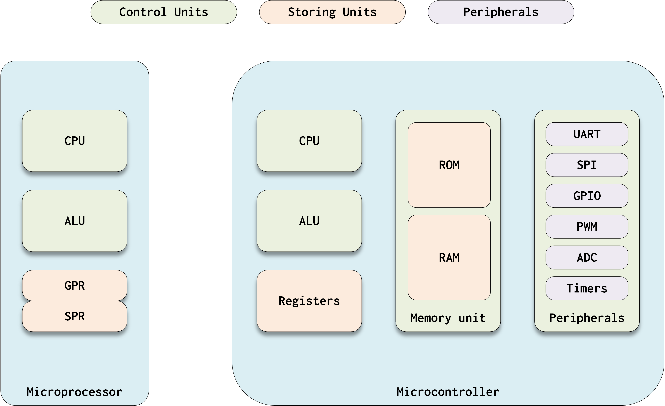
Microcontroller vs microprocessor

Slide 10
The big company analogy
Notes:
Or any big organization can work: political, non-profit, environmental, a house

Slide 11
EXECUTIVE BOARD

Slide 12
HR DEPARTMENT

Slide 13
Accountability & finance

Slide 14
Archive

Slide 15
External relations

Slide 16
It department

Slide 17
Microcontroller vs microprocessor

Slide 18
Microcontroller architecture

Slide 19
Disclaimer!
There are many types of architectures, or many ways of orgnizing stuff that we ususally group by the name “architecture”, this can include:
Instruction Set Architecture (ISA)
Processor Architecture
Memory Hierarchy
Input/Output Architecture
System Bus and Interconnection Networks
Parallelism and Concurrency
Power and Energy Management
Network Architecture
Security Architecture

Slide 20
Von Neumann architecture

Slide 21
Harvard architecture

Slide 22
Architectures in use

Slide 23
What is a microcontroller?
What do I care about in a microcontroller and why?

Slide 24
What is an embedded system?
What do I care about in embedded systems and why?

