Slide 1
Inside a microprocessor, What happens when you…
Multiply two numbers?
Compare two variables?
Add one to a number?
Print a string?
Press a key on a keyboard?
…

Slide 2
HOW DOES A COMPUTER COMPUTE?
Daniel Martínez
I7266 - Programación de Sistemas Embebidos
CUCEI - UDG

Slide 3
Class vs. McDonald’s
How to prepare a burger

Slide 4
How do we even make a burger?
Ingredients
A recipe
A place to cook it
A person to follow the recipe

Slide 5
Your approach
You have 5 minutes max.
(Go big, or go home)

Slide 6
McDonald’s approach
The company distributes the equipment, provided with certain standards from local providers as well as the ingredients. Also, in every store they provide cooking manuals and people trained to train other people.
The work is divided by groups, some people oversee the arriving goods, some people prepare the ingredients and place them in specific containers, some cook, some take orders and deliver, some do packaging, some clean and some supervise.
Once everything is in place, the ingredients arrive and are prepared and stored at certain times, the meat is precooked, and the cooks just “assembly” the ingredients to then finish cooking, pack and deliver as the orders arrive.
(Or my interpretation of it)

Slide 7
Divide & conquer

Slide 8
What is the ALU?

Slide 9
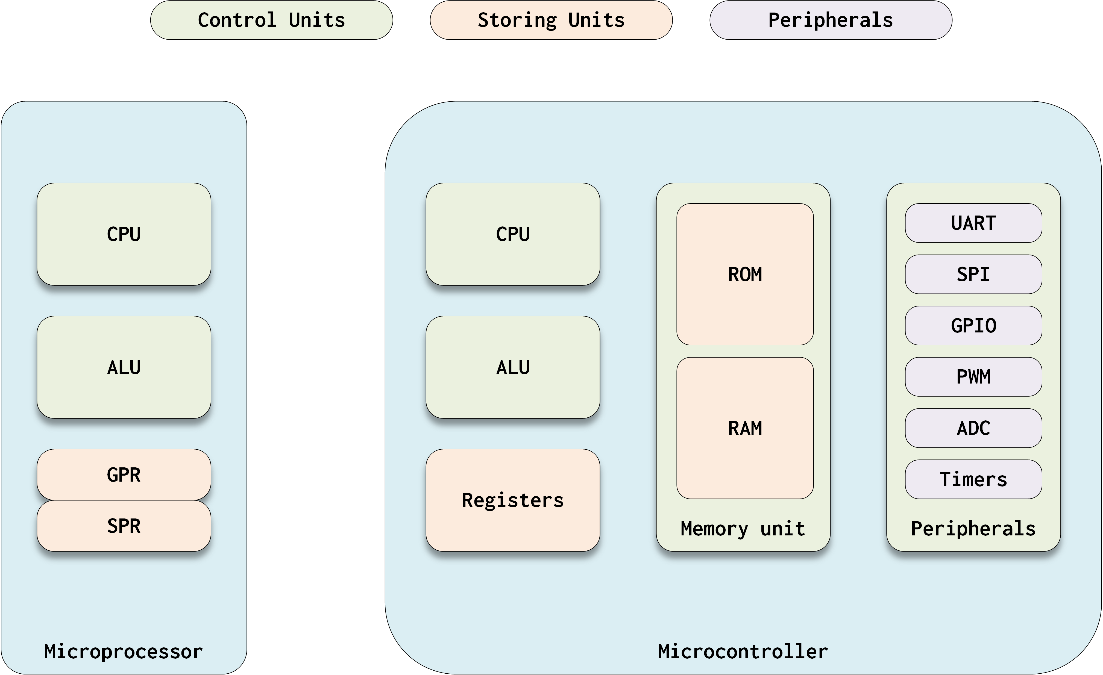
Microcontroller vs microprocessor

Slide 10
Digital systems basics (brief review)

Slide 11
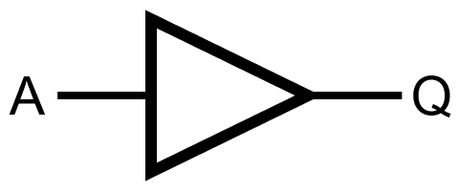
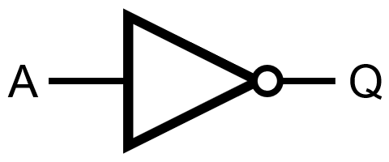
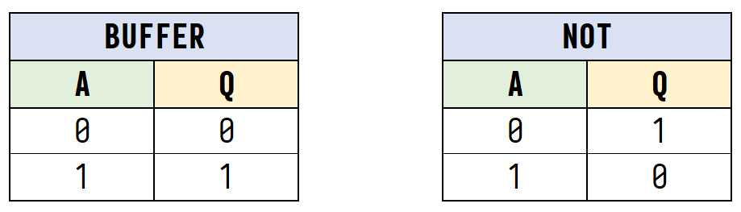

Slide 12
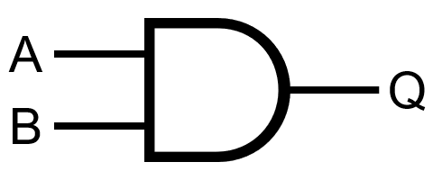
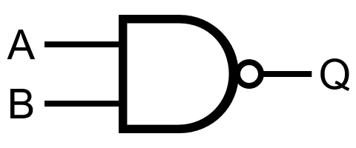
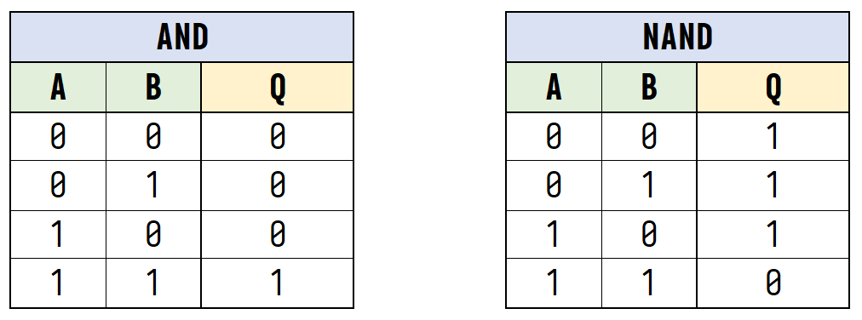

Slide 13
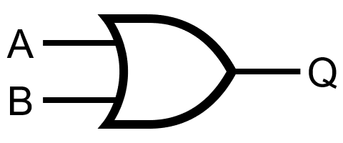
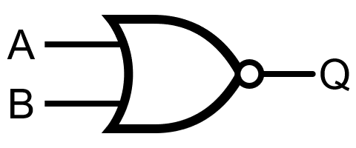
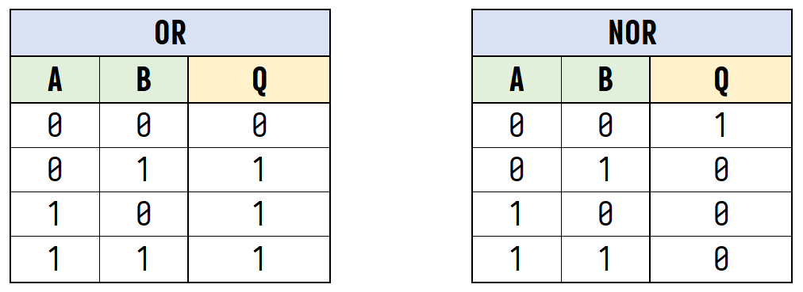

Slide 14
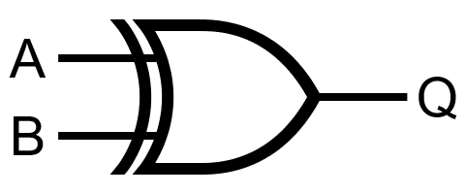

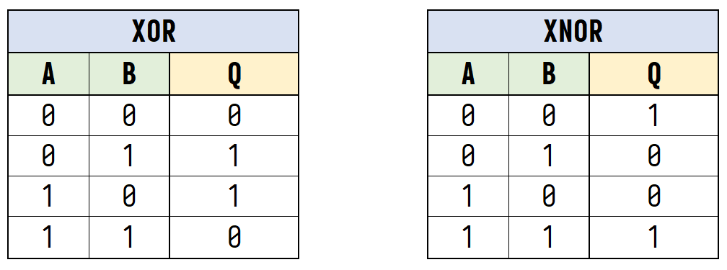

Slide 15
Adding two numbers

Slide 17
Adding two numbers v2

Slide 19
Multiplying two numbers

Slide 21
Compare two numbers

Slide 23
Me when…
Me when I see you deliver a homework that is just a copy-paste of a ChatGPT query

