Slide 1
Introductiory questions
How do we really communicate between embedded systems?
What is a communication protocol?
What do we have to take into account to communicate?

Slide 2
Communication protocols 1
Daniel Martínez
I7266 - Programación de Sistemas Embebidos
CUCEI - UDG

Slide 3
Communication protocols
What are they?

Slide 4
What is “communication”?
Communication is usually defined as the exchange of information
  In the context of microcontrollers, there is an exchange of information ocurring between the internal parts of it, but we usually refer to communication as external in the context of embedded systems
Communication needs some components:
  These are usually: a sender, a receiver and a medium.

Slide 5
What is a communication protocol?
Apart from the sender, receiver and the medium to communicate, we usually need a set of rules.
  These rules help us to have an efficient way of communicating
This set of rules is called a protocol.
Some of the characteristics are:
  Synchronous / Asynchronous?
  Serial / Parallel?
  Full-Duplex / Half-Duplex?

Slide 6
Layers for communications
You probably have heard about many parts that comprise the layers that allow communications to coexist.
  HTTP, HTTPS, TCP/IP, SSH, etc.
Networks are complex. To keep everything organized we separate its components into layers.
  Let us analyze the internet and the OSI model.

Slide 7
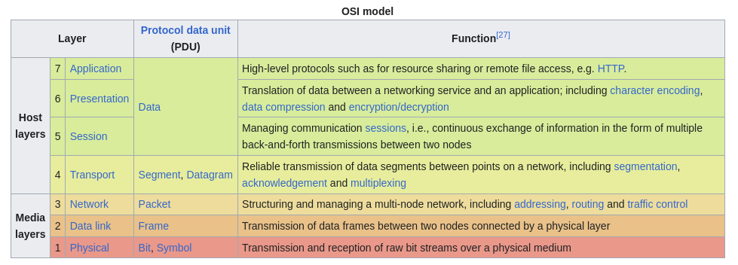
Taken from Wikipedia.com

Slide 8
USART

Slide 9
The USART protocol
Stands for:
  Universal
  Synchronous
  Asynchronous
  Receiver
  Transmitter

Slide 10
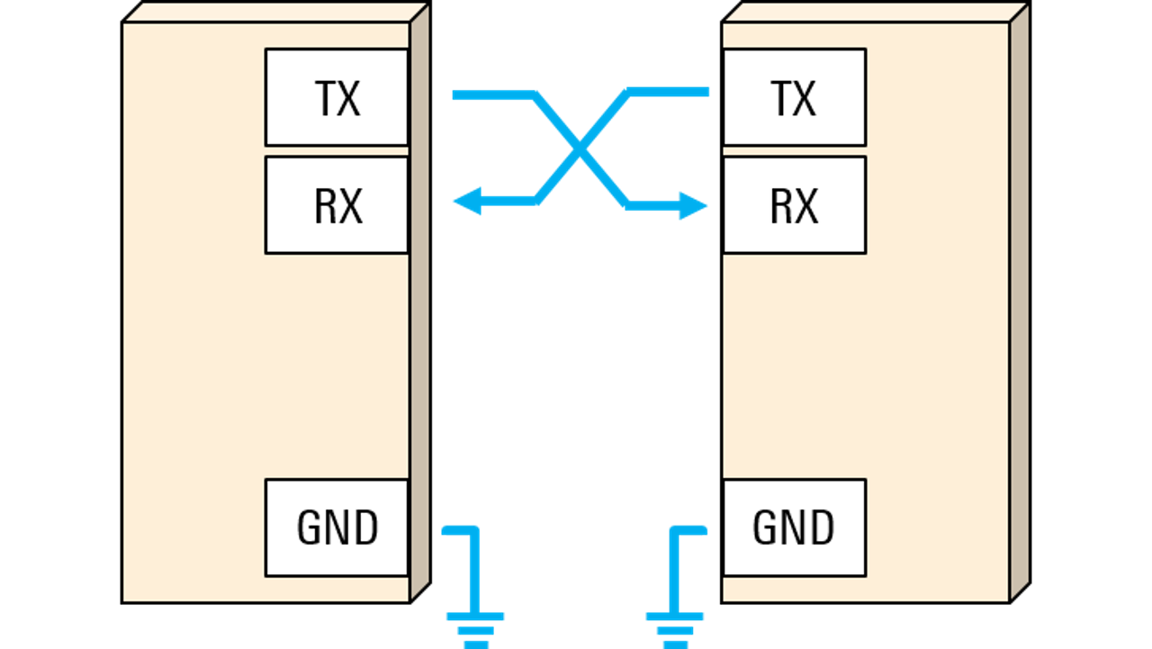
Taken from rohde-schwarz.com

Slide 11
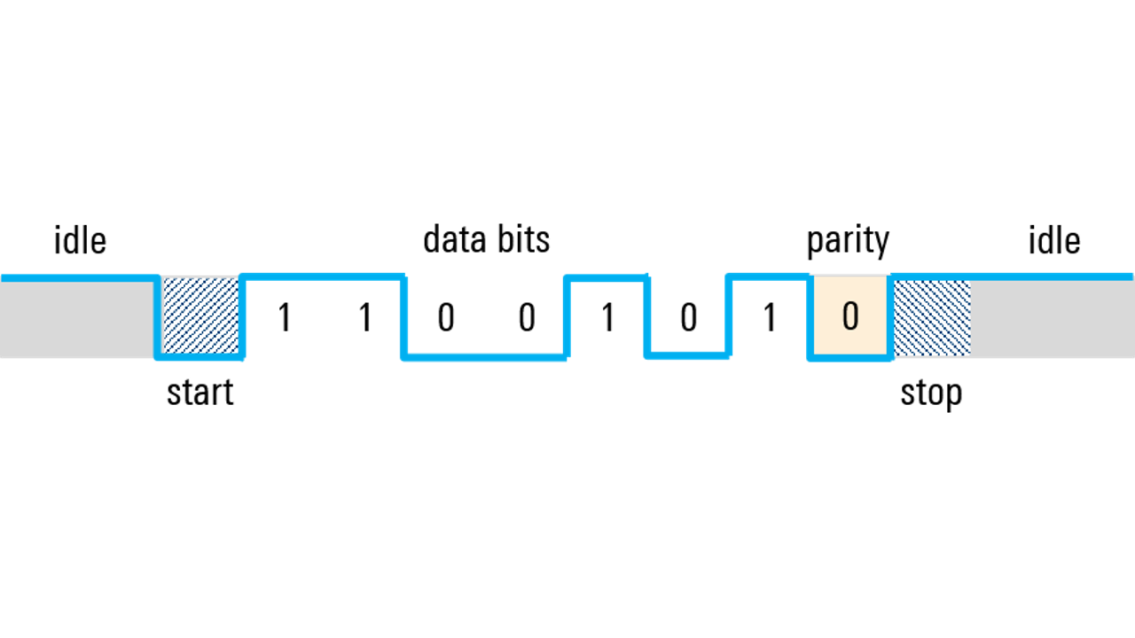
Taken from rohde-schwarz.com

Slide 12
Team work

Slide 13
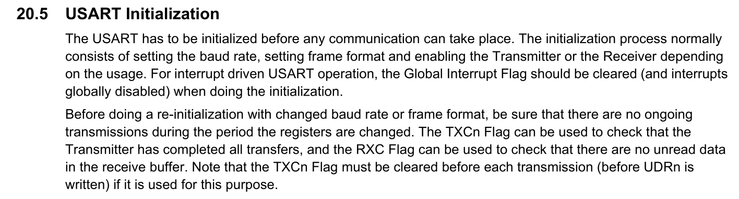

Slide 14
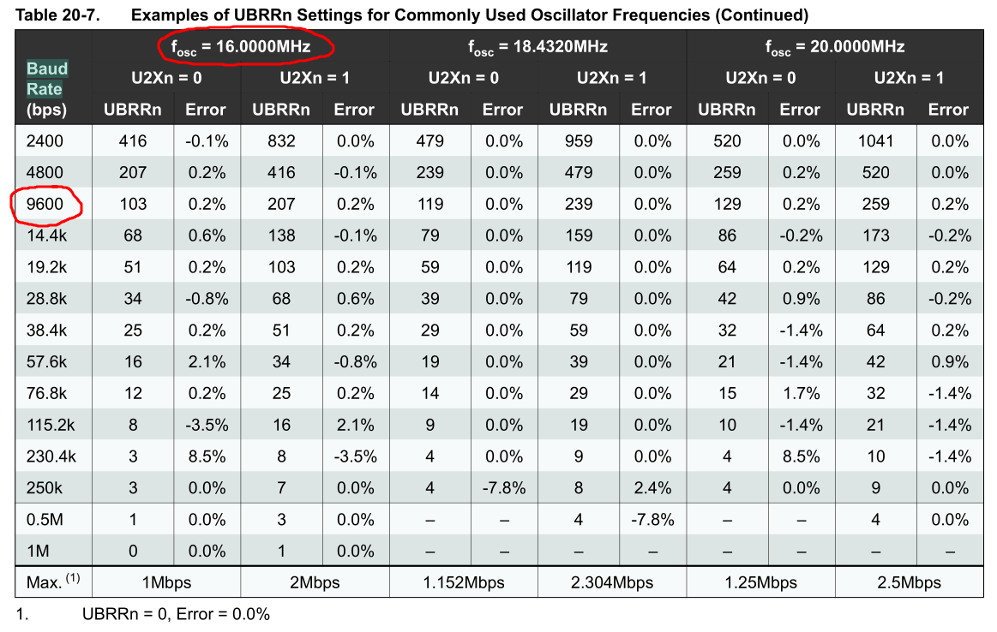

Slide 15
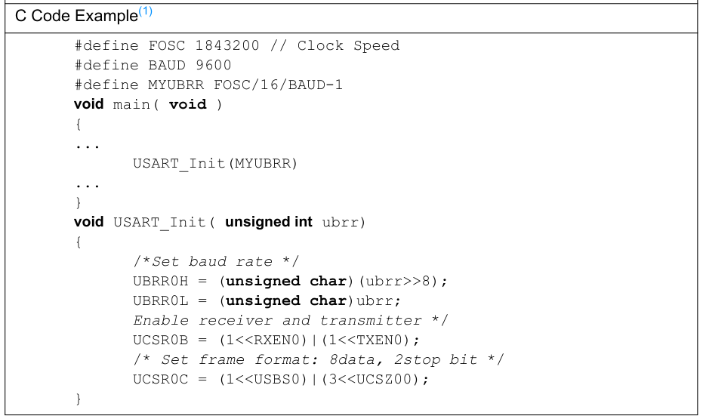

Slide 16
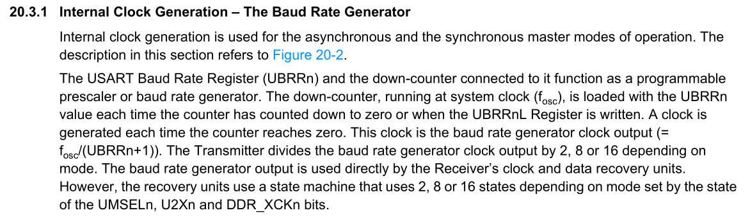

Slide 17
USART “Library”

Slide 18
There are various kinds
Libraries, in the context of programming, might mean multiple things
Mainly, there are pre-compiled static libraries and dynamic libraries
However, we usually call “library” to a C software module containingone or multiple header files (.h) and, optionally, one or multiple source files (.c)
  That is not a library, but we are going to create one of these

Slide 19
How to create a C Module
The ingredients and recipe

Slide 20
Step 1
Create the folder structure for a new project

Slide 21
Create the folder structure
Choose the path of your preference and create a new folder for your project
  I created one called “dummy_module”. In this folder, I will create my main.c file
Inside it, create another folder for your module
  Mine is called “includes” since I will use it to store multiple modules that I will include into my main program

Slide 22
Step 2
Create the header file

Slide 23
Inside the “includes” folder, create a new file with the name of your module and the extension “.h”
  In my case: usart.h
Before writing anything else, create the ifndef wrapper or once-only conditional.
  This is to avoid including the same header file multiple times, it is done as follows in the next slides

Slide 24
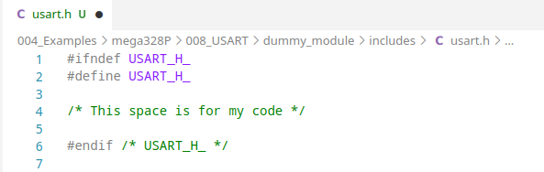
Since my header is called usart.h, my wrapper will evaluate if USART_H_ is defined or not

Slide 25
The wrapper does the following:
  In the first line, the directive #ifndef USART_H_ checks if the macro USART_H_ has not been defined before, being that the case, the following lines are evaluated.
  In the second line, the directive #define USART_H_ sets the macro USART_H_, so the preprocessor knows for the rest of the code that the file usart.h has been used already.
  At the end of the file, the directive #endif /* USART_H_ */ signals the end of the #ifndef from the first line. The comment is just a good way of telling other people “this #endif corresponds to the one where USART_H_ is evaluated”.
In other words:
  The wrapper, well, wraps all the code inside the header file, so the contents of the file are not evaluated (i.e., they are ignored) if they have already been added before.
More info here:
GCC - Once Only Headers

Slide 26
Step 3
Populate the header file

Slide 27
Rembemer what the preprocessor does to the includes?
  Wherever an #include is present, the file provided to the directive is “pasted” in that place.
  This means that if I want to add my USART functions to any other file, all I need to do is define my functions in the usart.h header file and include it wherever I want to use it.
Now I will populate my header file

Slide 28
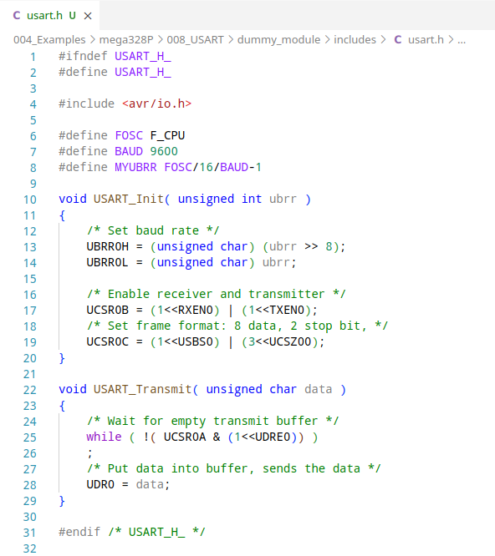

Slide 29
Step 4
Add it to my main file and compile

Slide 30
Now I should be ready to use my module
  I just need to add #include with the path to my header file between quotes. In my case: “includes/usart.h”
  (remember, local includes are wrapped inside double quotes)
When I want to use a function or a macro defined in that header file, I can use it just like if it was declared in my main file

Slide 31
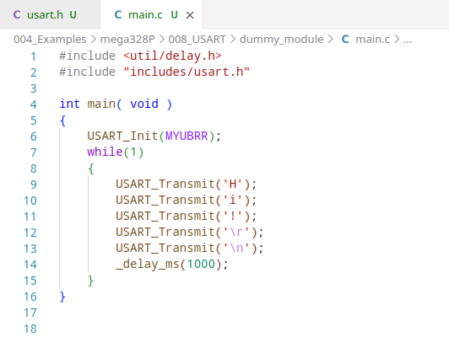

Slide 32
As you might see, this comes with a great advantage:
  The code looks clean and it is easy to understand.
  Since there are no declarations in the main file, it is easy to understand its purpose.
  The code is still there. When I want to see what is going on in the USART functions, I can just go to the header file.
Let us see if it works
  I will compile like it any other program and I expect to see no errors, I will use the following command:
avr-gcc -mmcu=atmega328p -g -Wall -Os -D F_CPU=16000000 main.c -o main.elf

Slide 33
Just so you remember, this is what each part of the command does.
  avr-gcc: this is the compiler command
  -mmcu=atmega328p: defines the microcontroller we are using
  -g: this argument enables some debugging options
  -Wall: enables all the compiler warnings
  -Os: enables optimization for size
  -D F_CPU=16000000: Sets the clock frequency as a global constant
  main.c: is the input source file
  -o main.elf: defines our desired output file
These are my personal preferences and the arguments -g -Wall are not mandatory.

Slide 34
Step 5
Upload the program and test it

Slide 35
Once I compiled my code, and prior to uploading it to the microcontroller, I have to convert the .elf file to an .hex file in intel hex format using the following command:
  avr-objcopy -O ihex main.elf main.hex
And then upload it with the following command:
  avrdude -p atmega328p -c usbasp -v -U flash:w:main.hex
Once the program has been uploaded, I use the screen command to read the serial output from my microcontroller.

Slide 36
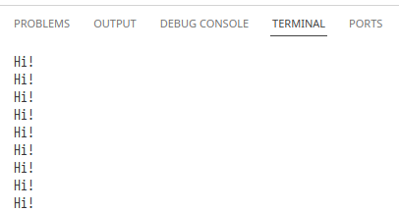

Slide 37
How to create a C Module V2
Corrected and improved

Slide 38
Works, but can be better
C modules can provide some options that we couln’t see in this last example.
From Harvey Mudd College:
A large C or C++ program should be divided into multiple files. This makes each file short enough to conveniently edit, print, etc. It also allows some of the code, e.g. utility functions such as linked list handlers or array allocation code, to be shared with other programs.

Slide 39
ChatGPT explains it just fine:
Splitting a C program with many functions into multiple C files is generally a good practice for multiple reasons:
  Modularity: Each file can focus on a specific aspect of the program. This makes the code easier to understand, maintain, and modify.
  Readability: Developers can quickly locate relevant functions and understand their purpose without having to sift through a large monolithic file.
  Encapsulation: Allows to encapsulate related functions together, as well as limiting the scope of variables.
  Compilation Efficiency: You don't need to recompile the entire program, just the modules you modify. Works best in large projects.
  Reusability: Modularizing your code makes it easier to reuse functions in other projects.
  Collaboration: Different developers can work on different modules concurrently without interfering with each other's code.

Slide 40
How can we make it better?
In the last example we defined a header file containing the functions we wanted.
That means, the code in the header file was integrated into our main file before compiling.
While this is okay, we can also create multiple C files, each one containing a set of related functionalities.

Slide 41
My take
A simple USART module

Slide 42
I will repeat the steps and populate my new header file, but this time it will only contain declarations and prototypes and it will be in the folder usart
I will include the following functions:
  USART_init: to initialize USART communication
  USART_putc: to send a character
  USART_puts: to send a string
  USART_getc: to receive a character
  USART_getl: to receive a string ended in “\r”

Slide 43
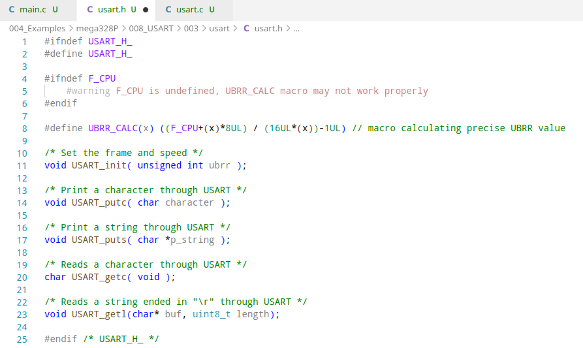

Slide 44
Now I will define my functions in a C source file with the same name (usart.c)
  And I have to add #include with the path to my header file between quotes. In this case: “usart.h” since it is in the same folder as my usart.c file.
The reason to add it to the C file is because that is where the definitions exist for the functions I will be defining

Slide 45
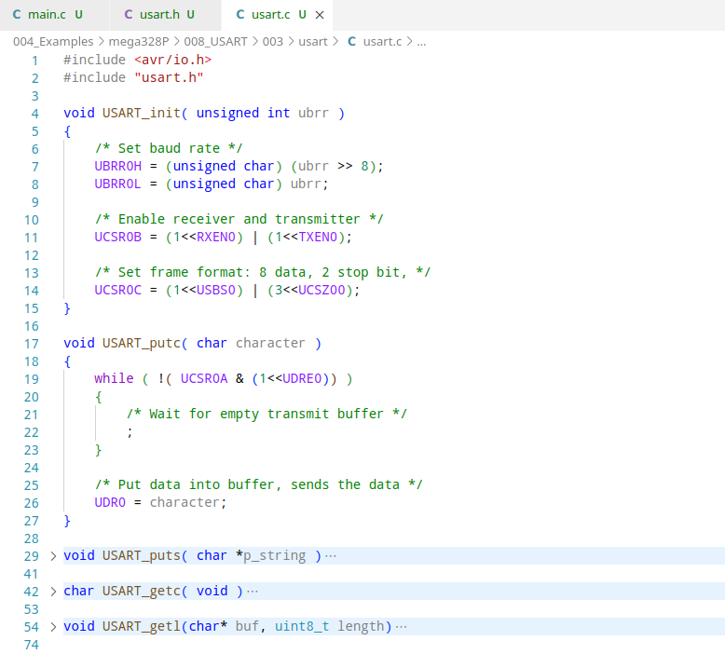

Slide 46
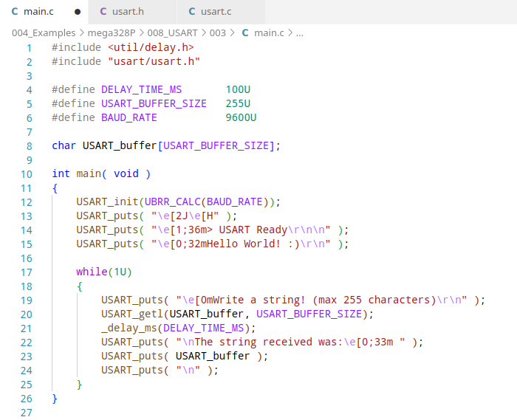
Finally, my main file:

Slide 47
Compilation can be now done in two different ways.
One is doing all in one single line:
  avr-gcc -mmcu=atmega328p -Wall -Os -D F_CPU=16000000 -o main.elf main.c usart/usart.c
The other is compiling every source file separately, and then link them together:
  (Compile main.c into main.o)
  avr-gcc -mmcu=atmega328p -Wall -Os -D F_CPU=16000000 -c main.c
  (Compile usart.c into usart.o)
  avr-gcc -mmcu=atmega328p -Wall -Os -D F_CPU=16000000 -c usart/usart.c
  (Link main.o and usart.o together)
  avr-gcc -mmcu=atmega328p -Wall -Os -D F_CPU=16000000 -o main.elf main.o usart.o

Slide 48
The first way indicates to the compiler to use main.c and usart.c as input files, so they are compiled an linked together in one step.
  This is fine when the project is small, it does not consume a lot of time if the files are a few lines long.
The other way seems trickier, but it is actually preferred for bigger projects.
  This is because a change in a single file in a project with dozens or hundreds of files would mean a considerable amount of time to compile.
  When done separately, you just need to re-compile the files with changes, not all the files, and then you just link them together.

Slide 49
Finally, and as always, the ELF file needs to be converted to intel hex format:
  avr-objcopy -O ihex main.elf main.hex
And then, uploaded to the microcontroller:
  avrdude -p atmega328p -c usbasp -v -U flash:w:main.hex
So. What does my program do?
  It asks for a string. After you enter it, it is printed back.

Slide 50
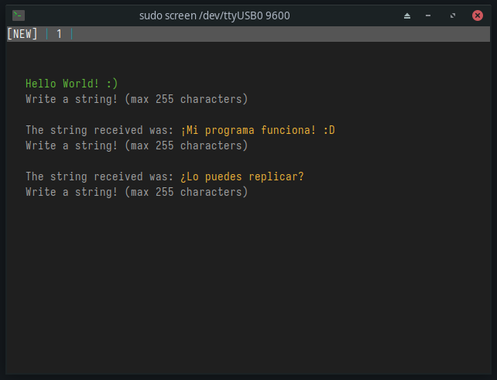

Slide 51
Can you do I2C?

Slide 52
Notices:

Slide 53
Thanks!
Please feel free to ask any related questions at any time.

