Slide 1
Normilization Types
First normal Form (1 NF)
Second normal form (2NF)
Third normal form (3NF)
Boyce & codd normal form (BCNF)
fourth normal form (4NF)
Fith normal form (5NF)
Sixth normal form (6NF)
1NF
2NF
3NF
BCNF
4NF

Slide 2
First Normal Form (1NF)
As per the rule of first normal formal form
An attribute (column) of a table cannot hold multiple values
It should hold only atomic (forming a single unit) values
Each record needs to be unique
An atomic value is a value that cannot be divided.
Employee Table
Emp_id | Name | MobileNo | Dept
E1001 | Ravi | 334578 | Sales
E1002 | Sanjna | 757565,7575657 | Purchase
E1003 | Kalu | 5656567,565668 | IT
E1004 | Anuj | 985672 | Sales
E1005 | Mohan | 895623 | Account

Slide 3
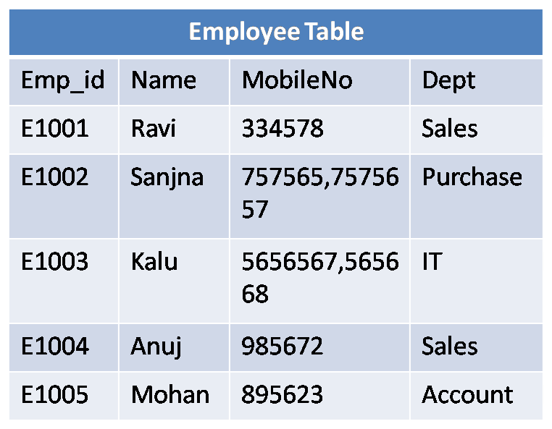
After 1st Normilization
Employee table
Emp_id | Name | MobileNo | Dept
E1001 | Ravi | 334578 | Sales
E1002 | Sanjna | 757565 | Purchase
E1002 | Sanjna | 7575657 | Purchase
E1003 | Kalu | 5656567 | IT
E1003 | Kalu | 565668 | IT
E1004 | Anuj | 985672 | Sales
E1005 | Mohan | 895623 | Account
Not a atomic value

Slide 4
2nd NF
Non key attribute
It should be in the first normal form
All non key attributes are fully functional dependent on the primary key in simple words it should not have partial dependency
Composite primary key : emp_id+Qualification
Non key attribute: age
How to find age of employee
Emp_id | Qualification | age
111 | MA | 38
111 | BTech | 38
222 | MCA | 38
333 | MS | 40
333 | MBA | 40
Composite key:emp_id+Qualification

Slide 5
2nd Normal Form To make the complies with 2nd NF we can break it in two tables like this:
Emp_id: primary key
Emp_id: Foreign key
Emp_id | Age
111 | 38
222 | 38
333 | 40
Emp_id | Qualification
111 | MA
111 | Btech
222 | MCA
333 | MS
333 | MBA
1st NF
.It should hold only atomic (forming a single unit) values.
. Each record needs to be unique
2nd NF
Non-key attribute should depend on single key.

Slide 6
3rd NF
Emp_id: primary key
Change in zip requires change in city
It is in second normal form
There is no transitive function dependency
A transitive function dependency is which changing a non-key column, might cause any of the other non-key columns to change.
Emp_id | Name | Zip | City
E100 | RAH | 20101 | GURUGRAM
E101 | RAJESH | 02228 | NOIDA
E102 | VASU | 60007 | CHICAGO
E103 | KARTHIK | 06389 | CHANDIGARH
E104 | JANVI | 02228 | NOIDA
Emp_id->zip->city | City dependent on zip dependent on emp_id
Emp_id->city | City dependent on Emp_id City indirectly dependent on Emp_id is called Transitive Functional Dependency Solution:Create New table for Zip and city

Slide 7
Solution: 3rd NF
Zip: primary key
Emp Table
Emp_id | Name | Zip
E100 | RAH | 20101
E101 | RAJESH | 02228
E102 | VASU | 60007
E103 | KARTHIK | 06389
E104 | JANVI | 02228
Zip Table
Zip | City
20101 | GURUGRAM
02228 | NOIDA
60007 | CHICAGO
06389 | CHANDIGARH
Emp_id: primary key
Zip:foreign key

