Slide 1
Inter Integrated Circuit Bus Protocol
(I²C)
By:
Harekrishna ray
Neel Pambhar
Ayushi Gajera

Slide 2
I²C bus => Philips, consumer products (TV)
Originally intended for operation on one single board (PCB)
Today, variety of devices are available with on-chip I²C interface. i.e. Microcontroller, E²PROM, A/D converters etc.

Slide 3
I²C Bus Terminology
Term | Description
Transmitter | Device which send data to bus
Receiver | Device which receives data from bus
Master | Device which initiates transfer, generate CLK signal to permit data transfer and stop data transfer
Slave | Device addressed by Master
Multi-Master | More than one Master control bus at same time
Arbitration | Procedure to allow one Master among Multi-Master, whose message is not corrupted

Slide 5
I²C Bus Characteristics
Two wires, SDA, SCL carry information between devices connected on bus
Every device hooked on the bus is identified by unique address (7-bit slave address)
Synchronous, Half-duplex serial communication
Unique Start and Stop conditions

Slide 6
Acknowledgement after each transferred byte
Improves reliability of communication
Multi-Master Capability
Bi-directional data transfer
No chip enable (Slave Select Signal, SPI) is required.

Slide 7
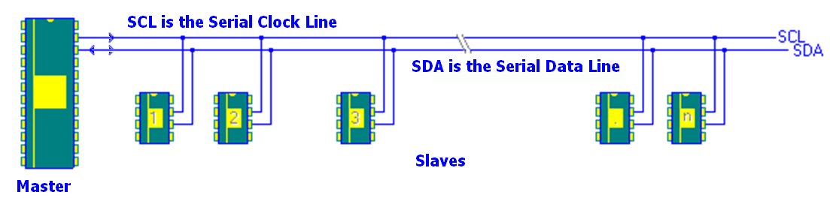
Realization

Slide 8
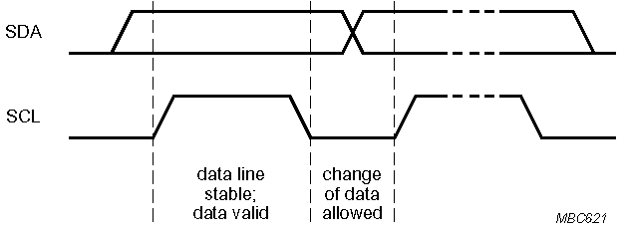
DATA Transfer on the I²C Bus
In normal data transfer, the data line (SDA) only changes state when the clock (SCL) is low.
SDA
SCL
Data line stable; Data valid
Change of data allowed

Slide 9
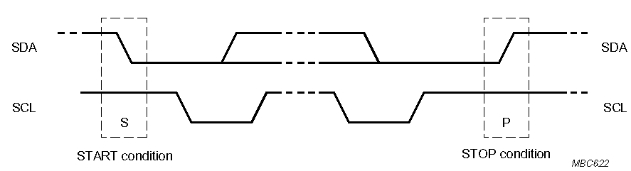
Start and Stop Conditions
A transition on the data line while the clock line is high is defined as either a start or a stop condition.
Both start and stop conditions are generated by the bus master
The bus is considered busy after a start condition, until a stop condition occurs
SDA
SDA
SCL
SCL
Start Condition
Stop Condition

Slide 10
Addressing Scheme
Every devices, hook up on bus=> own unique address.
Master => 7-bit address => device which it want to access.
After START condition, 7-bit address sent along with data direction bit (R/W’)
Always, first byte of data transfer.

Slide 11
First Byte in Data Transfer on the I²C Bus
MSB
LSB
R / Wr
7 – Bit Slave Address
ACK
By Slave
R/W’
0 – Slave written by Master
1 – Slave read by Master
ACK – Generated by the slave whose address has been output

Slide 13
MASTER
SLAVE

Slide 14
Acknowledge
The acknowledge takes place after every byte. The acknowledge bit allows the receiver to signal the transmitter that the byte was successfully received and another byte may be sent.
The Acknowledge signal is defined as follows: the transmitter releases the SDA line during the acknowledge clock pulse so the receiver can pull the SDA line LOW and it remains stable LOW during the HIGH period of this clock pulse.
When SDA remains HIGH during 9th clock pulse, this is defined as the Not Acknowledge signal. The master can then generate either a STOP condition to abort the transfer, or a repeated START condition to start a new transfer.

Slide 15
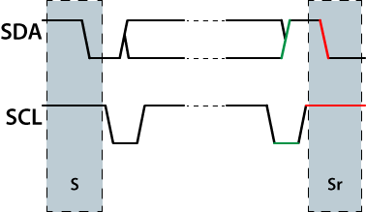
Repeated START (Sr) Condition
Instead of the STOP condition, the master can generate a repeated START (Sr) condition.
Like a START condition, to generate a repeated START condition, the master changes the SDA line from one to zero while the SCL line is HIGH
source:DNLWARE

Slide 16
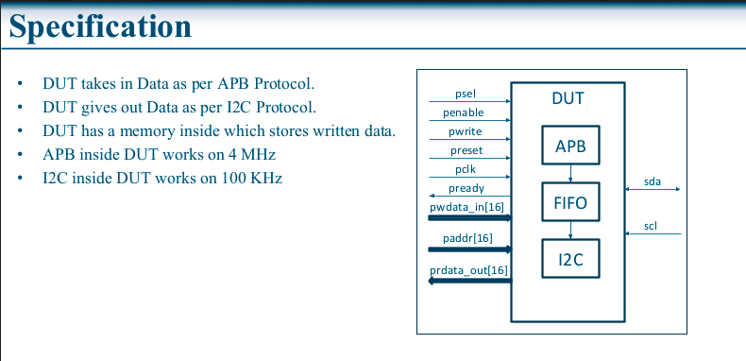
APB-I2C BRIDGE

