Slide 1
EECS 373
Design of Microprocessor-Based Systems
Prabal Dutta
University of Michigan
AMBA: Advanced Microcontroller Bus Architecture
AHB: AMBA High-performance Bus
APB: Advanced Peripheral Bus
Slides developed in part by
Mark Brehob & Prabal Dutta

Slide 2
Busses: the glue that connects the pieces
C
Assembly
Machine Code
EECS 370
Central
Processing
Unit
ISA
Software
Hardware
bl (int)
ldr (read)
str (write)
System Buses
AHB/APB
Interrupts
GPIO/INT
Timers
USART
DAC/ADC
Internal &
External
Memory
Internal
External
Input
I2C
SPI
ADC
DAC
EMC
Output
Capture
UART
Interrupt
Compare

Slide 3
Today…
MMIO: Memory-Mapped I/O review
AMBA: Advanced Microcontroller Bus Architecture
APB: Advanced Peripheral Bus
AHB: AMBA High-performance Bus

Slide 4
Memory-Mapped I/O (MMIO)
I/O model in which the same address bus/space is used to
  Do memory accesses (e.g. to RAM)
  Do I/O operations (e.g. to I/O pins or peripheral registers)
Reading and writing memory addresses allows us to
  Read peripheral state (e.g. value of an I/O pin or FSM’s DFF)
  Issue peripheral commands (e.g. set an I/O pin or FSM’s state)
How?
  Memory has an address and value
  Can equate a pointer to desired address
  Can set/get de-referenced value to change memory
  Can control peripheral state in this way

Slide 5
Reading register bits with MMIO
How?
  Let’s say that red, green, and blue pushbuttons are mapped to memory address 0xB0000003 at bits 0, 1, and 2, respectively
  When pushed, we will read a ‘1’ from the corresponding bit
  When released, we will read a ‘0’ from the corresponding bit
  Address \ Bit 31 24 23 16 15 8 7 210
  0xB0000003 -------- -------- -------- -----
  Must mask (and perhaps shift) to select target bits for reading
#define PBS_REG 0xB0000003
int isBlueButtonPressed() {
return (*((uint32_t *)PBS_REG) & 0x00000004) >> 2;
}

Slide 6
Writing register bits with MMIO
How?
  Let’s say that red, green, and blue LEDs are mapped to memory address 0xB0000004 at bits 0, 1, and 2, respectively
  Writing a ‘1’ (‘0’) to the corresponding bit turns on (off) the LED
  Address \ Bit 31 24 23 16 15 8 7 210
  0xB0000004 -------- -------- -------- -----
  When updating (set/clear) bits, must preserve remaining contents
  Use bitmask to select target bits for manipulation, e.g.
#define LED_REG 0xB0000004
void setRedLed() {
*((uint32_t *)LED_REG) |= 0x1;
}
void setGreenLed() {
*((uint32_t *)LED_REG) |= 0x2;
}
#define LED_REG 0xB0000004
void clearRedLed() {
*((uint32_t *)LED_REG) &= ~(0x00000001);
}
void clearBlueLed() {
*((uint32_t *)LED_REG) &= ~(0x00000004);
}

Slide 7
Some useful C keywords
const
  Makes variable value or pointer parameter unmodifiable
  const foo = 32;
register
  Tells compiler to locate variables in a CPU register if possible
  register int x;
static
  Preserve variable value after its scope ends
  Does not go on the stack
  static int x;
volatile
  Opposite of const
  Can be changed in the background
  volatile int I;

Slide 8
Today…
MMIO: Memory-Mapped I/O review
AMBA: Advanced Microcontroller Bus Architecture
APB: Advanced Peripheral Bus
AHB: AMBA High-performance Bus

Slide 9
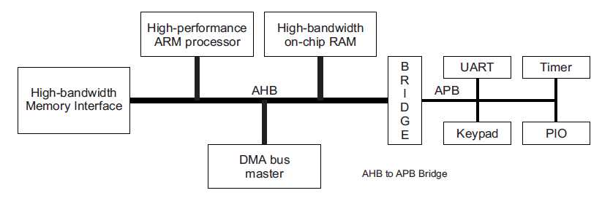
Advanced Microcontroller Bus Architecture (AMBA)
- Advanced/AMBA High-performance Bus (AHB)
- Advanced Peripheral Bus (APB)
AHB
APB
High performance
Pipelined operation
Burst transfers
Multiple bus masters
Split transactions
Low power
Latched address/control
Simple interface
Suitable of many peripherals

Slide 10
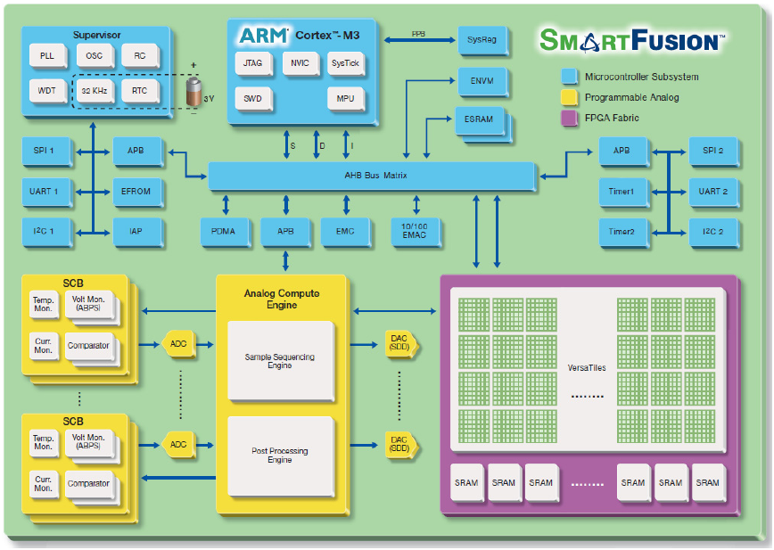
Actel SmartFusion system/bus architecture

Slide 11
Today…
MMIO: Memory-Mapped I/O review
AMBA: Advanced Microcontroller Bus Architecture
APB: Advanced Peripheral Bus
AHB: AMBA High-performance Bus

Slide 12
APB: a simple bus that is easy to work with
Low-cost
Low-power
Low-complexity
Low-bandwidth
Non-pipelined
Ideal for peripherals

Slide 13
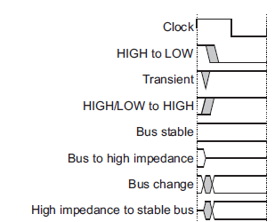
Notation

Slide 14
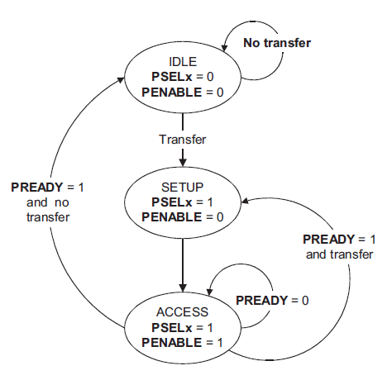
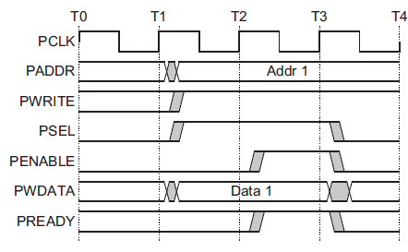
APB bus state machine
IDLE
  Default APB state
SETUP
  When transfer required
  PSELx is asserted
  Only one cycle
ACCESS
  PENABLE is asserted
  Addr, write, select, and write data remain stable
  Stay if PREADY = L
  Goto IDLE if PREADY = H and no more data
  Goto SETUP is PREADY = H and more data pending
Setup phase begins
with this rising edge
Setup
Phase
Access
Phase

Slide 15
APB signal definitions
PCLK: the bus clock source (rising-edge triggered)
PRESETn: the bus (and typically system) reset signal (active low)
PADDR: the APB address bus (can be up to 32-bits wide)
PSELx: the select line for each slave device
PENABLE: indicates the 2nd and subsequent cycles of an APB xfer
PWRITE: indicates transfer direction (Write=H, Read=L)
PWDATA: the write data bus (can be up to 32-bits wide)
PREADY: used to extend a transfer
PRDATA: the read data bus (can be up to 32-bits wide)
PSLVERR: indicates a transfer error (OKAY=L, ERROR=H)

Slide 16
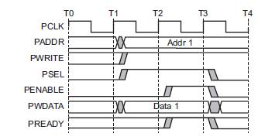
APB bus signals in action
PCLK
  Clock
PADDR
  Address on bus
PWRITE
  1=Write, 0=Read
PWDATA
  Data written to the I/O device. Supplied by the bus master/processor.

Slide 17
APB bus signals
PSEL
  Asserted if the current bus transaction is targeted to this device
PENABLE
  High during entire transaction other than the first cycle.
PREADY
  Driven by target. Similar to our #ACK. Indicates if the target is ready to do transaction.
  Each target has it’s own PREADY

Slide 18
A write transfer with no wait states
Setup phase begins
with this rising edge
Setup
Phase
Access
Phase

Slide 19
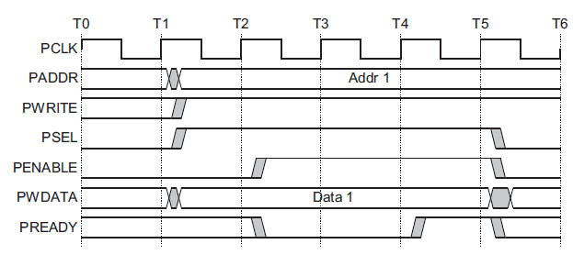
A write transfer with wait states
Setup phase begins
with this rising edge
Setup
Phase
Wait
State
Wait
State
Access
Phase

Slide 20
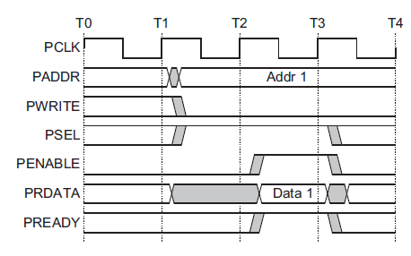
A read transfer with no wait states
Setup phase begins
with this rising edge
Setup
Phase
Access
Phase

Slide 21
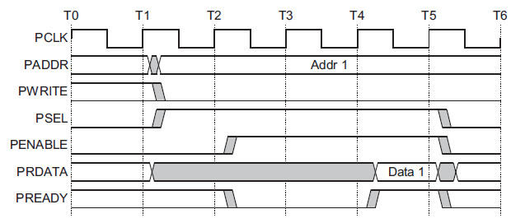
A read transfer with wait states
Setup phase begins
with this rising edge
Setup
Phase
Wait
State
Wait
State
Access
Phase

Slide 22
Example setup
We will assume we have one bus master “CPU” and two slave devices (D1 and D2)
  D1 is mapped to 0x00001000-0x0000100F
  D2 is mapped to 0x00001010-0x0000101F

Slide 23
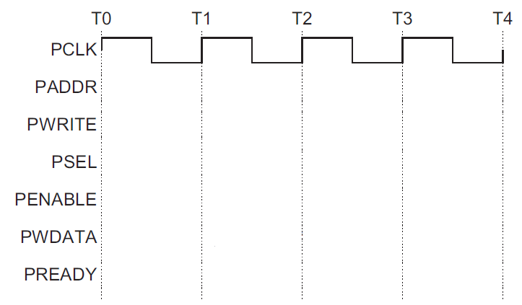
CPU stores to location 0x00001004 with no stalls
D1
D2

Slide 24
Writes
Let’s do some hardware examples!

Slide 25
Design a device which writes to a register whenever any address in its range is written
What if we want to have the LSB of this register control an LED?
PWDATA[31:0]
PWRITE
PENABLE
PSEL
PADDR[7:0]
PCLK
PREADY
32-bit Reg
D[31:0]
Q[31:0]
EN
C
LED
We are assuming APB only gets lowest 8 bits of address here…

Slide 26
Reg A should be written at address 0x00001000
Reg B should be written at address 0x00001004
PWDATA[31:0]
PWRITE
PENABLE
PSEL
PADDR[7:0]
PCLK
PREADY
32-bit Reg A
D[31:0]
Q[31:0]
EN
C
32-bit Reg B
D[31:0]
Q[31:0]
EN
C
We are assuming APB only gets lowest 8 bits of address here…

Slide 27
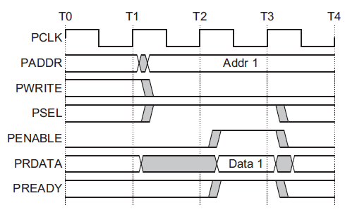
Reads…
The key thing here is that each slave device has its own read data (PRDATA) bus!
Recall that “R” is from the initiator’s viewpoint—the device drives data when read.

Slide 28
Let’s say we want a device that provides data from a switch on a read to any address it is assigned.
(so returns a 0 or 1)
PWRITE
PENABLE
PSEL
PADDR[7:0]
PCLK
PREADY
PRDATA[32:0]
Mr. Switch

Slide 29
Device provides data from switch A if address
0x00001000 is read from. B if address 0x00001004 is read from
PWRITE
PENABLE
PSEL
PADDR[7:0]
PCLK
PREADY
PRDATA[31:0]
Mr.
Switch
Mrs.
Switch

Slide 30
All reads read from register, all writes write…
PWDATA[31:0]
PWRITE
PENABLE
PSEL
PADDR[7:0]
PCLK
PREADY
PREADY
PRDATA[31:0]
32-bit Reg
D[31:0]
Q[31:0]
EN
C
We are assuming APB only gets lowest 8 bits of address here…

Slide 31
Things left out…
There is another signal, PSLVERR (APB Slave Error) which we can drive high if things go bad.
  We’ll just tie that to 0.
PRESETn
  Active low system reset signal
  (needed for stateful peripherals)
Note that we are assuming that our device need not stall.
  We could stall if needed.
    I can’t find a limit on how long, but I suspect at some point the processor would generate an error.

Slide 32
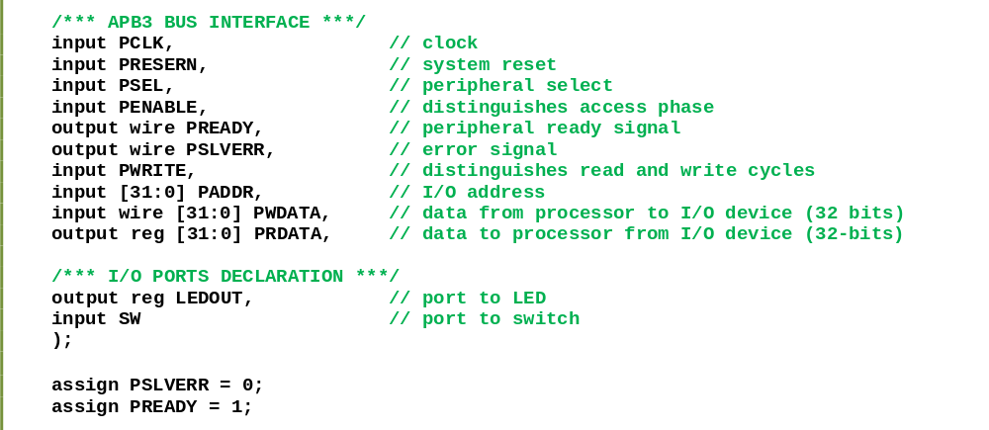
Verilog!

Slide 33
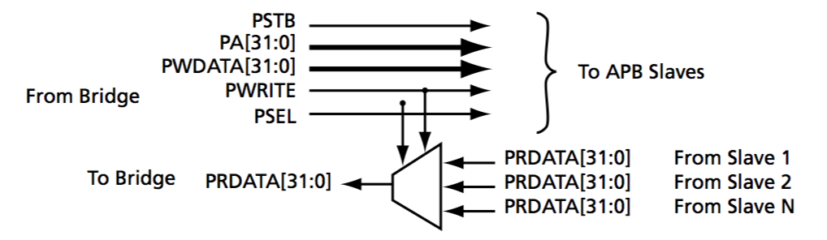
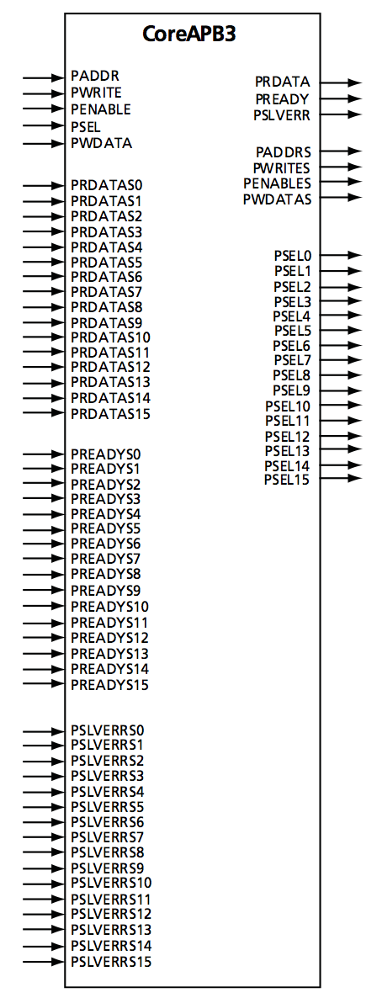
Actel/Microsemi implementation of CoreAPB3
ARM APB spec is silent about sharing signals
  PSEL, PREADY, PRDATA are shared
  Hence, every peripheral needs its own decode logic…which is cumbersome
Actel CoreAPB3 (and other) module(s) help
Allocates per-slave signals
  PSEL, PREADY, PRDATA, PSLVERR broken out
  CoreAPB3 supports 16 slaves
  Performs address decoding for PSEL
  De-multiplexes PSEL signal
  Multiplexes PREADY, PRDATA, PSLVERR

Slide 34
Today…
MMIO: Memory-Mapped I/O review
AMBA: Advanced Microcontroller Bus Architecture
APB: Advanced Peripheral Bus
AHB: AMBA High-performance Bus

Slide 35
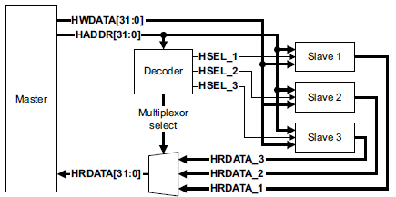
AHB-Lite supports single bus master and provides high-bandwidth operation
Burst transfers
Single clock-edge operation
Non-tri-state implementation
Configurable bus width

Slide 36
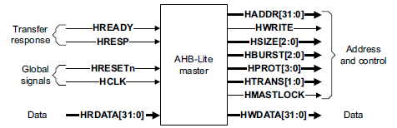
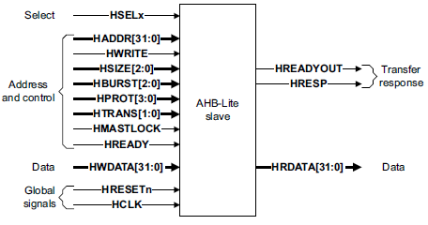
AHB-Lite bus master/slave interface
Global signals
  HCLK
  HRESETn
Master out/slave in
  HADDR (address)
  HWDATA (write data)
  Control
    HWRITE
    HSIZE
    HBURST
    HPROT
    HTRANS
    HMASTLOCK
Slave out/master in
  HRDATA (read data)
  HREADY
  HRESP

Slide 37
AHB-Lite signal definitions
Global signals
  HCLK: the bus clock source (rising-edge triggered)
  HRESETn: the bus (and system) reset signal (active low)
Master out/slave in
  HADDR[31:0]: the 32-bit system address bus
  HWDATA[31:0]: the system write data bus
  Control
    HWRITE: indicates transfer direction (Write=1, Read=0)
    HSIZE[2:0]: indicates size of transfer (byte, halfword, or word)
    HBURST[2:0]: indicates single or burst transfer (1, 4, 8, 16 beats)
    HPROT[3:0]: provides protection information (e.g. I or D; user or handler)
    HTRANS: indicates current transfer type (e.g. idle, busy, nonseq, seq)
    HMASTLOCK: indicates a locked (atomic) transfer sequence
Slave out/master in
  HRDATA[31:0]: the slave read data bus
  HREADY: indicates previous transfer is complete
  HRESP: the transfer response (OKAY=0, ERROR=1)

Slide 38
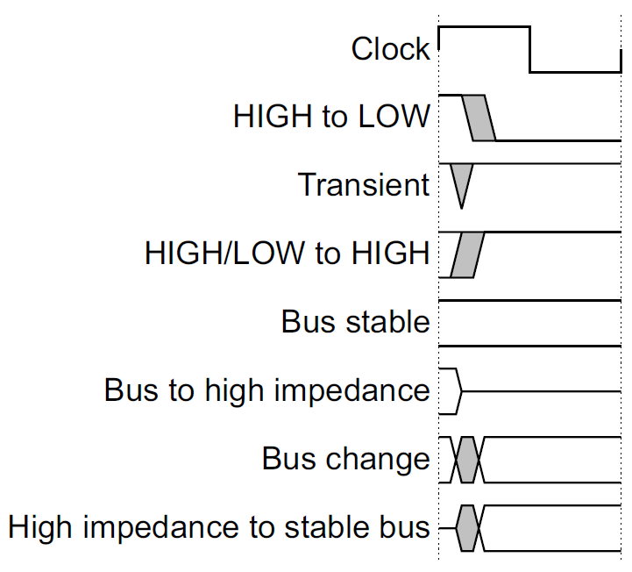
Key to timing diagram conventions
Timing diagrams
  Clock
  Stable values
  Transitions
  High-impedance
Signal conventions
  Lower case ‘n’ denote active low (e.g. RESETn)
  Prefix ‘H’ denotes AHB
  Prefix ‘P’ denotes APB

Slide 39
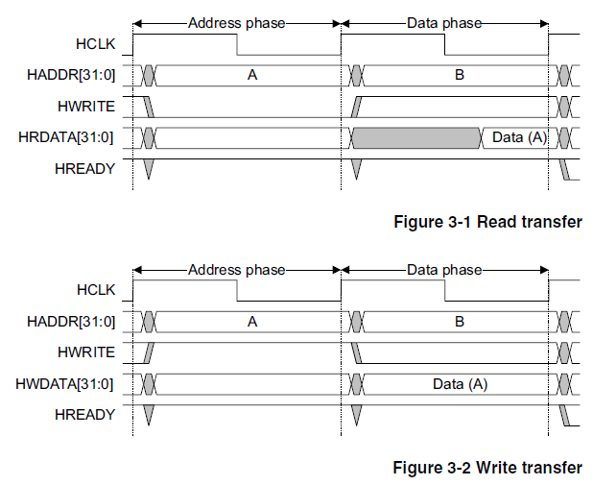
Basic read and write transfers with no wait states
Pipelined
Address
& Data
Transfer

Slide 40
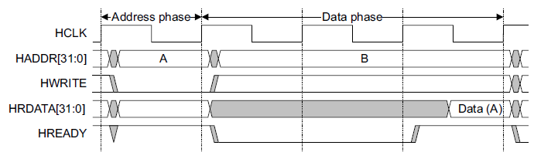
Read transfer with two wait states
Two wait states
added by slave
by asserting
HREADY low
Valid data
produced

Slide 41
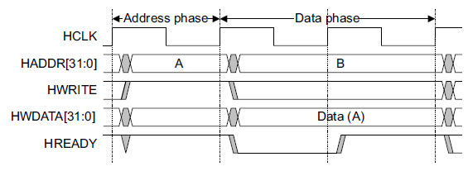
Write transfer with one wait state
One wait state
added by slave
by asserting
HREADY low
Valid data
held stable

Slide 42
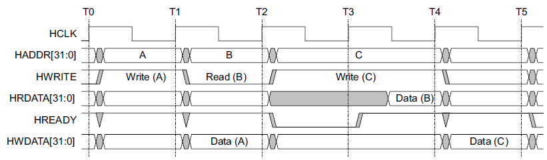
Wait states extend the address phase of next transfer
Address stage of
the next transfer
is also extended
One wait state
added by slave
by asserting
HREADY low

Slide 43
Today…
MMIO: Memory-Mapped I/O review
AMBA: Advanced Microcontroller Bus Architecture
APB: Advanced Peripheral Bus
AHB: AMBA High-performance Bus
- Low-level details included for completeness
- But we’ll skip most of these details

Slide 44
Transfers can be of four types (HTRANS[1:0])
IDLE (b00)
  No data transfer is required
  Slave must OKAY w/o waiting
  Slave must ignore IDLE
BUSY (b01)
  Insert idle cycles in a burst
  Burst will continue afterward
  Address/control reflects next transfer in burst
  Slave must OKAY w/o waiting
  Slave must ignore BUSY
NONSEQ (b10)
  Indicates single transfer or first transfer of a burst
  Address/control unrelated to prior transfers
SEQ (b11)
  Remaining transfers in a burst
  Addr = prior addr + transfer size

Slide 45
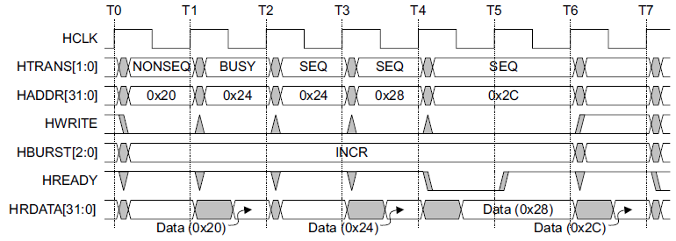
A four beat burst with master busy and slave wait
Master busy
indicated by
HTRANS[1:0]
One wait state
added by slave
by asserting
HREADY low

Slide 46
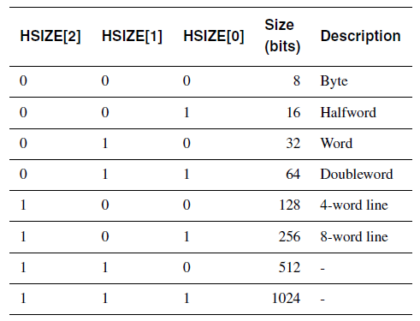
Controlling the size (width) of a transfer
HSIZE[2:0] encodes the size
The cannot exceed the data bus width (e.g. 32-bits)
HSIZE + HBURST is determines wrapping boundary for wrapping bursts
HSIZE must remain constant throughout a burst transfer

Slide 47
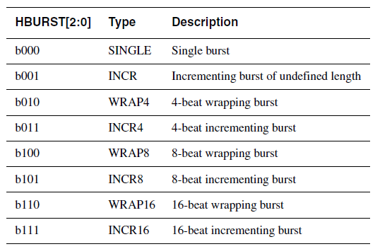
Controlling the burst beats (length) of a transfer
Burst of 1, 4, 8, 16, and undef
HBURST[2:0] encodes the type
Incremental burst
Wrapping bursts
  4 beats x 4-byte words wrapping
  Wraps at 16 byte boundary
  E.g. 0x34, 0x38, 0x3c, 0x30,…
Bursts must not cross 1KB address boundaries

Slide 48
A four beat wrapping burst (WRAP4)

Slide 49
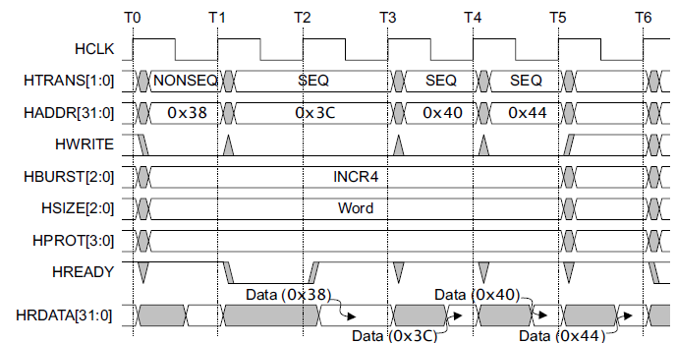
A four beat incrementing burst (INCR4)

Slide 50
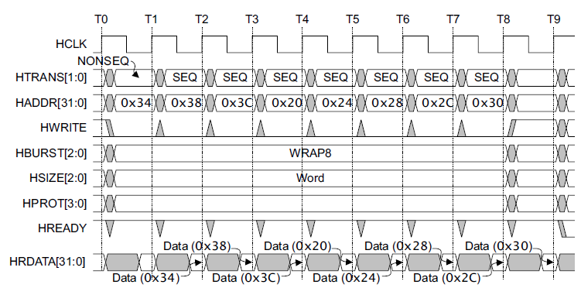
An eight beat wrapping burst (WRAP8)

Slide 51
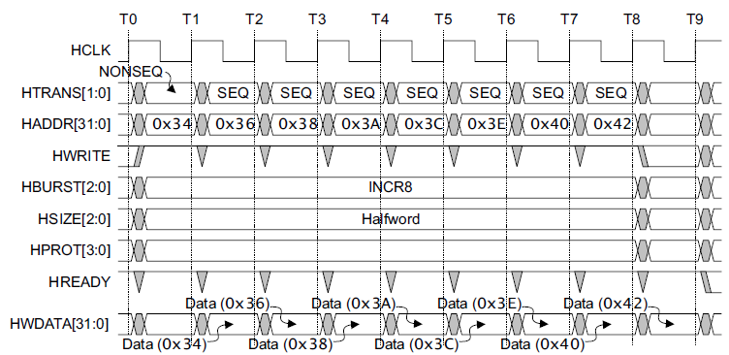
An eight beat incrementing burst
(INCR8) using half-word transfers

Slide 52
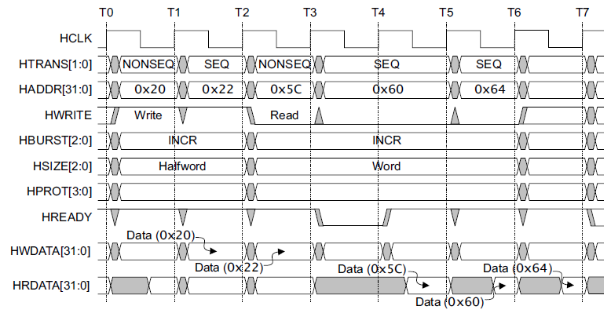
An undefined length incrementing burst (INCR)

Slide 53
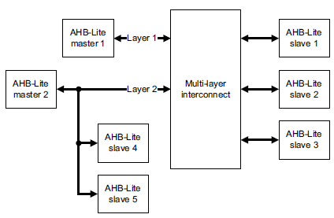
Multi-master AHB-Lite requires a multi-layer interconnect
AHB-Lite is single-master
Multi-master operation
  Must isolate masters
  Each master assigned to layer
  Interconnect arbitrates slave accesses
Full crossbar switch often unneeded
  Slaves 1, 2, 3 are shared
  Slaves 4, 5 are local to Master 1

Slide 54
Questions?
Comments?
Discussion?

