Slide 1

CARE AND CURE
Theme:
SOFTWARE
CODE WIZARDS

Slide 2
1. The Overview
Hello, we are the code wizards team and we are here to present our innovation.
This project is concerned with the problems faced by the patients in order to get the best hospital and doctors available in it for the medical condition they have.
LEARN NOW

Slide 3
2. The Problem
>> The innovation provide an app for all the people of the country in which they can search for the best hospital and doctor available in it for the disease they are suffering from.
>> They can also get information about the doctors experience in that field.
>>They can also book an appointment directly in any hospital with a doctor without talking to any consultant .
Many patients from different cities are not able to get any information of the doctor and the hospital. They are also not able to book an appointment with them.
This innovation is concerned to all the people of the country having severe medical conditions.
LEARN NOW

Slide 4
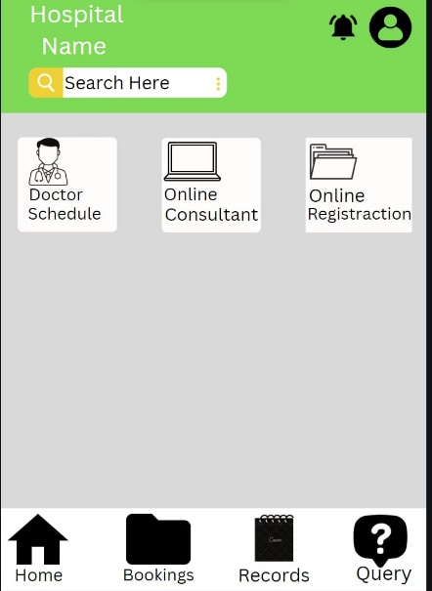
3.The Solution
~This innovation is compelling because many people living in different cities cannot have any information of the other doctors and the hospitals to cure their illness.
~Their money and time is wasted in looking for a particular hospital and doctors.
The app will look something like this
~The innovation provides an app for the people to easily choose the best hospitals and doctors for their medical conditions and can book an appointment with them without any delay.
LEARN NOW

Slide 5
4. The innovation
~ A patient will choose this app as it will allow him/her to get the best hospitals and the doctors to cure their illness while sitting at home.
~ They don’t have to call the hospital and wait till the call is received.
~ The payment option will also be available in the app so they can directly book an appointment.
~ Due to this app the time in looking for the hospitals and doctor will be saved.
~ People can book an appointment with any other doctors in any of the cities.
~ Money is also saved as patient will not visit every city to look for the best doctor for their illness.
LEARN NOW

Slide 6
5. Market & Opportunity
Expenditure cost :
~Feature and functionality
~Developer charge
~App maintenance cost and additional services.
~Approx cost -10k$-20k$
~Profit-100k$-200k$
The target market is 10% of the SAM will count.
As we know that there are 27cr. Families in India.
So if 10% of the total families use the app and for starting basis user give ₹10 so the total revenue will 27 cr. And it will increase with time .
LEARN NOW

Slide 7
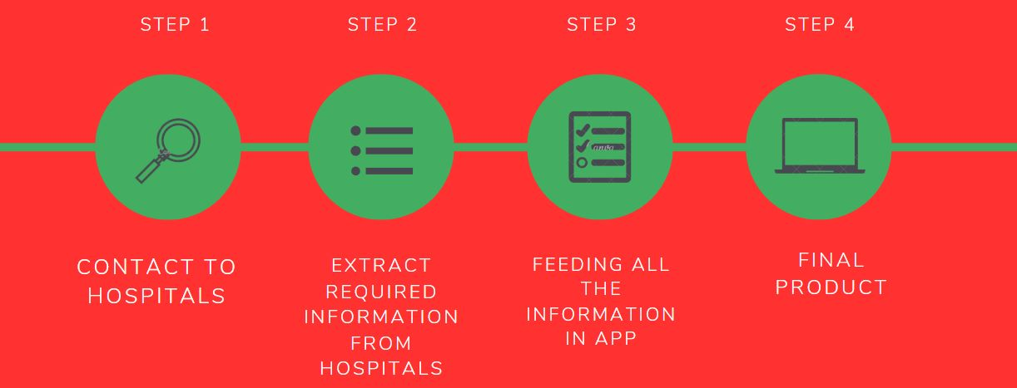
6. The Technology/Innovation
~The software architecture and design are being developed, and the major components and interfaces are being defined.
~The TRL level is currently 2.
~By using this app people can save their time and money.
~They don’t have to search different locations to get information.
~Earlier nobody has thought of making app like this.
LEARN NOW

Slide 8
7. Competitive Landscape
~No other app is available in market which tells about the availability of the doctor.
~Others app only provide online consultant and some are for appointment.
~It also provide online consultation, registration and payment options.
~Due to this app the crowd is reduced in the hospitals.
~Unnecessary calls can be reduced.
~Increase brand value of hospital.
~All hospitals facility available only in one app(registration ,enquiry, appointment )
LEARN NOW

Slide 9
8. Business Model
We are planning to make money by these methods:
~Advertising
~Subscription model
~In-add purchases
~Crowd funding
~Several transaction charge
We have viable business model as it is:
~A compelling business plan
~A True idea case
~A dynamic market opportunity
~No competition
LEARN NOW

Slide 10
10. The Team
Mohd Aftab
Prashant Dixit
Btech/cse
Front end developer
Python developer
Database management
Machine learning
We both the members as a team wanted to help people by seeking a solution to this problem so maximum no. of people can get treatment of their illness as soon as possible with the best hospitals and doctors available in the country without wasting their crucial time.
LEARN NOW

Slide 11
Thankyou

