Slide 1
NovaMart E-Commerce
Sales Data Analysis using SQL
Business questions → SQL analysis → management insights
Data period: January 2023 – June 2025
Project role: Data Analyst
NovaMart E-Commerce Sales Analysis • SQL Portfolio Project
1

Slide 2
1. Business Problem
Source: NovaMart client problem statement
• NovaMart is a multi-category online retailer operating across Electronics, Clothing, Home & Kitchen, Sports & Outdoors, and Beauty & Personal Care.
• Management wants a clearer view of sales performance, customer behavior, profitability, inventory health, order patterns, and payment performance.
• The analysis is designed to turn transactional data into SQL-backed answers that can support inventory, marketing, pricing, and customer-retention decisions.
NovaMart E-Commerce Sales Analysis • SQL Portfolio Project
2

Slide 3
2. Data & Relational Structure
Three related tables supplied for the analysis
500
Customers
199
Products
850
Orders
• Customers: customer identity, contact details, location, signup date, gender, and age.
• Products: product, category/sub-category, brand, selling price, cost price, and stock.
• Orders: customer/product references, order date, quantity, amount, status, and payment method.
• SQL joins connect customer, product, and order information for business-level analysis.
NovaMart E-Commerce Sales Analysis • SQL Portfolio Project
3

Slide 4
3. Analysis Scope
30 business questions organized by difficulty
11
Basic
9
Intermediate
10
Advanced
• Basic: filtering, aggregation, stock, product and order lookups.
• Intermediate: joins, grouping, customer spend, product/category performance, and remaining stock.
• Advanced: time-series revenue, revenue share, profitability, ranking, segmentation, stock-out risk, payment analysis, and MoM growth.
NovaMart E-Commerce Sales Analysis • SQL Portfolio Project
4

Slide 5
4. SQL Techniques Used
The query set demonstrates progressively more analytical SQL
• Filtering: WHERE, BETWEEN, IN, DISTINCT
• Aggregation: SUM, AVG, COUNT, MIN, MAX
• Relational analysis: INNER JOIN and LEFT JOIN
• Grouping: GROUP BY with HAVING and ORDER BY
• Advanced SQL: CTEs, RANK() OVER(PARTITION BY ...), LAG() OVER(...), CASE segmentation, DATE_FORMAT
• Business metrics: revenue share, gross profit, gross margin, customer lifetime value, stock-out risk, and MoM growth
NovaMart E-Commerce Sales Analysis • SQL Portfolio Project
5

Slide 6
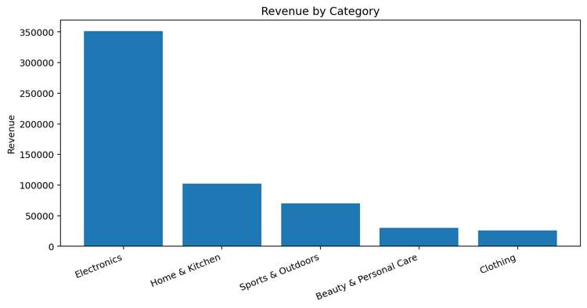
5. Revenue Performance by Category
Q22 output: revenue contribution across completed + shipped orders
Electronics: $351,632.40 (60.61%)
Home & Kitchen: $102,324.02 (17.64%)
Sports & Outdoors: $70,351.18 (12.13%)
Beauty & Personal Care: $29,926.08 (5.15%)
Clothing: $25,940.79 (4.47%)
Observation
Electronics contributes 60.61% of the reported category revenue.
NovaMart E-Commerce Sales Analysis • SQL Portfolio Project
6

Slide 7
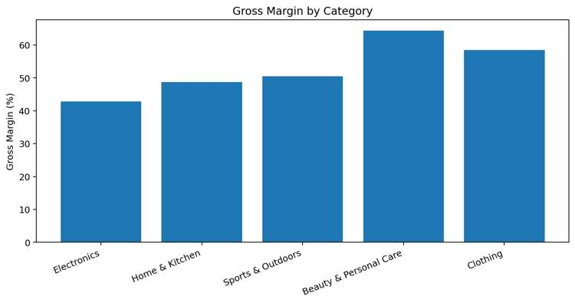
6. Profitability by Category
Q23 output using Profit = Total_Amount − Cost_Price × Quantity
Electronics: $150,774.84 profit • 42.88% margin
Home & Kitchen: $49,650.82 profit • 48.72% margin
Sports & Outdoors: $35,541.24 profit • 50.52% margin
Beauty & Personal Care: $19,279.42 profit • 64.42% margin
Clothing: $15,182.24 profit • 58.53% margin
Reported highest margin: Beauty & Personal Care (64.42%).
NovaMart E-Commerce Sales Analysis • SQL Portfolio Project
7

Slide 8
7. Customer Value Analysis
Q19 and Q27 outputs
$13,557.56
Highest lifetime value reported
Todd Fischer
Top-spend customer in Q19
≥ $1,000
High-value threshold used in Q27
• Q19 identifies Todd Fischer as the highest-lifetime-value customer in the provided output.
• Q24 ranks the top 10 customers by total spend.
• Q27 segments customers using the project's thresholds: High Value ≥ $1,000; Medium Value ≥ $500; otherwise Low Value.
• These outputs can support retention and customer-value analysis.
NovaMart E-Commerce Sales Analysis • SQL Portfolio Project
8

Slide 9
8. Inventory & Stock-Out Risk
Q20 and Q28 focus on remaining stock and risk
29,914
Total initial stock reported in Q5
5 units
Current stock of reported risk item
8 sold
Reported sales quantity for risk item
• Q10 reports NovaPhone X1-Lite as the product with the lowest stock: 4 units.
• Q20 calculates remaining stock after Completed/Shipped sales and orders results by remaining stock ascending.
• Q28 flags products with current stock < 10 and total sold above the average product sales quantity.
• The provided Q28 output flags ForgeAudio HD-Lite with 5 current units and 8 units sold.
NovaMart E-Commerce Sales Analysis • SQL Portfolio Project
9

Slide 10
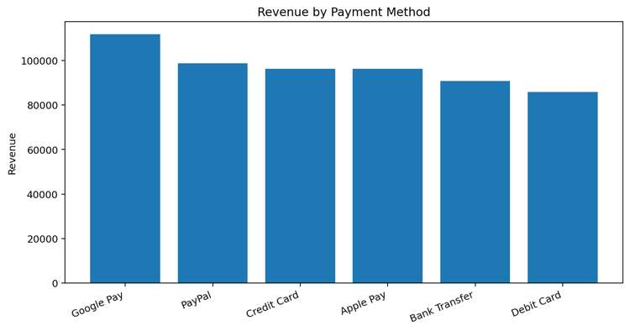
9. Payment Method Performance
Q29 output: orders, average order value, and revenue
Google Pay: 138 orders • AOV $810.72 • $111,879.26 revenue
PayPal: 121 orders • AOV $816.11 • $98,748.88 revenue
Credit Card: 114 orders • AOV $845.44 • $96,360.81 revenue
Apple Pay: 110 orders • AOV $875.73 • $96,330.81 revenue
Bank Transfer: 125 orders • AOV $726.91 • $90,863.55 revenue
Debit Card: 114 orders • AOV $754.13 • $85,971.36 revenue
NovaMart E-Commerce Sales Analysis • SQL Portfolio Project
10

Slide 11
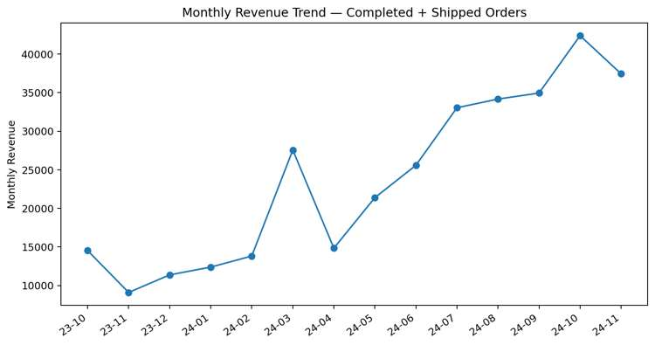
10. Revenue Trend & MoM Growth
Q21 and Q30 outputs
• Peak MoM growth in the displayed Q30 output: +99.40% in 2024-03.
• The trend then shows several positive-growth months through 2024.
• 2024-11 shows a reported MoM decline of about 11.65% in Q30.
• Q21 extends the monthly revenue view through 2025-06.
NovaMart E-Commerce Sales Analysis • SQL Portfolio Project
11

Slide 12
11. Management-Level Takeaways
Insights directly supported by the provided SQL outputs
• Electronics is the dominant reported revenue category at 60.61% contribution.
• Beauty & Personal Care has the highest reported gross margin at 64.42%, despite a smaller revenue contribution.
• The customer analysis identifies a clear high-value segment and a top-spending customer for retention analysis.
• Inventory queries surface low-stock products and remaining-stock exposure after completed/shipped sales.
• Payment analysis shows Google Pay with the highest reported revenue, while Apple Pay has the highest reported average order value.
• The monthly analysis shows substantial variation in revenue and month-over-month growth.
NovaMart E-Commerce Sales Analysis • SQL Portfolio Project
12

Slide 13
12. SQL Quality Review Before Publishing
Important consistency issues visible in the submitted query set
• Q12 uses 'Shiped' in the status filter, while other queries use 'Shipped'. This can exclude shipped orders and explains why Q12 revenue differs from later category-revenue outputs.
• Q14 asks for 'at least 3 orders' but uses HAVING COUNT(...) > 3. Use >= 3 for the stated requirement.
• Q25 is labeled 'cancellation rate' but calculates only the monthly count of cancelled orders. A rate requires cancelled orders divided by total orders for the month.
• Q18 groups by city while also selecting customer name. Under strict SQL modes this is invalid; if the goal is city-level spend, aggregate only by city.
• Q6/Q10 pair MAX/MIN with a non-aggregated product name. ORDER BY ... DESC/ASC LIMIT 1 is safer when the product identity must match the extreme value.
NovaMart E-Commerce Sales Analysis • SQL Portfolio Project
13

Slide 14
GitHub Portfolio Package
• README.md — project context, business questions, methodology, findings, SQL techniques, and repository structure.
• sql/novamart_analysis.sql — SQL analysis script.
• presentation/NovaMart_Ecommerce_SQL_Analysis.pptx — presentation for academic/project showcase.
• data/ — reserved for the source CSV files to be added later.
• assets/ — reserved for dashboard screenshots or project visuals.
Suggested project title: NovaMart E-Commerce Sales Analysis | SQL Business Intelligence
NovaMart E-Commerce Sales Analysis • SQL Portfolio Project
14

