Slide 1

PURNEA COLLEGE OF ENGINEERING
A Project on
An IoT BASED CAR PARKING SYSTEM
Department of
Electronics & Communication Engineering
PREPARED BY:- GUIDED BY:-
Shubham Kumar (17104131027) Prof. Vikas Kumar
Ashish Kumar Gupta (17104131023) Asst. Professor ECE Department
Ankit Kumar (17104131025) PCE, PURNEA
Bambam Kumar (17104131028)
Bishwabhandhu Kumar (17104131024)
Shubham Kumar (17104131022)

Slide 2
Contents:
Objective
Introduction
Circuit Component
Circuit Diagram
Working Procedure
Advantages
Applications
Conclusion

Slide 3
Objective
The main aim of this project is reduces the risk of finding the parking slots in any parking area.
It eliminates the unnecessary travelling of vehicles across the filled parking slots in a city.

Slide 4
INTRODUCTION:
Now a days, main problem in malls, function halls and etc., is parking. It is due to the lack of sufficient parking space. Now a days the vehicles in a family are greater than the head count of the family members, and due to this the vehicles are also increased in the country, which leads to the parking scenario which is unhappily falling short to the current requirements in the country. Due to this parking is difficult and it also increases the time needed to park the vehicle with increase in the fuel consumption of the vehicle. And during the working days the companies and offices are facing the problem of the parking in urban areas. Now a days vehicles are most affordable to the low income group families also and the vehicles especially the cars are taking lot of space. Due to the increase in vehicles the parking space is also not sufficient in this congested cities. Whether at a shopping malls, stations and airport, problems with parking is a big issue. Most of the time people spend their time on searching parking, to park their vehicles. Thus, lot of congestion occurs in the traffic which leads to a tedious job to find the parking space to park their vehicle. The most traffic occurs only because of vehicle congestion in the urban areas thus people are wasting time in searching the parking area abnormally to park their vehicles. And one more issue is also added to this is pollution, which effects the entire environment due to this increase in vehicles.

Slide 5
Component description
Hardware App
Arduino UNO Blynk App
Node MCU
IR Sensor
Light Dependent Sensor
Light Emitting Diode
Transistors(BC547)

Slide 6
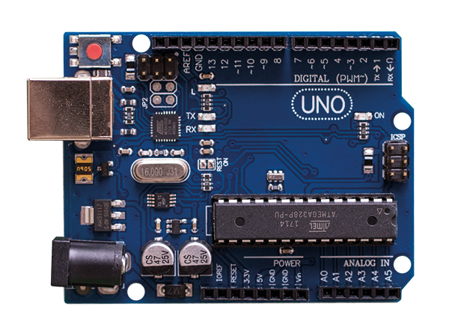
Arduino UNO R3: Arduino Uno R3 is one kind of ATmega328P based microcontroller board. It includes the whole thing required to hold up the microcontroller; just attach it to a PC with the help of a USB cable, and give the supply using AC-DC adapter or a battery to get started. The term Uno means “one” in the language of “Italian” and was selected for marking the release of Arduino’s IDE 1.0 software. The R3 Arduino Uno is the 3rd as well as most recent modification of the Arduino Uno. Arduino board and IDE software are the reference versions of Arduino and currently progressed to new releases. The Uno-board is the primary in a sequence of USB-Arduino boards, & the reference model designed for the Arduino platform.

Slide 7
Arduino Uno R3 Specifications:
It is an ATmega328P based Microcontroller
The Operating Voltage of the Arduino is 5V
The recommended input voltage ranges from 7V to 12V
The i/p voltage (limit) is 6V to 20V
Digital input and output pins-14
Digital input & output pins (PWM)-6
Analog i/p pins are 6
DC Current for each I/O Pin is 20 mA
DC Current used for 3.3V Pin is 50 mA
Flash Memory -32 KB, and 0.5 KB memory is used by the boot loader
SRAM is 2 KB
EEPROM is 1 KB
The speed of the CLK is 16 MHz
In Built LED
Length and width of the Arduino are 68.6 mm X 53.4 mm
The weight of the Arduino board is 25 g

Slide 8
Node MCU
32-bit RISC CPU 80Mhz
64KB of instruction RAM
4MB flash
96KB of data RAM
13-GPIO pins
SPI
Can be programmed with Lua, C/C++,Python, Basic Arduino IDE

Slide 9
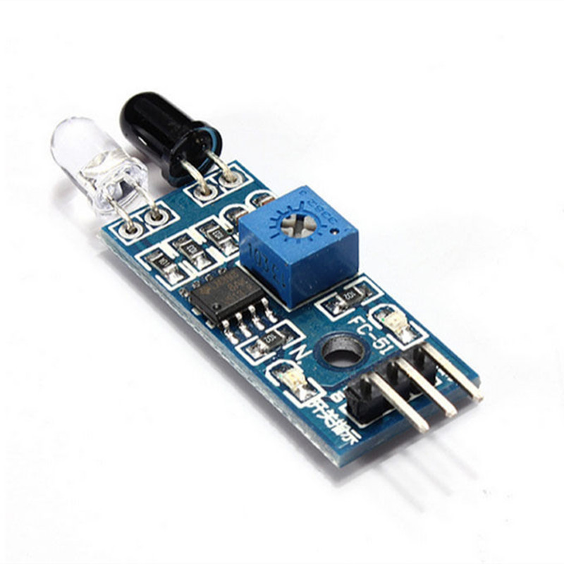
IR Sensor: IR sensor is an electronic device, that emits the light in order to sense some object of the surroundings. An IR sensor can measure the heat of an object as well as detects the motion. Usually, in the infrared spectrum, all the objects radiate some form of thermal radiation. These types of radiations are invisible to our eyes, but infrared sensor can detect these radiations.

Slide 10
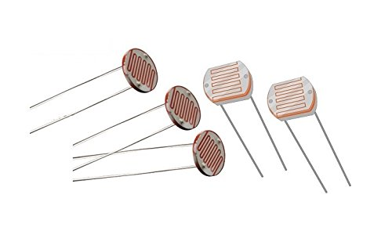
Light Dependent Sensor:
Light dependent resistors, LDRs or photoresistors are often used in electronic circuit designs where it is necessary to detect the presence or the level of light.
These electronic components can be described by a variety of names from light dependent resistor, LDR, photoresistor, or even photo cell, photocell or photoconductor.

Slide 11
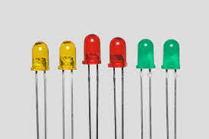
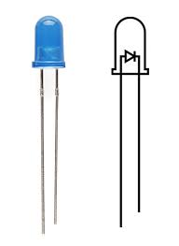
Light Emitting Diode:
A light emitting diode (LED) is a semiconductor light source LED’s are used as indicator lamps in many devices, and are increasingly used for lighting’

Slide 12
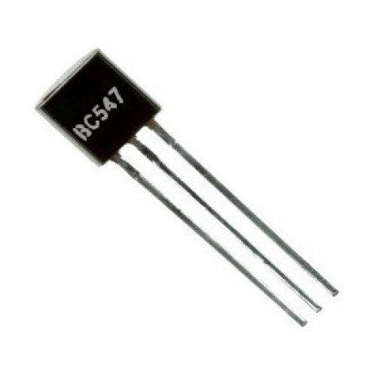
Transistor(BC 547): The BC547 transistor is an NPN transistor. A transistor is nothing but the transfer of resistance which is used for amplifying the current. A small current of the base terminal of this transistor will control the large current of emitter and base terminals. The main function of this transistor is to amplify as well as switching purposes. The maximum gain current of this transistor is 800A.

Slide 13
Working Procedure: Output of the LDR pin is connected to A0 (analog) port of Arduino Uno board. Connect all output of the IR sensors to port numbers A1, A2, A3, A4 and A5 respectively (analog) which is the input signal to the Arduino board. Connect the ground of all the IR sensors to GND port. The output signals from LED are connected to port number 5, 6, 9, 10 and 11 respectively. Again connect all the negative terminals of LED’s to GND port. Power is passed to the Arduino (7-12V).

Slide 14
Step 1:- Install the blynk app(Smart Parking App) on your mobile phone. Step 2:- With the help of Blynk app, Sreach for a parking slot on your deatination. Step 3:- Select a particular parking slot.

Slide 15
Advantages:
This circuit uses LED Bulbs, so it is very low cost and it has more life span.
Maximum energy can be saved.
Low maintenance and low power consumption.
Low power consumption.
Less manpower required.
Shorter waiting time at parking place.
It saves fuel, money, and time.
Reduce Pollution.
Reduced traffic.
Efficiency

Slide 16
Application:
Parking Lighting.
Street Lights.
Garden Lights’
Highways.
The smart car parking system can be implemented in
Shopping Malls
Restaurants
Theatres

Slide 17
Conclusion:
The system is now used only for One way traffic in highways.
Continuous uses of LDR and IR sensors even in day time.
Not switched on before the sunset.
This project Focuses on implementation of car parking place detection using Internet of Things.
The system Benefits of smart parking go well beyond avoiding time wasting.
Developing a smart parking solution with in a city solves the pollution problem.

Slide 18
References
https://www.google.com\
https://www.udemy.com/course/iot-internet-of-things-automation-with-esp8266/learn/lecture/12065946?start=15#content
https://nodemcu.readthedocs.io/en/release/
https://www.elprocus.com/infrared-ir-sensor-circuit-and-working/

Slide 19
Thank you.

